Slide 1

EDA ON AMCAT DATA

Slide 2
About me
I am B.Sai Manoj, and I have recently completed my B.Tech in Electronics and Communication Engineering from B V Raju Institute of Technology.
I want to learn Data Science because it aligns with my analytical thinking and passion for problem-solving. The field of Data Science offers vast opportunities to work with cutting-edge technologies like machine learning, artificial intelligence, and big data, which have transformative potential across industries. I am eager to develop the skills necessary to extract meaningful insights from data and contribute to data-driven decision-making.
I am a fresher with no work experience as of now. However, I am enthusiastic about gaining hands-on experience in the field of Data Science through projects and internships
LinkedIn Profile : https://www.linkedin.com/in/b-sai-manoj-9a4376310/
Github Profile : https://github.com/manojsai105

Slide 3
Business Problem
We have given a csv file which consists of Amacat Data.
And this data represents what is the salary of an employee who’ve been currently working and left the company .
Here now we need to perform various data manipulation operation and find out the result for our respective research questions .

Slide 4
Performing Exploratory Data Analysis (EDA) on the data-set . Consider Salary as a target variable
Step 1: Cleaning the Dataset
The first step is to check for missing values in the data .
If there are any missing values we need to clean the data .

Slide 5
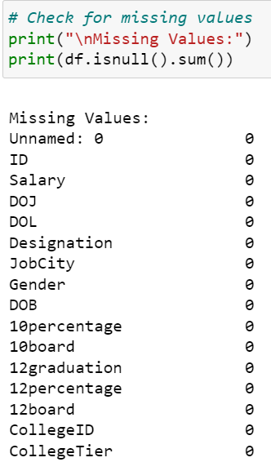
As there are no missing values in the given data there is no need to clean the data .
Let us perform the next step i.e., data manipulation .

Slide 6
Step 2: -Data Manipulation
IQR is used to know about the outliers in the given data
Using df.info() we can find out the data type of each column and the number of missing values it contain .
And we have used df.describe() to know about the summary statistics of the data .

Slide 7
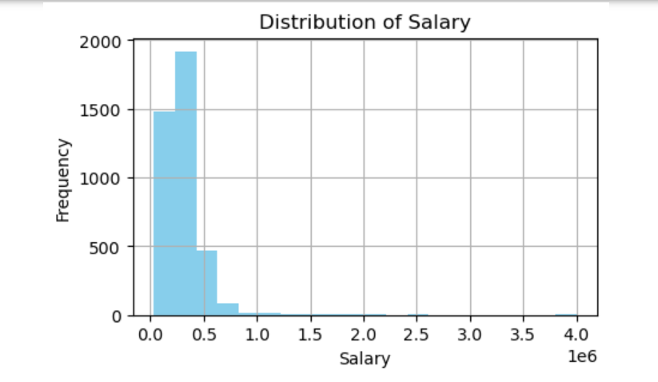
Uni-variate Analysis
We have done the Univariate analysis by plotting a histogram of each column in the given dataset .

Slide 8
Here we have done a univariate analysis by using Salary column .
Here we have got right skewed data .
The histogram shows the distribution of salaries in a dataset. The x-axis shows the salary range, and the y-axis shows the number of people who fall into that range. The salary range is divided into 20 bins, each spanning $50,000.

Slide 9
Bivariate Analysis
We have done Bivariate analysis using the columns in the given dataframe by plotting them as stacked bar chart in the ipnyb notebook .
No let us see a bi variate analysis by plotting a scatter plot .

Slide 10
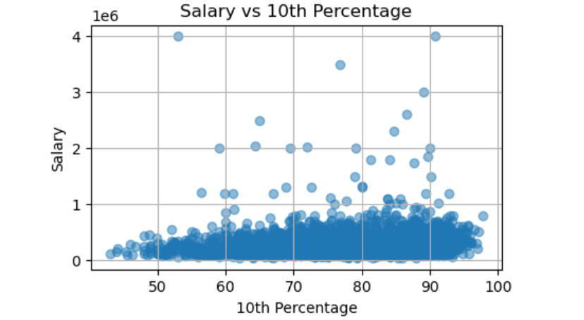
Bivariate Analysis
Here we have done the bi varaiate analysis using salary and 10th percentage columns in the given dataframe .
The scatter plot shows a positive correlation between salary and 10th-grade percentage in India. Each dot on the graph represents one person's data. The x-axis shows the person's 10th-grade percentage, and the y-axis shows their salary.
There is a clear upward trend in the data, indicating that people with higher 10th-grade percentages tend to have higher salaries
However, there is also a lot of variation in the data. Some people with low 10th-grade percentages have high salaries, and some people with high 10th-grade percentages have low salaries.
This suggests that there are other factors besides 10th-grade percentage that affect salary, such as education, experience, and skills.

Slide 11
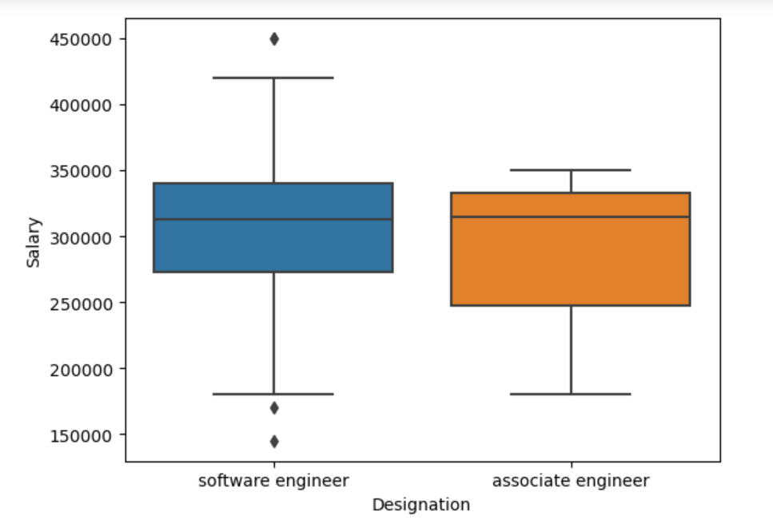
Key Business Question
Q) Times of India article dated Jan 18, 2019 states that “After doing your Computer Science Engineering
if you take up jobs as a Programming Analyst, Software Engineer, Hardware Engineer and Associate Engineer you can earn up to 2.5-3 lakhs as a fresh graduate.” Test this claim with the data given to you.
First we need to filter our data frame to the only employees who are studied the computer science and engineering
Then we need to again filter that data frame according to their job designation given in the question ,
After filtering we have know that the student who studied Computer science has their designation Software Engineer and Associative Engineer,

Slide 12
Finally we need to find the average of the Salary Column .
But the average value here we have got is : “325815.2173913043”

Slide 13
Q and A
1)What is the highest salary of employees who left the __company and his experience ?
4000000.0
2)Open_Experience of employees who has high salary and left __the company ?
-0.1295 and -2.6572
3) Count of employees still working and the no of employees __having salary greater than average salary?
1095
4) Comparing men average salary and women salary?
avg salary male = 311716.21177244326, female = 294937.3040752351

Slide 14
5)Find the count of women who left the company and not left the company and for every thing find salary greater than average salary ?
left ---> women: 509 ; present ---> women: 149
7)Filter the df with a particular designation and find the avg _Salary ?
Average salary of senior quality engineer : 444000.0

Slide 15
8) In which year less number of the employees left the company and what is the highest salary in that year?
Year | Salary
2005 | 1,80,000
2008 | 65000
2009 | 120000

Slide 16

THANK YOU

