Slide 1

INTRODUCTION TO MANAGEMENT BSC.CSIT IIIrd Semester
GANESH JOSHI
Symbiosis International University

Slide 2
THE ENVIRONMENT OF MANAGEMENT
CHAPTER 3

Slide 3
Business
Stephenson defines business as, "The regular production or purchase and sale of goods undertaken with an objective of earning profit and acquiring wealth through the satisfaction of human wants."
According to Dicksee, "Business refers to a form of activity conducted with an objective of earning profits for the benefit of those on whose behalf the activity is conducted."
Lewis Henry defines business as, "Human activity directed towards producing or acquiring wealth through buying and selling of goods."
Thus, the term business means continuous production and distribution of goods and services with the aim of earning profits under uncertain market conditions.

Slide 4
Features of Business
Exchange of goods and services
Deals in numerous transactions
Profit is the main Objective
Business skills for economic success
Risks and Uncertainties
Connected with production
Buyer and Seller
To Satisfy human wants
Social obligations

Slide 5
Concept of Business Environment
Encompasses all those factors that affect a company's operations; including customers, competitors, suppliers, distributors, industry trends, substitutes, regulations, government activities, the economy, demographics, social and cultural factors, innovations, and technological developments.
It may also be referred to as Operating environment.

Slide 6
Characteristics of Business Environment
Complex
Dynamic
Multi-faceted
Far- reaching impact

Slide 7
Why Study Business Environment ?

Slide 8
Why study Business Environment
The success of every business depends upon adapting itself to the environment within which it functions
Example
When there is a change in government policies, the business has to make the necessary changes to adapt itself to the new policies
Change in technology may render the existing products obsolete, introduction of colour T.V television replaced the black and white T.V or introduction of computers replaced type writers.

Slide 9
Why Study Business Environment?
Development of broad strategies to ensure sustainability
To foresee the impact of socio-economic changes at the national and international levels on firm’s ability
Analysis of competitor’s strategies and formulation of effective counter measures
To keep oneself dynamic

Slide 10
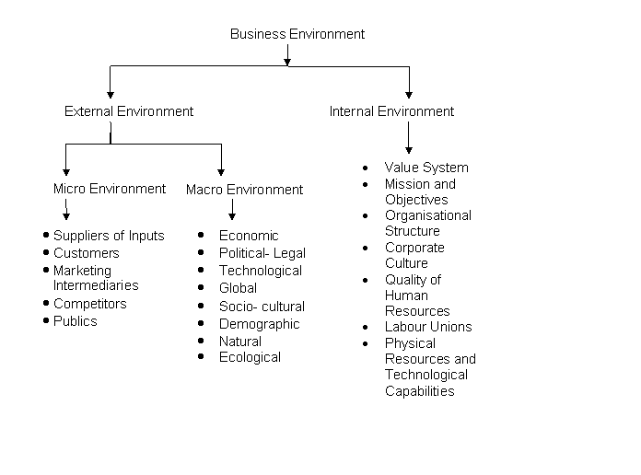
INTERNAL & EXTERNAL ENVIRONMENT

Slide 11
Internal Environment
Refers to all the factors that are within an organization which impart strengths or cause weaknesses of strategic nature. It is controllable.

Slide 12
Forces of Internal Environment
Goals and Policies
Mission and Objectives
Resources
Culture
Management Structure and Nature
Human Resources
Customer
Labour Unions
Media
Competitors
Pressure Groups

Slide 13
External Environment
Includes all factors outside the organization which provide opportunities or pose threats to the organization
Uncontrollable factors
Consists of Micro and Macro environment

Slide 14
Micro Environment
“It consists of the factors in the company’s immediate environment that affect the performance of the company”.

Slide 15
Micro Environment Factors
Suppliers
Customers
Marketing Intermediaries
Competitors
Publics
Financial Community

Slide 16
Macro Environment
It comprises general trends and forces that may not immediately affect the organization but sooner or later will alter the way organization operates.
Macro Environment :-
Economic
Non Economic

Slide 17
Economic Environment
Economic stages that exists at a given time in a country
Economic system that is adopted by a country.
Economic planning, such as five year plans, budgets, etc.
Economic policies for example, monetary and fiscal policies
Economic Indices such as National Income, Per Capital Income, Disposable Income, Rate of growth of GNP, Distribution of Income, Rate of savings, Balance of Payments etc.
Economic Problems
Notes:
Disposable Income:-

Slide 18
National Income: The total income earned by citizens & business of a country
Per Capita Income: Income of the people in an economic unit such as country or city.
Disposable Income: The amount of money that households have available for spending & saving after income taxes have been accounted for.DPI=PI-PI Taxes payments
GDP(Gross domestic Product):The market value of all final goods and services produced within a country in a economy in a one year period.
GNP(Gross National Product): Aggregate final output of citizens & business of an economy in one year period.
Balance of Payments: A country’s record of all transactions between its residents and the residents of all foreign nations.

Slide 19
Non Economic Environment
Cultural Environment
Demographic Environment
Technological Environment
Political Environment

Slide 20
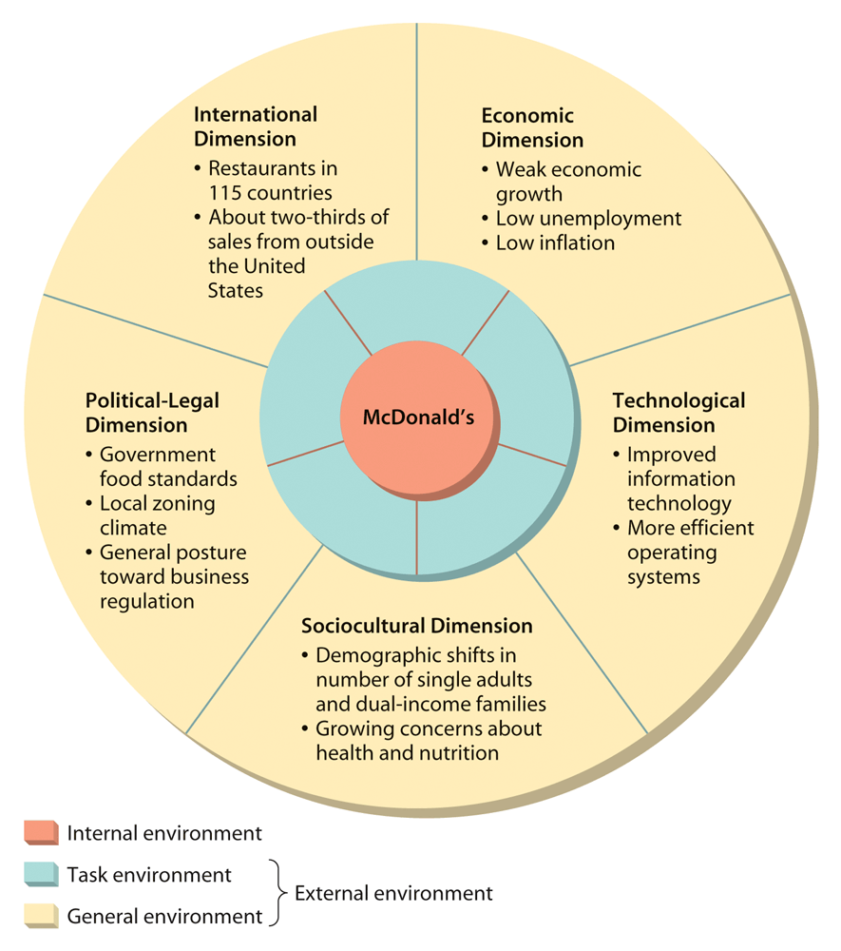
McDonald’s External Environment

Slide 21


Slide 22
PEST Analysis
P
POLITICAL ENVIRONMENT
Political system,Political Institutions, Pressure groups
E
ECONOMIC ENVIRONMENT
Economic System-Free Market, Centrally Planned economy, Mixed economy
S
SOCIO-CULTURAL ENVIRONMENT
Demographics-Size, Age, Population
T
TECHNOLOGICAL ENVIRONMENT
Economic policies- Monetary, Fiscal, Industrial policy
Economic condition: Income, business cycle, Inflation
Social institutions: Family ,Reference group, Social class
Social change: life style pattern
Cultural:- Value, belief, religion, language
Level of technology: Labour based and Capital based
Pace of technological change
Technology transfer
R&D
Notes:
Monetary Policy :Interest rates, money supply
Fiscal policy: Tax,expenditure

Slide 23
CSR

Slide 24
CSR CORPORATE SOCIAL RESPONSIBILITY
CSR is a management concept whereby companies integrate social and environmental concerns in their business operations and interactions with their stakeholders.
CSR is generally understood as being the way through which a company achieves a balance of economic, environmental and social imperatives while at the same time addressing the expectations of shareholders and stakeholders.
In this sense it is important to draw a distinction between CSR, which can be a strategic business management concept, and charity, sponsorships or philanthropy.
Even though the latter can also make a valuable contribution to poverty reduction, will directly enhance the reputation of a company and strengthen its brand, the concept of CSR clearly goes beyond that.

Slide 25
Key CSR Issues
Environmental management, eco-efficiency, responsible sourcing, stakeholder engagement, labour standards and working conditions, employee and community relations, social equity, gender balance, human rights, good governance, and anti-corruption measures.

Slide 26
Diageo Sustainability & Responsibility
People celebrate with our brands – and by doing so become a link in a chain that connects rivers and fields, distilleries, breweries and vineyards, transport networks, the hospitality industry, communities and everyone who works in and around them.
Our Sustainability & Responsibility (S&R) Strategy encompasses the actions Diageo takes each day, and every day, to support every link in this chain. We call this celebrating life, today and tomorrow.

Slide 27
Areas of Social Responsibility for Company
Towards Consumers
Product promotion
Towards Investors
Maximize investors wealth
Towards Community
Environment quality
Product safety
Quality
Fair account
Environment protection

Slide 28
Towards Employees
Work environment
Towards Government
Legal compliance
Work life balance
Occupational safety and health
Impartiality

Slide 29
Approaches to SR
Legal Compliance
Ethical Compliance
Philanthropic Actions
Internal Accountability

Slide 30
LEGAL COMPLIANCE
Finance manager is responsible for true and fair financial reporting and disclosure.
Legal Manager is involved in all areas of legal compliance.
Marketing manager is responsible for compliance of sales, advertising and consumer protection laws.

Slide 31
ETHICAL COMPLIANCE
Moral rules for decision making
Bribes and corruption
Misuse of assets
Relationships
Rights and duties

Slide 32
PHILANTHROPIC ACTIONS
Organizations contribute money to charity or worthy social causes

Slide 33
INTERNAL ACCOUNTABILITY
Corporate goal specify accountability for social responsibility
Proactive approach
Anticipate problems and solve them before they arise

Slide 34
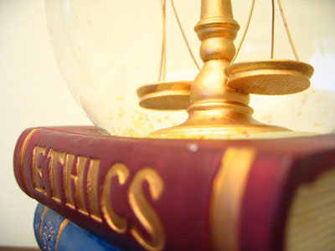
MANAGEMENT ETHICS/ BUSINESS ETHICS

Slide 35
MANAGEMENT ETHICS
Rick Griffin “ Ethics is an individual's personal belief about whether a behavior, action or decision is right or wrong”
Management ethics is the ethical treatment of employees, stockholders, owners, and the public by a company. A company, while needing to make a profit, should have good ethics.
Employees should be treated well, whether they are employed here or overseas. By being respectful of the environment in the community a company shows good ethics, and good, honest records also show respect to stockholders and owners
Ethics is reflected in an individual behaviour
Ethical Behaviour differs from person to person. For one person certain behaviour may be ethical. For others, the same behaviour may be unethical

Slide 36
While each company has a different ethical standard, management ethics are largely the same in every industry.
The main goal of management ethics is to treat all employees and customers justly and fairly. It is believed that by following a moral and ethical code, business will improve.
When applied to everyday business, acting ethically means adhering to law, competing with others in an honest manner, and performing daily tasks without any element of deceit.
Many companies around the globe update written codes of conduct as a result of past corporate scandals.
Although managers must follow the same codes of conduct as employees, these individuals have additional obligations

Slide 37
Factors Influencing Business Ethics
Ethical Standard of Managers
Action of Peers and Top Managers
Organizational Culture
Organizational Environment
Societal Forces

Slide 38
Ethical Standard of Managers
They are the soucre of individual ethics
They influence employer-employee relations
A managers values and moral contribute to his ethical standards

Slide 39
Action of Peers and Top Managers
They are the source of professional ethics
Action of peers and top managers influence managerial ethics
Pressure to perform can lead to unethical acts

Slide 40
Organizational Culture
Codes of ethics may lay down moral rules for decision making
They may prohibit bribes and corruption
They provide road map to oranization culture

Slide 41
Organizational Environment
Organizational environment influences ethical behaviour to managers
Policies and Practices also influence managerial ethics
Ethical behaviour should be appreciated and promoted

Slide 42
Societal Forces
They are the source of societal ethics
They consist of values, standards and norms embodied in society's laws, customs, practices.
They represent universal values

