Slide 1
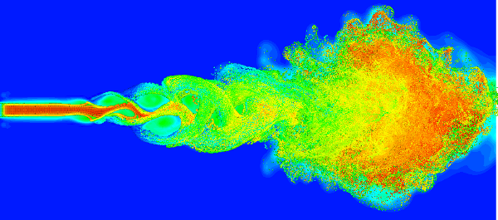
Turbulence
Turbulence is an irregular motion which is characterized by random fluctuations of physical properties with time when a fluid flow past solid surfaces or neighboring streams of the same or different fluid.

Slide 2
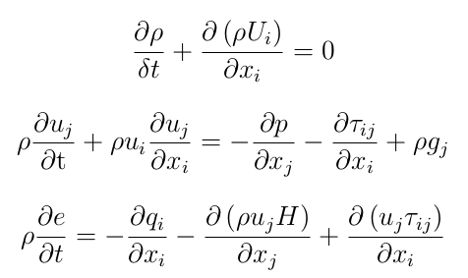
Navier Stokes Equation

Slide 3
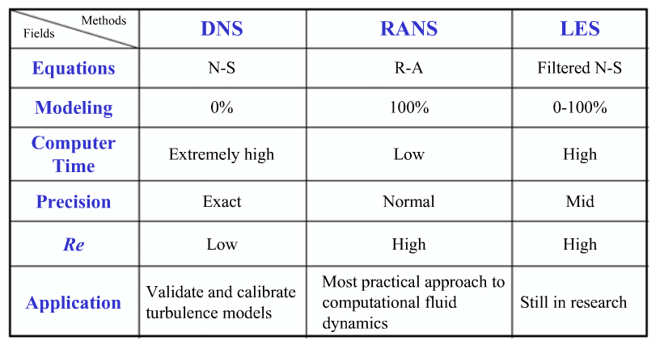
Solving NSE

Slide 4
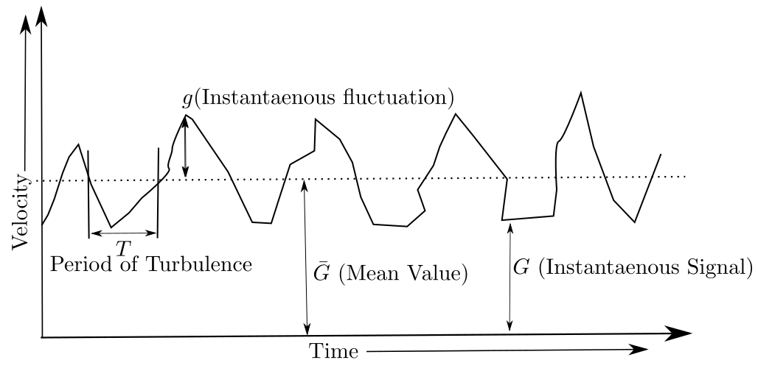

Turbulence Modeling
Reynolds Decomposition

Slide 5
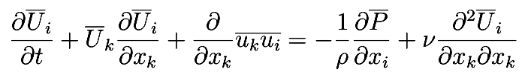
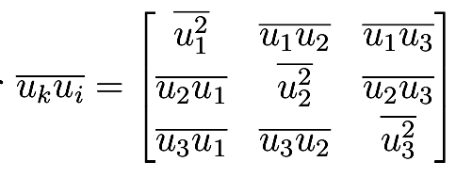

Reynolds Averaged Navier Stokes (RANS)
Reynolds Tensor
Turbulent kinetic energy

Slide 6
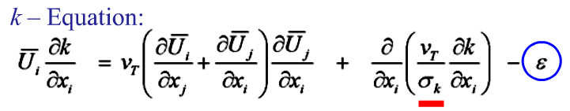
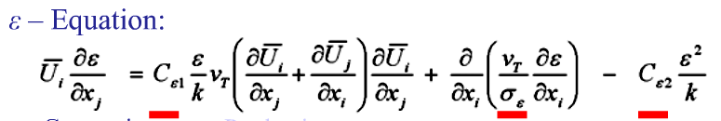
K-epsilon model

