Slide 1
AI IN SOFTWARE ENGINEERING
Case 57:
Airline Crew Scheduling
PROTOTYPE CONCEPT
01
Duty inputs
Duty-Limit Validator | Dayananda Sagar University
02
Check sample rules
Manoj • Roll Number 57
03
Accept or explain
SPIRAL
SCRUM
CHATGPT
Conceptual flow; not an integrated roster app.
CASE SCENARIO: 400 CREW MEMBERS • A DUTY-TIME VIOLATION CAN GROUND A FLIGHT

Slide 2
01 / CONTEXT
A duty-limit violation can ground a flight
400
Operational constraints
Failure consequence
Duty-time laws govern daily duty, rest between duties, and cumulative work.
An invalid assignment may make a flight non-compliant or require replanning.
crew members
in the case scenario
Engineering challenge
Prototype boundary
One violation can affect flight readiness and crew safety.
Rules must be explicit, traceable, tested at boundaries, and kept current.
The current code checks one set of numeric inputs; it does not generate rosters.
The 400-person figure is a scenario target—not a measured capacity claim.
AI IN SOFTWARE ENGINEERING | CASE 57 | MANOJ • ROLL 57
02 / 13

Slide 3
02 / APPROACH
IMPLEMENTED CORE
Objectives: make each constraint testable
01 Clarify rules
02 Build a small validator
03 Verify behavior
Translate requirements into explicit inequalities, inclusive boundaries, and stable reasons.
Implement a Python function that returns an accept/reject decision and explanation.
Exercise normal, boundary, over-limit, and invalid-negative inputs with automated tests.
CURRENTLY IMPLEMENTED
NOT CLAIMED / NEXT
`validate_duty()` checks three numeric totals.
No full roster optimization or 400-crew benchmark.
Current full local suite: 36 tests passed.
No roster generator, crew database, or production workflow.
Negative values raise `ValueError`.
Confirm rule values with an authoritative source.
AI IN SOFTWARE ENGINEERING | CASE 57 | MANOJ • ROLL 57
03 / 13

Slide 4
03 / PROCESS MODEL
FIXED CASE CHOICE
Spiral development puts rule risks first
1 OBJECTIVES
2 RISK ANALYSIS
Scope, constraints,
alternatives
Rule ambiguity,
conflicts, safety
Review risks before expanding scope
4 REVIEW + PLAN
3 DEVELOP + TEST
Stakeholder review,
next iteration
Validator, boundaries,
negative inputs
Case risks: duty-day definition, standby treatment, incompatible limits, and AI hallucinations.
AI IN SOFTWARE ENGINEERING | CASE 57 | MANOJ • ROLL 57
04 / 13

Slide 5
04 / AGILE METHOD
FIXED CASE CHOICE
Scrum makes constraint work reviewable
PRODUCT
BACKLOG
SPRINT
PLANNING
SPRINT
WORK
REVIEW
RETRO
Rules + stories
Select a goal
Build + test
Inspect result
Improve process
Example sprint goal
Definition of Done
Validate one crew duty record against explicit daily, rest, and rolling-week sample rules; show a reason for rejection.
Rules documented • boundaries tested • suite green • changes reviewed • assumptions disclosed
Project note: role assignments are a solo simulation; L2.4 still needs estimates from three classmates.
AI IN SOFTWARE ENGINEERING | CASE 57 | MANOJ • ROLL 57
05 / 13

Slide 6
05 / SYSTEM DESIGN
IMPLEMENTED VS PROPOSED
A small function anchors the current prototype
IMPLEMENTED FLOW
Current implementation
Browser dashboard
or API caller
Flask JSON API
→ validate_duty
Decision + reason
or HTTP 400 input error
Responsive Flask dashboard and JSON API call the shared validator. No crew database or roster generator.
POSSIBLE FUTURE INTEGRATION
Dashed-by-meaning: target architecture only; not deployed or evidenced.
Planner UI / API
Validator
Review + store
AI IN SOFTWARE ENGINEERING | CASE 57 | MANOJ • ROLL 57
06 / 13

Slide 7
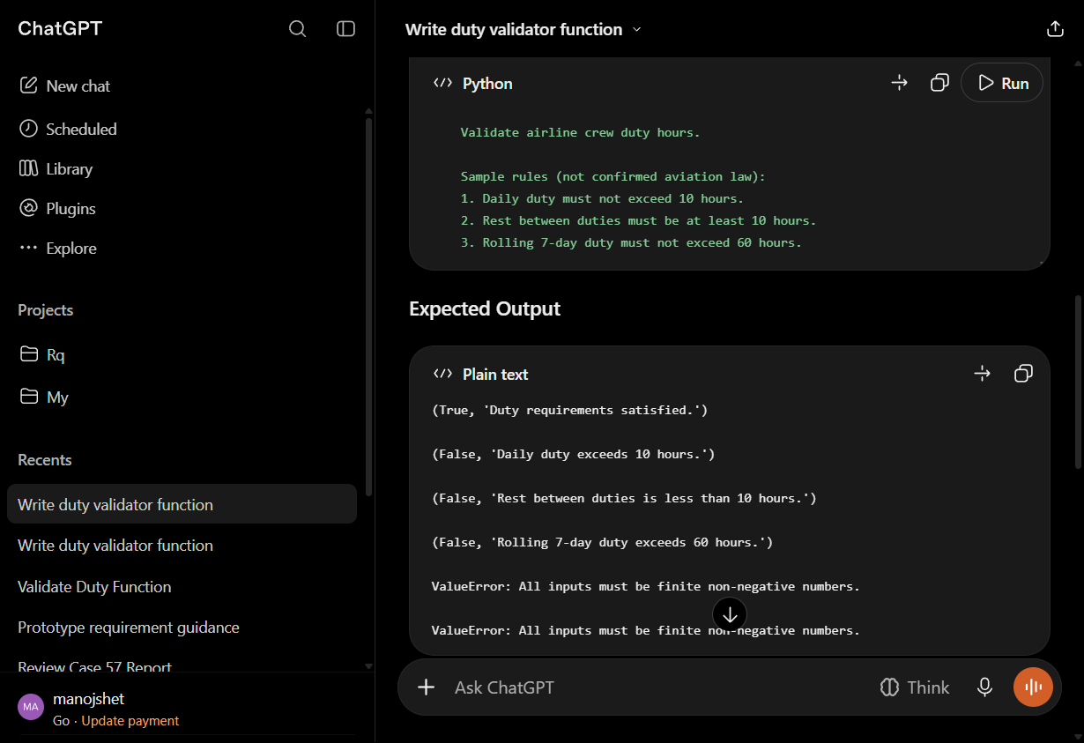
06 / AI-ASSISTED ENGINEERING
CHATGPT REQUIRED BY CASE
AI can draft ideas; people must verify the rules
Prompt with
sample rules
Compare to
rule source
Review code
and tests
Run tests;
accept / revise
Evidence-informed use
L1.4 and L1.5 preserve actual ChatGPT prompts and outputs. L1.5 found 9/10 expected outcomes; Boolean input was accepted unexpectedly.
Guardrails: no real crew data; treat outputs as suggestions; record verification and decisions.
Genuine prompt/output screenshot • L3.1 evidence
AI IN SOFTWARE ENGINEERING | CASE 57 | MANOJ • ROLL 57
07 / 13

Slide 8
07 / PROTOTYPE
RULES REQUIRE APPROVAL
The validator applies explicit sample rules
RULE
CONDITION
BOUNDARY
RESULT
Rule priority
Daily duty
hours_today <= 10
10.0 accepted
Else reject
Daily violation → rest violation → weekly violation. First applicable reason is returned.
Rest
rest_hours >= 10
10.0 accepted
Else reject
Rolling 7 days
hours_last_7_days <= 60
60.0 accepted
Else reject
Scope caveat
Input
any value < 0
not applicable
Raise ValueError
No timestamps, duty-day calculation, or roster generation.
10 / 10 / 60 hours are configurable educational assumptions, not confirmed aviation law.
AI IN SOFTWARE ENGINEERING | CASE 57 | MANOJ • ROLL 57
08 / 13

Slide 9
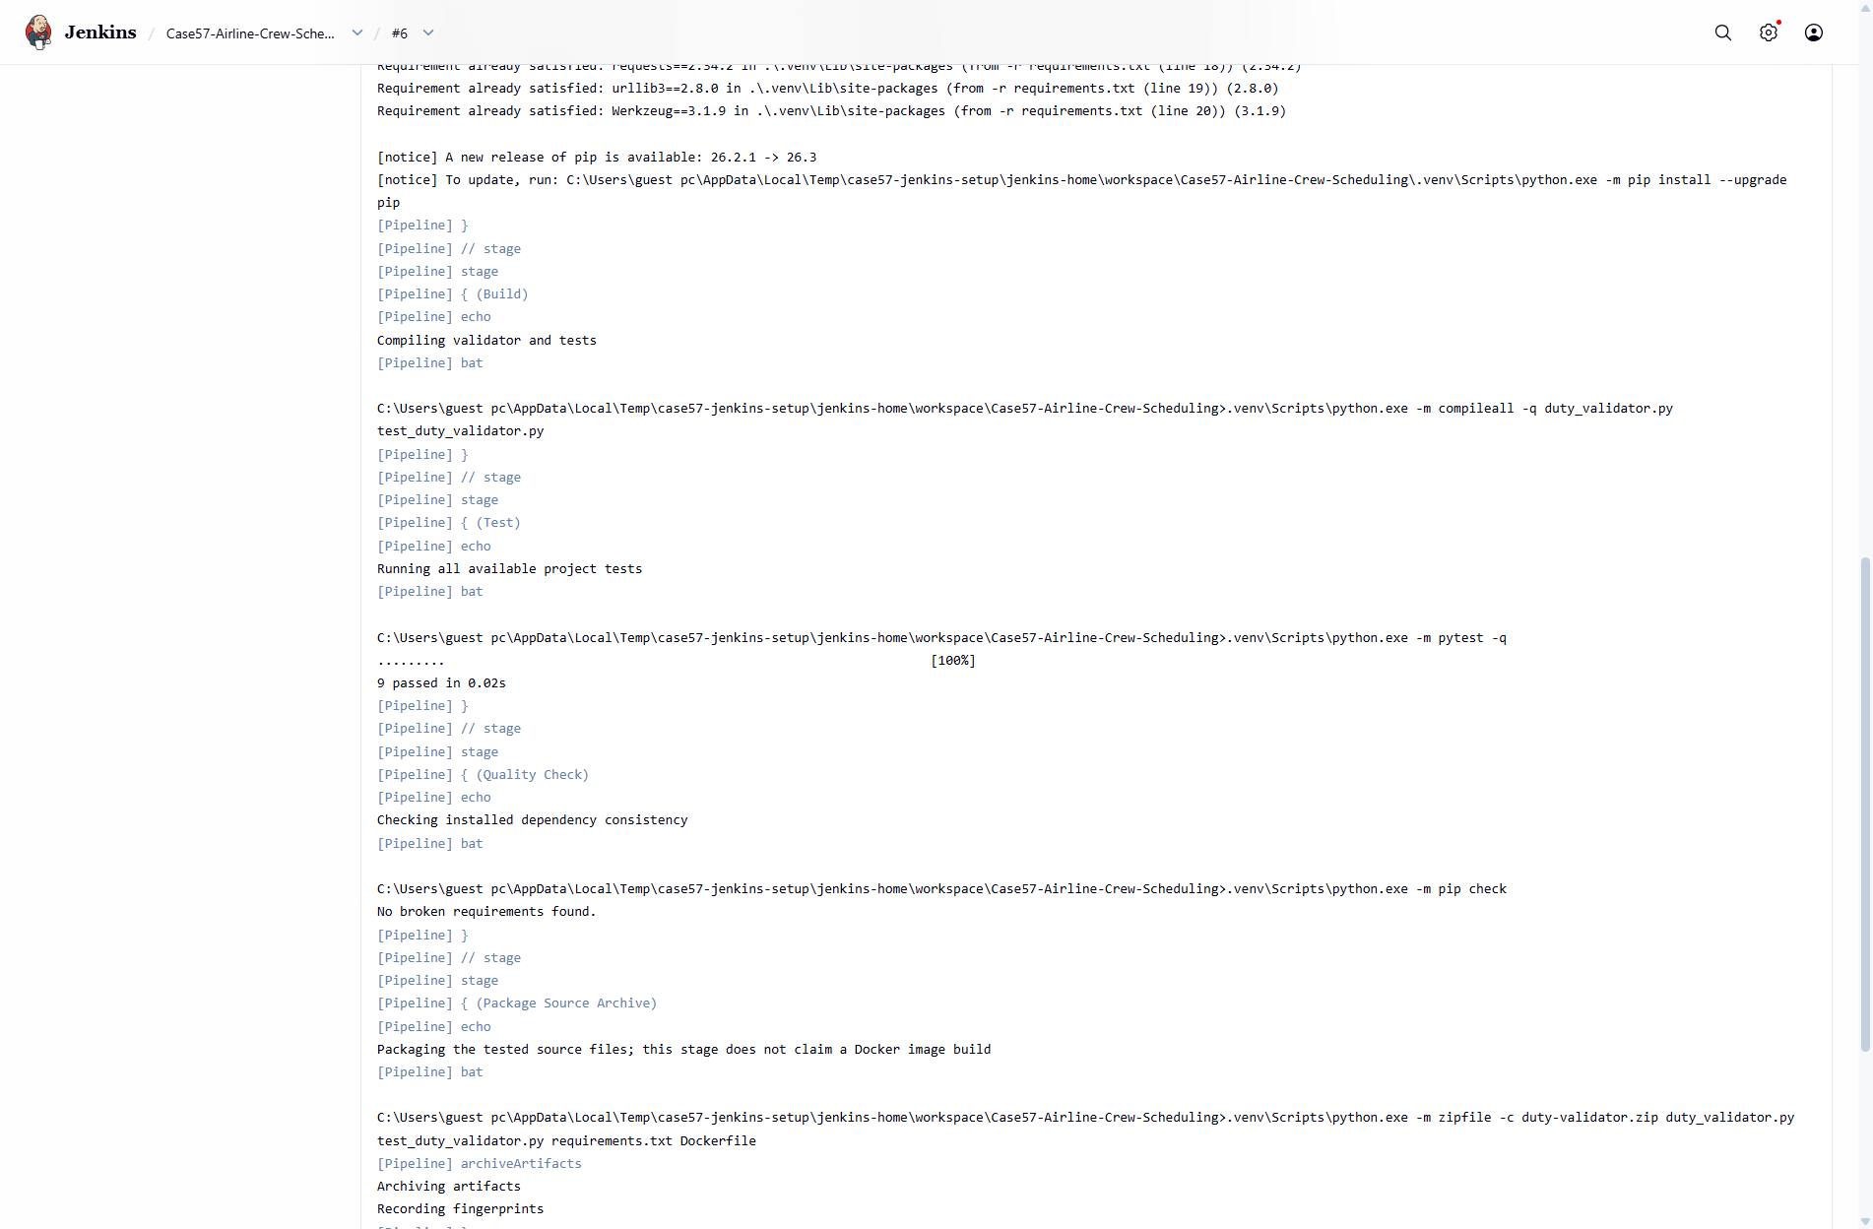
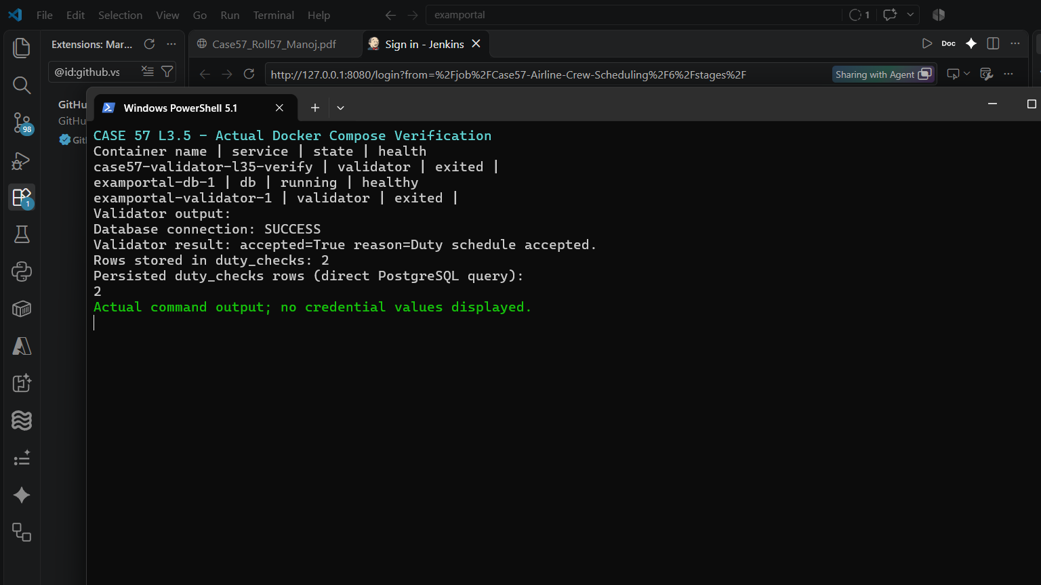
08 / DELIVERY
SUCCESSFUL RUNS • LIMITS REMAIN
Jenkins and Compose have real execution evidence
GitHub checkout
Install + build
Test + quality
Package
exact two-dot remote
dependencies / compile
9 passed / pip check
source ZIP archived
Jenkins #6 • SUCCESS
Compose • EXECUTED
Exact GitHub checkout; install, compile, 9 tests, pip check and ZIP packaging completed.
Validator connected to healthy PostgreSQL; two persisted rows verified. One-shot demo only.
Still missing: Jenkins controlled failing-test → corrected-success build. Historical success does not prove that experiment.
AI IN SOFTWARE ENGINEERING | CASE 57 | MANOJ • ROLL 57
09 / 13

Slide 10
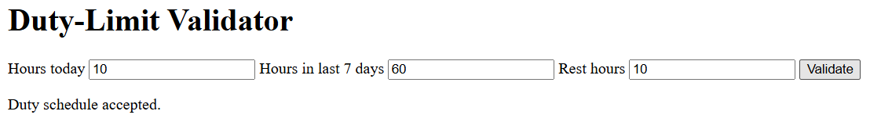
09 / VERIFICATION
36 LOCAL TESTS PASSED
Boundary tests protect the small rule engine
UNIT + API • 36 tests
UI • Selenium POM
SCALE • not measured
Cropped genuine L4.3 Chrome screenshot • Page Object Model run
Execution evidence
Exact 10 / 10 / 60 boundaries, over-limit values, and invalid API inputs are covered. AI review supported 9/10 generated case designs; the unsupported Boolean expectation was removed. No 400-crew benchmark.
Both plain Selenium and POM passed boundary and daily-violation assertions in Chrome. The screenshot shows the accepted (10, 60, 10) state; the 10.5-hour rejection is recorded in the run log.
L4.3 locator maintenance: 3 edits in plain Selenium vs 1 in POM. The 400-crew scale was not measured.
AI IN SOFTWARE ENGINEERING | CASE 57 | MANOJ • ROLL 57
10 / 13

Slide 11
10 / QUALITY
DISTINGUISH THE TOOLS
Static-analysis evidence is not a SonarQube scan
Pylint
Flake8
Bandit
Validator 10/10; test-file findings
1.25/10. Not SonarQube.
Current scoped checks clean;
historical W292 screenshot.
No issue in the scoped scan.
Limited scope.
SONARQUBE QUALITY GATE — NOT RUN / NOT EVIDENCED
Quality needs tests, review, security analysis, and verified rules.
A clean tool result is limited to the rules and files scanned.
AI IN SOFTWARE ENGINEERING | CASE 57 | MANOJ • ROLL 57
11 / 13

Slide 12
11 / RESPONSIBLE AI
NO AI ROSTER CLAIM
Fairness needs oversight—and a real roster to assess
Current decision
Responsible use
The function uses duty-hour values, not names or demographics, and returns a reason a planner can review.
Keep personal crew data out of prompts; verify AI output against approved rules; keep humans accountable.
Limitations
Outstanding evidence
Sample law unconfirmed; direct function accepts bool as numeric; no roster or scale evaluation.
Human inputs still pending; Jenkins failure/fix experiment and SonarQube remain outstanding.
Fairness in AI-generated rosters is a future requirement—not a demonstrated feature.
AI IN SOFTWARE ENGINEERING | CASE 57 | MANOJ • ROLL 57
12 / 13

Slide 13
12 / CLOSE
A tested prototype is a starting point—not legal approval
17 COMPLETE
5 PARTIAL
3 PENDING • 0 BLOCKED
Documented practical work with supporting evidence.
Missing a tool, evidence, or a required comparison.
AI substitutes are not counted as human participation.
Next gates: obtain 3 genuine human inputs • run Jenkins failure/fix • enable SonarQube • measure scale and fairness
REFERENCES
AI in Software Engineering Assignment Book (75 Cases), Case 57, pp. 228–231.
Project implementation and tests: duty_validator.py; test_duty_validator.py; test_ai_generated.py.
CASE57_EVIDENCE_AUDIT.md and CASE57_LAB_EVIDENCE (25 lab records).
GitHub: github.com/manojshet2005/Airline-Crew-Scheduling. (verified remote ends in ..git).
AI IN SOFTWARE ENGINEERING | CASE 57 | MANOJ • ROLL 57
13 / 13

