Slide 1


K.RAMAKRISHNAN COLLEGE OF ENGINEERING
(AUTONOMOUS)
GUARDIAN COMMUNICATION PORTAL
Presented by,
Name : S .MANOJ
Register No. : 8115U23ME025
Roll. No. : ME2325
Year : II
Date of Review : 20-06-2024

Slide 2
PRESENTATION OVERVIEW
Objective
System Architecture(Flow Diagram)
Modules
CodeTantra Implementation Screenshot
Conclusion
Future Scope
References

Slide 3
OBJECTIVE OF THE PROJECT
"To introduce and demonstrate the Guardian Communication Portal as a comprehensive, secure, and user-friendly platform designed to streamline and enhance communication processes. The portal aims to provide real-time, reliable access to critical information, facilitate efficient collaboration, and ensure seamless interactions for users across multiple devices and locations, ultimately improving overall communication and decision-making."
.

Slide 4
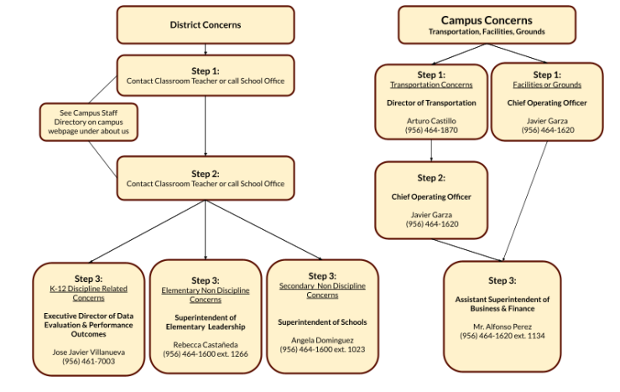
PROPOSED SYSTEM
ARCHITECTURE/FLOW DIAGRAM
.

Slide 5
MODULES
.
1. User Authentication & Authorization Module
Login/Signup: User registration and authentication.
2. Messaging and Communication Module
Real-time Messaging: Instant messaging, private chats, and group chats.
3.Collaboration Tools Module
File Sharing and Storage: Uploading, downloading, and sharing files.

Slide 6
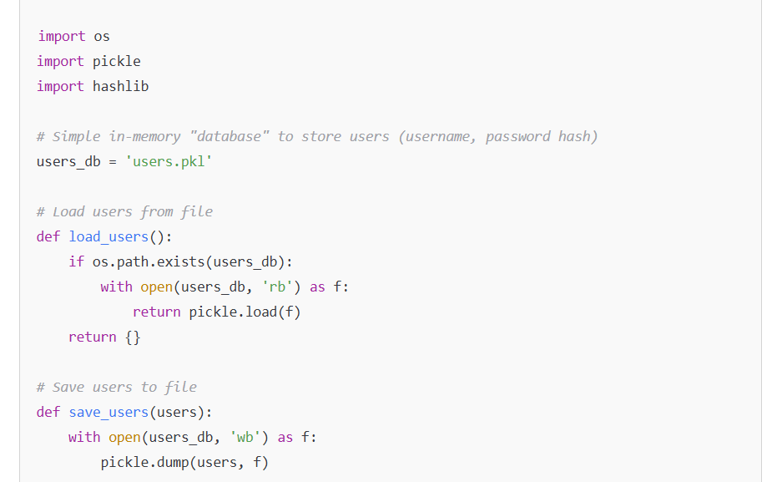
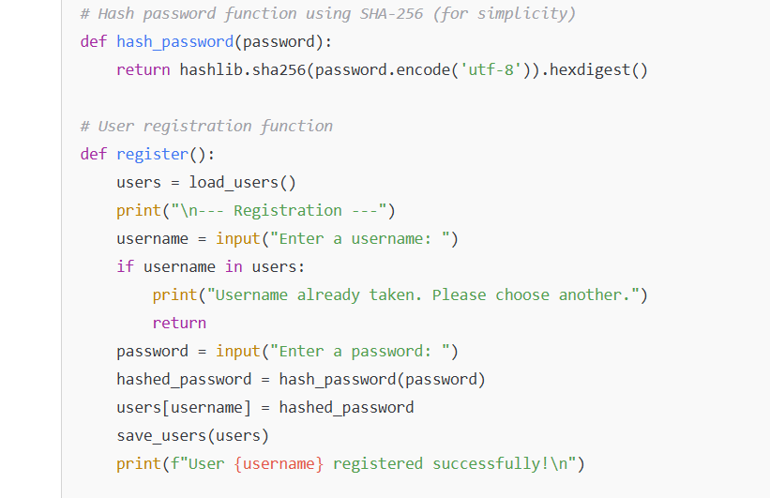
CodeTantra Implementation Screenshot

Slide 7
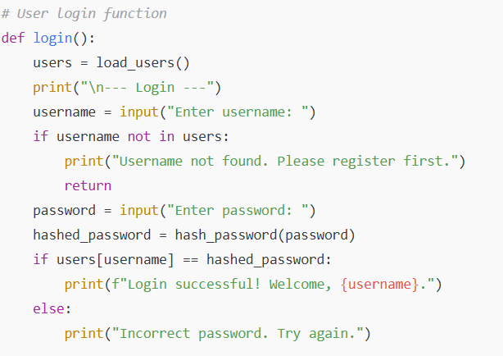
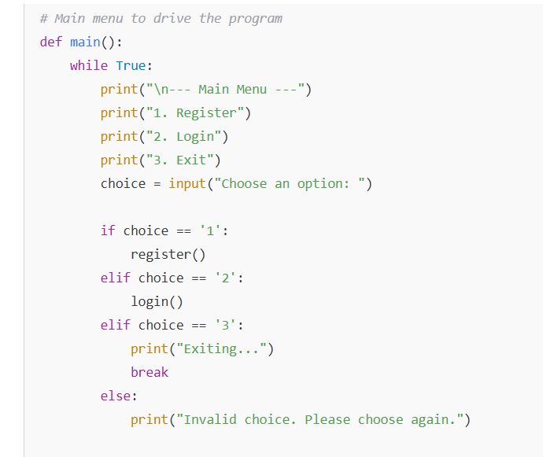

Slide 8
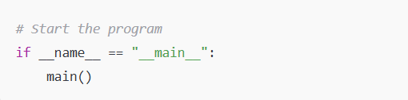

Slide 9
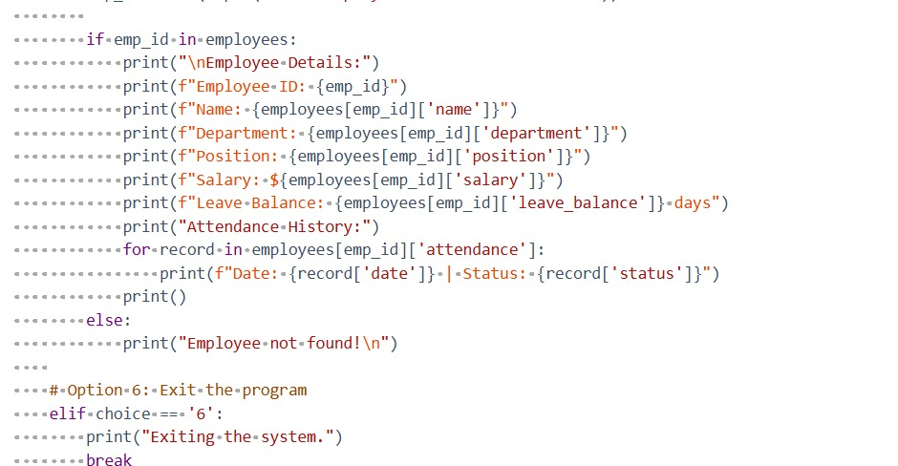

Slide 10


Slide 11


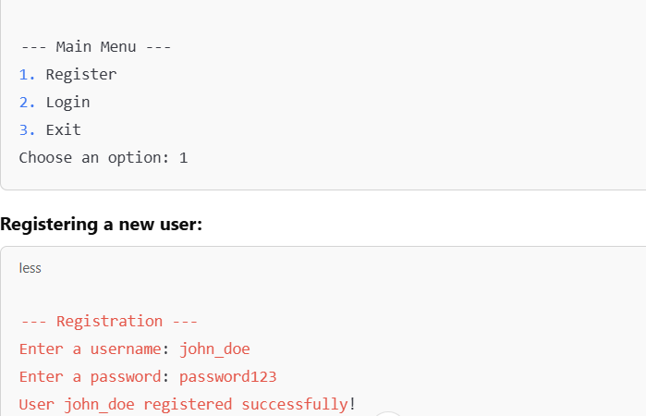
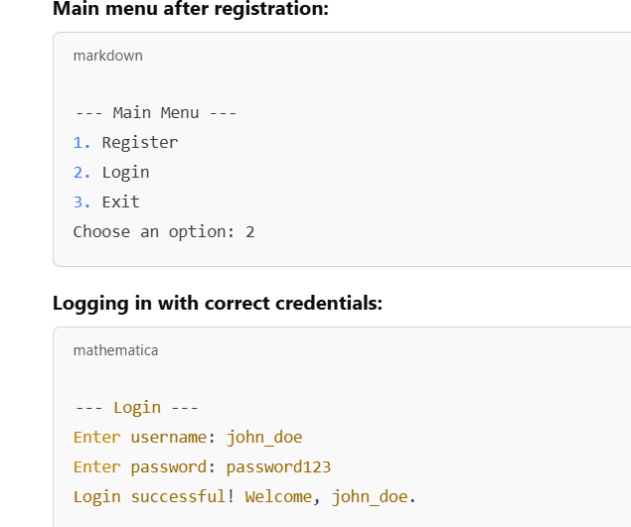

Slide 12
FUTURE SCOPES
Enhanced Security & Privacy
End-to-End Encryption
Two-Factor Authentication (2FA)
Role-Based Access Control (RBAC)
Mobile App Development
Native Android & iOS Apps
Offline Access & Push Notifications
Mobile Messaging Integration (WhatsApp, SMS)
AI & Analytics
Academic & Behavioral Analytics
AI-Powered Progress Reports
Health & Wellness Monitoring

Slide 13
REFERENCE
Python Documentation: https://docs.python.org/3/
Python Built-in Functions: https://docs.python.org/3/library/functions.html
Python Control Flow Statements: https://docs.python.org/3/tutorial/controlflow.html
Python String Methods: https://docs.python.org/3/library/stdtypes.html#string-methods
Python Lists: https://docs.python.org/3/tutorial/datastructures.html

Slide 14
CONCLUSION
The Guardian Communication Portal serves as a powerful tool to bridge the communication gap between schools, educators, and guardians, fostering a collaborative environment that prioritizes the well-being and academic success of students. By providing real-time updates, transparent communication, and easy access to essential information, the portal ensures that guardians remain actively engaged in their child's educational journey.

Slide 15


