Slide 1
Midpoint Demo and Adjustment Memo
Calibrated multi-factor case routing for RescueNet
Manoj Venkatachalaiah | CISC 699, Dr. Shaalan | Prepared October 21, 2026
Submitted late (due Oct 18). No live review took place, so this deck is the slide-supported demo; everything on it comes from real runs.
Notes:
This is the slide-supported version of the midpoint demo. It is late: the assignment was due October 18. There was no live review session, so I am presenting the evidence as slides. Every number is from a real run recorded in the repository.

Slide 2
The project as it is, not as I hoped
Built and working: AHP calculator, the v2 classifier path, 108 tests, an evaluation harness with pre-registered cases.
Deployed this week behind a flag (default unchanged): 13 of 13 measured cases assigned, 0 errors.
Not shown: that v2 routes better. By raw score v1 and v2 each match 3 of 6 annotated cases and pick the same winners.
Biggest finding: the scoring formula, not the weighting method, limits correctness.
Biggest weakness: independence. One annotator, one judge (AI-proposed judgments), no supervisor review, 8 synthetic cases.
Notes:
Self-check from the assignment: did I present the project as it is, or as I hoped it would be? As it is, the weighting method works mechanically, is deployed behind a flag and was measured without regression. It has not been shown to route better than the baseline, and everything rests on one person.

Slide 3
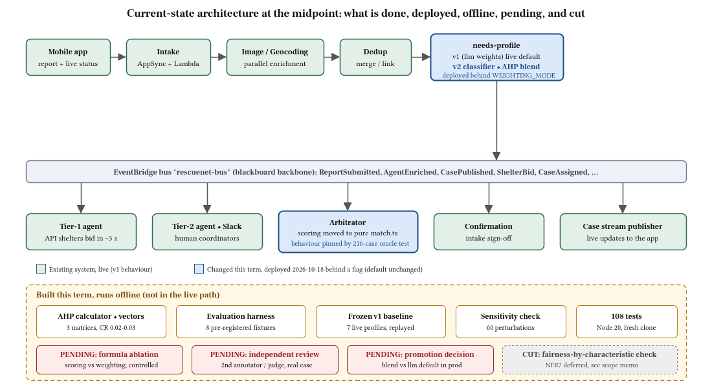
Current-state architecture
Notes:
Green is the existing system, unchanged by default. Blue is what changed this term and is deployed behind a flag. Amber runs offline. Red is pending and grey is cut.

Slide 4
Deployed pipeline: same reports, v1 vs v2
Scenario | v1 (llm): top two weights | v2 (blend): top two weights | v2 archetype probabilities | Winner
injured + loose | vet care 0.45, pickup urgency 0.35 | vet care 0.38, pickup urgency 0.23 | IC 0.65 / UT 0.30 / SR 0.05 | same: manhattan-acc
injured | vet care 0.50, pickup urgency 0.25 | vet care 0.52, pickup urgency 0.16 | IC 0.95 / UT 0.00 / SR 0.05 | same: manhattan-acc
loose | pickup urgency 0.50, proximity 0.30 | proximity 0.38, pickup urgency 0.37 | IC 0.00 / UT 0.95 / SR 0.05 | same: manhattan-acc
Injured case: vet care dominates in both. Loose healthy dog: pickup and proximity dominate.
Every scenario was won by the same shelter in both modes (KI-17): this run shows no regression, not better routing.
Notes:
Six real cases per mode went through the deployed pipeline, same reports, different locations. The needs profile shows how each case weights the five factors. Under llm the model writes the weights; under blend the model only gives archetype probabilities and the weights are computed in code from the adopted AHP vectors. The winner is the same in both, because one shelter dominates the seeded roster.

Slide 5
Latency, errors, and rollback on the deployed pipeline
13/13
0
cases ASSIGNED, no escalations
error lines across the 9 pipeline functions
24.7 | 24.1
7.3 s
median seconds, llm | blend
rollback (env var); next case stored no v2 fields
needs-profile Lambda median: 3.7 s (llm), 3.3 s (blend).
Notes:
Time is submission to a scored assignment, which includes the fixed fifteen second bid window. Both modes sit between about 23 and 29 seconds against a 30 second target. This is one environment with demo data, and each block began on freshly reconfigured functions, so treat it as indicative, not a production benchmark.

Slide 6
Offline comparison: v1 vs v2 on the pre-registered cases
Frozen v1 = 7 live profiles recorded once, replayed.
v1 and v2 pick the same shelter in every case by raw score.
Classifier: 7 of 7 agree with the annotation; probabilities are near one-hot.
Sensitivity: 60 one-step perturbations, largest flip count 1 (limit: fewer than 2).
The formula counts shelter capacity twice and misses SYN-01.
Notes:
Pre-registered annotations, 6 cases with a single best shelter. By raw top score both methods match 3 of 6 and choose the same shelter in every case. The extra two wins for v2 come only from the alphabetical tie rule that was written down before the run, and that happens to agree with the annotations. I report both numbers.

Slide 7
Requirements and success criteria: achieved, partial, not yet
ID | Requirement | Status
SC1 | Species check fixed and regression-tested | Achieved
SC2 | AHP CR < 0.10; sensitivity (60 perturbations) | Achieved; validity partial
SC3 | v2 at least as good as v1 on annotated cases | Met, but weak (ties by raw score)
SC4 | Deployed, no regression, about 30 s, rollback | Achieved (small sample)
SC5 | Supervisor acceptance at the midpoint | Not yet
FR7/FR8 | Convex blend; safe fallback | Achieved (fallback offline)
NFR6 | Reproducible weights and scores | Achieved (identical hashes)
NFR7 | Fairness by shelter characteristic | Cut
Notes:
Honest status against the original requirements. SC5, supervisor acceptance, is not yet because no supervisor review has taken place.

Slide 8
Critique received: Hard Stop 3 scored 90/100
Instructor priority | Response | Status
1 Non-production deployment, latency, rollback | Deployed and measured 2026-10-18 | Done (one environment)
2 Supervisor review with a record | On the critical path before Hard Stop 4 | Open
3 Independent validation (annotator, judge) | Second annotator and judge; disagreement analysis | Open
4 Isolate the scoring formula | Controlled ablation: formula by weights | Open
5 Human review of AI-generated work | Written review of scoring, fallback, harness | Open
6 More cases; privacy-reviewed real case | Pre-registered expansion; real case if permitted | Open
Notes:
No live midpoint review took place, so the critique on record is the Hard Stop 3 feedback. Each of the instructor's priorities became a backlog item.

Slide 9
Scope adjustment: keep, cut, defer, protect
PROTECT
KEEP
Controlled ablation: formula vs weights
Independent annotator and judge
Student-led review records
Pre-registration and reproducibility
Blend design and the fallback (supervisor-approved)
Harness and sensitivity check
Stop treating the blend as proven better
CUT
DEFER
Fairness-by-characteristic check (NFR7)
Why: n = 8; one shelter won all 13 measured cases
Next if more must go: classifier calibration
Promoting blend to default (after the ablation)
Classifier calibration
Real-case evaluation (needs PII review)
Notes:
Each decision is tied to evidence. The one cut is the fairness check: with eight cases and one dominant shelter in the roster it would show that shelter, not a pattern, and it would not change any decision.

Slide 10
Critical path, weeks 8 to 14
Due | Deliverable | Non-negotiable milestone
Oct 25 | Hard Stop 4 | Pre-registered new cases; ablation run; second annotator; supervisor review
Nov 1 | Results memo | Ablation results with uncertainty; promotion decision
Nov 8 | Hard Stop 5 | Isolated-environment measurement; clean synth; validation archive
Nov 15 | Full draft | Report with results, limitations, independent-review evidence
Nov 22 / 29 | Hard Stop 6 / rehearsal | Draft, deck, final test evidence; package check
Dec 6 | Hard Stop 7, final | Final artifact, report, demo
Notes:
The path that must not slip is pre-registered cases, then the ablation, then the independent review.

Slide 11
What I am not claiming
That v2 routes better than v1. By raw score they are identical on every case.
That the latency numbers are a production benchmark: one environment, demo data, a small sample, cold starts at each block.
That the weights are right. They are consistent, single-judge, AI-proposed, with no source for their magnitudes.
That the live roster tests routing: one dominant shelter won every measured case in both modes.
That anyone besides me has reviewed this work.
Notes:
These limits are in the memo too. The deployment evidence is real but narrow.

Slide 12
Supervisor prompt: what would I cut after week 8?
The fairness-by-shelter-characteristic check (NFR7), already cut.
Next candidate: classifier calibration.
Not to be cut: the controlled ablation, independent annotation, and the student-led review records.
Everything else in the plan depends on knowing whether the weights or the formula drive routing.
Notes:
The fairness check is already cut. If more has to go, classifier calibration is next. The ablation, independent annotation and the review records are not to be cut.

