Slide 1

Day-4
Prepared By
Isysway Technologies

Slide 2
Topics Covered
Route 53
Amazon Simple Storage Services

Slide 3
What is Route 53?
Amazon Route 53 is a highly available and scalable Domain Name System (DNS) web service.
It is designed for developers and corporates to route the end users to Internet applications by translating human readable names like www.mydomain.com, into the numeric IP addresses like 192.0.2.1 that computers use to connect to each other.

Slide 4
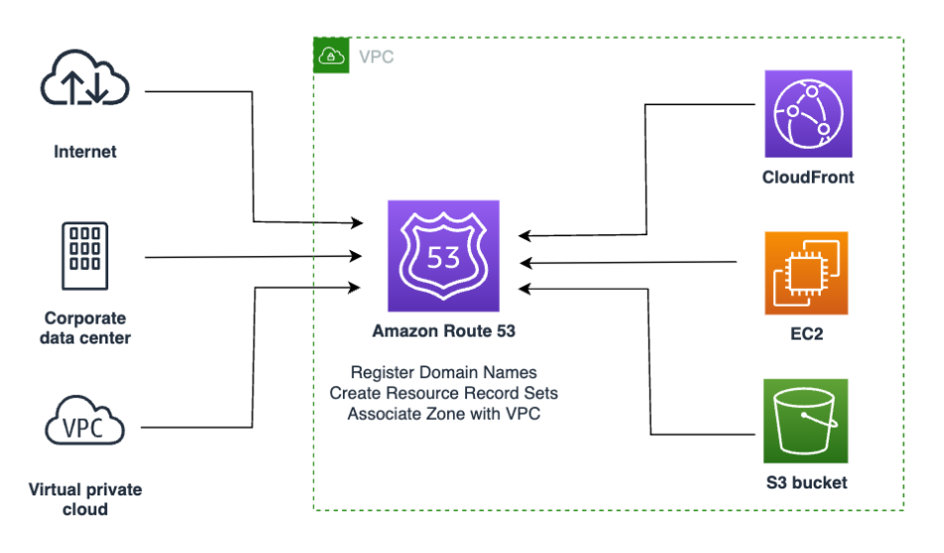


Slide 5
Amazon S3 (Simple Storage Service)
S3 Overview and Buckets
Buckets Creation
Static webpage creation
Version control and Lifecycle Management

Slide 6
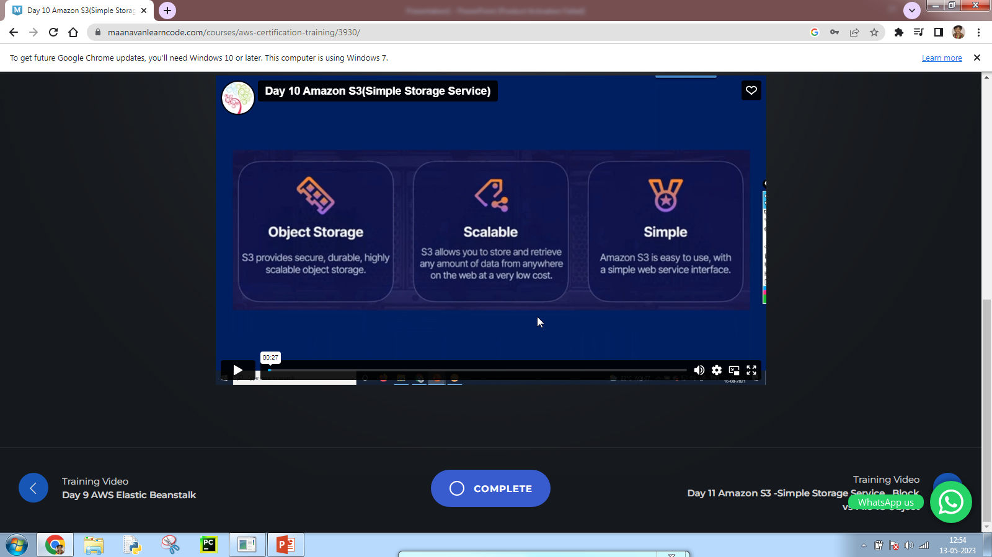

Slide 7
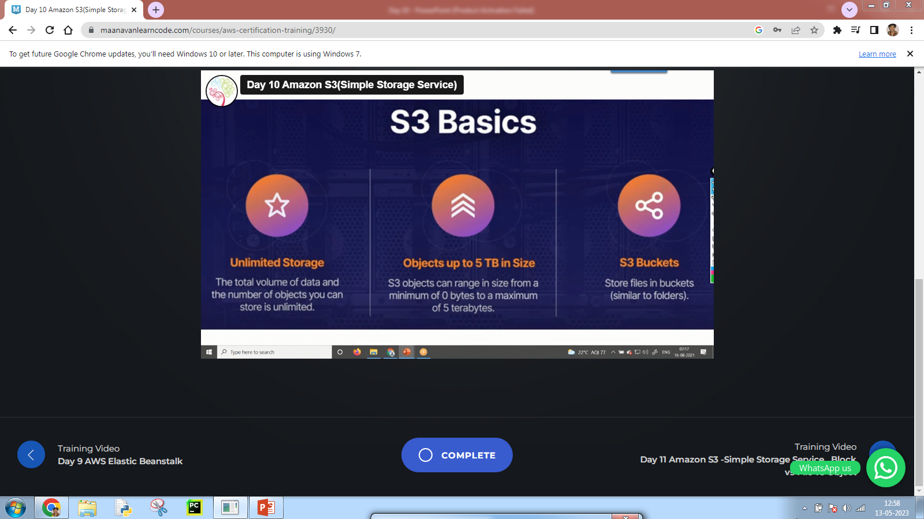

Slide 8
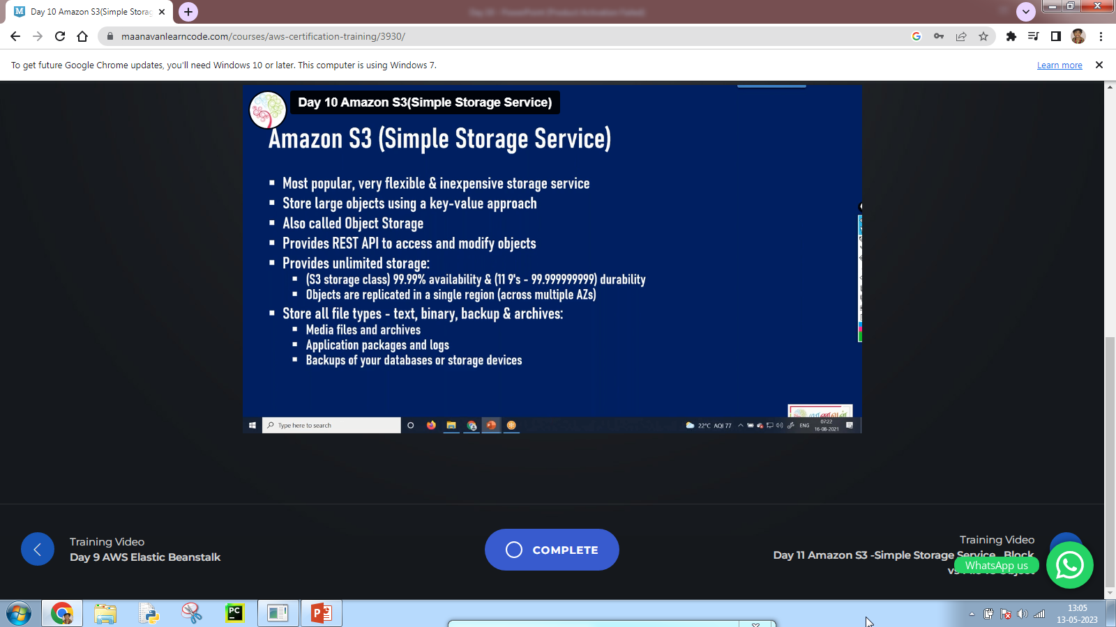

Slide 9
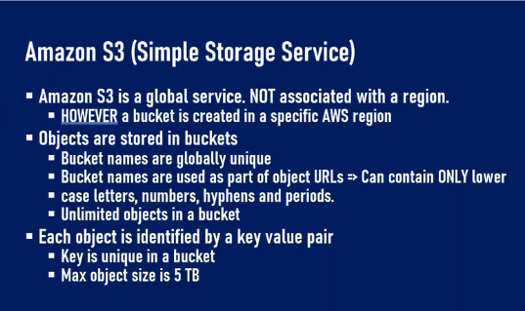

Slide 10
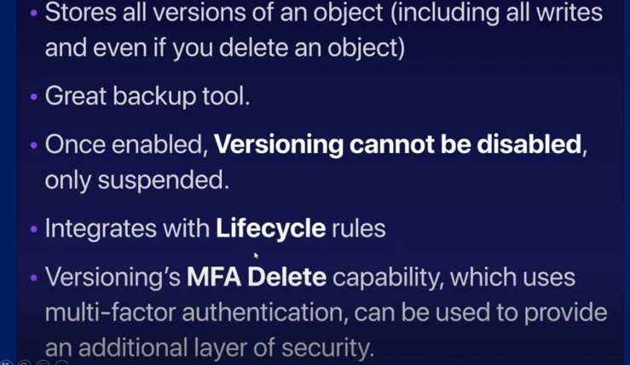

Slide 11
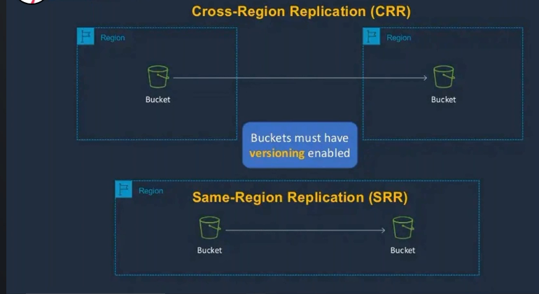


Slide 12
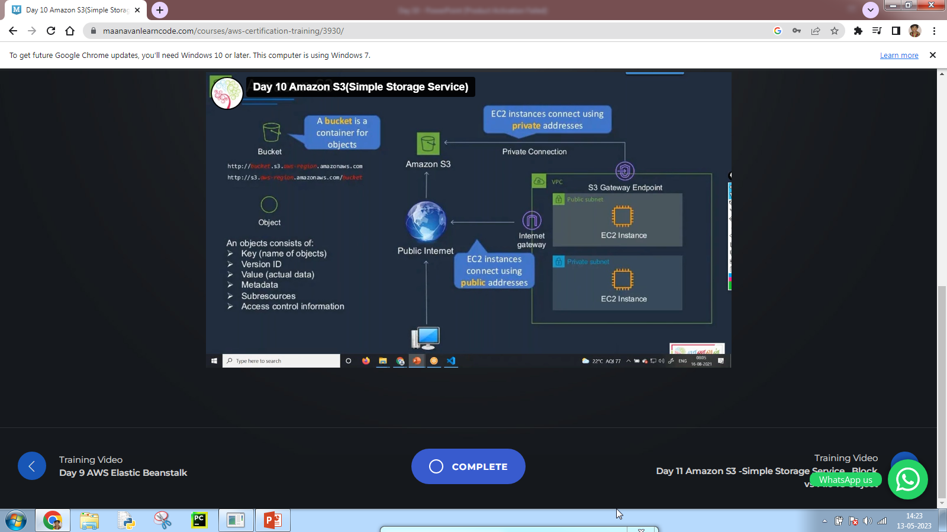

Slide 13
Version Control and Lifecycle Management
s3’s Lifecycle Management integrates S3 and Glacier and makes the details visible via the Storage Class of each object.
The data for objects with a Storage Class of Standard or RRS (Reduced Redundancy Storage) is stored in S3. If the Storage Class is Glacier, then the data is stored in Glacier. Regardless of the Storage Class, the objects are accessible through the S3 API and other S3 tools.
Lifecycle Management allows you to define time-based rules that can trigger Transition (changing the Storage Class to Glacier) and Expiration (deletion of objects). The Expiration rules give you the ability to delete objects (or versions of objects) that are older than a particular age.
You can use these rules to ensure that the objects remain available in case of an accidental or planned delete while limiting your storage costs by deleting them after they are older than your preferred rollback window.

