Slide 1
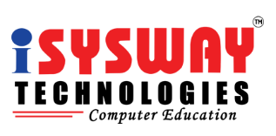
Day-5
Prepared By
Isysway Technologies

Slide 2
Topics Covered
Database
Simple Notification Services

Slide 3
Database
Database Overview
Database Creation
Amazon Relational Database Service

Slide 4
What is Database?
A database is a collection of data that is organized, which is also called structured data. It can be accessed or stored in a computer system. It can be managed through a Database Management System (DBMS), a software used to manage data. Database refers to related data in a structured form.
Relational Databases: A relational database’s contents are arranged as a collection of tables with rows and columns. Accessing structured data is made most flexible and efficient by relational database technology.

Slide 5
RDS (Managed Relational Database Service)
Amazon Relational Database Service (Amazon RDS) is a web service that makes it easier to set up, operate, and scale a relational database in the AWS Cloud.
It provides cost-efficient, resizable capacity for an industry-standard relational database and manages common database administration tasks.

Slide 6
Amazon RDS provides the following specific advantages over database deployments that aren't fully managed:
You can use the database products you are already familiar with: MariaDB, Microsoft SQL Server, MySQL, Oracle, and PostgreSQL.
Amazon RDS manages backups, software patching, automatic failure detection, and recovery.
You can turn on automated backups, or manually create your own backup snapshots. You can use these backups to restore a database. The Amazon RDS restore process works reliably and efficiently.
You can get high availability with a primary instance and a synchronous secondary instance that you can fail over to when problems occur. You can also use read replicas to increase read scaling.
In addition to the security in your database package, you can help control who can access your RDS databases. To do so, you can use AWS Identity and Access Management (IAM) to define users and permissions. You can also help protect your databases by putting them in a virtual private cloud (VPC).

Slide 7
DB engines
A DB engine is the specific relational database software that runs on your DB instance. Amazon RDS currently supports the following engines:
MariaDB
Microsoft SQL Server
MySQL
Oracle
PostgreSQL

Slide 8
What is Amazon SQS?
A message queuing service
Amazon SQS provides queues for high-throughput, system-to-system messaging. You can use queues to decouple heavyweight processes and to buffer and batch work. Amazon SQS stores messages until microservices and serverless applications process them.

Slide 9
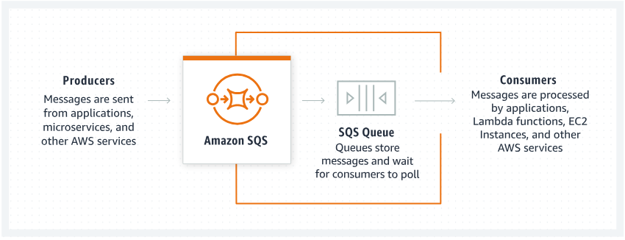
Amazon SQS allows producers to send messages to a queue. Messages are then stored in an SQS Queue. When consumers are ready to process new messages they poll them from the queue. Applications, microservices, and multiple AWS services can take the role of producers or consumers.

Slide 10
What is Amazon SNS?
Amazon Simple Notification Service (Amazon SNS) is a managed service that provides message delivery from publishers to subscribers (also known as producers and consumers).
Publishers communicate asynchronously with subscribers by sending messages to a topic, which is a logical access point and communication channel.
Clients can subscribe to the SNS topic and receive published messages using a supported endpoint type, such as Amazon Kinesis Data Firehose, Amazon SQS, AWS Lambda, HTTP, email, mobile push notifications, and mobile text messages (SMS).

Slide 11
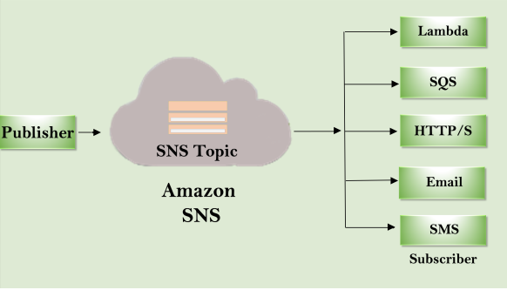

Slide 12
Amazon SNS provides the following features and capabilities:
Application –to-application messaging
Application-to-person notifications
Standard and FIFO topics
Message durability
Message archiving and analytics
Message attributes
Message filtering
Message security

