Slide 1
Day-6
Prepared By
Isysway Technologies

Slide 2
Topics Covered
CloudWatch
Lambda

Slide 3

CloudWatch
Amazon CloudWatch monitors your Amazon Web Services (AWS) resources and the applications you run on AWS in real time. You can use CloudWatch to collect and track metrics, which are variables you can measure for your resources and applications.

Slide 4
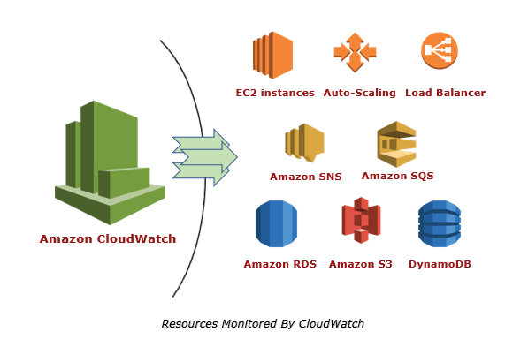
Advantages of CloudWatch
offers ease of use for basic functions;
provides visibility for all AWS monitoring
data on one platform;
effectively collects metrics for AWS environments;
increases and optimizes operational performance of AWS and on-premises resources;
offers integration with other AWS resources.

Slide 5
Lambda
Overview
Functions using Lambda
Hands-on- Automatic backup (S3 Bucket)
Hands-on-upload Notification (S3 Bucket)
Hands-on- Start and Stop Schedule in Ec2
Hands-on- Alexa creation

Slide 6
Serverless Computing
Serverless computing allows you to build and run applications and services without thinking about servers.
With serverless computing, your application still runs on servers, but all the server management is done by AWS.
At the core of serverless computing is AWS Lambda, which lets you run your code without provisioning or managing servers.

Slide 7
What is Lambda?
AWS Lambda is a serverless, event-driven compute service that lets you run code for virtually any type of application or backend service without provisioning or managing servers.
You pay only for the compute time you consume - there is no charge when your code is not running.
With Lambda, you can run code for virtually any type of application or backend service - all with zero administration.
Just upload your code, and Lambda takes care of everything required to run and scale your code with high availability.
You can set up your code to automatically trigger from other AWS services or call it directly from any web or mobile app.
AWS Lambda automatically runs code in response to multiple events, such as HTTP requests via Amazon API Gateway, modifications to objects in Amazon Simple Storage Service (Amazon S3) buckets, table updates in Amazon DynamoDB, and state transitions in AWS Step Functions.

Slide 8
Benefits of Lambda
No servers to manage.
Continuous scaling.
Millisecond metering.
Increases innovation.
Modernize your applications.
Support for developers.

Slide 9
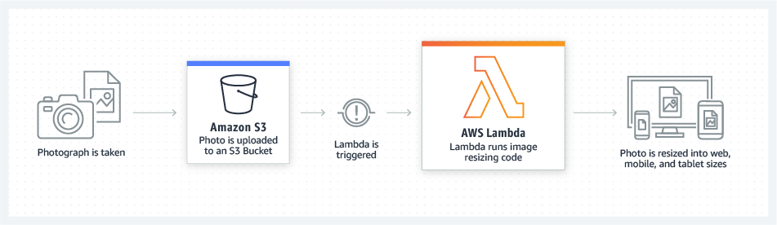
Example of Lambda

