Slide 1

Day-7
Prepared By
Isysway Technologies

Slide 2
Topics Covered
Containerization
GITHUB
AWS Services Overview

Slide 3
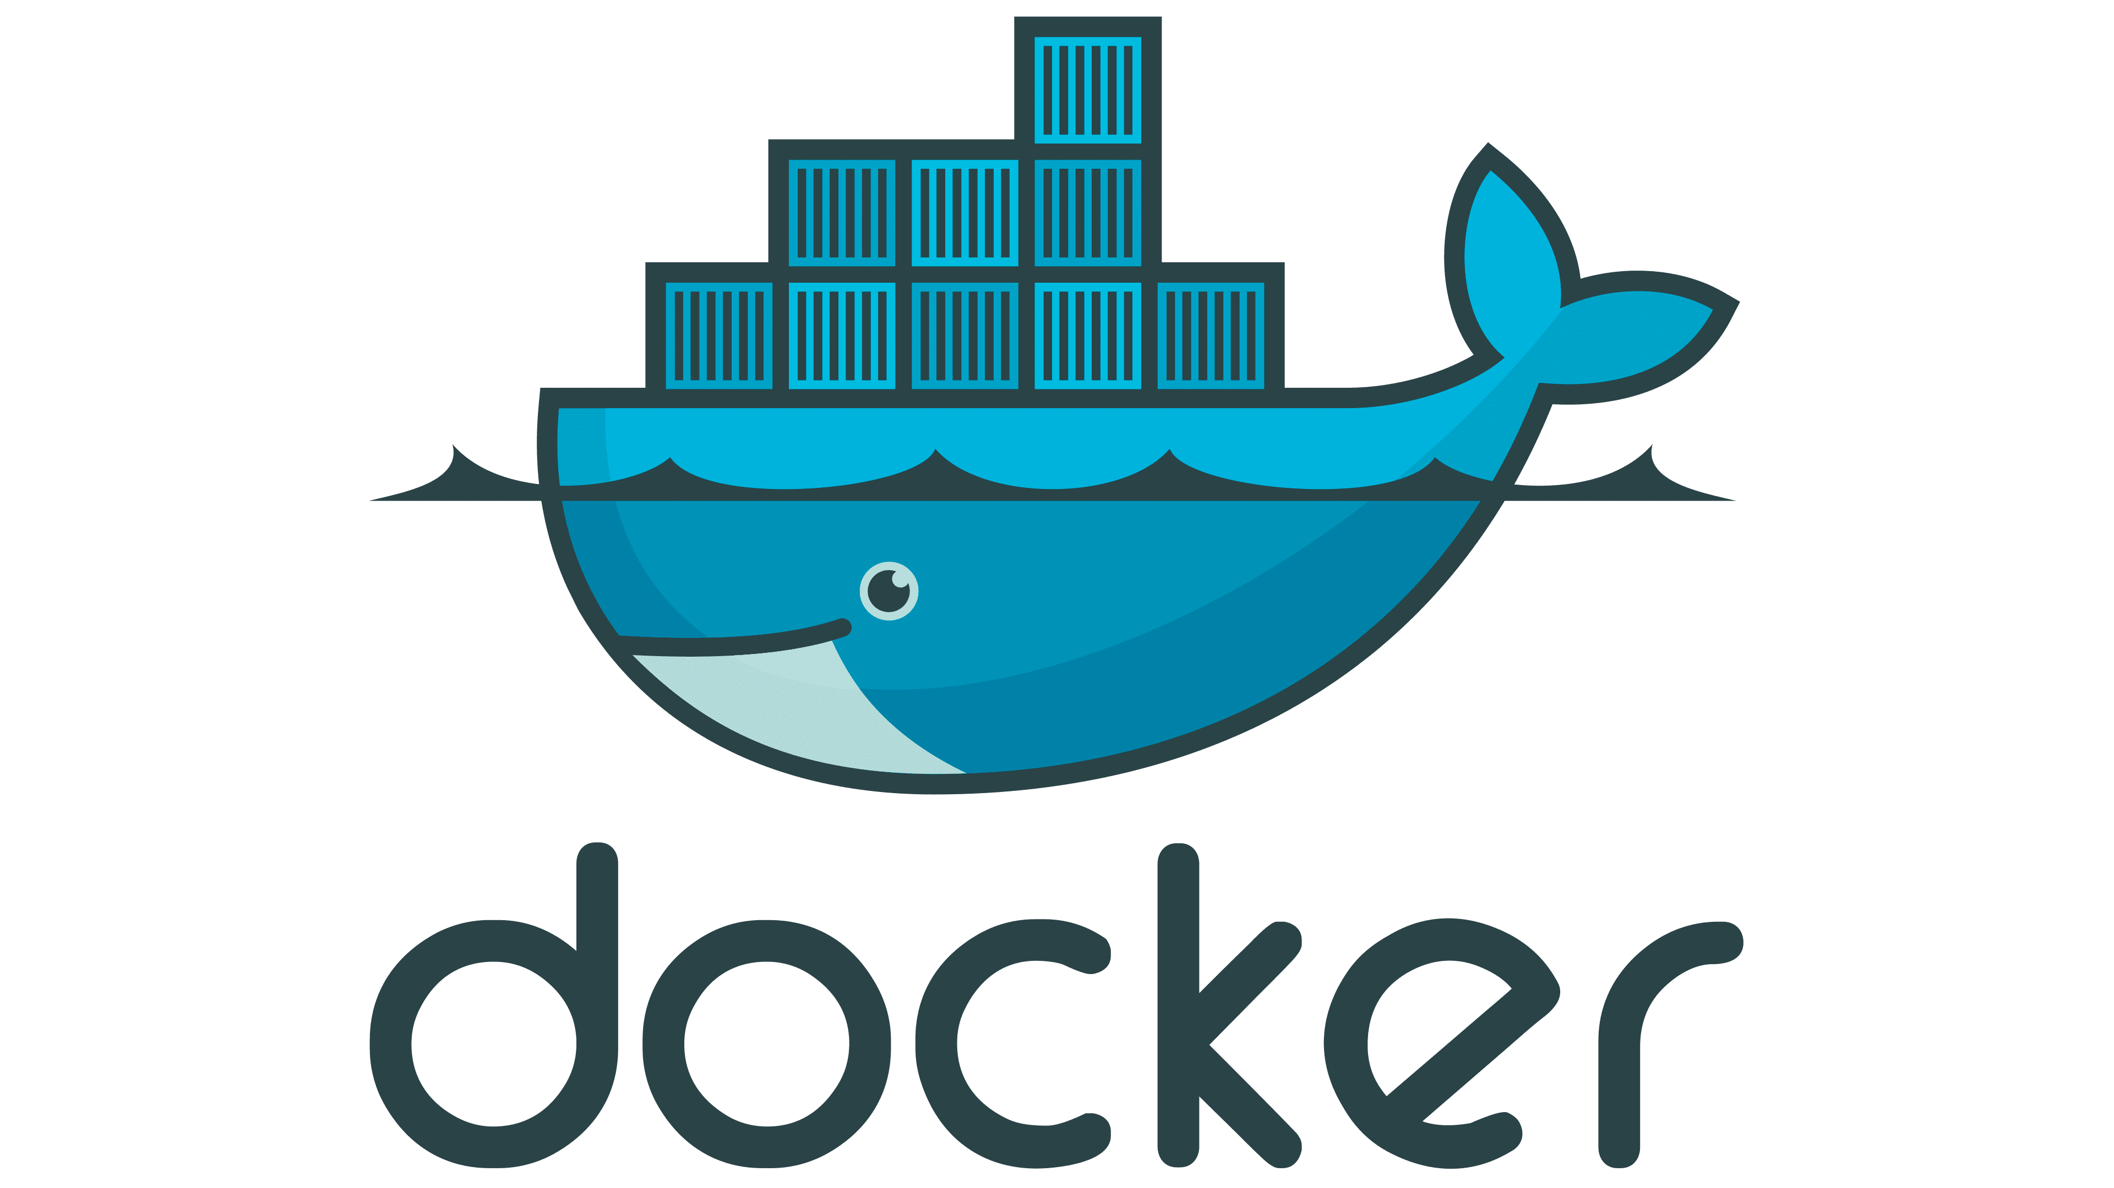

Slide 4

DOCKER
In Traditional IT Setup
Developer
Tester
Production & environment
Java
Tomcat server
Develop the Code
Java
Tomcat server
Test the Code
Java
Tomcat server
Deploy the Code

Slide 5
DOCKER
Repeating same process again and again it consuming
More time
More manual efforts
And mainly versions variations
To rectify all these problems

Slide 6
DOCKER
It’s the DevOps tool
Open Source
It’s the tool define to make it easier to create deploy and run applications using containers

Slide 7
CONTAINERS
It’s the packages of an applications with all of the parts it needs such us libraries and others dependencies.
It working on client server Architecture.

Slide 8
DOCKER ENGINE
It is simply the Docker applications installed on your Host machine which is work as client server applications.
All we need to install Docker applications in your Host machine to create image and run containers.
We can use Docker Repository to get and create images.

Slide 9
DOCKER hub
It is know us Docker hub where we can share image public to use by others developers

Slide 10
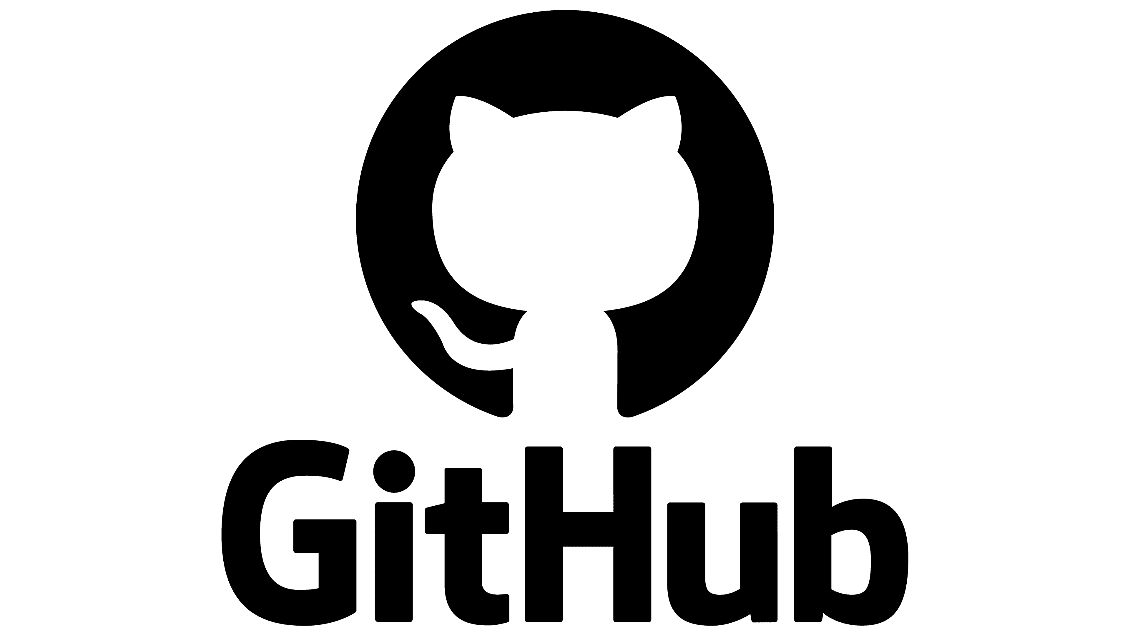

Slide 11
GIT (Global Information Tracker)
Tool for version control
To Keep Track Code
Track The Changes made in code
Its creates check points where the changes made
Synchronize code
While multiples developers working on different parts of codes to sync all codes into one project

Slide 12
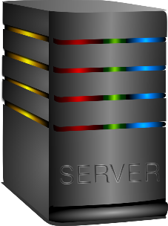
HOST Repository
Dev-1
a = 1;
b = 2;
C = 3;
Dev-2
a = 1;
B = 2;
D = 4;
Server will sync all the Part of the Code

Slide 13
GIT HUB
Code hosting platform.
We can store our code into GitHub servers.

Slide 14
USE CASES
Even you are solo or Freelance developer
We use different machine to code.
It helps to save all ours codes in one place.
We can full all the changes made in code from GitHub.
Even forget to push change made in code we can working different parts of codes and sync in later.

Slide 15
USE CASES
If you are Team of developers
Mainly for code collaboration
We can review the code and add comment
Mostly used for open sources project

Slide 16
USE CASES
MAIN CODE
BUGS
FEATURES

Slide 17
OTHER USE CASES
We can copy the code , Modify it and insist to change in the main code to author if it’s the reasonable change by Pull request.
We can create profile and upload codes.
Main things to notices all ours codes are public.
If you want keep it private have to pay for that.

Slide 18
For job seekers & devs
Create a GitHub Profile & Push Your code in to Repository
We Can add Our GitHub Profile in your Resume
Its Help us to show our quality of code to the Respective Employers

