Slide 1
Day-8
Prepared By
Isysway Technologies

Slide 2
Topics Covered
Cloud Front
Virtual Private Network
Amazon Athena

Slide 3
Cloud Front
Securely deliver content with low latency and high transfer speeds.
Amazon CloudFront is a fast content delivery network (CDN) service that securely delivers data, videos, applications, and APIs to customers globally with low latency and high transfer speeds.

Slide 4

Amazon Virtual Private Cloud (VPC)
Amazon VPC
Amazon VPC and subnets
Networking

Slide 5
VPC (Virtual Private Cloud)
VPC stands for Virtual Private Cloud.
Amazon Virtual Private Cloud (Amazon VPC) provides a logically isolated area of the AWS cloud where you can launch AWS resources in a virtual network that you define.
You have complete control over your virtual networking environment, including a selection of your IP address range, the creation of subnets, and configuration of route tables and network gateways.

Slide 6
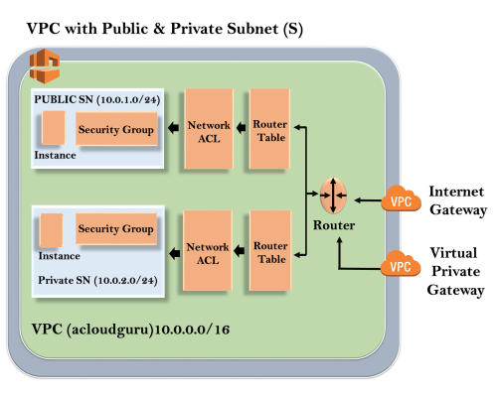

Architecture of VPC

Slide 7
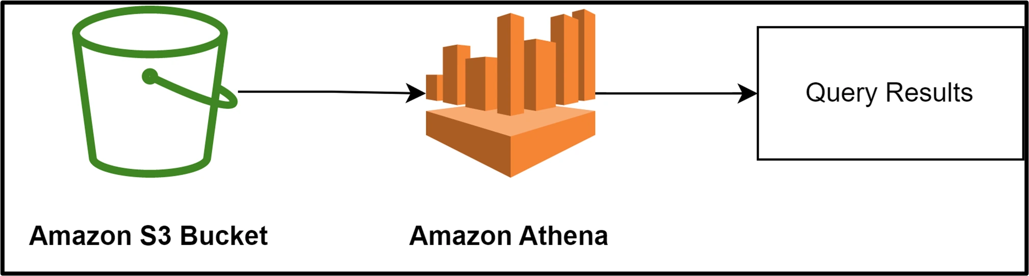
Amazon Athena
Start querying data instantly.
Amazon Athena is an interactive query service that makes it easy to analyze data in Amazon S3 and other federated data sources using standard SQL.

