Slide 1
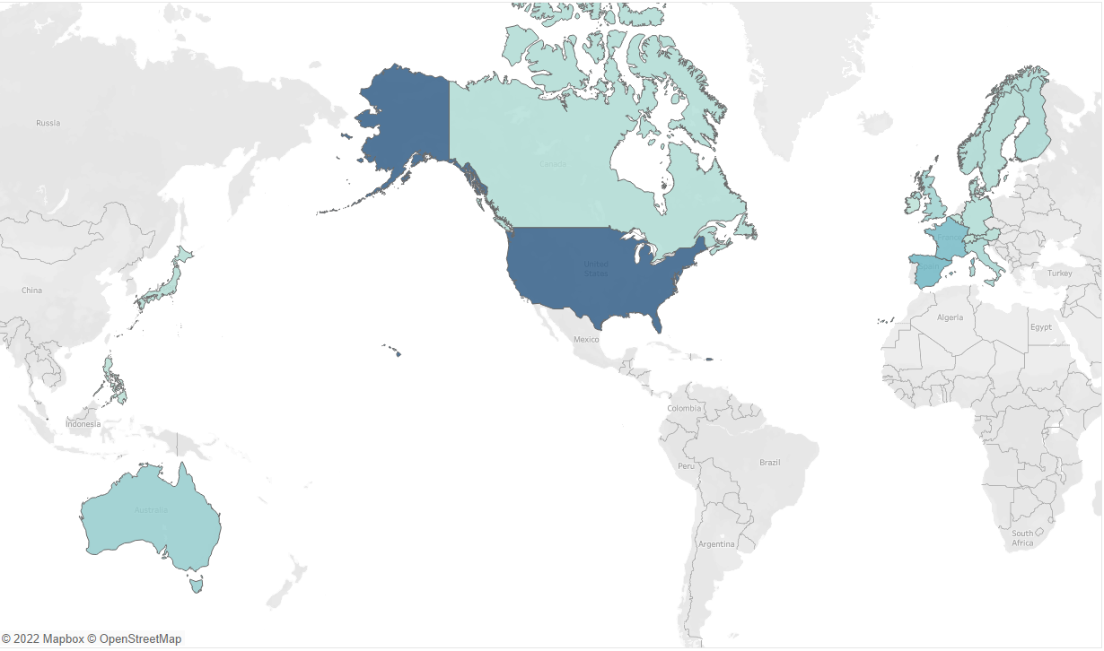
MRA Project - Milestone 1
DEEPAK SINGH
Great Learning Online 25-JuNE-2023
PGDSBA G4 SEPT 22A

Slide 2
Project Agenda
Problem Statement An automobile parts manufacturing company has collected data of transactions for 3 years.
Action
Exploratory Data Analysis
RFM Analysis
Customer Segmentation
Inferences

Slide 3
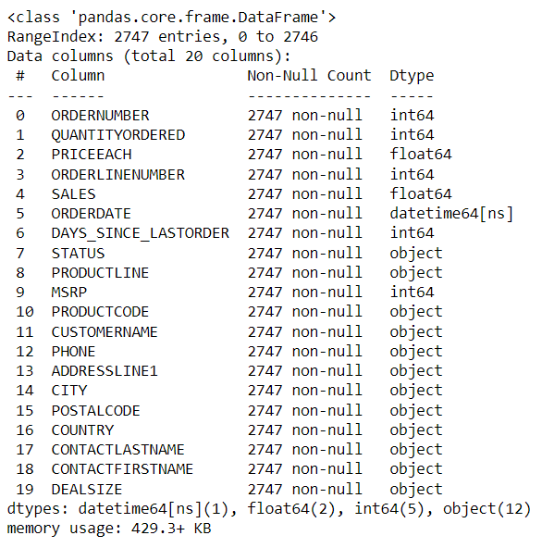

Exploratory Data Analysis
The data is about an automobile parts manufacturing company.
They have provided the data collected of transactions for 3 years.
We can explore the given Dataset using Python & Tableau
The shape of the given Dataset is 2747 x 20 columns
The data has 2747 entries
The data has 1 datetime64 , 2 float64, 5 int64,and 12 Object data types.
This data more or less reflects the purchasing behavior of customers in different categories .
The company is into automobile part manufacture, and they have different product line like Classic car , Motorcycles, aeroplanes etc.

Slide 4
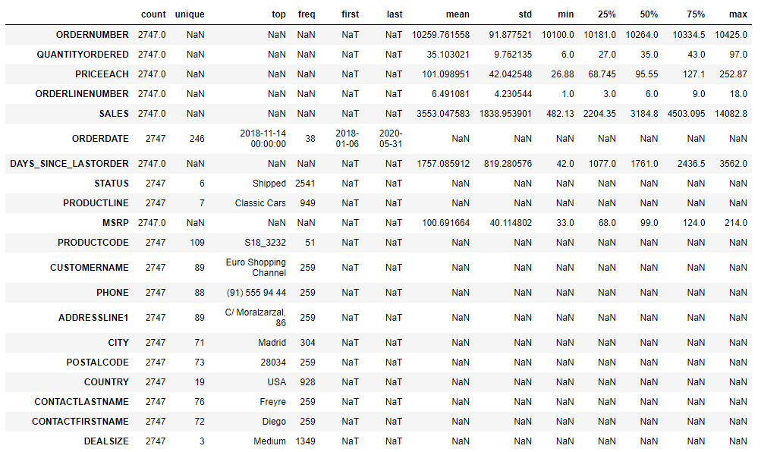
Exploratory Data Analysis
Highest Purchases have been seen by
Customer Name - Euro Shopping Channel
City - Madrid
Country - USA
Product Line - Classic Cars

Slide 5
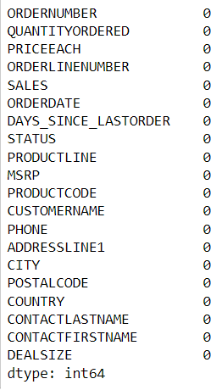
Exploratory Data Analysis
We can further understand that there are no null values in the given dataset
From the univariate analysis we can see that the dataset has a few outliers
These can be seen with Quantity Ordered, Price of the item, days to order
And sales.
The data follows close to a normal distribution with Date of Order
The other data are slightly skewed in nature
The dataset has both no null values and no duplicate rows of data.

Slide 6
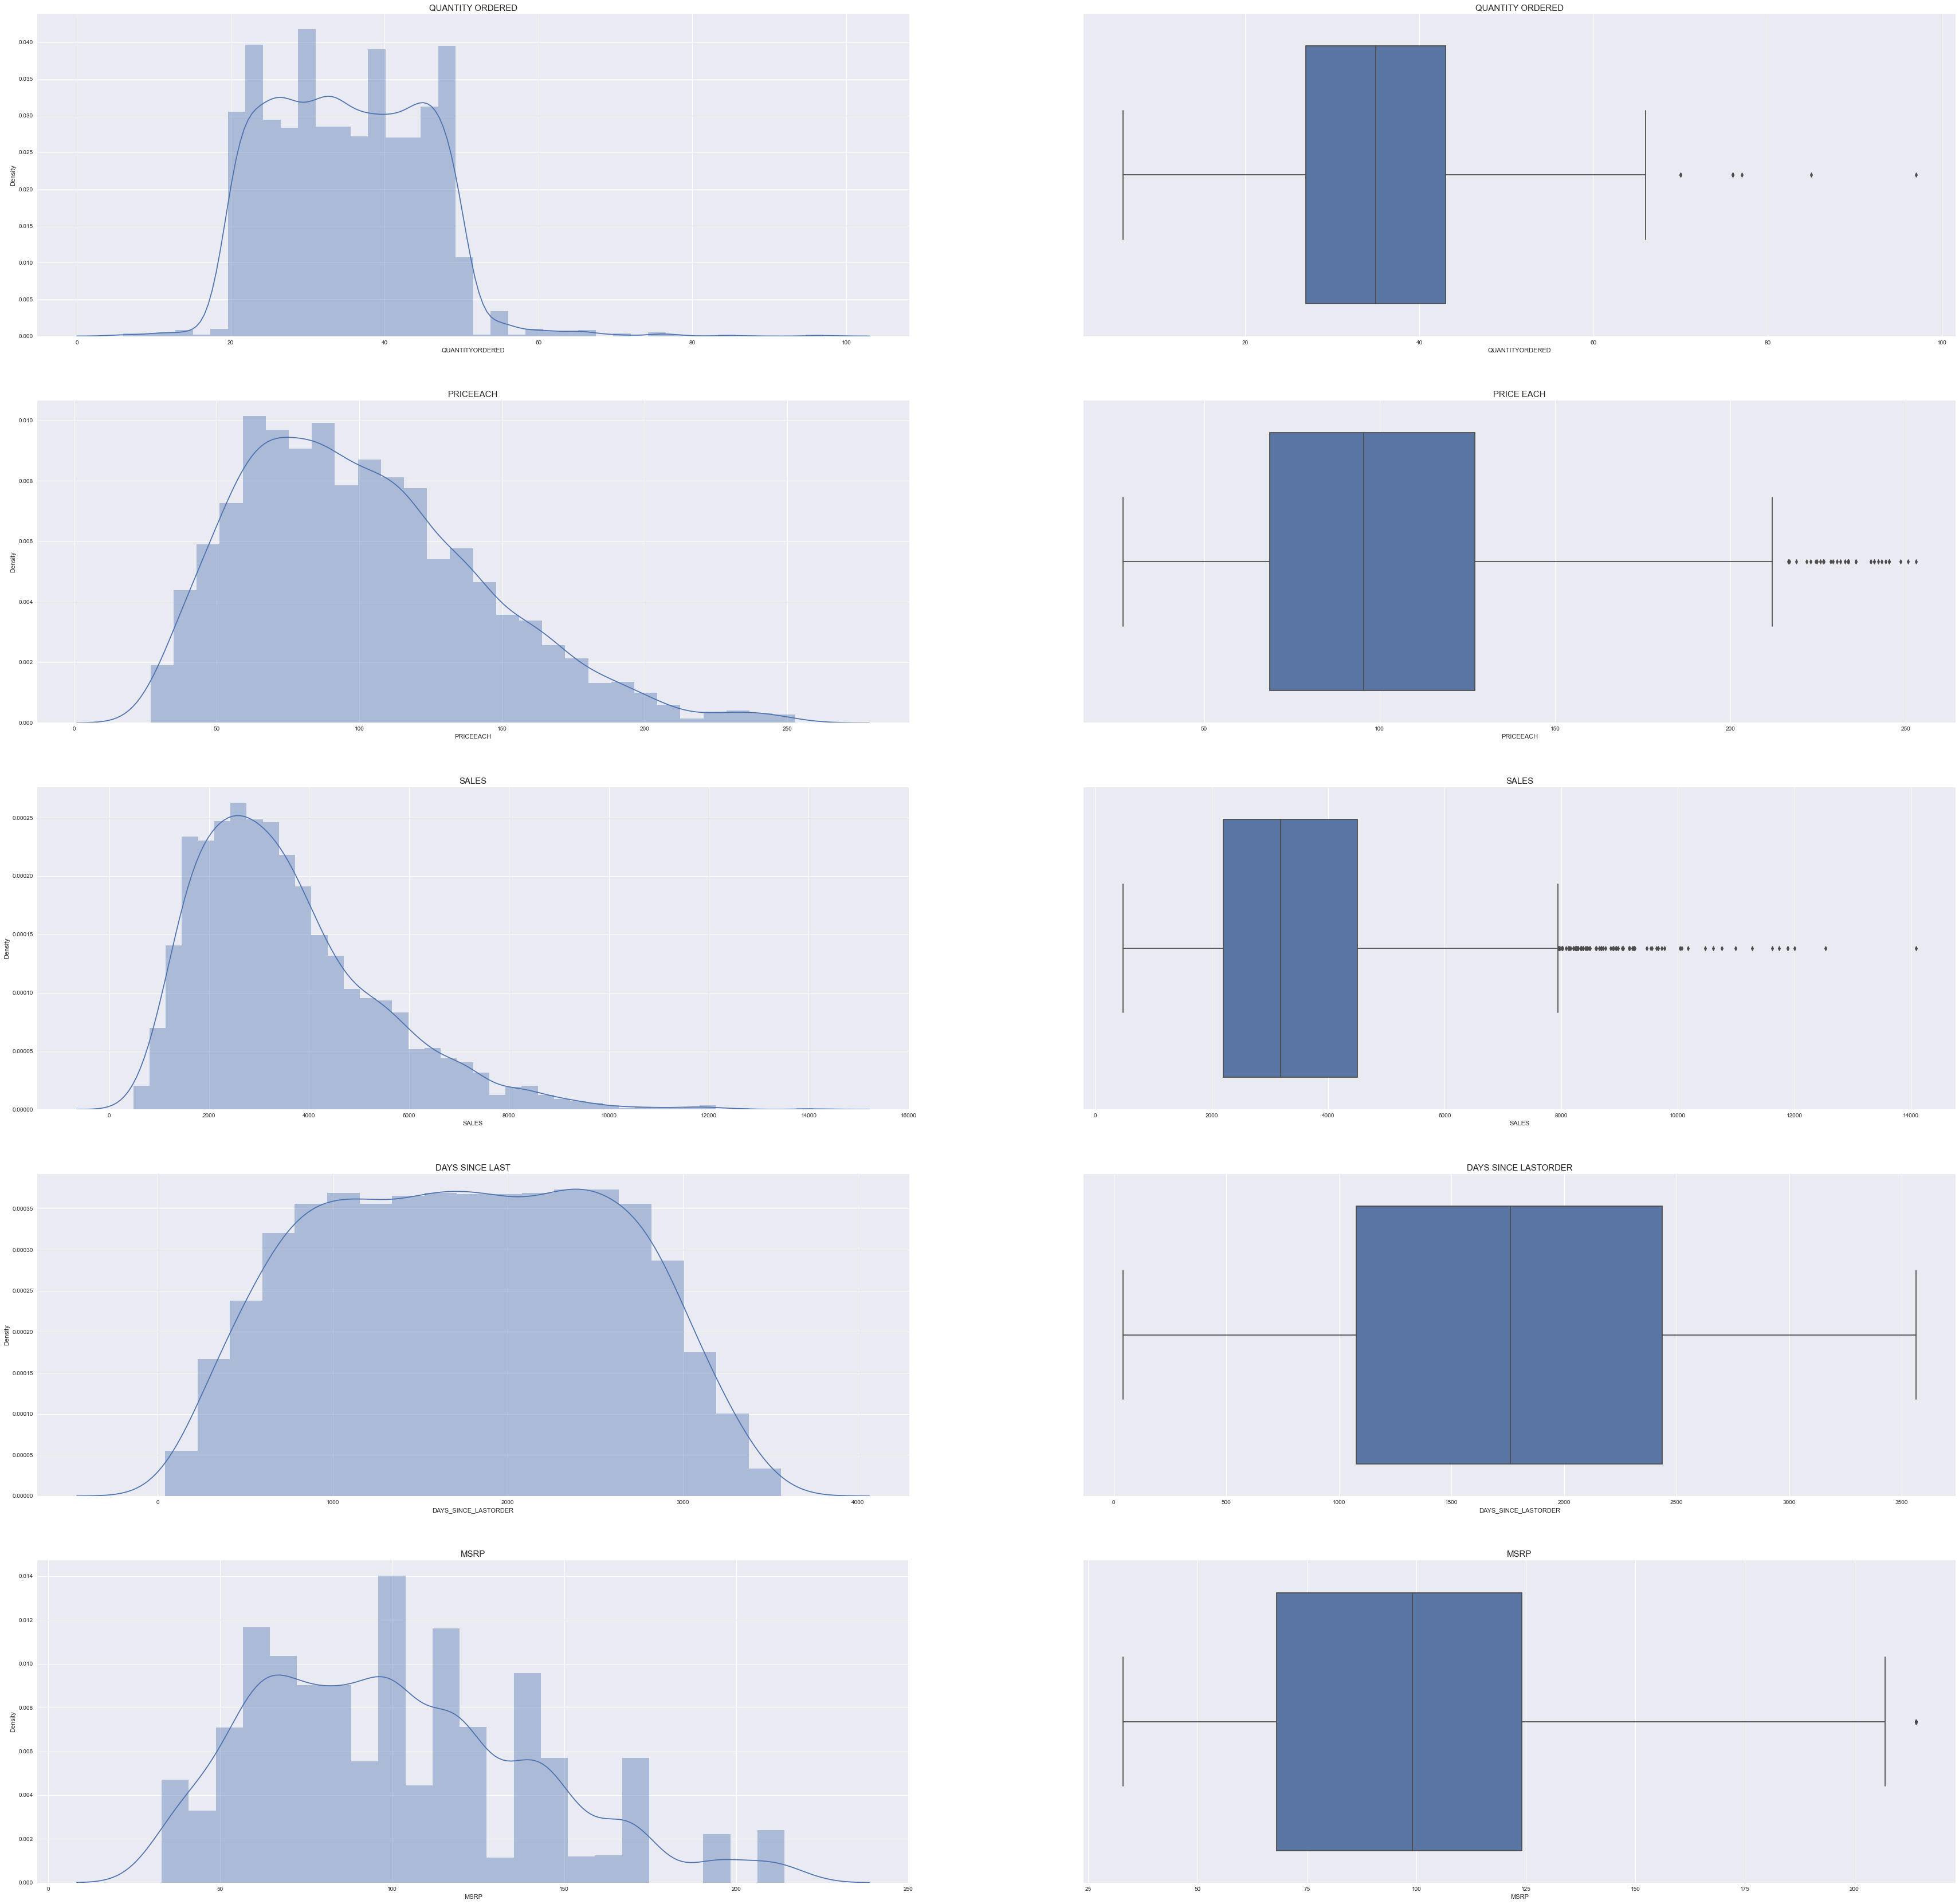
Univariate Analysis

Slide 7
Univariate Analysis

Slide 8
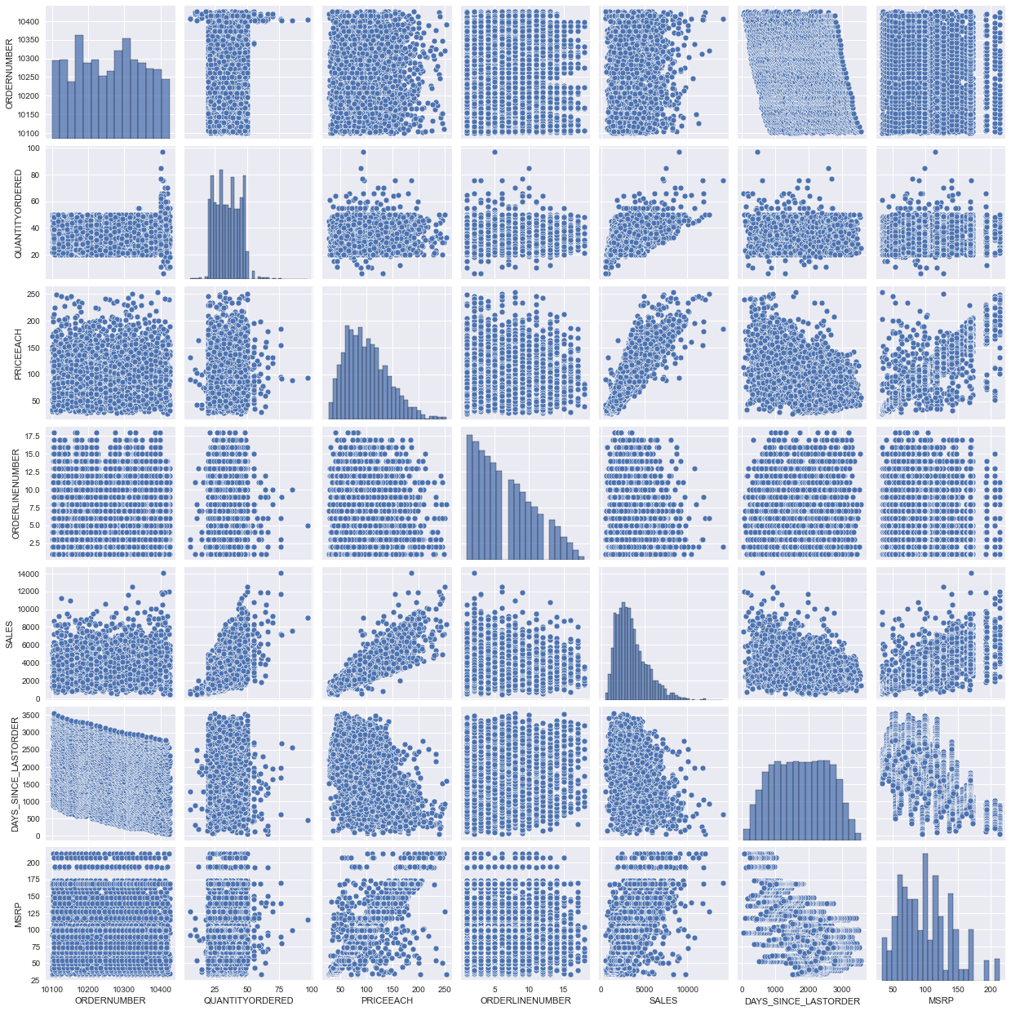
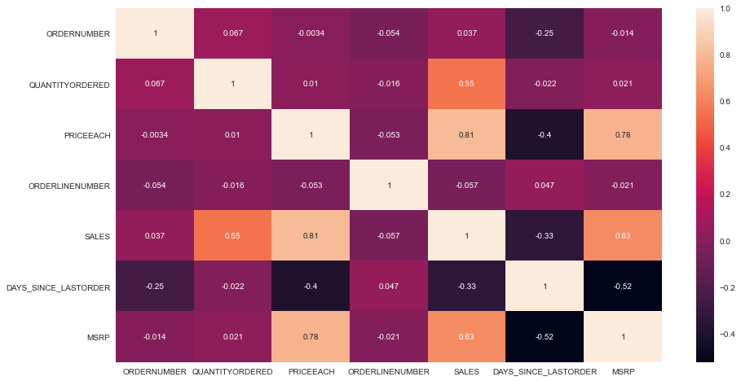
Heatmap and Bivariate
A high value of corelation can be seen between Sales and Price each with a value of 0.81.

Slide 9
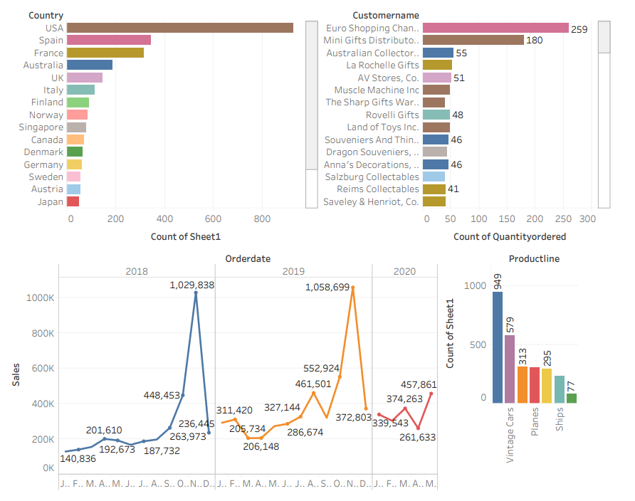

Slide 10
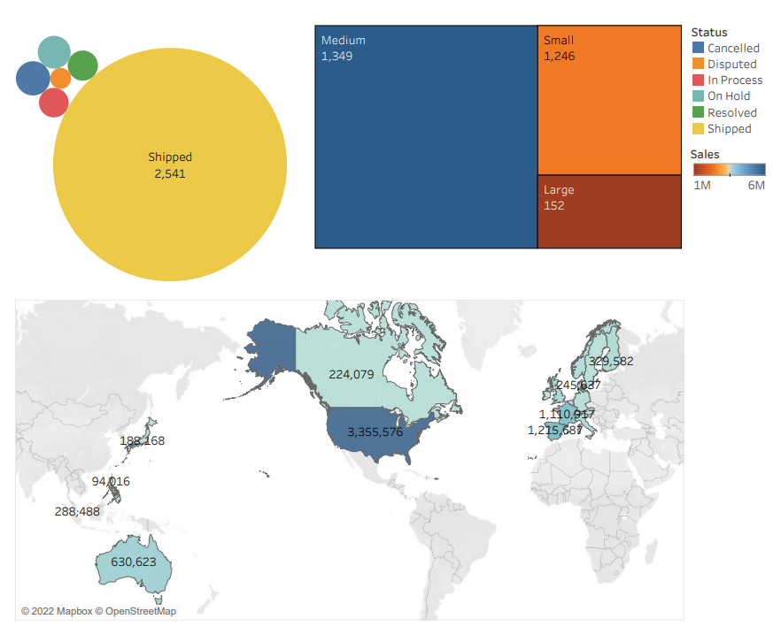

Slide 11
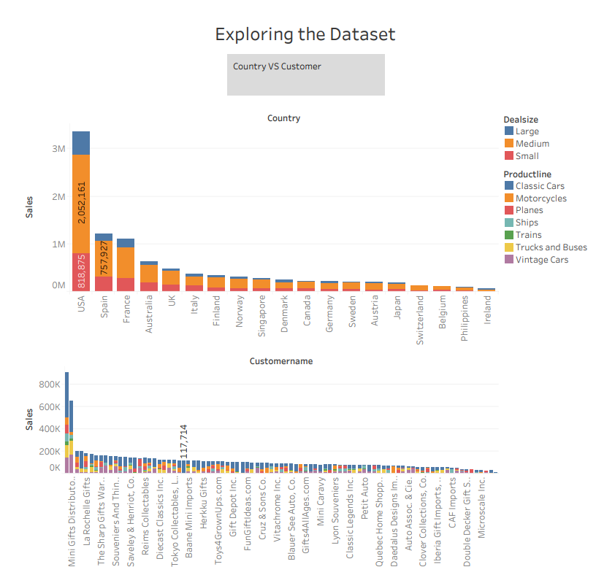

Slide 12
Exploratory Data Analysis - Inference
From the EDA performed, we can see that the highest sales are seen from the USA followed by Spain and Frace
Eurogulf shipping channel & Mini gifts distribution have made high number of purchases
A trend of purchases could be seen in the month of November for both years.
The period of October November and December shows a seasonal pattern of sales
The most sold products are classic cars followed by Vintage Cars
The purchases mainly held data of Shipped items as well as Medium sized items in the given dataset.

Slide 13
RFM Analysis
For working on the RFM analysis we need to consider the following attributes
Recency (R): Who have purchased recently? Number of days since last purchase (least recency, an individual with high low recency is considered valuable)
Frequency (F): Who has purchased frequently? It means the total number of purchases. ( high frequency)
Monetary Value(M): Who have high purchase amount? It means the total money customer spent (high monetary value is important)

Slide 14
Parameters and Assumptions
Customer Segmentation done by using KNIME and MS Excel by dividing the data based on Recency, Frequency and Monetary variables sales, customer name and order number
We can understand from the sales column that the parameter is an aggregation of the monetary column within the given case study
The dates are considered and subtracted directly against the current date
Best Customers - are the customers, who bought most recently, most often, and are heavy spenders. There is high possibility of them buying new products and will help promote the brand.
Loyal Customers – They have an average frequency of purchases with the organization
Customers on the verge of Churn – those who make inferquenct purchases who may opt out of the product/service with the organization

Slide 15
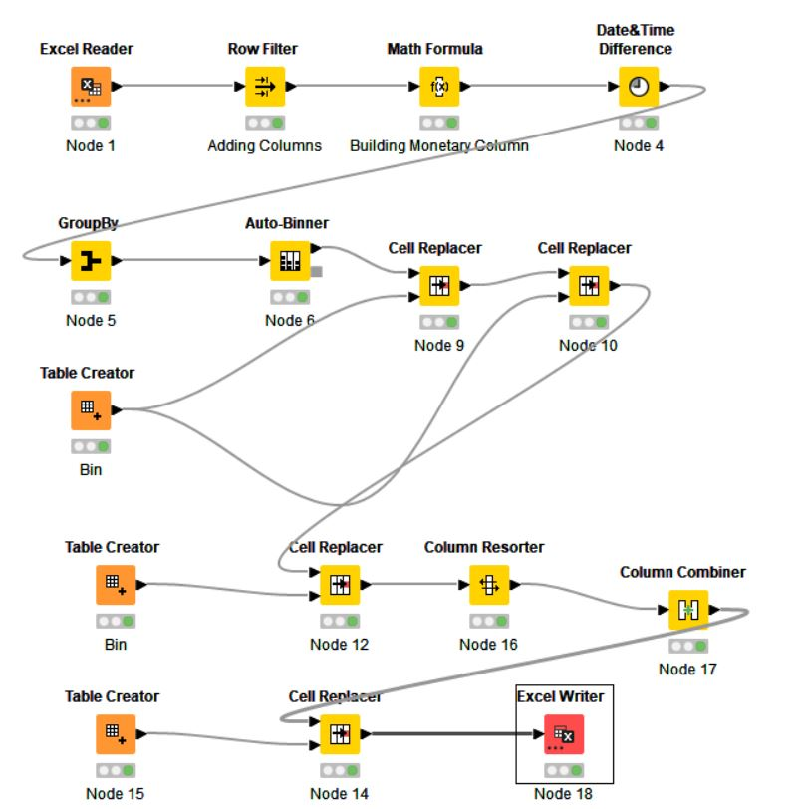
RFM Workflow

Slide 16
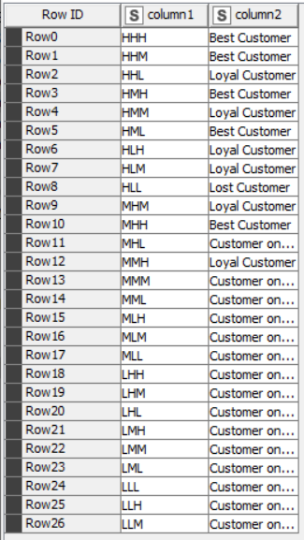
Customer Segmentation
Customer Segmentation done by using KNIME and MS Excel by dividing the data based on Recency, Frequency and Monetary variables sales, customer name and order number
Then created four different bin for each Recency, frequency & Monetary using percentile range(0,0.25, 0.75,100).
We have further worked around on readdressing each of these bins into Best Customers, Loyal Customers, Customers on the verge of churn and Lost Customers.

Slide 17
KNIME Output File with Segmentation
CUSTOMERNAME | ORDERNUMBER | QUANTITYORDERED | PRICEEACH | ORDERLINENUMBER | SALES | ORDERDATE | DAYS_SINCE_LASTORDER | STATUS | PRODUCTLINE | MSRP | PRODUCTCODE | DEALSIZE | Monetary | Recency | ORDERNUMBER [Binned] | Monetary [Binned] | Recency [Binned] | RECENCY_HML | FREQUENCY_HML | MONETARY_HML | RFM Analysis | Customer Definition
AV Stores, Co. | 51 | 34.86275 | 51 | 51 | 3094.271 | 51 | 51 | Shipped | 51 | 92.84314 | 51 | 51 | 157807.8 | 959 | Bin 3 | Bin 3 | Bin 2 | M | H | H | MHH | Best Customer
Alpha Cognac | 20 | 34.35 | 20 | 20 | 3524.422 | 20 | 20 | Shipped | 20 | 97.15 | 20 | 20 | 70488.44 | 827 | Bin 1 | Bin 1 | Bin 1 | H | L | L | HLL | Lost Customer
Amica Models & Co. | 26 | 32.42308 | 26 | 26 | 3619.895 | 26 | 26 | Shipped | 26 | 107.6538 | 26 | 26 | 94117.26 | 1028 | Bin 2 | Bin 2 | Bin 3 | L | M | M | LMM | Customer on Churn
Anna's Decorations, Ltd | 46 | 31.93478 | 46 | 46 | 3347.742 | 46 | 46 | Shipped | 46 | 104.7174 | 46 | 46 | 153996.1 | 846 | Bin 3 | Bin 3 | Bin 2 | M | H | H | MHH | Best Customer
Atelier graphique | 7 | 38.57143 | 7 | 7 | 3454.28 | 7 | 7 | Shipped | 7 | 95.57143 | 7 | 7 | 24179.96 | 951 | Bin 1 | Bin 1 | Bin 2 | M | L | L | MLL | Customer on Churn
Australian Collectables, Ltd | 23 | 30.65217 | 23 | 23 | 2808.324 | 23 | 23 | Shipped | 23 | 88.13043 | 23 | 23 | 64591.46 | 785 | Bin 2 | Bin 1 | Bin 1 | H | M | L | HML | Best Customer
Australian Collectors, Co. | 55 | 35.01818 | 55 | 55 | 3654.462 | 55 | 55 | Shipped | 55 | 103.5273 | 55 | 55 | 200995.4 | 947 | Bin 3 | Bin 3 | Bin 2 | M | H | H | MHH | Best Customer
Australian Gift Network, Co | 15 | 36.33333 | 15 | 15 | 3964.608 | 15 | 15 | Shipped | 15 | 111.5333 | 15 | 15 | 59469.12 | 882 | Bin 1 | Bin 1 | Bin 2 | M | L | L | MLL | Customer on Churn
Auto Assoc. & Cie. | 18 | 35.38889 | 18 | 18 | 3601.907 | 18 | 18 | Shipped | 18 | 100.3889 | 18 | 18 | 64834.32 | 996 | Bin 1 | Bin 1 | Bin 3 | L | L | L | LLL | Customer on Churn

Slide 18
Best & Loyal Customers in the Dataset
CUSTOMERNAME | RECENCY_HML | FREQUENCY_HML | MONETARY_HML | RFM Analysis | Customer Definition
AV Stores, Co. | M | H | H | MHH | Best Customer
Anna's Decorations, Ltd | M | H | H | MHH | Best Customer
Australian Collectables, Ltd | H | M | L | HML | Best Customer
Australian Collectors, Co. | M | H | H | MHH | Best Customer
Danish Wholesale Imports | H | H | H | HHH | Best Customer
Diecast Classics Inc. | H | M | H | HMH | Best Customer
Dragon Souveniers, Ltd. | M | H | H | MHH | Best Customer
Euro Shopping Channel | H | H | H | HHH | Best Customer
CUSTOMERNAME | RECENCY_HML | FREQUENCY_HML | MONETARY_HML | RFM Analysis | Customer Definition
Auto Canal Petit | H | M | M | HMM | Loyal Customer
Corrida Auto Replicas, Ltd | M | M | H | MMH | Loyal Customer
Gift Depot Inc. | H | M | M | HMM | Loyal Customer
Gifts4AllAges.com | H | M | M | HMM | Loyal Customer
Lyon Souveniers | H | L | M | HLM | Loyal Customer
Mini Caravy | H | L | M | HLM | Loyal Customer

Slide 19
Customers on the Verge of Churn
CUSTOMERNAME | RECENCY_HML | FREQUENCY_HML | MONETARY_HML | RFM Analysis | Customer Definition
Amica Models & Co. | L | M | M | LMM | Customer on Churn
Atelier graphique | M | L | L | MLL | Customer on Churn
Australian Gift Network, Co | M | L | L | MLL | Customer on Churn
Auto Assoc. & Cie. | L | L | L | LLL | Customer on Churn
Auto-Moto Classics Inc. | M | L | L | MLL | Customer on Churn
Baane Mini Imports | M | M | M | MMM | Customer on Churn
Bavarian Collectables Imports, Co. | L | L | L | LLL | Customer on Churn
Blauer See Auto, Co. | M | M | M | MMM | Customer on Churn

Slide 20
Lost Customers
CUSTOMERNAME | RECENCY_HML | FREQUENCY_HML | MONETARY_HML | RFM Analysis | Customer Definition
Alpha Cognac | H | L | L | HLL | Lost Customer
Amica Models & Co. | L | M | M | LMM | Lost Customer
Atelier graphique | M | L | L | MLL | Lost Customer
Australian Gift Network, Co | M | L | L | MLL | Lost Customer
Auto Assoc. & Cie. | L | L | L | LLL | Lost Customer
Auto-Moto Classics Inc. | M | L | L | MLL | Lost Customer

Slide 21
Recommendation
Using Recency, frequency & monetary parameters we have grouped our Top , loyal, on the verge of churning and lose customers.
The organization can explore sales and marketing techniques to turn customers who are on the verge of churning into those who would become loyal customers.
The organization can improve recency by giving out coupons and marketing strategies that would allow customers to make repeat purchases.
The organization can further explore on the poor purchases made by at risk customers to understand the products that are purchase to further explore on the purchase practices that are undertaken by the same.

