Slide 1
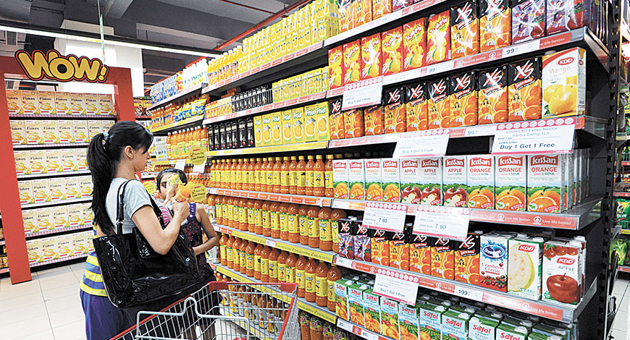
Marketing & Retail Analysis Milestone 2
DEEPAK SINGH
PGDSBA Batch G4 Sep 2023A

Slide 2
Agenda
Problem Statement
A Grocery Store shared the transactional data with you. Your job is to identify the most popular combos that can be suggested to the Grocery Store chain after a thorough analysis of the most commonly occurring sets of items in the customer orders. The Store doesn’t have any combo offers. Can you suggest the best combos & offers?
Actionable Items
EDA Dataset
Develop Basket Analysis
KNIME Workflow
Insight
Recommendation

Slide 3
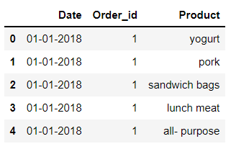
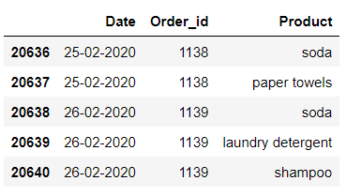
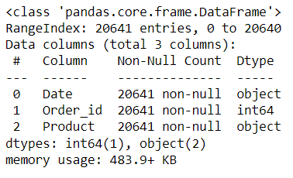

Grocery store Dataset
The data is about an Grocery store with Order Entry, Date of Transaction and Products.
They have provided the data collected of transactions between 1-1-2018 and 26-2-2020.
The data has 20641 entries rows and 3 columns
This can be further understood as 2 object data type (Date and Product) and 1 integer data type (Order ID).

Slide 4


Grocery store Dataset
The data set does not have any Null entries in any of its columns.
The Number of Unique Entries per columns is as follows
Date – 603
Order ID – 1139
Product - 37
The data has 4730 duplicate entries within the dataset, however these can be considered as multiple purchases made by different individuals choosing the same products.

Slide 5
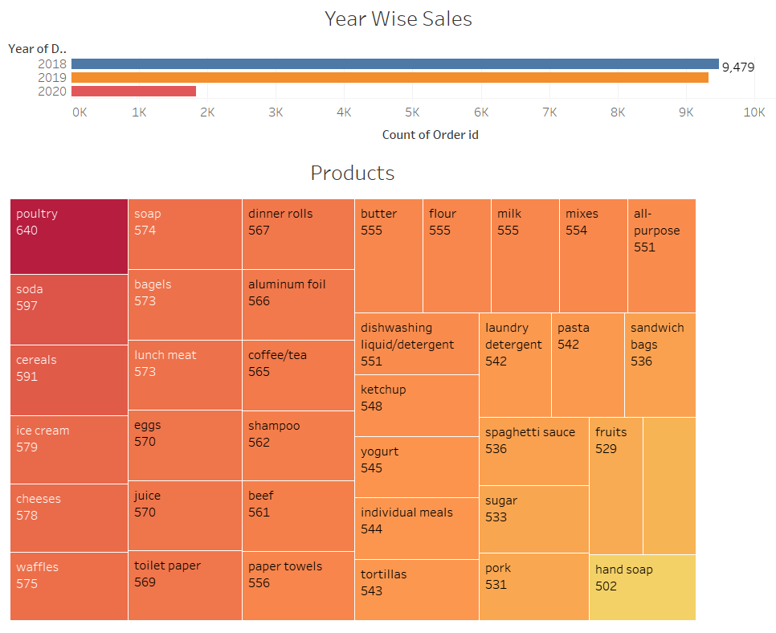
Grocery store Dataset
The Dataset has maximum entries seen in 2018 and 2019 followed by 2020.
The Data in 2020 is however seen only till the month of February
The most purchased items in the Grocery list include
Poultry – 640
Soda – 597
Cereal – 591
Ice Cream – 579
Cheeses – 578

Slide 6
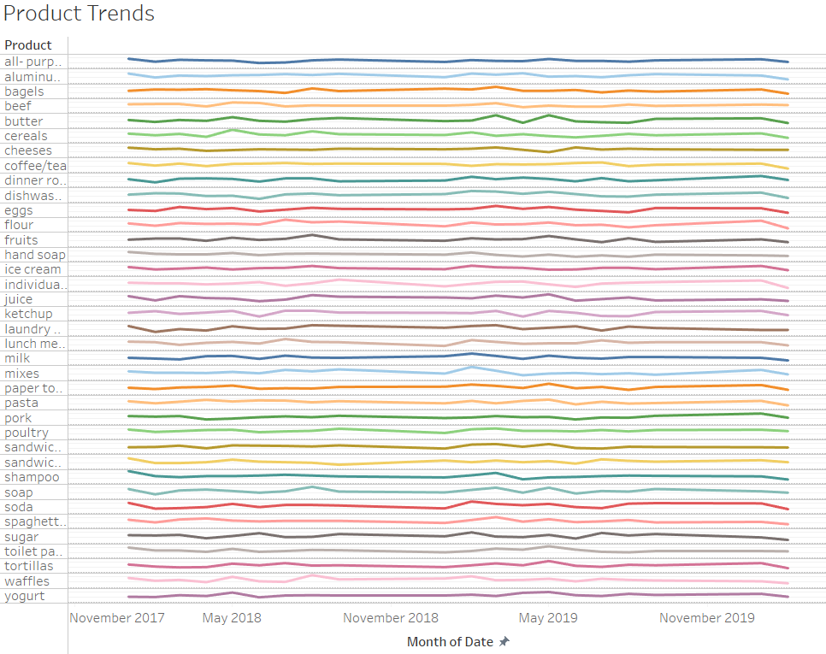
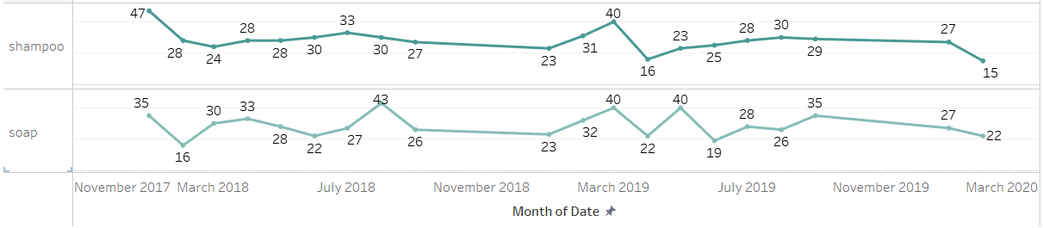
Grocery Dataset
It is difficult to understand an overall seasonality or trend in the purchases, however all purchases seem to lay under a value of oddly 50 units through the dataset.
Closer examination can allow us to understand that there may be similar purchasing patterns between products of a particular category
Eg. Soap and Shampoo show similar close purchasing patterns

Slide 7
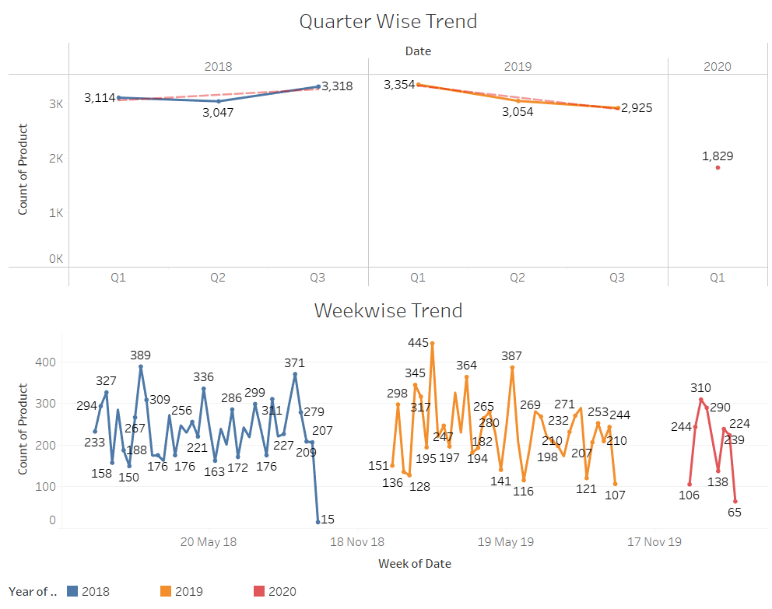
Exploring Trends
We can see a downward trend in the overall number of sales in the given Dataset
We can see that Quarter 3 of 2018 had the highest number of orders
This was followed by Quarter 1 of 2019 and further it showed a decline in sales
Quarter 3 of 2019 has shown very low sales over the period of 2018 and 2019.
Quarter 4 of every year does not seem to show any sales figures
A seasonal trend is difficult to observe in the given case

Slide 8
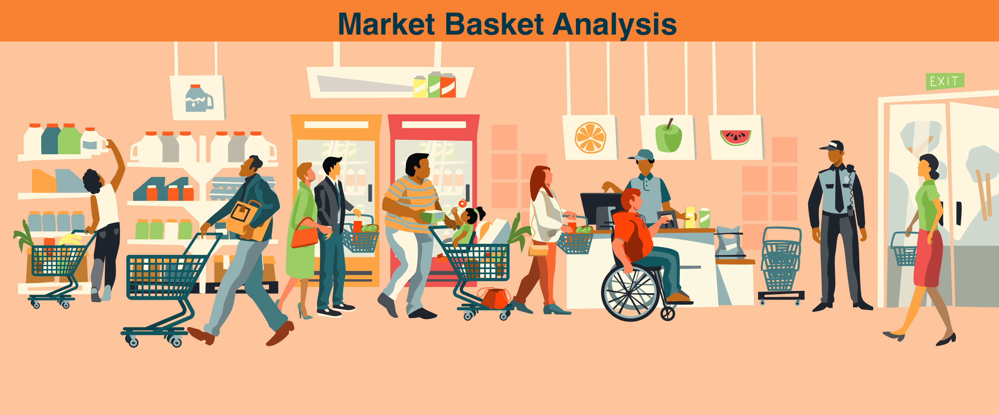
Market Basket Analysis
Market basket analysis is a data mining technique used by retailers to increase sales by better understanding customer purchasing patterns. It involves analyzing large data sets, such as purchase history, to reveal product groupings and products that are likely to be purchased together.
The adoption of market basket analysis was aided by the advent of electronic point-of-sale (POS) systems
Market basket analysis is a data mining technique used by retailers to increase sales by better understanding customer purchasing patterns. It involves analyzing large data sets, such as purchase history, to reveal product groupings and products that are likely to be purchased together.

Slide 9
Association Mining
In data science, association rules are used to find correlations and co-occurrences between data sets. They are ideally used to explain patterns in data from seemingly independent information repositories, such as relational databases and transactional databases. The act of using association rules is sometimes referred to as "association rule mining" or "mining associations.“
Support, confidence level, and lift are the three measures that help us compute the same
High-support rules describe that an action is likely to repeat as a pattern with the consumer
Confidence allows the organization to improve their return rates.
The strength of the relationship between the products on the antecedents and consequents columns of the association is summarised by lift.
If the lift is larger the lift, there would be a stronger relationship between the products.

Slide 10
Lift Value – Support - Confidence
Item-sets whose support is greater or equal than minimum support threshold are considered as Frequent Item Sets
Strong rule are applicable if Rule A implies Rule B where both cases satisfies a minimum support and a minimum confidence
The lift can be defined as the correlation between A and B in the rule where A implies B. This correlation would describe how one item-set A would affect another item B.

Slide 11
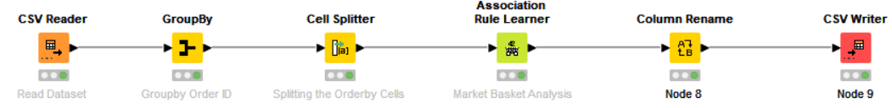
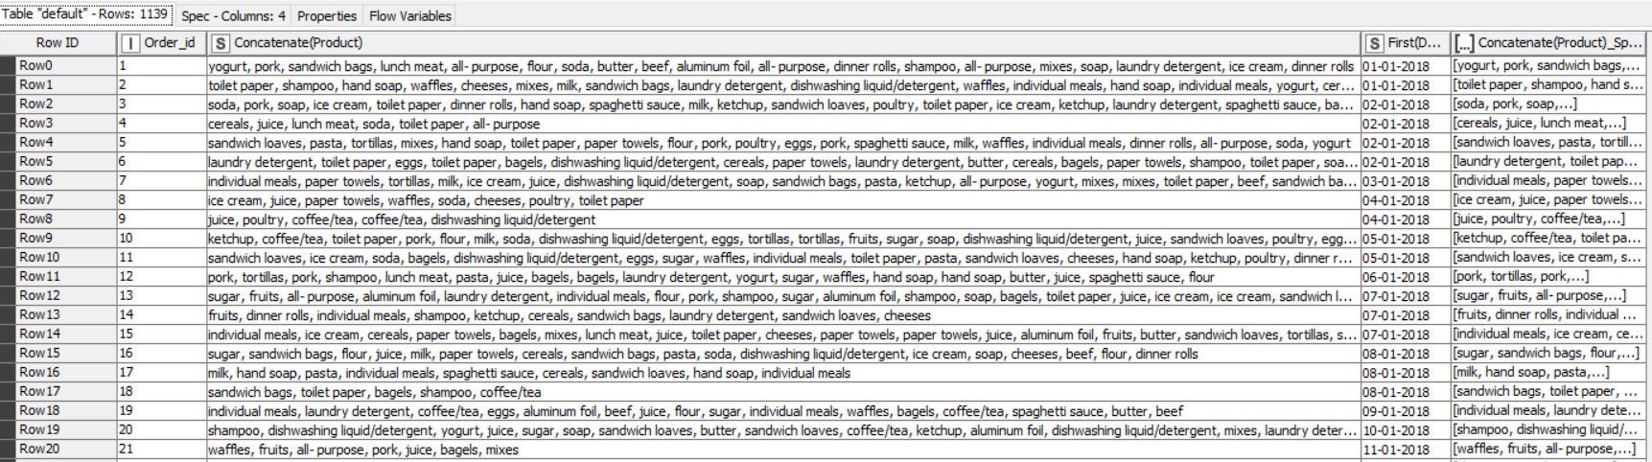
KNIME Workflow
KNIME has been employed to study the Dataset by ordering the products by OrderId
We acquire an output as follows, grouping the Products together as String

Slide 12
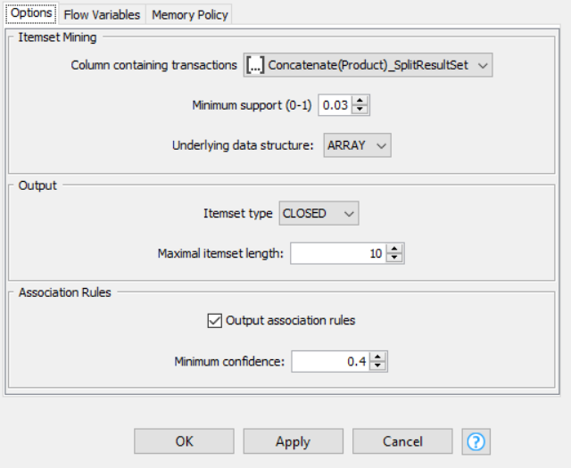
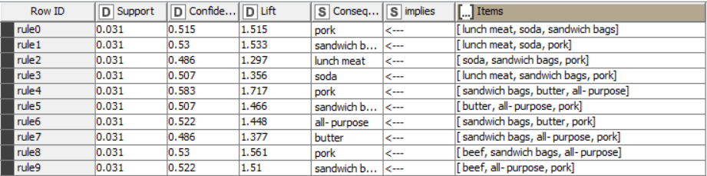
Multi Basket Analysis
We were able to address the Dataset by giving a very low value of support since the number of data entries are very high in value.
We were thus able to generate a large volume of associations to help us understand and study the buying patterns and trends
Associations that have higher lift values are accepted to be true
There are 20,642 records in the grocery dataset, totaling 1139 orders.
Customers have purchased with an average of 18 products per order.
Iteration Values
Min Support = 0.03
Minimum Confidence = 0.4
Max Length = 10

Slide 13
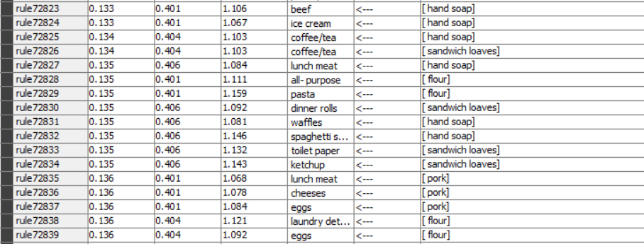
Multi Basket Analysis
As per the rule those who purchased
Ketchup would buy Sandwich Loaves
Pasta will buy flour
All- purpose will also buy Flour

Slide 14
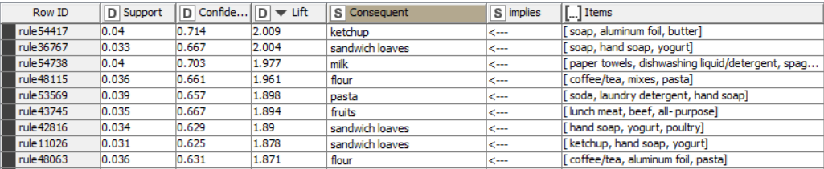
Multi Basket Analysis
The grocery store could look at catering towards multiple offers of addressing customer needs by looking at the following combinations that have high relationship

Slide 15
Insights
From the analysis we can conclude that there has been a fall in the overall sales for the organization
2018 saw the highest orders followed by 2019 and 2020
We need to further explore on the sales figures that are not shown of Quarter 4 of 2018 and 2019
The grocery store can work around on providing promotions during Quarter 2 to improve sales and further drive customer satisfaction towards repeat purchases in Quarter 3
Hand Soap, Fruits and Sandwich loaves are the three most lowest items that are sold by the grocery store, the store can look to further invest other products and variety to improve customer purchases

Slide 16
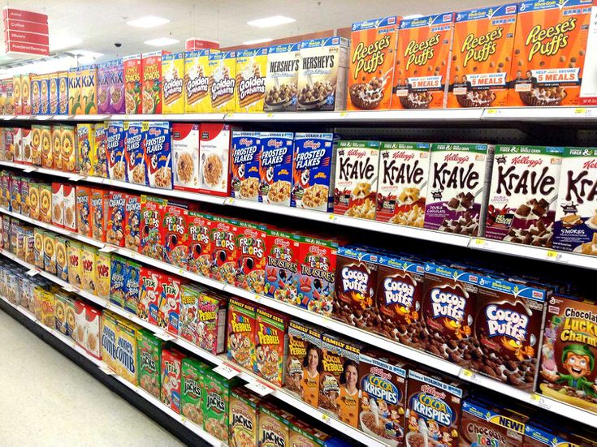
Recommendations
The fast moving items within the store are the following
Poultry
Soda
Cereals
Ice cream
Cheeses
Waffles
They can be paired with offers to help further improve on their sales
Poultry has a strong relationship to be purchased with laundry detergent, sandwich loaves and shampoo
Soda can be paired with ice cream, soap or mixers
Cereals can be paired with lunch meat, yoghurt or bagels
Ice creams hold a strong relationship with aluminium foil, sandwich loaves and cheeses
Cheeses can be paired with Ice cream, coffee/tea or even yoghurt
Waffles can be sold with lunch meat, ketchup or pasta

Slide 17
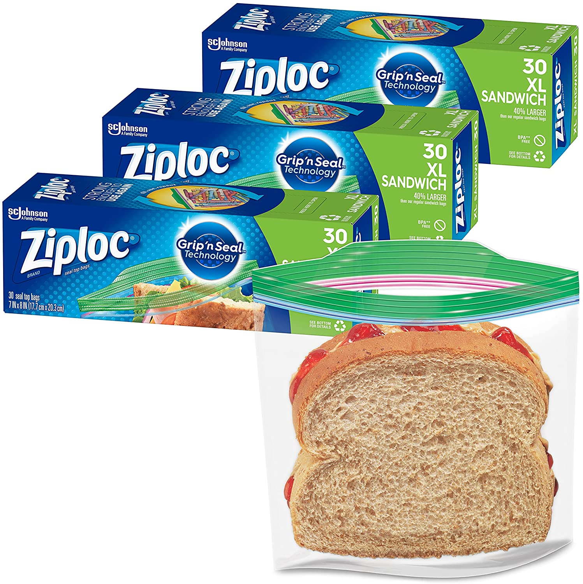
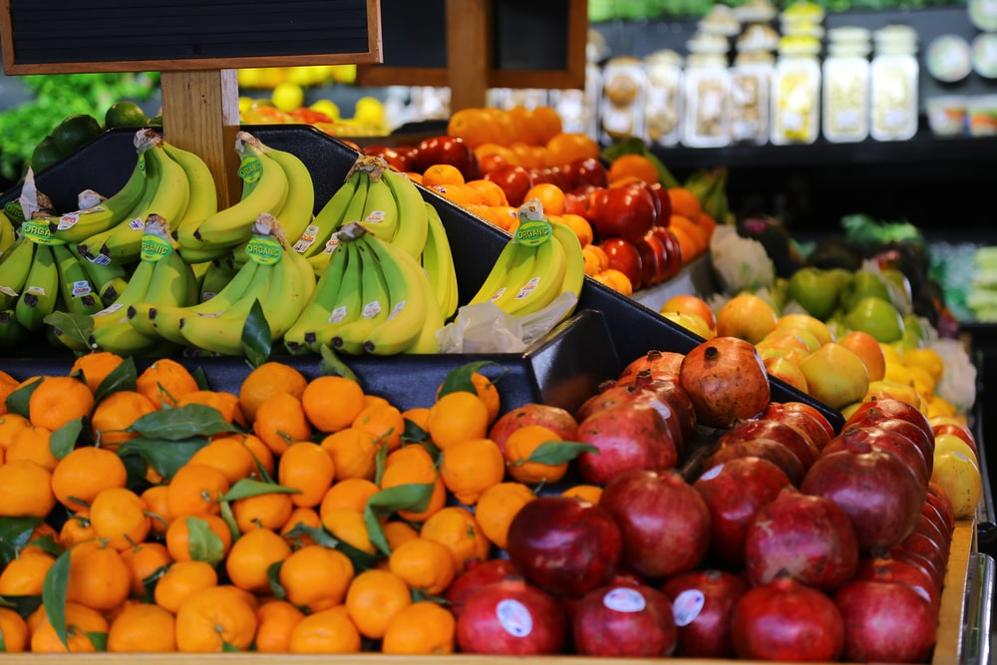
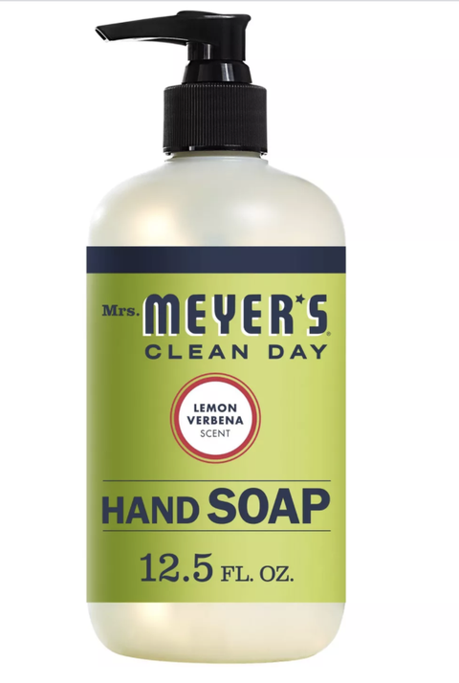
Recommendations
The combinations recommended work around the multi basket analysis in ensuring that the strong relationship between the items can be utilized to better recommend and bring about optimum sales to the grocery store
The store can look at providing offers that improve sales on poorly selling iterms such as
Sandwich bags off the shelf before they expire by pairing them with
Lunch meat, Soda or Pork.
Hand soap can be paired with
Lunch meat, ketchup or Pork to further sell the products
Fruits can be paired with
Beef, Sandwich bags and Port to improve their sales
Furthermore, the customer survey can be undertaken to understand if there is any challenges with the current range of products within these categories in terms of taste, flavour or preference to improve on their sales
Categories can also be paired based on use such as Hand soaps can be promoted along with detergents to improve sales.

Slide 18
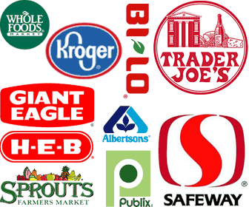
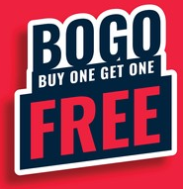
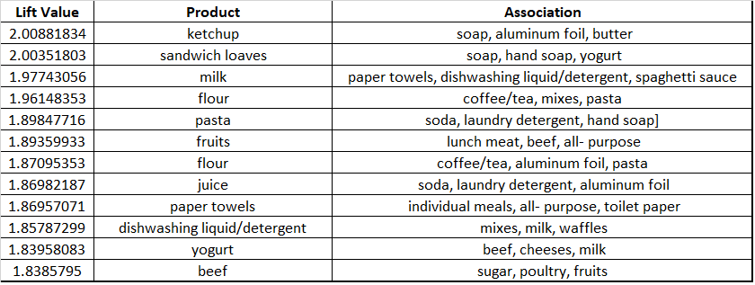
Recommendations
Further Study
Sales within Competing Grocery stores and the pricing strategy or promotional items can also be further investigated to replicate and compete with the sales patterns
Offers such as BOGO (Buy One get One Free) or BTGO (Buy Two Get One Free) can be addressed for products that are being sold at a moderate to slow pace
Products with very high lift value can be studied to further understand buyer behaviour and effectively deliver products with association

Slide 19

THANK YOU

