Slide 1
DOCKER
building a simple installer script that sets up docker on a fresh linux system

Slide 2
Name of the bash file

Slide 3
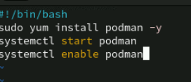
Script file

Slide 4
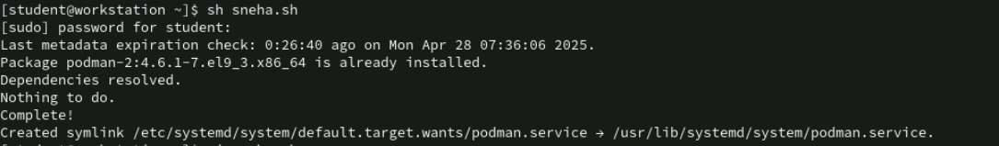
Output of the script file

Slide 5
Thank you

