Slide 1
IBM Data Science Capstone Project Venues of Thessaly, an overview
Manolis Efthimiou
12/04/2021

Slide 2
Business Problem
Thessaly is a geographic and modern administrative region in central Greece, a country known for Tourism. In this project we will make an overview of the venues of the 4 biggest cities in Thessaly.
Volos, Larisa, Karditsa and Trikala.
Which type of venues are found in these cities, and how good are their ratings?
How similar or dissimilar are these 4 cities that are geographically close, in regard to the venues they offer?

Slide 3
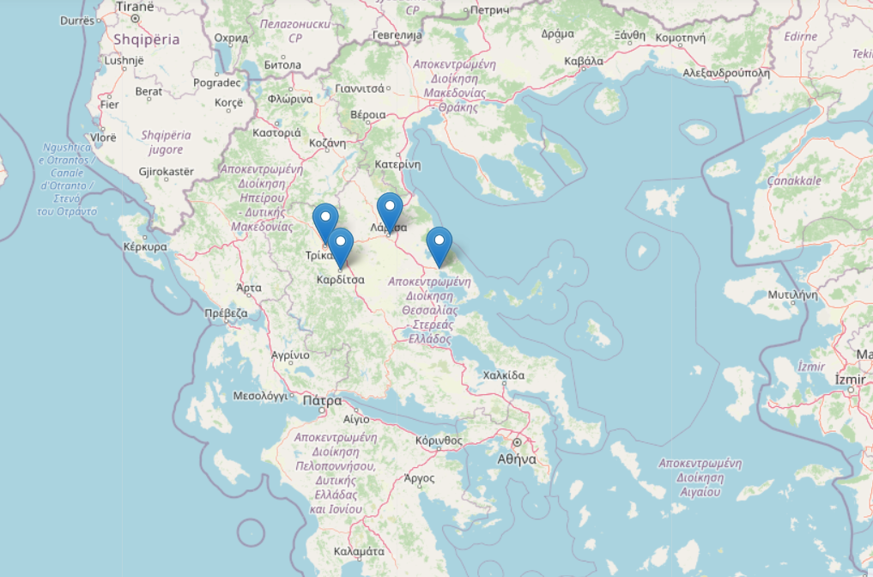
Which type of venues are found in these cities, and how good are their ratings?
A tool for seeing any gaps that can be filled by any businessman willing to make an attempt in the region

Slide 4
Data acquired
From the Foursquare API were about each venue's
location, geographical coordinates about latitude and longitude
category of venue, like cafeteria, bar, etc
ratings that Foursquare users gave them
From the Geopy API to obtain latitude and longitude of cities automatically, for ease of receptiveness for other locations

Slide 5
Methodology
Data collection
272 venues info acquired from Foursquare
Data cleaning
257 venues kept,
split to 7 venue types (food, cafes, alcohol, leisure, cultural, athletic, sweets)
Data exploration
metrics in total, mean ratings per type
top rated venues per type
Visualization
per city: all venues, top venues
Clustering
depending on venue category & rating

Slide 6
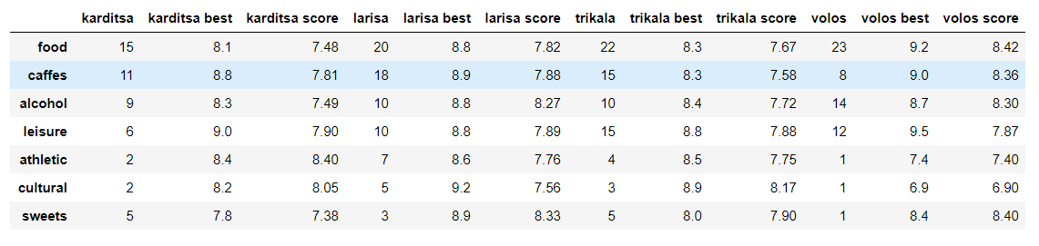
Metrics per venue type
Total venues - top rated venue - Mean rating

Slide 7
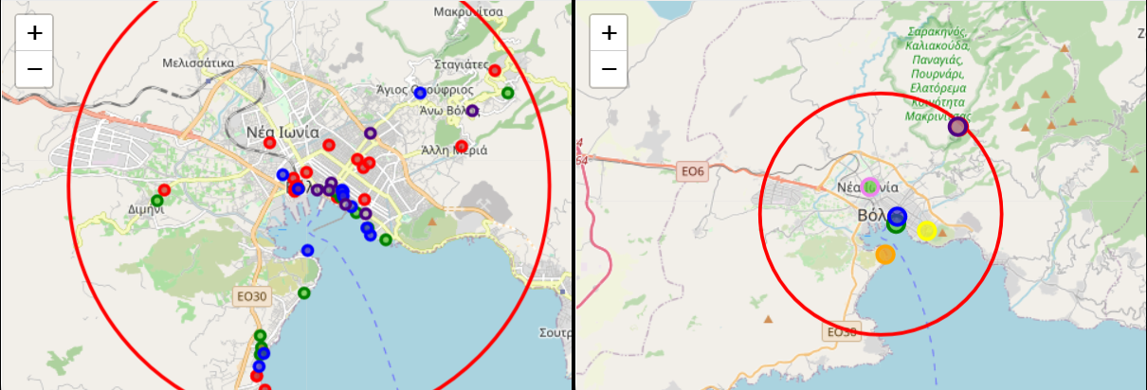
Map for every city
Info by popup when clicking on map
All venues top rated venues

Slide 8
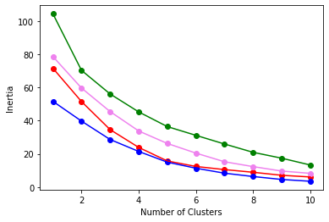
Clustering
Discover natural grouping for the venues of every city
K-means algorithm
3 clusters
Metrics per city per cluster
Elbow method

Slide 9
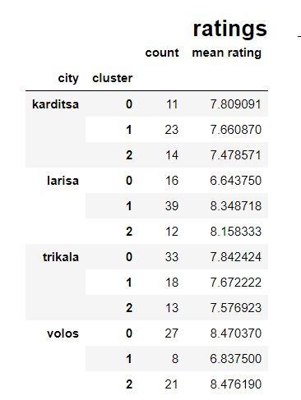
Metrics
total venues, and mean rating found per city and per cluster

Slide 10
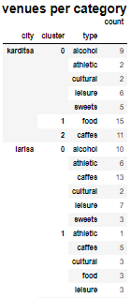
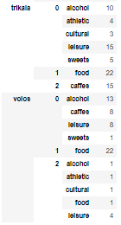
Metrics
total venues per category per city per cluster

Slide 11
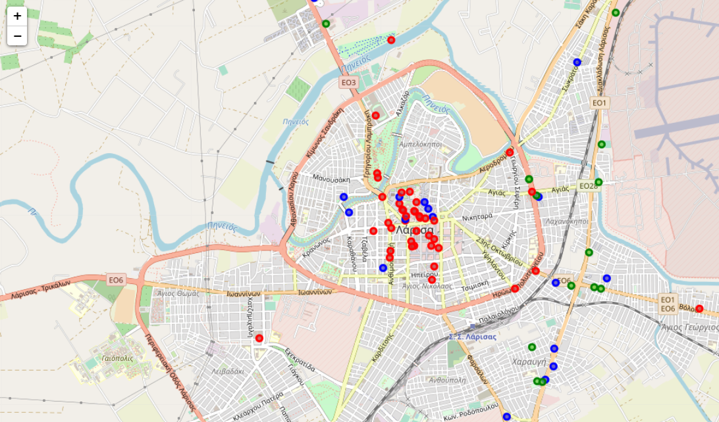
Clustered venues map per city
Info by popup when clicking on map

Slide 12
Results and Discussion
Most frequent venue categories are explained by the nature of Greece's economy which relies a lot on Tourism, local or foreign
Venues of type ‘leisure have higher ratings for what was done from the local government, like parks and plazas, in comparison to what is private economic activity, like nightclubs and resorts
High rating, so interest too, for venues of historical interest
Biggest similarity between the 4 cities is that the food venues were always a distinct cluster.
The cafes had to be a separate type of venue due to the Greek population culture

Slide 13
There is a correlation with a venues geographic proximity to the city’s center or at least it’s accessibility with main roads, and its rating
The highest ratings are for the city of Larisa, the biggest in population and known for it’s night life.
The highest rated venues, were found in Volos, for the category of food (mean of 8.42). That is explained by the fact that region is well known for it's restaurants with tsipouro (a drink with alcohol).
For Volos, the highest ratings for the venue types of food and cafes, are inside the radius of 3-6 km, to the mountain Pilio

