Slide 1
Original GaussCtrl: Multi-View Editing Flow
1. Render
Training Views
(RGB + Depth)
2. DDIM Inversion
→ noisy latent z₀
per view
3. Edit in Chunks
ControlNet + Depth
Cross-View Attention
4. Fine-tune 3DGS
on edited images
→
→
→
Cross-View Attention:
Each view attends to tokens from 4 fixed reference views (unedited, DDIM-inverted latents). Sharing attention to the same references enforces multi-view consistency throughout the diffusion process.

Slide 2
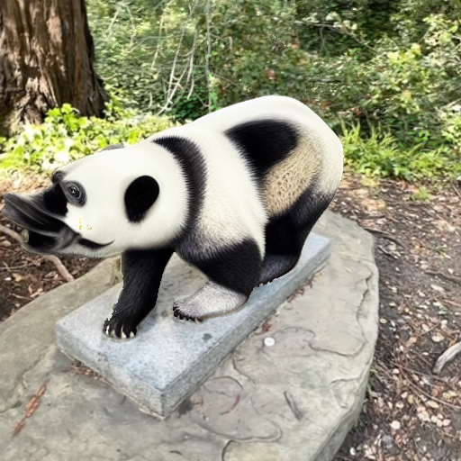
First Attempt: Editing Reference View Without Cross-View Context
Branch: Sequential_Reference_Generation
Idea: edit ref₀ alone (no cross-view attention), DDIM-invert, use as reference latent for remaining views
↓
Problem
Without cross-view attention, ref₀ has no multi-view context.
The model edits in isolation → appearance is inconsistent
with the rest of the scene geometry and viewpoint.
Result: unusable edit quality (see image →)
ref₀ edited without cross-view attention (experiment: panda_seq_v3)

Slide 3
Current Approach: Sequential Reference Editing with Re-inversion
Branch: Sequential_Reference_z0
1
Edit ref₀ with cross-view attention to all 4 original (unedited) latents
↓
2
DDIM-invert edited ref₀ → z₀ (edited latent)
↓
3
Edit ref₁ attending to the edited ref₀ latent
↓
4
Continue: each ref_k attends to already-edited ref₀ … ref_{k−1}
↓
5
Edit all target views attending to the 4 edited reference latents
Key insight: by propagating edits through reference views before editing target views, each target attends to already-edited (mutually consistent) references — improving cross-view coherence.

