Slide 1

FULL STACK-PYTHON Student Portal
Presentation by :
N. Manogna

Slide 2
Agenda
Project Overview
Tech Stack
System Architecture
Key Features
UI Screenshots
Database Design
Code Highlights
Challenges & Solutions
Future Enhancements
Conclusion
Q&A

Slide 3
Project Overview
A web application for students to register, login, view marks,
and for admins to manage student data and marks.
Users: Students and Admins.

Slide 4
Tech Stack
Frontend: HTML, CSS
Backend: Python Flask
Database: SQLite / MySQL
Tools: VS Code

Slide 5
System Architecture
Browser Client → Flask Server → Database
Secure user authentication and CRUD operations.
Data flow: Register → Login → Dashboard → Results.

Slide 6
Key Features
• Register & Login
• Admin Dashboard
• Add/View Marks
• Student Dashboard
• Logout and Secure Session

Slide 7
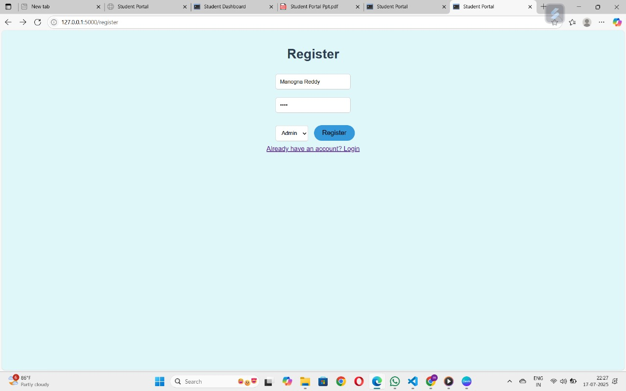
Register Page

Slide 8
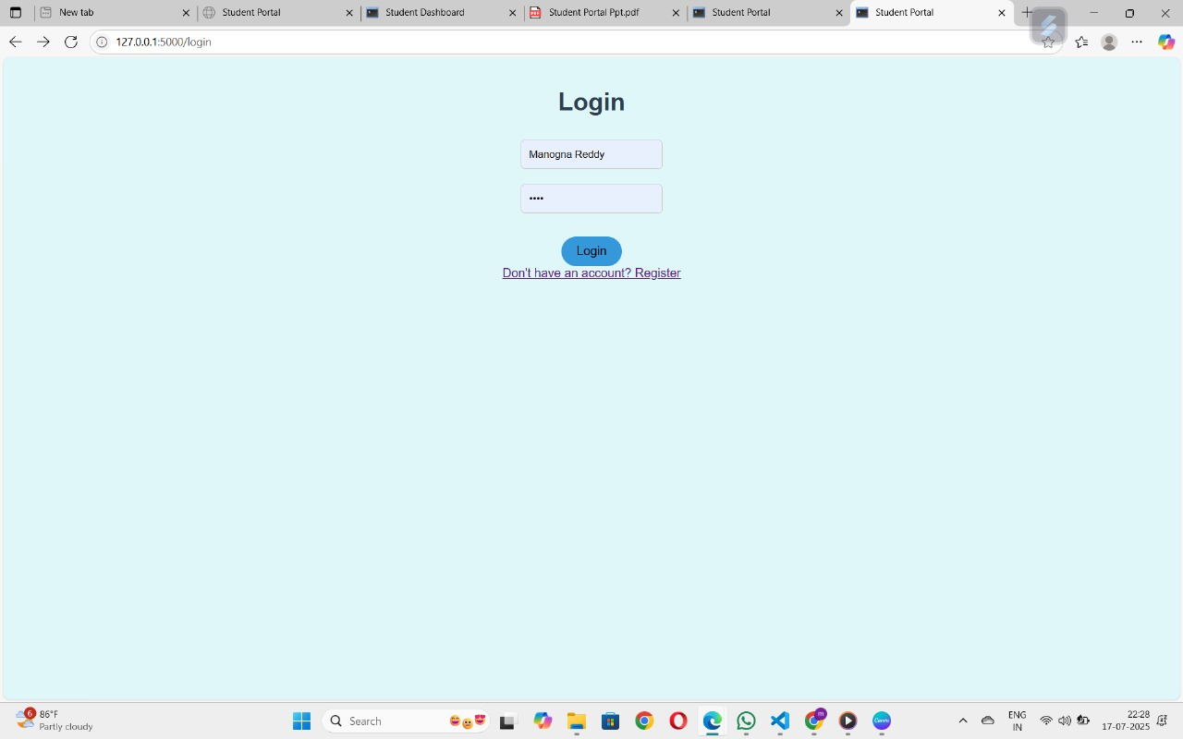
Login Page

Slide 9
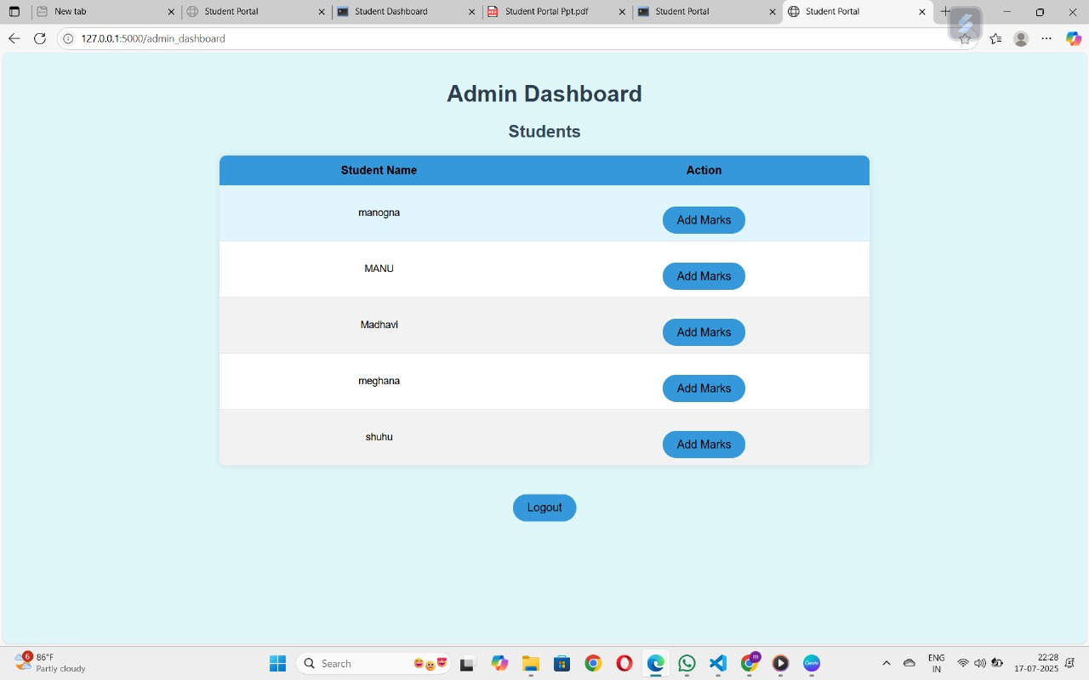
Admin Dashboard

Slide 10
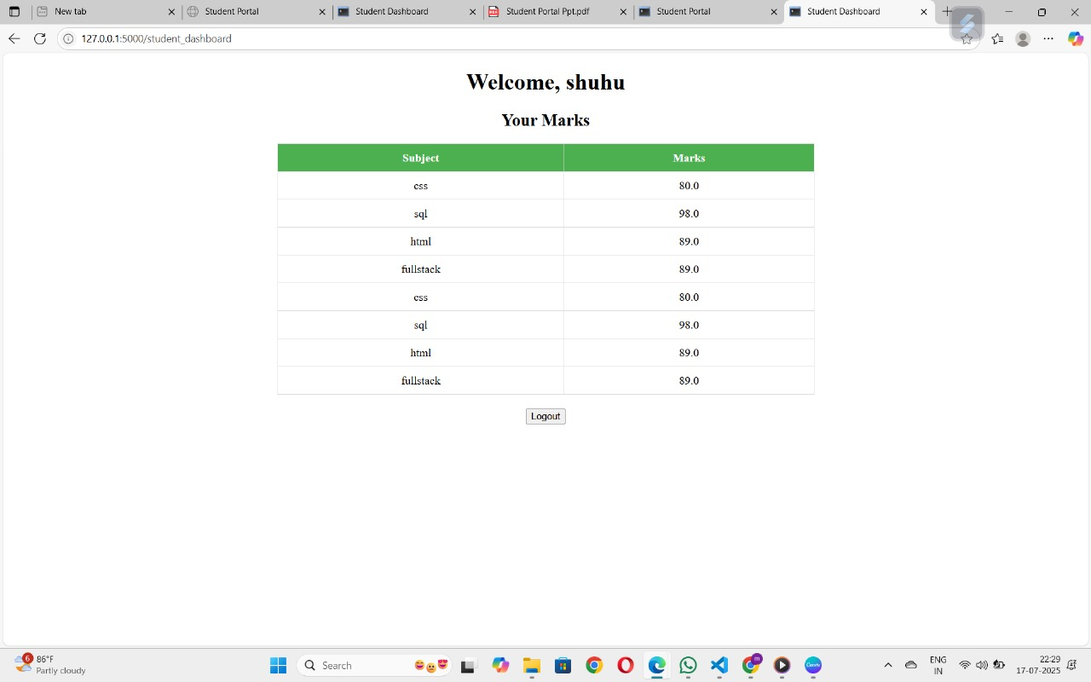
Student Dashboard

Slide 11
Database Design
Tables: Users, Marks
Fields: UserID, Username, Password, Role, Subject, Marks

Slide 12
Code Highlights
Python Flask routes for Register, Login, Dashboard
Secure password hashing
CRUD operations for Marks
Session management

Slide 13
Challenges & Solutions
Challenge: Secure user authentication
Solution: Used hashed passwords, sessions
Challenge: Data consistency
Solution: Proper CRUD and validation

Slide 14
Future Enhancements
Add notifications
Mobile App version
Advanced analytics for marks
Email alerts for results

Slide 15
Conclusion
Student Portal simplifies student data management
Supports both students and admins
Easy to scale and maintain.

Slide 16
Thank You!
Questions & Answers

