Slide 1
Spring Boot Integration with RabbitMq, MongoDb and ELK

Slide 2
Table of Content:
Rabbitmq: https://www.rabbitmq.com/getstarted.html
MongoDb: https://docs.mongodb.com/
Elasticsearch/Logstash/Kibana: https://www.elastic.co/
Spring Boot: https://spring.io/projects/spring-boot

Slide 3
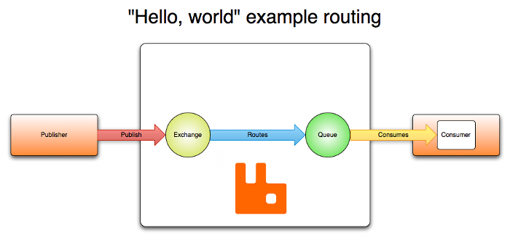
RabbitMq
RabbitMQ is one of the most popular open source message brokers.
http://localhost:15672/

Slide 4
MongoDb
MongoDB is an open-source document database that provides high performance, high availability, and automatic scaling across a configurable set of systems that function as storage nodes.
MongoDB stores all data in documents, which are JSON-style data structures composed of field-and-value pairs.
http://localhost:27017/

Slide 5
MongoDb commands on Mongo Client:
show dbs ## show all the db schema
use <db_name> ## use mylib
db.books.insert({"name":"MongoDb book"}) ## Here books is collectionName
show collections ## show all the collections inside db
db.books.find() ## show all record from the books collection

Slide 6
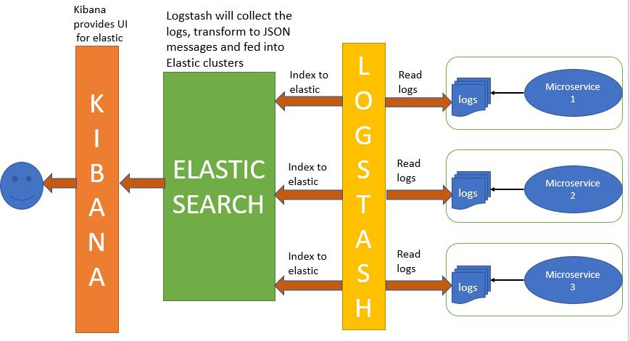
ELK (Elastic Search, Logstash, Kibana):

Slide 7
Elastic Search:
Elasticsearch is a NoSQL database that is based on the Lucene search engine.
http://localhost:9200/

Slide 8
Kibana:
Kibana is a visualization UI layer that works on top of Elasticsearch.
http://localhost:5601/

Slide 9
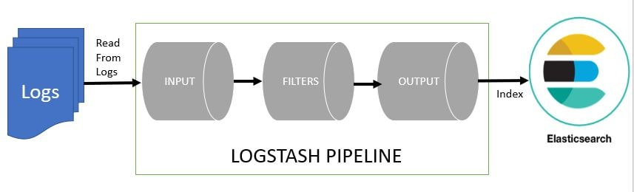
Logstash:
Logstash is a log pipeline tool that accepts inputs from various sources, executes different transformations, and exports the data to various targets.
http://localhost:9600/
logstash –f logstash.conf

Slide 10
SpringBoot Application
SpringRabbitMqProducer
Plain Message Publish to RabbitMq:
POST method http://localhost:1234/producer/send/manoj
JSON Message Publish to RabbitMq:
POST method http://localhost:1234/producer/publish/
{
"subs_uid": "100",
"subs_name": "airtel",
"subs_address": "UK3",
"subs_type": "3G3",
"subs_cellno": "8050133996"
}
Get record from MongoDb:
GET method http://localhost:1234/producer/get

Slide 11
MongoDb Client Commands:
> show dbs
DemoSubs 0.000GB
NSDL 0.000GB
admin 0.000GB
config 0.000GB
local 0.000GB
mongo 0.000GB
> use DemoSubs
switched to db DemoSubs
> show collections
SubscriberInfo
> db.SubscriberInfo.find()
{ "_id" : ObjectId("5eedb5a2e3e9351924a24ad4"), "_class" : "com.nokia.rabbitmq.documents.Subscriber", "subs_uid" : "100", "subs_name" : "airtel", "subs_address" : "UK3", "subs_type" : "3G3", "subs_cellno" : "8050133996" }
>

Slide 12
spring-boot-RabbitMqConsumer
This is asynchronous listener.
Received message from the RabbitMQ

