Slide 1
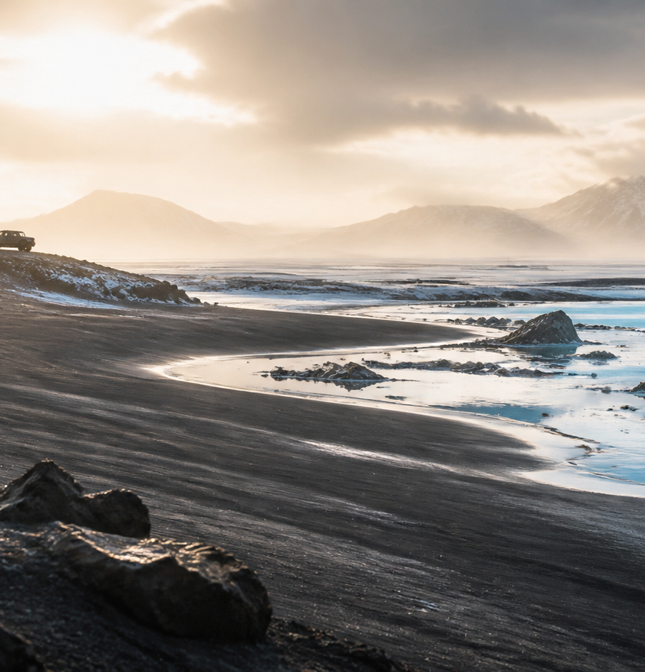
AURELIA
The Far North
ICELAND · PRIVATE EXPEDITION
Seven days shaped by basalt, geothermal heat, and northern light.
PRIVATE HELICOPTER / AURORA LODGE
Notes:
[Sources]
- User-provided Manor source deck: AURELIA — The Far North.
- Hero image reused from the source deck.

Slide 2
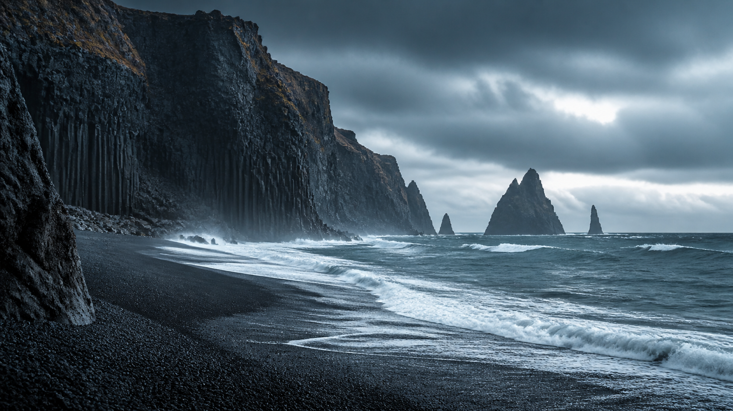
THE EDGE OF WEATHER
Land becomes
a private horizon.
Basalt. Wind. A route with no ordinary arrival.
02 / 10
Notes:
[Sources]
- User-provided Manor source deck: AURELIA — The Far North.
- Full-bleed landscape reused from the source deck.

Slide 3
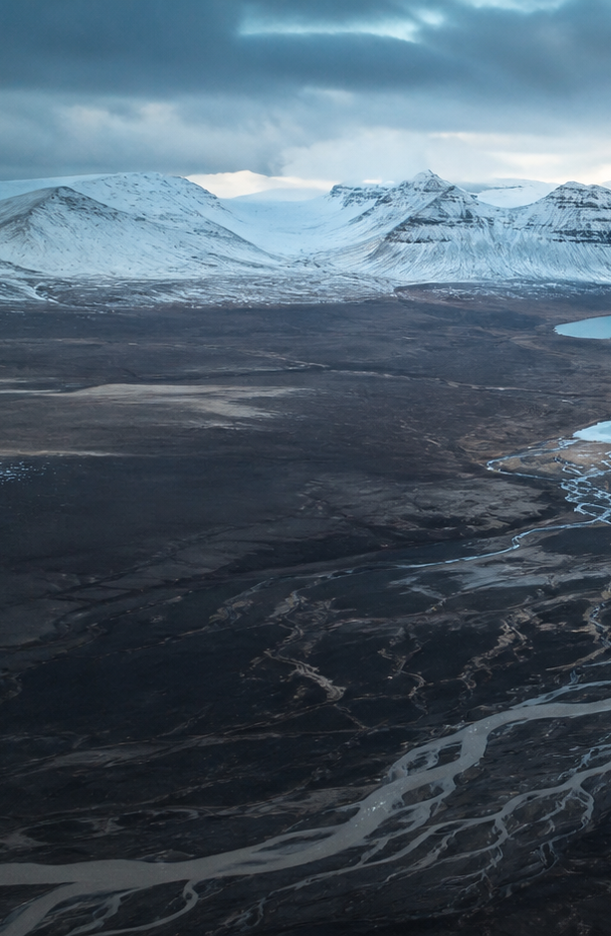
SEVEN-DAY SEQUENCE
A route paced
by light
01
Reykjavík
Arrival and private briefing
02
Glacial lagoon
Ice float and black-sand crossing
03
Mountain pass
Highland traverse by 4×4
04
Geothermal zone
Ridge walk and thermal immersion
05
Aurora lodge
Observatory night and final descent
03 / 10
Notes:
[Sources]
- User-provided Manor source deck: AURELIA — The Far North.
- Aerial image reused from the source deck; route copy adapted from the source deck.

Slide 4
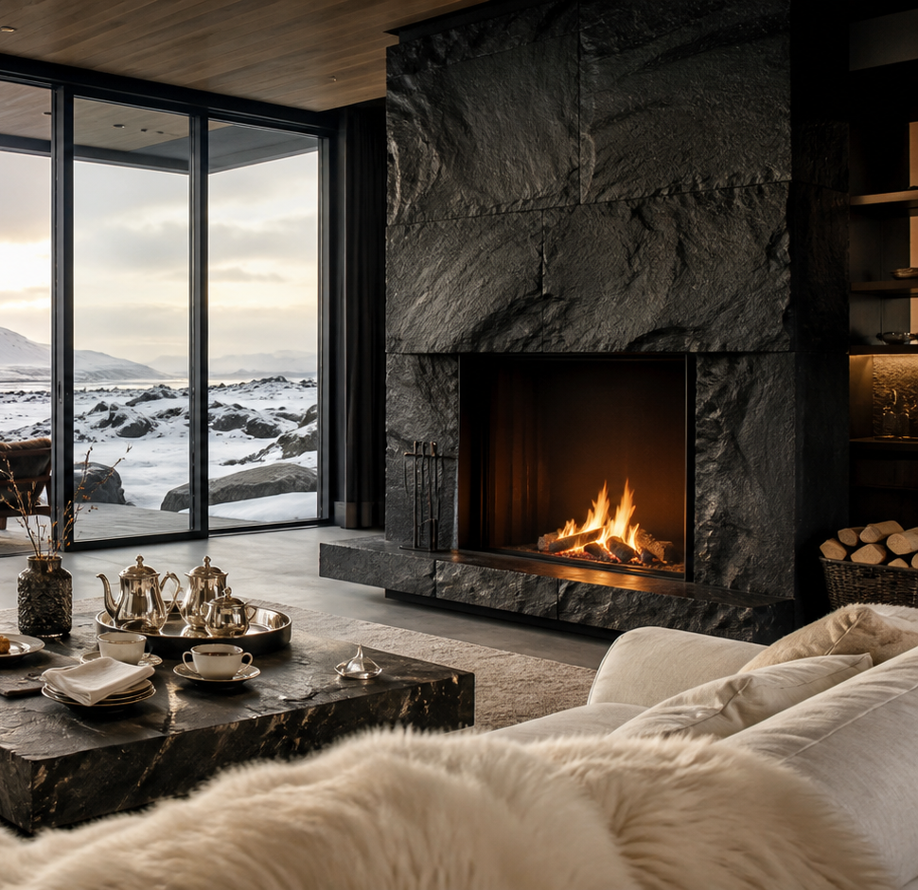
ACCOMMODATION
Aurora Lodge
“Where northern light meets the earth’s warmth.”
Private geothermal pools
Observatory dome and aurora guide
Wellness spa and farm-to-table dining
04 / 10
Notes:
[Sources]
- User-provided Manor source deck: AURELIA — The Far North.
- Lodge image and service details reused from the source deck.

Slide 5
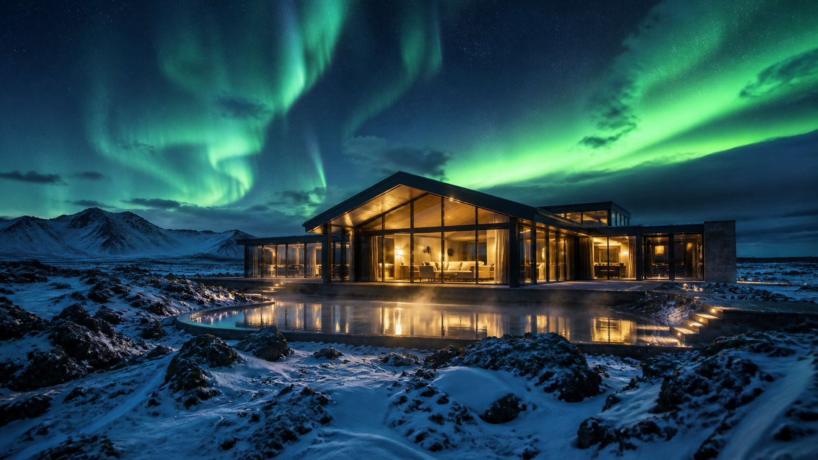
AURORA NIGHT
The sky is the final room.
Private observatory session · weather-led timing
05 / 10
Notes:
[Sources]
- User-provided Manor source deck: AURELIA — The Far North.
- Aurora lodge image reused from the source deck.

Slide 6
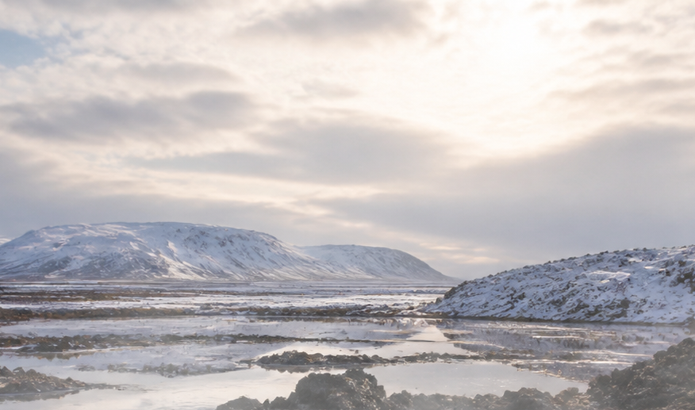
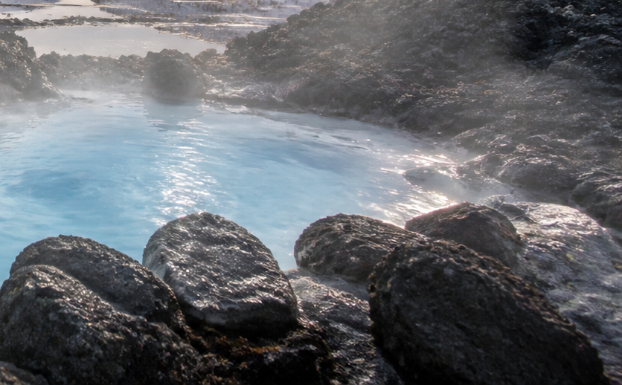
DAY FIVE
Heat beneath the snow
06:00
Pre-dawn geothermal walk
09:30
Hot spring immersion
12:00
Thermal geology briefing
15:30
Crater observation
19:00
Lodge dinner preparation
06 / 10
Notes:
[Sources]
- User-provided Manor source deck: AURELIA — The Far North.
- Landscape and geothermal images reused from the source deck.

Slide 7
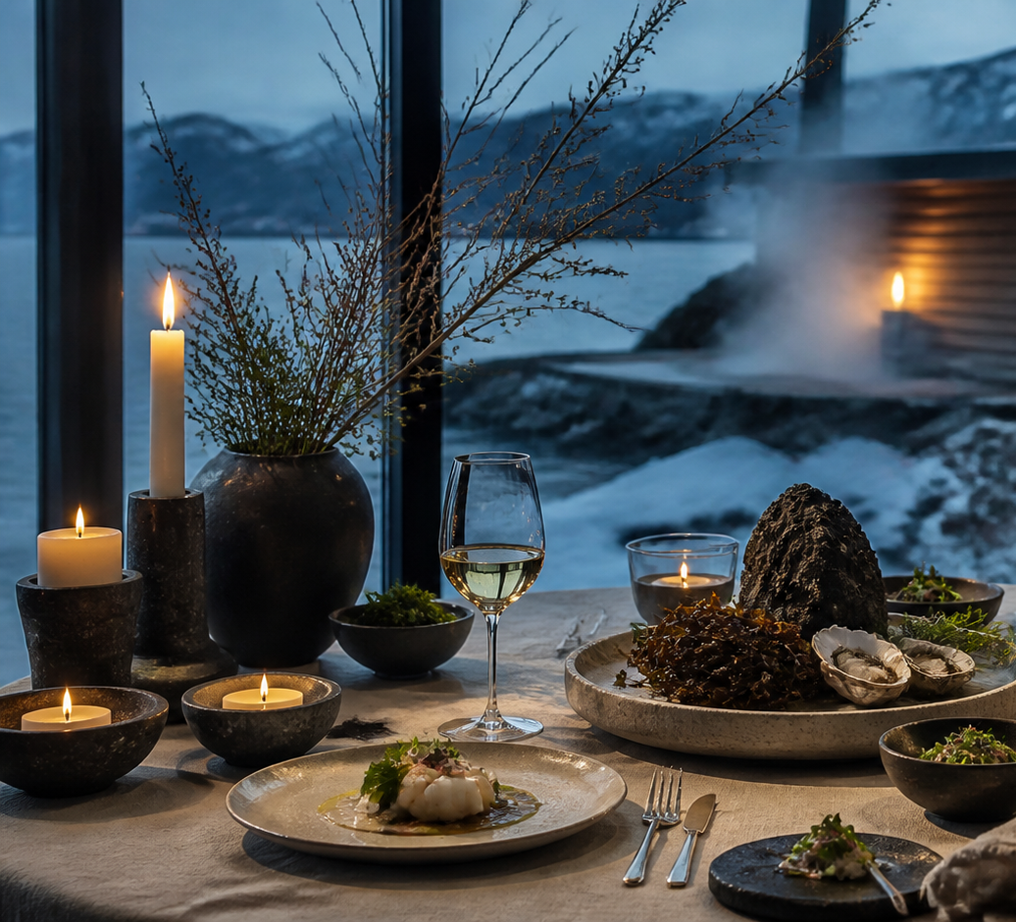
CUISINE AND WELLNESS
Rest is part of the route
Geothermal-heated cuisine, valley ingredients, and time to recover before the next crossing.
DAILY WELLNESS · SPA ACCESS · PRIVATE DINING
07 / 10
Notes:
[Sources]
- User-provided Manor source deck: AURELIA — The Far North.
- Dining image and program copy reused from the source deck.

Slide 8
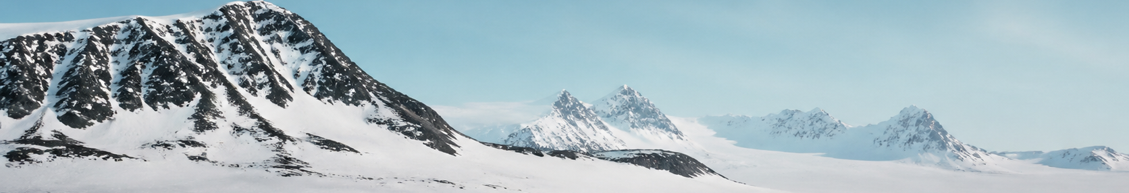
EVERY DETAIL ARRANGED
What the expedition includes
TRANSPORT
STAY
EXPERIENCE
—
Private helicopter transfers
—
Aurora Lodge — four nights
—
Aurora photography sessions
—
Expedition-grade 4×4 fleet
—
Luxury base-camp nights
—
Expert glacier guides
—
All ground logistics
—
All meals and beverages
—
Geothermal wellness access
08 / 10
Notes:
[Sources]
- User-provided Manor source deck: AURELIA — The Far North.
- Panoramic image and inclusion list reused from the source deck.

Slide 9
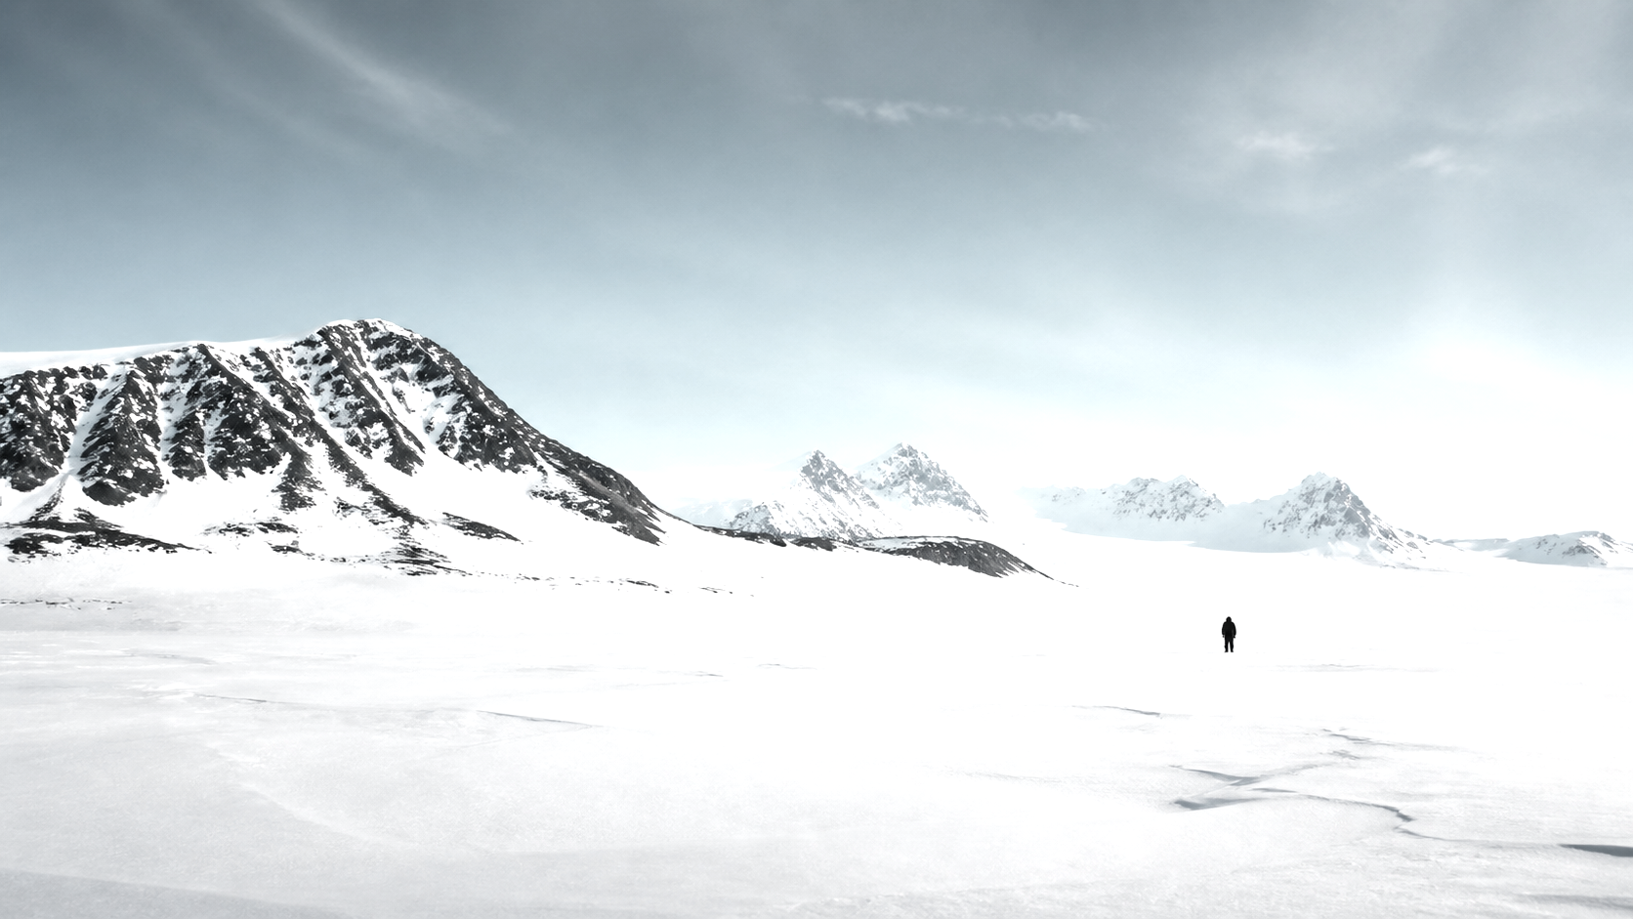
STILLNESS, RESERVED.
Space is the luxury.
09 / 10
Notes:
[Sources]
- User-provided Manor source deck: AURELIA — The Far North.
- Minimal winter landscape reused from the source deck.

Slide 10
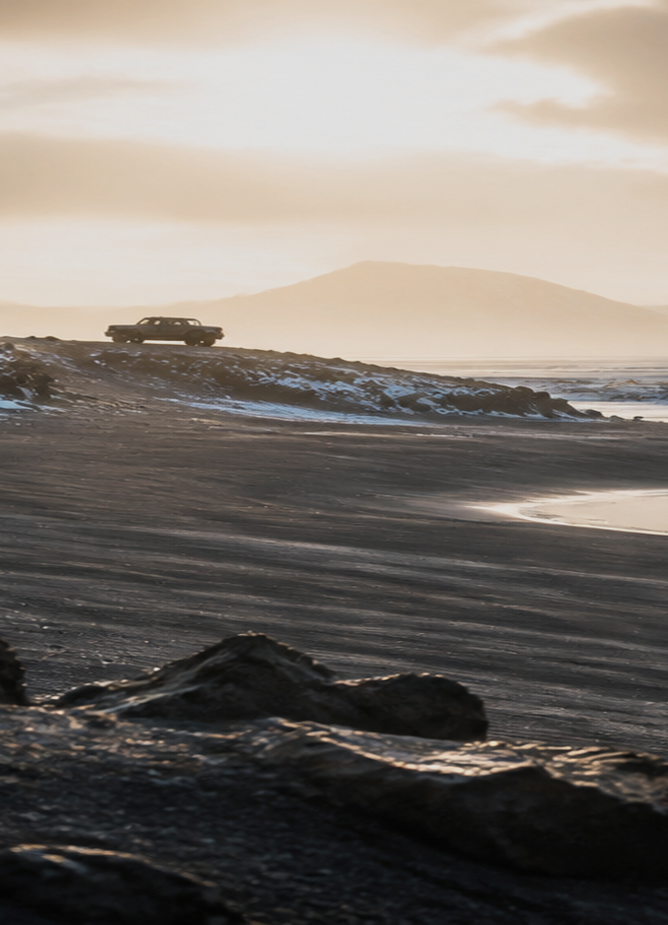
BEGIN YOUR EXPEDITION
Ready for the far north?
Schedule a private consultation with an expedition planner.
hello@aurelia-expeditions.com
+354 555 0100
10 / 10
Notes:
[Sources]
- User-provided Manor source deck: AURELIA — The Far North.
- Closing landscape reused from the source deck; contact details retained from the source deck.

