Slide 1
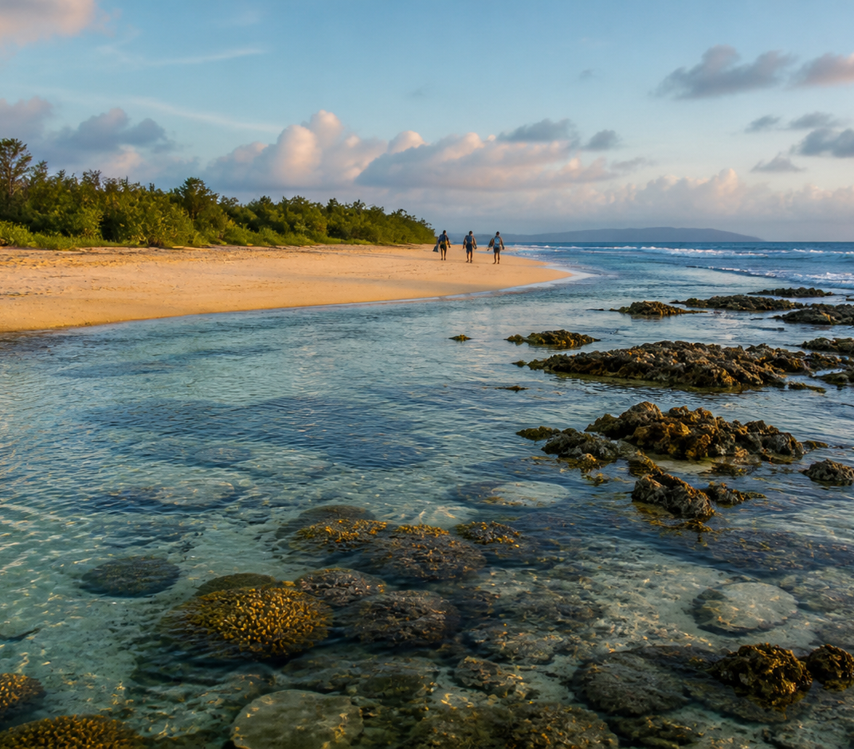
BLUE
COMMONS
2027 OCEAN
IMPACT REPORT
Coastal restoration, field evidence, and transparent donor action.
FICTIONAL 2027 REPORT
01 / 10
Notes:
[Sources]
- User-provided Manor source deck: BLUE COMMONS — 2027 Ocean Impact Report.
- Coastal hero image reused from the source deck.

Slide 2
BLUE COMMONS
2027 OCEAN IMPACT
Nurseries build abundance
Quiet coves shelter young marine life before it moves into open water.
01
02
03
SHELTER
FOOD WEB
RESILIENCE
Complex roots reduce predation.
Small species feed larger ones.
Living shorelines soften storms.
Demonstration framing — not a scientific estimate.
02 / 10
Notes:
[Sources]
- User-provided Manor source deck: BLUE COMMONS — 2027 Ocean Impact Report.

Slide 3
BLUE COMMONS
2027 OCEAN IMPACT
2027 coastal momentum
1,240
86
14
72%
volunteer hours
hectares restored
nursery coves monitored
funding to field delivery
All figures are fictional demonstration values for template evaluation.
03 / 10
Notes:
[Sources]
- User-provided Manor source deck: BLUE COMMONS — 2027 Ocean Impact Report.

Slide 4
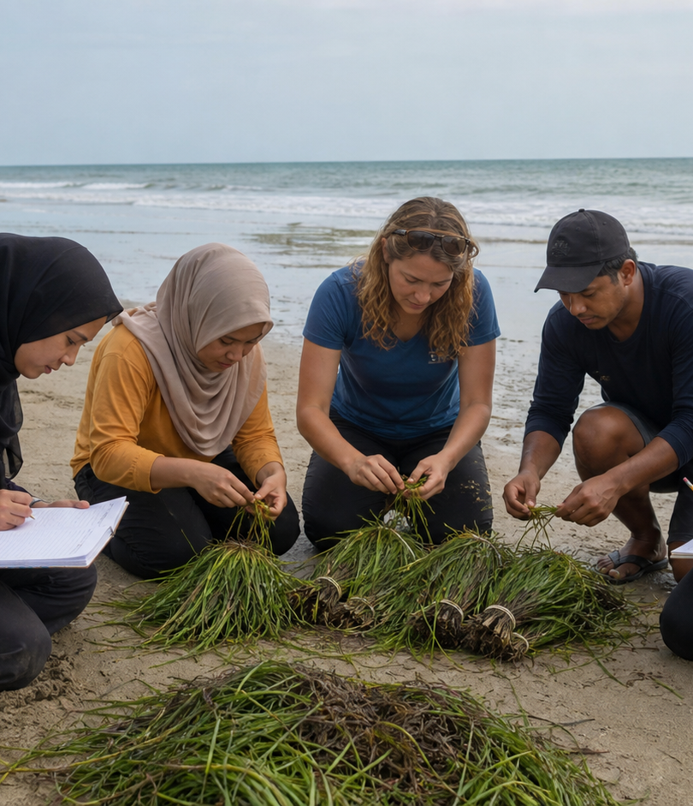
BLUE COMMONS
2027 OCEAN IMPACT
Residents lead the method
“We count the coast first.”
Local guides paired youth volunteers with restoration staff to map tide windows, flag safe access routes, and log nursery sightings.
28 households joined shoreline walks.
04 / 10
Notes:
[Sources]
- User-provided Manor source deck: BLUE COMMONS — 2027 Ocean Impact Report.
- Fieldwork image and story retained from the source deck.

Slide 5
BLUE COMMONS
2027 OCEAN IMPACT
Coves and crews connect
North Cove
East Flats
Market Pier
Lagoon Edge
Illustrative monitoring route — not a geographic map.
05 / 10
Notes:
[Sources]
- User-provided Manor source deck: BLUE COMMONS — 2027 Ocean Impact Report.

Slide 6
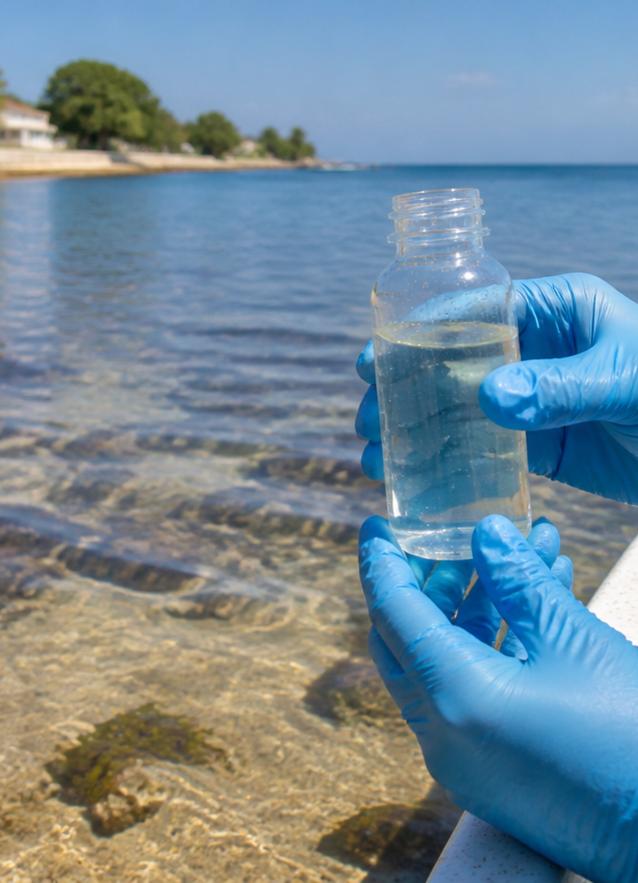
BLUE COMMONS
2027 OCEAN IMPACT
Evidence guides timing
PLANTING WINDOW
July–November
06 / 10
Notes:
[Sources]
- User-provided Manor source deck: BLUE COMMONS — 2027 Ocean Impact Report.
- Water-quality image reused from the source deck; chart values retained from the source deck.

Slide 7
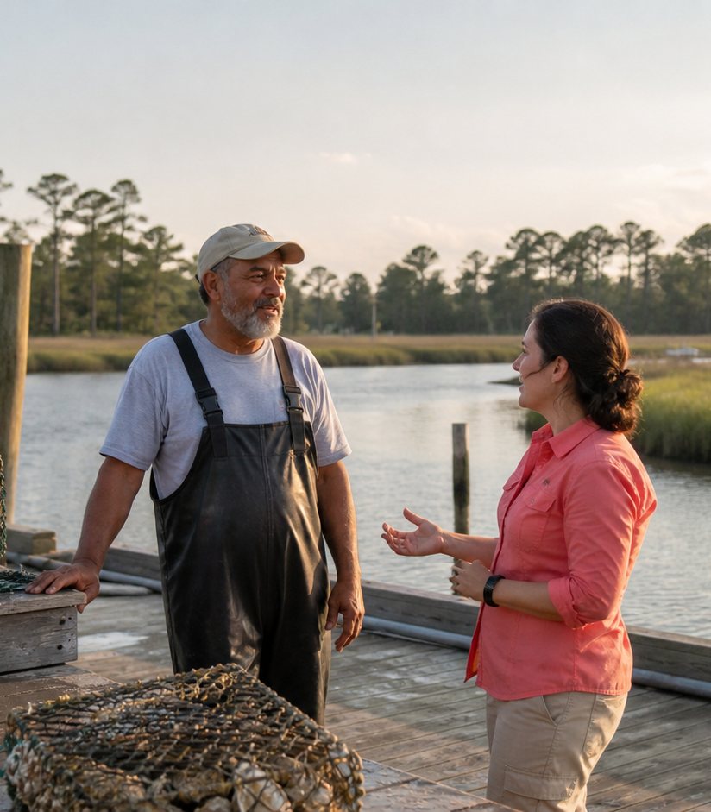
BLUE COMMONS
2027 OCEAN IMPACT
Livelihoods grow with the shoreline
“Good restoration keeps work local.”
46
12
9
paid field days
local suppliers
youth stipends
07 / 10
Notes:
[Sources]
- User-provided Manor source deck: BLUE COMMONS — 2027 Ocean Impact Report.
- Harbor livelihoods image and fictional indicators retained from the source deck.

Slide 8
BLUE COMMONS
2027 OCEAN IMPACT
Funds favor field delivery
$2.4M fictional annual budget
08 / 10
Notes:
[Sources]
- User-provided Manor source deck: BLUE COMMONS — 2027 Ocean Impact Report.
- Funding allocation values retained from the source deck.

Slide 9
BLUE COMMONS
2027 OCEAN IMPACT
Priorities for 2028
01
02
03
VERIFY
PROTECT
GROW
Publish open monitoring summaries each quarter.
Expand nursery buffers with town councils.
Train more local crew leads before peak season.
09 / 10
Notes:
[Sources]
- User-provided Manor source deck: BLUE COMMONS — 2027 Ocean Impact Report.

Slide 10
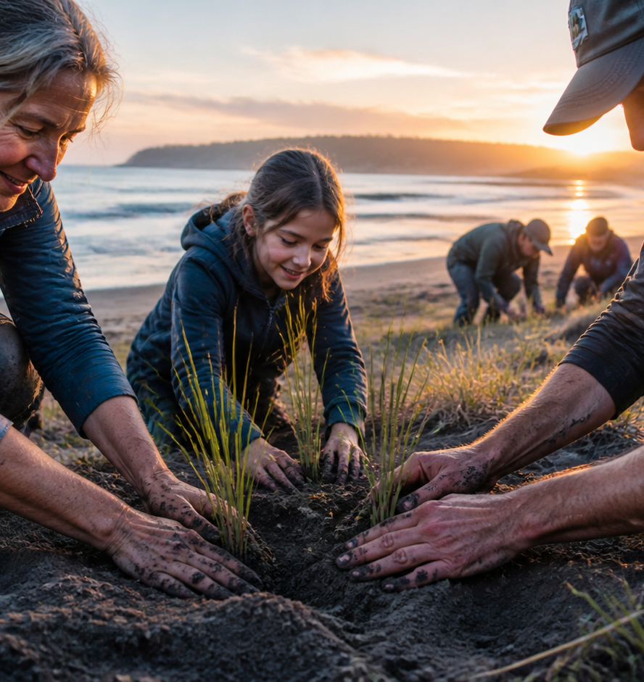
BLUE COMMONS
2027 OCEAN IMPACT
Help nurseries
become commons
Your gift funds monitoring gear, local field days, and restoration plants for the next season.
bluecommons.example/donate
10 / 10
Notes:
[Sources]
- User-provided Manor source deck: BLUE COMMONS — 2027 Ocean Impact Report.
- Restoration image and donor call-to-action retained from the source deck.

