Slide 1
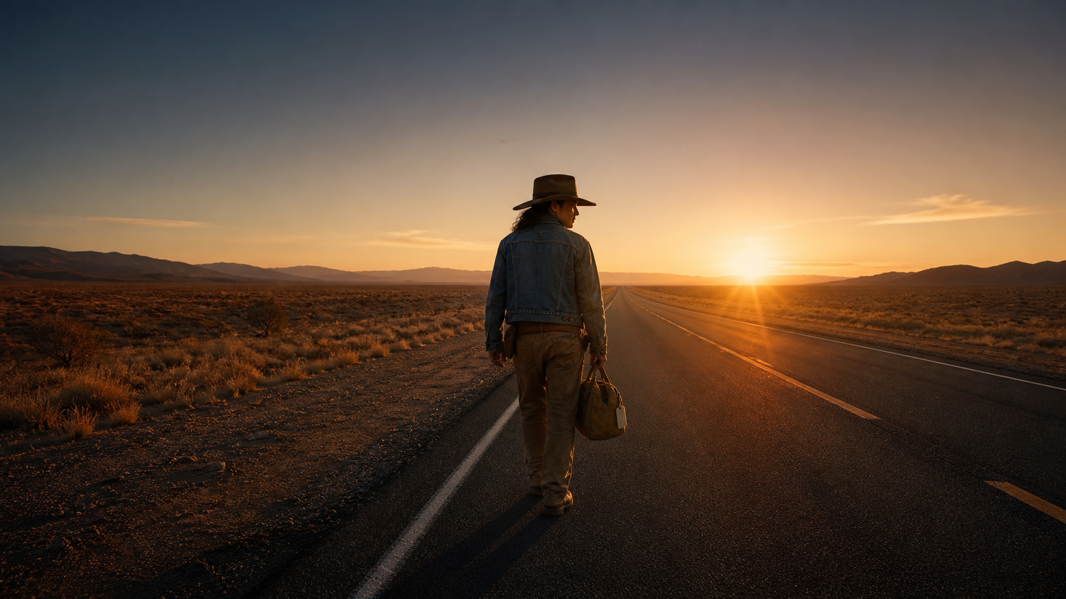
CINDER
ROAD
A NEO-WESTERN ABOUT DEBT, MEMORY, AND THREE NIGHTS OF FIRE.
CINDER ROAD / 01 / 10
FICTIONAL FEATURE PITCH
Notes:
[Sources]
- User-provided Manor source deck: Source deck: CINDER ROAD — Neo-Western Film Pitch (Manor AI)..
- Sunset protagonist image reused from the source deck.

Slide 2
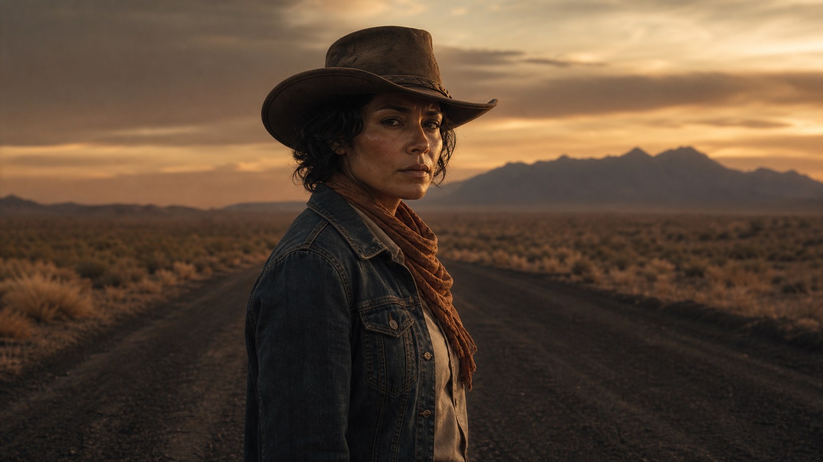
MARA VALE
Former fire investigator.
Current repo driver.
One debt she cannot outrun.
CINDER ROAD / 02 / 10
FICTIONAL FEATURE PITCH
Notes:
[Sources]
- User-provided Manor source deck: Source deck: CINDER ROAD — Neo-Western Film Pitch (Manor AI)..
- Character portrait reused from the source deck.

Slide 3
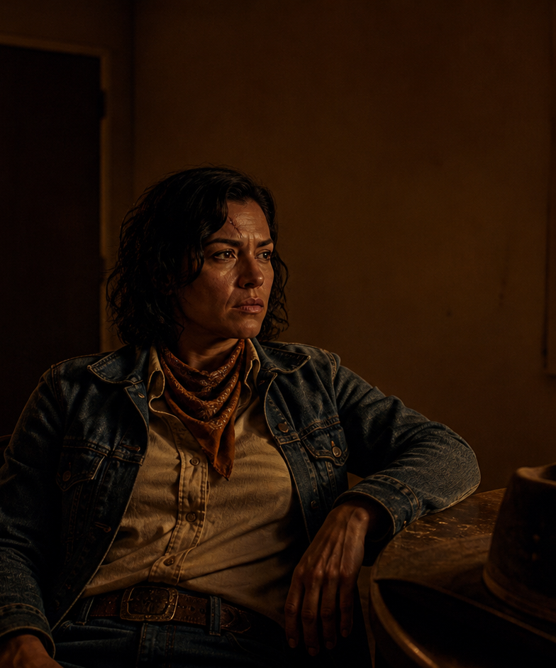
THE STORY ENGINE
Every target reveals
a piece of the fire.
Mara is hired to recover three vehicles from the same desert county. Each owner remembers the refinery blaze differently. By the third night, repossession becomes investigation.
Debt opens the door. Memory supplies the motive.
CINDER ROAD / 03 / 10
FICTIONAL FEATURE PITCH
Notes:
[Sources]
- User-provided Manor source deck: Source deck: CINDER ROAD — Neo-Western Film Pitch (Manor AI)..
- Seated portrait reused from the source deck.

Slide 4
THREE NIGHTS. THREE TARGETS.
NIGHT 01
NIGHT 02
NIGHT 03
THE PREACHER
THE WIDOW
THE SHERIFF
A pickup with blood in the bed.
A coupe with a taped confession.
A cruiser that should not exist.
CINDER ROAD / 04 / 10
FICTIONAL FEATURE PITCH
Notes:
[Sources]
- User-provided Manor source deck: Source deck: CINDER ROAD — Neo-Western Film Pitch (Manor AI)..

Slide 5
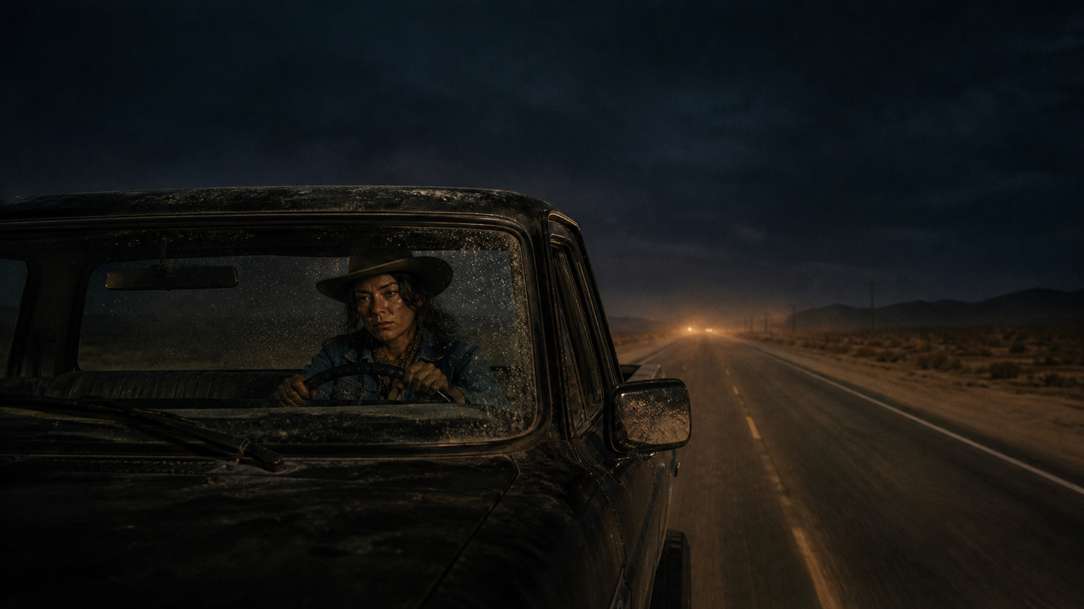
THE ROAD KNOWS
WHO IS LYING.
Headlights cut the story into evidence: dust, chrome, ash, faces.
CINDER ROAD / 05 / 10
FICTIONAL FEATURE PITCH
Notes:
[Sources]
- User-provided Manor source deck: Source deck: CINDER ROAD — Neo-Western Film Pitch (Manor AI)..
- Night-road image reused as a cinematic full-bleed spread.

Slide 6
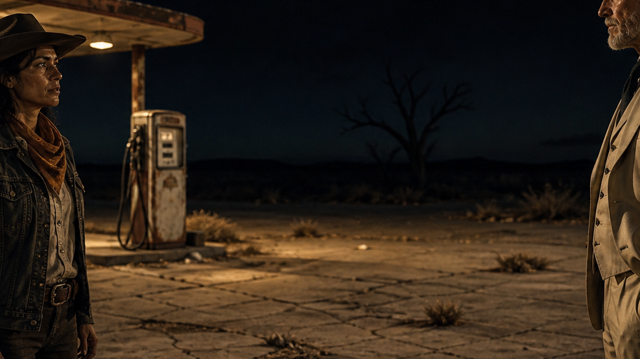
THE HUNTER
WEARS A BADGE.
Sheriff Danner wants the cars gone, the witnesses quiet, and Mara remembered as unreliable.
ANTAGONIST / LOCAL POWER
CINDER ROAD / 06 / 10
FICTIONAL FEATURE PITCH
Notes:
[Sources]
- User-provided Manor source deck: Source deck: CINDER ROAD — Neo-Western Film Pitch (Manor AI)..
- Confrontation image reused from the source deck.

Slide 7
A WESTERN WITHOUT CLEAN HANDS.
01
DEBT
Every obligation has a body.
02
MEMORY
Truth changes with ownership.
03
FIRE
The past keeps its own weather.
04
MERCY
Justice arrives late and compromised.
CINDER ROAD / 07 / 10
FICTIONAL FEATURE PITCH
Notes:
[Sources]
- User-provided Manor source deck: Source deck: CINDER ROAD — Neo-Western Film Pitch (Manor AI)..

Slide 8
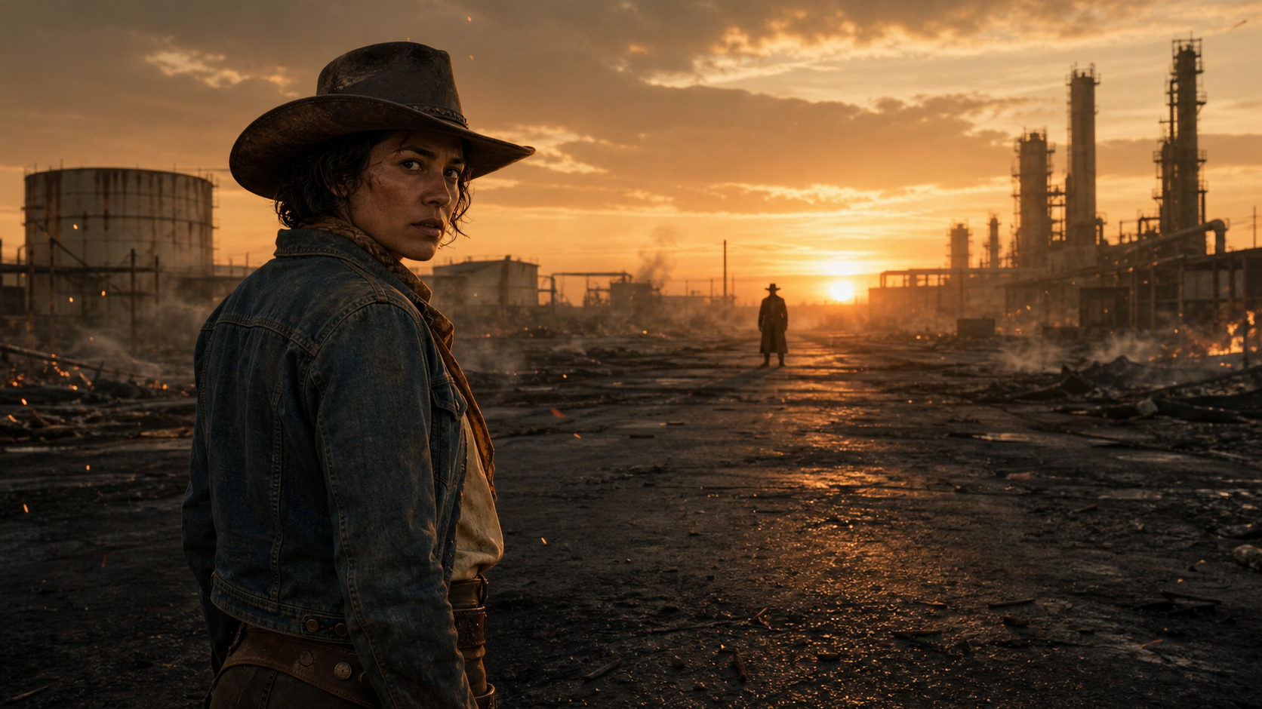
THE THIRD NIGHT
REACHES THE REFINERY.
23:10
Gate opens
23:42
Records surface
00:16
Fire line breaks
00:28
Mara chooses witness over proof
CINDER ROAD / 08 / 10
FICTIONAL FEATURE PITCH
Notes:
[Sources]
- User-provided Manor source deck: Source deck: CINDER ROAD — Neo-Western Film Pitch (Manor AI)..
- Refinery sunset image reused from the source deck.

Slide 9
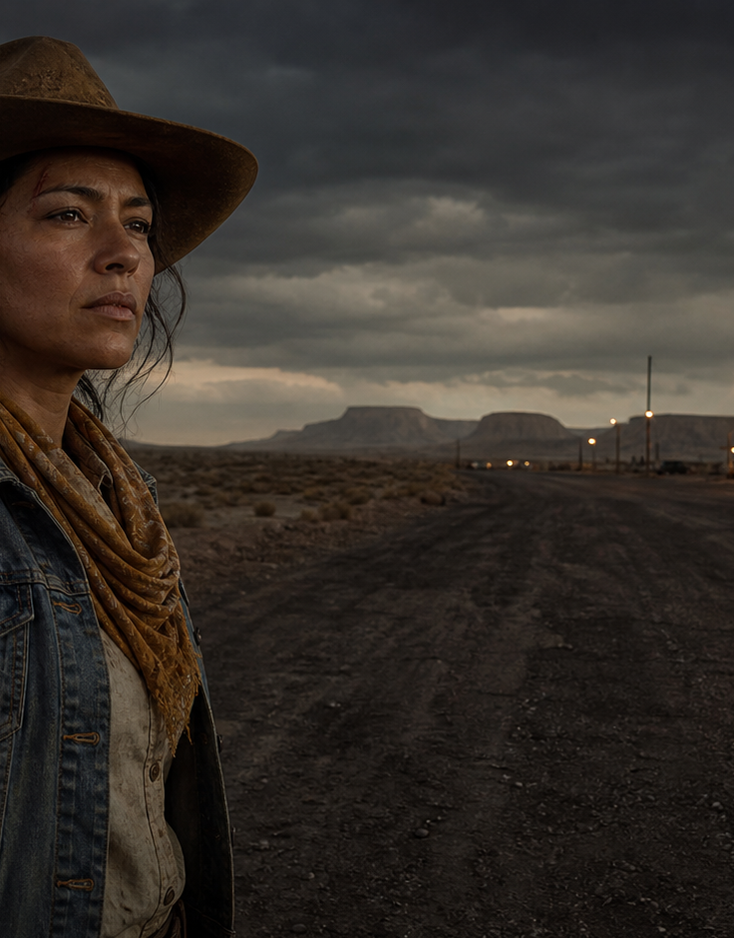
WHY NOW
Debt is infrastructure.
Truth is local.
Fire is political.
CINDER ROAD uses genre momentum to examine who gets believed when work, land, and public authority share the same owner.
CINDER ROAD / 09 / 10
FICTIONAL FEATURE PITCH
Notes:
[Sources]
- User-provided Manor source deck: Source deck: CINDER ROAD — Neo-Western Film Pitch (Manor AI)..
- Desert-road image reused from the source deck.

Slide 10
GREENLIGHT
THE ROAD.
Contained locations. Prestige cast. A visual world built for the big screen.
CINDER ROAD
CINDER ROAD / 10 / 10
FICTIONAL FEATURE PITCH
Notes:
[Sources]
- User-provided Manor source deck: Source deck: CINDER ROAD — Neo-Western Film Pitch (Manor AI)..
- Sunset image reused as a closing background.

