Slide 1
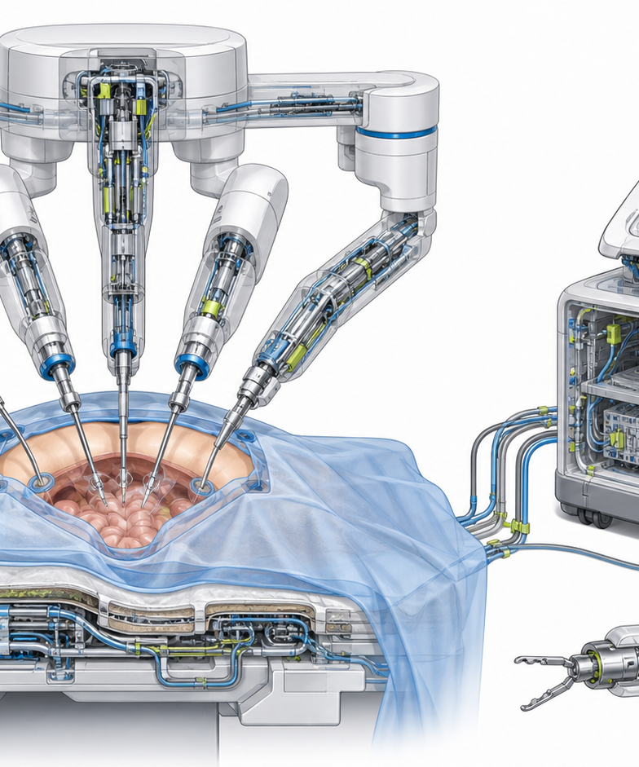
FICTIONAL SURGICAL ROBOTICS CONFERENCE
HELIO-SX
Evidence Review
Workflow reliability before outcome claims.
DISCUSSION DECK
Notes:
[Sources]
- User-provided Manor source deck: Source deck: HELIO-SX — Surgical Robotics Evidence Review (Manor AI)..
- Device image reused from the source deck. All data are fictional demonstration values.

Slide 2
OBSERVED VARIABILITY
Friction clusters before docking
22 min
31%
18%
median setup
repeat confirmation
handoff gap
WORKFLOW FRICTION
INTERPRETATION
• Repeated docking confirmation
• Setup variation obscures learning
• Handoffs are inconsistently captured
Variation appears pre-incision. Review team choreography and device readiness separately.
HELIO-SX EVIDENCE REVIEW
02 / 10
Notes:
[Sources]
- User-provided Manor source deck: Source deck: HELIO-SX — Surgical Robotics Evidence Review (Manor AI)..
- Fictional demonstration metrics retained and reframed for clarity.

Slide 3
LEARNING SIGNALS
Measure the system,
not just the surgeon.
WORKFLOW
EVIDENCE
01
TEAM
role choreography
02
DEVICE
readiness state
03
SITE
local protocol
04
CASE
clinical complexity
HELIO-SX EVIDENCE REVIEW
03 / 10
Notes:
[Sources]
- User-provided Manor source deck: Source deck: HELIO-SX — Surgical Robotics Evidence Review (Manor AI)..

Slide 4
PROSPECTIVE COHORT
Capture design answers four review questions
Element | Value | Unit | Capture method | Review purpose
Cases | 64 | procedures | site log | feasibility
Sites | 4 | hospitals | protocol file | generalizability
Run-in | 8 | cases / site | training log | learning effect
Follow-up | 30 | days | chart review | safety screen
All entries are fictional demonstration data for template layout only.
HELIO-SX EVIDENCE REVIEW
04 / 10
Notes:
[Sources]
- User-provided Manor source deck: Source deck: HELIO-SX — Surgical Robotics Evidence Review (Manor AI)..
- Fictional cohort table reconstructed as an editable native table.

Slide 5
SETUP TIME
Experience compresses docking variability
22 min
illustrative independent-phase median
HELIO-SX EVIDENCE REVIEW
05 / 10
Notes:
[Sources]
- User-provided Manor source deck: Source deck: HELIO-SX — Surgical Robotics Evidence Review (Manor AI)..
- Fictional setup-time series visualized as an editable native chart.

Slide 6
LEARNING CURVE
The curve flattens; the review question changes.
AFTER CASE 24
Shift from speed to consistency, evidence completeness, and escalation discipline.
HELIO-SX EVIDENCE REVIEW
06 / 10
Notes:
[Sources]
- User-provided Manor source deck: Source deck: HELIO-SX — Surgical Robotics Evidence Review (Manor AI)..
- Fictional learning-curve values visualized as an editable native chart.

Slide 7
SAFETY SIGNALS
Adjudicate signals before attributing outcomes
3
5
9
CONVERSIONS
READMISSIONS
DEVICE PAUSES
not attributed
30-day window
intraoperative log
Interpretation
Review pause events separately from patient outcomes; use blinded adjudication for all three signals.
HELIO-SX EVIDENCE REVIEW
07 / 10
Notes:
[Sources]
- User-provided Manor source deck: Source deck: HELIO-SX — Surgical Robotics Evidence Review (Manor AI)..
- Fictional safety indicators retained for design demonstration.

Slide 8
AUDITABLE WORKFLOW
Evidence follows the handoff
01
02
03
04
05
ROOM READY
DOCKING
CONSOLE
EXCHANGE
UNDOCK
CAPTURE LAYER
Time stamps · pause reasons · instrument exchanges · handoff owner
HELIO-SX EVIDENCE REVIEW
08 / 10
Notes:
[Sources]
- User-provided Manor source deck: Source deck: HELIO-SX — Surgical Robotics Evidence Review (Manor AI)..

Slide 9
VALIDATION FRAME
Three questions. Three evidence lanes.
01
WORKFLOW RELIABILITY
Are roles and states consistent?
02
LEARNING EFFECT
Does performance stabilize by phase?
03
SAFETY REVIEW
Are signals independently adjudicated?
HELIO-SX EVIDENCE REVIEW
09 / 10
Notes:
[Sources]
- User-provided Manor source deck: Source deck: HELIO-SX — Surgical Robotics Evidence Review (Manor AI)..

Slide 10
TAKEAWAY
Treat HELIO-SX evidence as a workflow study first.
01
02
03
FRAME
AUDIT
SET
discussion around workflow states
missing or inconsistent evidence
the next protocol and review gate
HELIO-SX EVIDENCE REVIEW
10 / 10
Notes:
[Sources]
- User-provided Manor source deck: Source deck: HELIO-SX — Surgical Robotics Evidence Review (Manor AI)..

