Slide 1
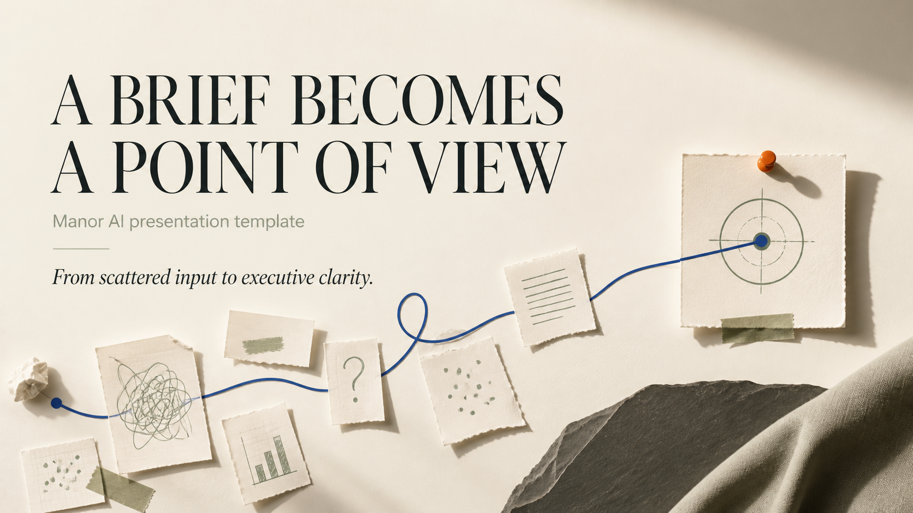
Notes:
[Sources]
User prompt only; all visible page artwork generated as one AI image in Manor Advanced Presentation Mode.
[/Sources]

Slide 2
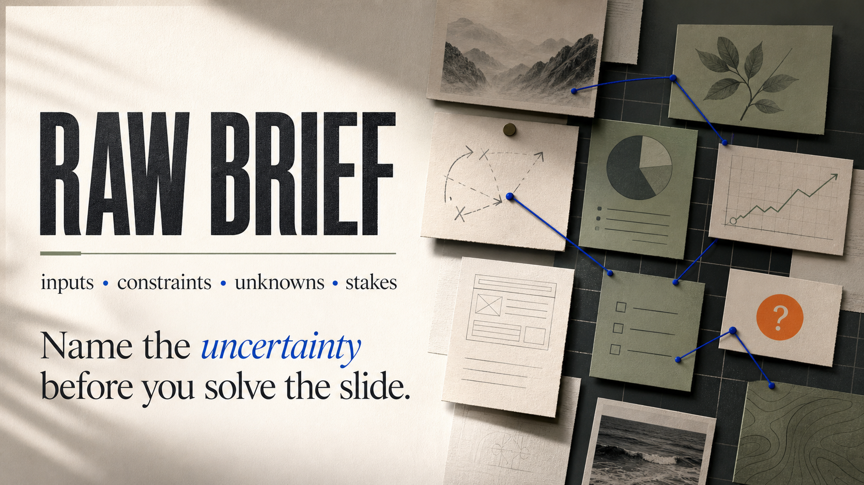
Notes:
[Sources]
User prompt only; all visible page artwork generated as one AI image in Manor Advanced Presentation Mode.
[/Sources]

Slide 3
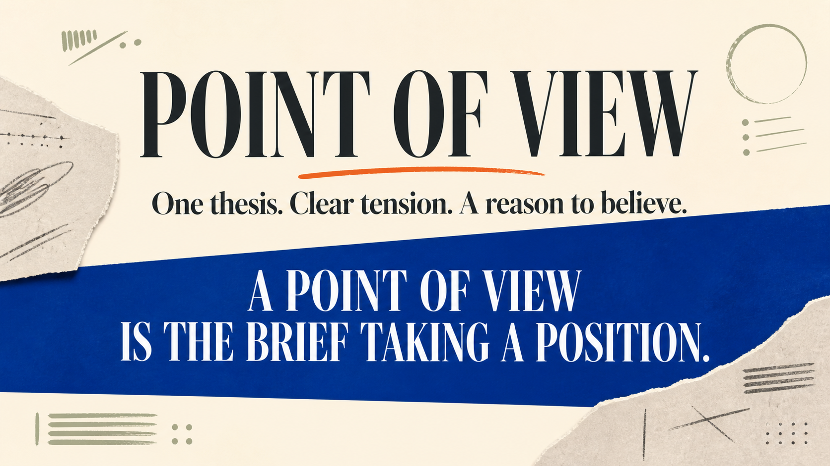
Notes:
[Sources]
User prompt only; all visible page artwork generated as one AI image in Manor Advanced Presentation Mode.
[/Sources]

Slide 4

Notes:
[Sources]
User prompt only; all visible page artwork generated as one AI image in Manor Advanced Presentation Mode.
[/Sources]

Slide 5
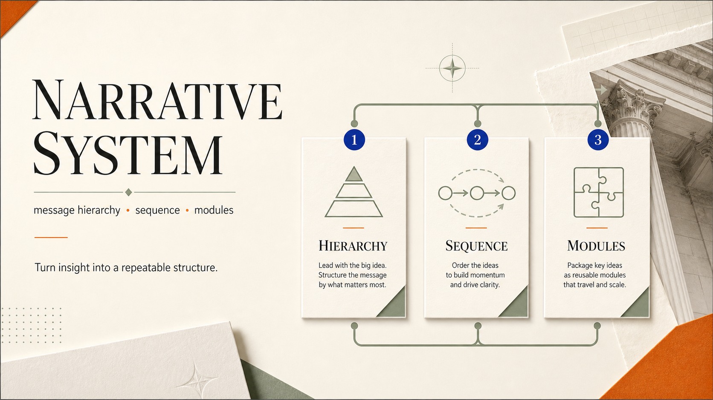
Notes:
[Sources]
User prompt only; all visible page artwork generated as one AI image in Manor Advanced Presentation Mode.
[/Sources]

Slide 6
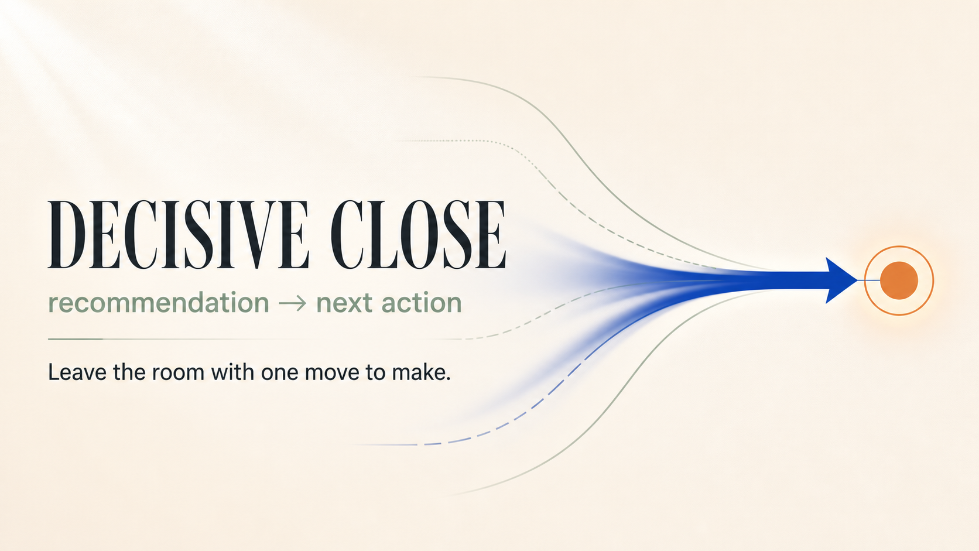
Notes:
[Sources]
User prompt only; all visible page artwork generated as one AI image in Manor Advanced Presentation Mode.
[/Sources]

