Slide 1
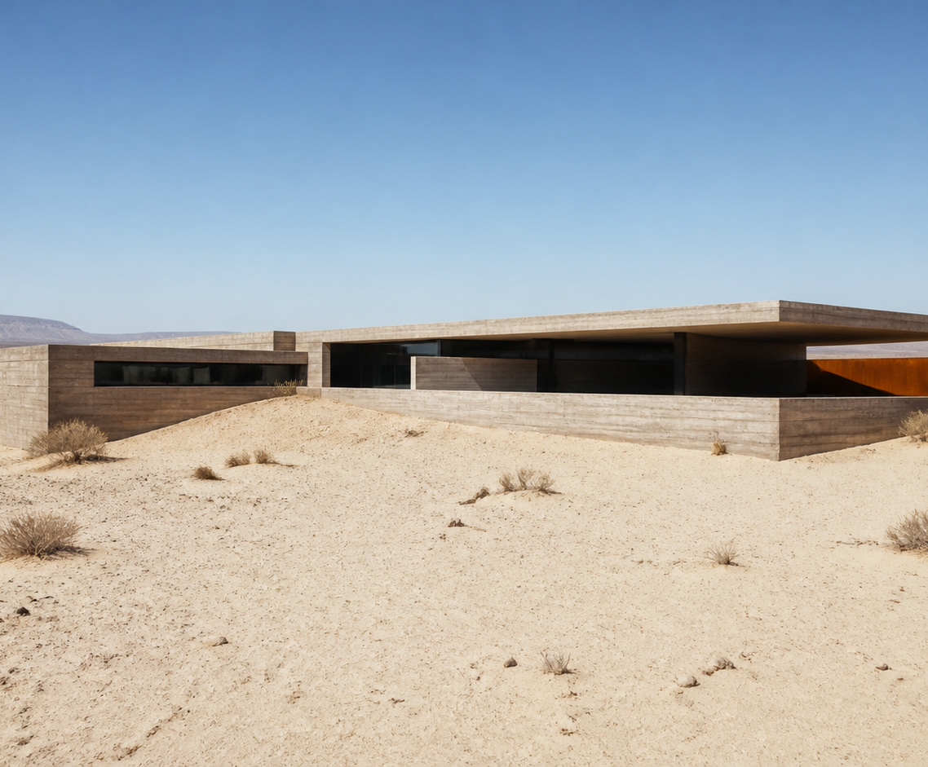
MONOLITH
HOUSE
ARCHITECTURE MONOGRAPH
A fictional desert residence composed as one low mass — calibrated for shade, silence, and thermal delay.
01
COVER
MONOLITH HOUSE
Notes:
[Sources]
- User-provided Manor source deck: MONOLITH HOUSE — Architecture Monograph.
- Exterior photograph reused from the source deck.

Slide 2
The house is a thermal instrument.
N
PREMISE
Compact mass reduces exposed surface area.
CLIMATE
Thermal lag and night purge shape use.
LONG FACE
WEST EXPOSURE
ORIENTATION
Long face avoids west exposure.
310 m² · one level · dry-wash frontage
02
SITE AND CLIMATE PREMISE
MONOLITH HOUSE
Notes:
[Sources]
- User-provided Manor source deck: MONOLITH HOUSE — Architecture Monograph.

Slide 3
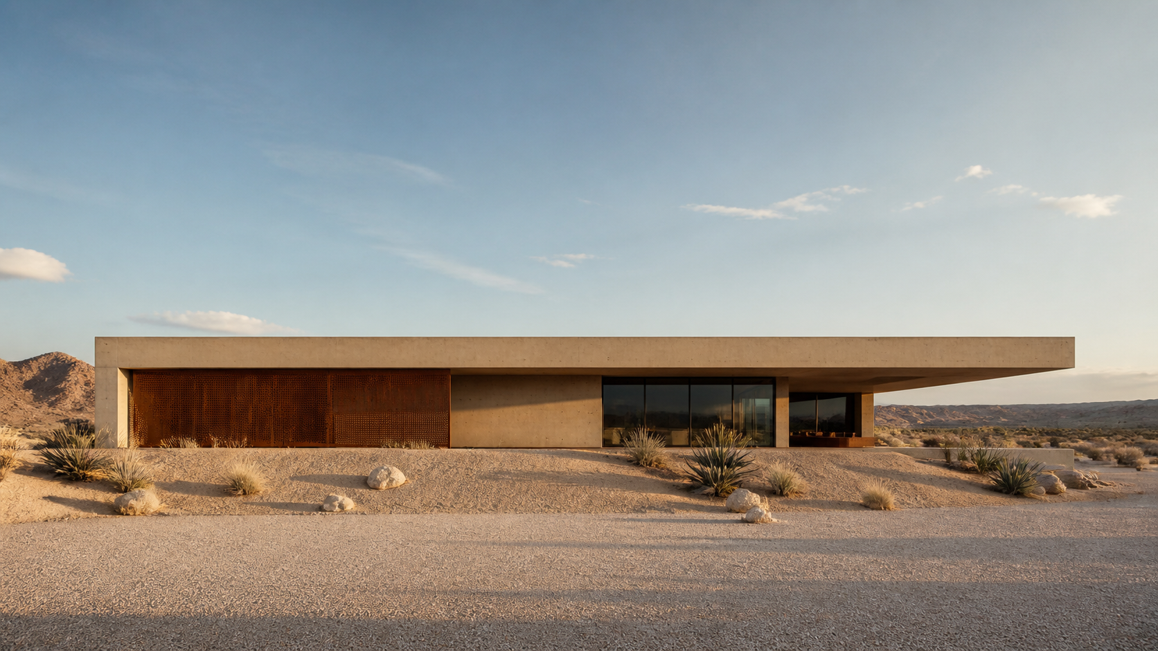
LOW MASS / LONG SHADOW
The roofline disappears
into the basin.
03
EXTERIOR APPROACH
MONOLITH HOUSE
Notes:
[Sources]
- User-provided Manor source deck: MONOLITH HOUSE — Architecture Monograph.
- Exterior approach photograph reused from the source deck.

Slide 4
Circulation is a single controlled line.
STUDIO
SLEEPING
LIVING
ENTRY
ENTRY → COURT → LIVING → SLEEPING
THERMAL MASS
COURT
A compressed entrance opens toward protected winter light.
04
PLAN AND CIRCULATION
MONOLITH HOUSE
Notes:
[Sources]
- User-provided Manor source deck: MONOLITH HOUSE — Architecture Monograph.

Slide 5
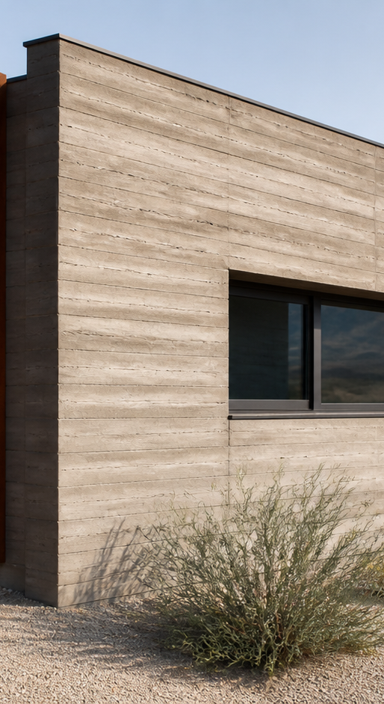
The palette is deliberately narrow.
CONCRETE
CHARCOAL
PLASTER
RUST
STUDY
fine vertical grain
solar frames
light wash
operable shade
05
MATERIAL PALETTE
MONOLITH HOUSE
Notes:
[Sources]
- User-provided Manor source deck: MONOLITH HOUSE — Architecture Monograph.
- Detail photograph reused from the source deck.

Slide 6
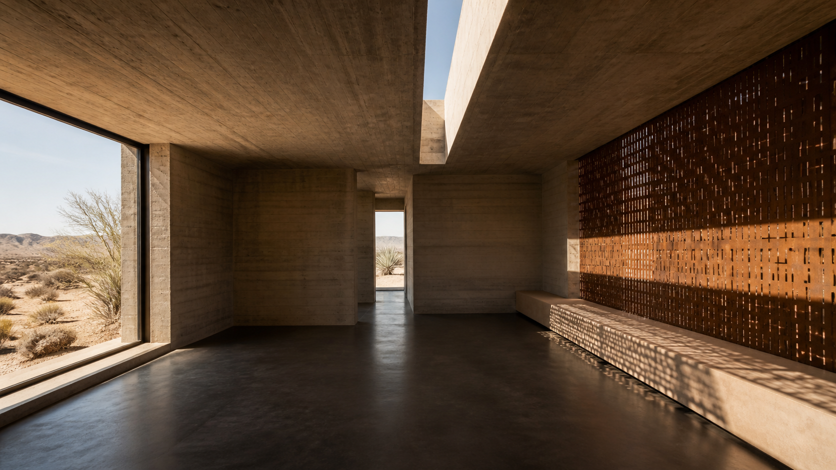
SHADE
BECOMES
A ROOM.
Perforated rust screens turn noon into a measured interior light.
06
INTERIOR LIGHT
MONOLITH HOUSE
Notes:
[Sources]
- User-provided Manor source deck: MONOLITH HOUSE — Architecture Monograph.
- Interior photograph reused from the source deck.

Slide 7
Section turns heat into delay.
MASS
SUN DEFLECTED
Stores night coolth.
SHADE
Slows afternoon gain.
PURGE
Releases heat after sunset.
07
SECTION AND THERMAL STRATEGY
MONOLITH HOUSE
Notes:
[Sources]
- User-provided Manor source deck: MONOLITH HOUSE — Architecture Monograph.

Slide 8
Details reduce the house to joints.
01
02
03
SHADOW REVEAL
SCREEN ANCHOR
ROOF EDGE
A deep line keeps plaster from reading as trim.
Rust steel stands proud of the concrete mass.
A thin cap finishes the long horizontal line.
All dimensions and assemblies are fictional.
08
CONSTRUCTION DETAILS
MONOLITH HOUSE
Notes:
[Sources]
- User-provided Manor source deck: MONOLITH HOUSE — Architecture Monograph.

Slide 9
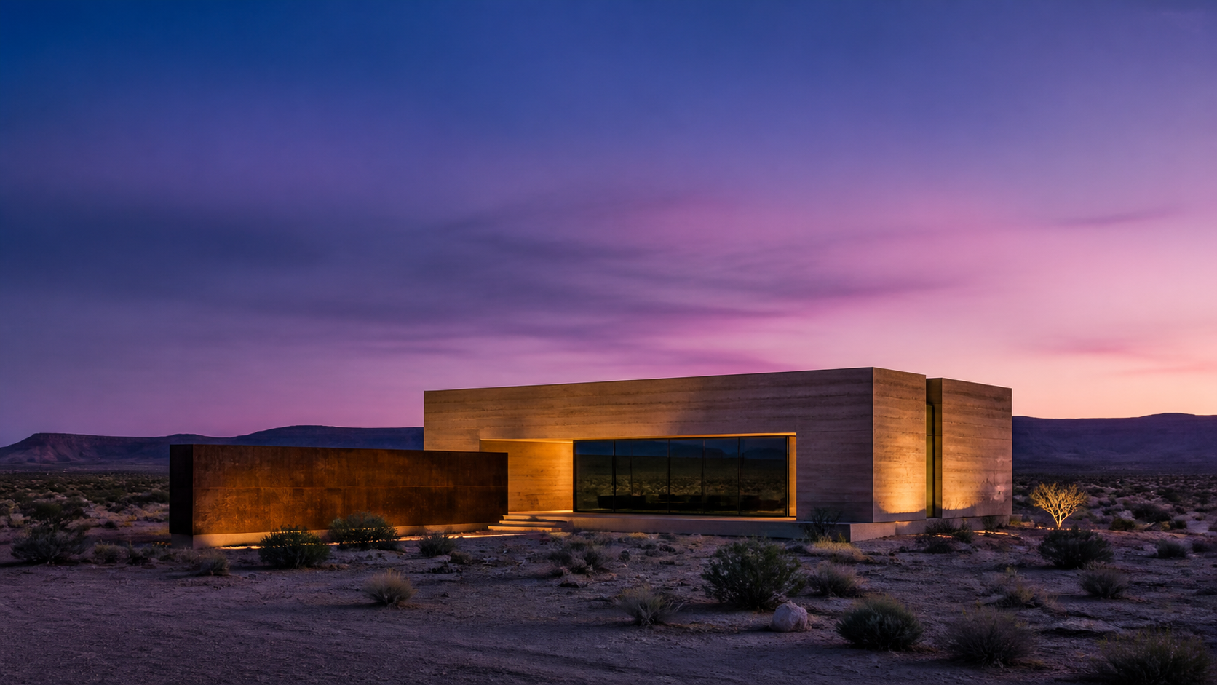
At dusk, the monolith becomes an ember line.
QUIET OCCUPANCY / SHIELDED GLAZING / WARM CONCRETE
09
DUSK EXPERIENCE
MONOLITH HOUSE
Notes:
[Sources]
- User-provided Manor source deck: MONOLITH HOUSE — Architecture Monograph.
- Dusk exterior photograph reused from the source deck.

Slide 10
MONOLITH HOUSE
A subtraction from desert light.
PROJECT CREDITS
ARCHITECT
North Basin Studio
Compact, shaded, and materially calm.
LANDSCAPE
Dry Wash Atelier
STRUCTURE
Mass + Frame Lab
LOCATION
Desert basin
YEAR
2028 concept
END
10
CREDITS AND CLOSING STATEMENT
MONOLITH HOUSE
Notes:
[Sources]
- User-provided Manor source deck: MONOLITH HOUSE — Architecture Monograph.

