Slide 1
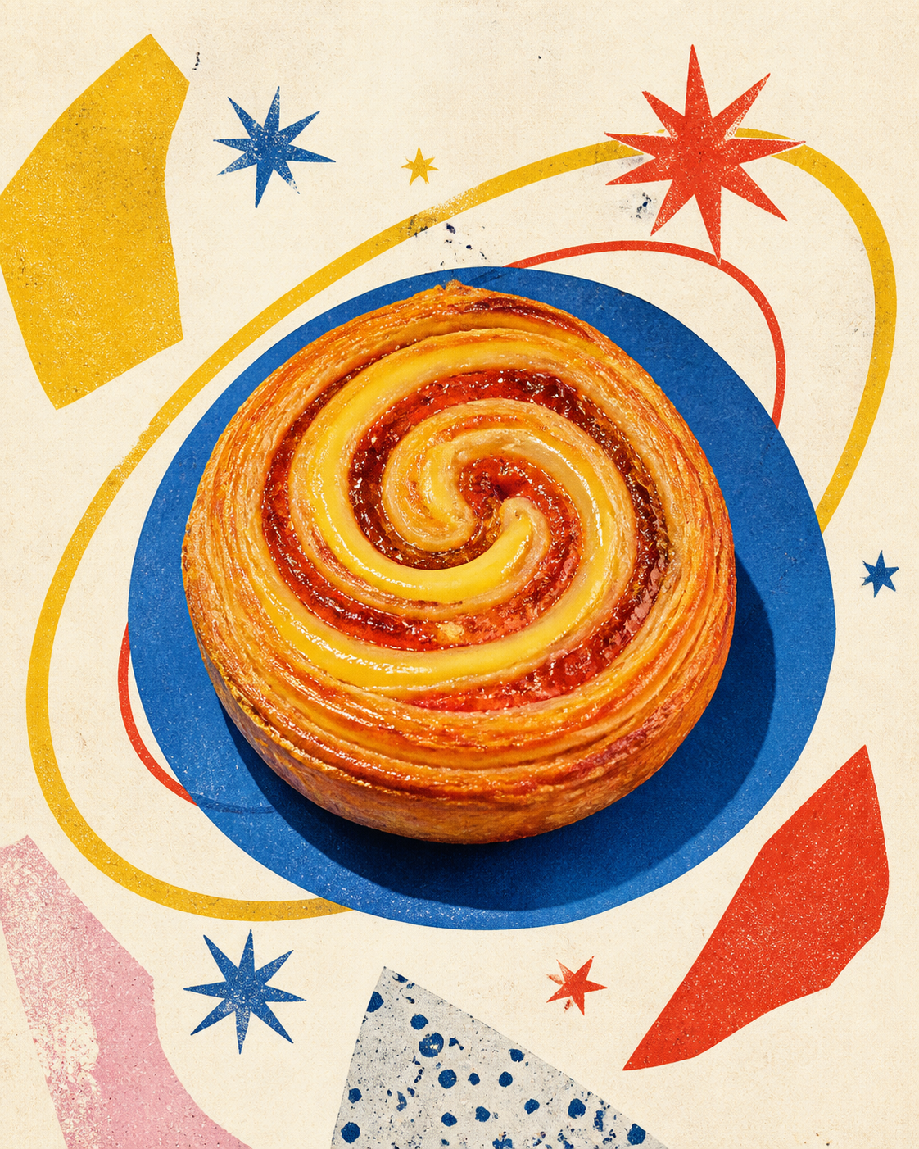
ORBITAL
BAKERY
A launch playbook for a bakery that treats every morning like an opening night.
01
FICTIONAL BRAND SYSTEM
Notes:
[Sources]
- User-provided Manor source deck: Source deck: ORBITAL BAKERY — Brand Launch Playbook (Manor AI)..
- Pastry photograph reused from the source deck.

Slide 2
THE MORNING
IS THE CAMPAIGN.
7:12
AM
People do not need another pastry list. They need a repeatable ritual: smell, color, warmth, and a reason to arrive before the day gets loud.
THE DAILY WINDOW
ORBITAL BAKERY / 02 / 10
WARM BAKES. BRIGHT DAYS.
Notes:
[Sources]
- User-provided Manor source deck: Source deck: ORBITAL BAKERY — Brand Launch Playbook (Manor AI)..

Slide 3
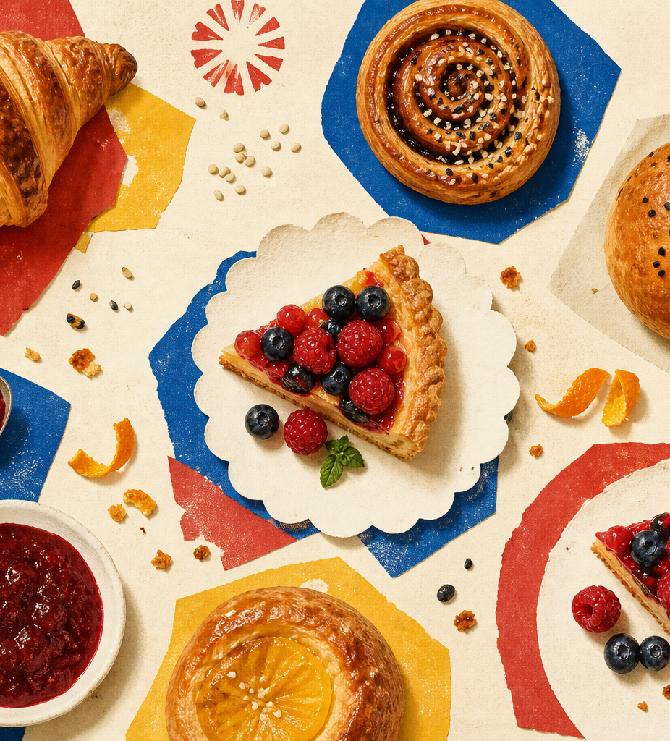
A SMALL UNIVERSE,
BAKED DAILY.
01
SUN BUN
citrus / cardamom
02
COMET LOAF
sesame / rye
03
MOON TART
pear / almond
04
ORBIT BOX
six rotating bakes
ORBITAL BAKERY / 03 / 10
WARM BAKES. BRIGHT DAYS.
Notes:
[Sources]
- User-provided Manor source deck: Source deck: ORBITAL BAKERY — Brand Launch Playbook (Manor AI)..
- Bakery assortment photograph reused from the source deck.

Slide 4
ONE BITE
SHOULD TRAVEL.
Product photography carries the brand before copy does.
ORBITAL BAKERY / 04 / 10
WARM BAKES. BRIGHT DAYS.
Notes:
[Sources]
- User-provided Manor source deck: Source deck: ORBITAL BAKERY — Brand Launch Playbook (Manor AI)..
- Hero pastry photograph reused as a full-bleed editorial spread.

Slide 5
THE IDENTITY HAS
FOUR FLAVORS.
TOMATO
COBALT
YOLK
MINT
ENERGY
TRUST
JOY
AIR
ORBITAL BAKERY / 05 / 10
WARM BAKES. BRIGHT DAYS.
Notes:
[Sources]
- User-provided Manor source deck: Source deck: ORBITAL BAKERY — Brand Launch Playbook (Manor AI)..

Slide 6
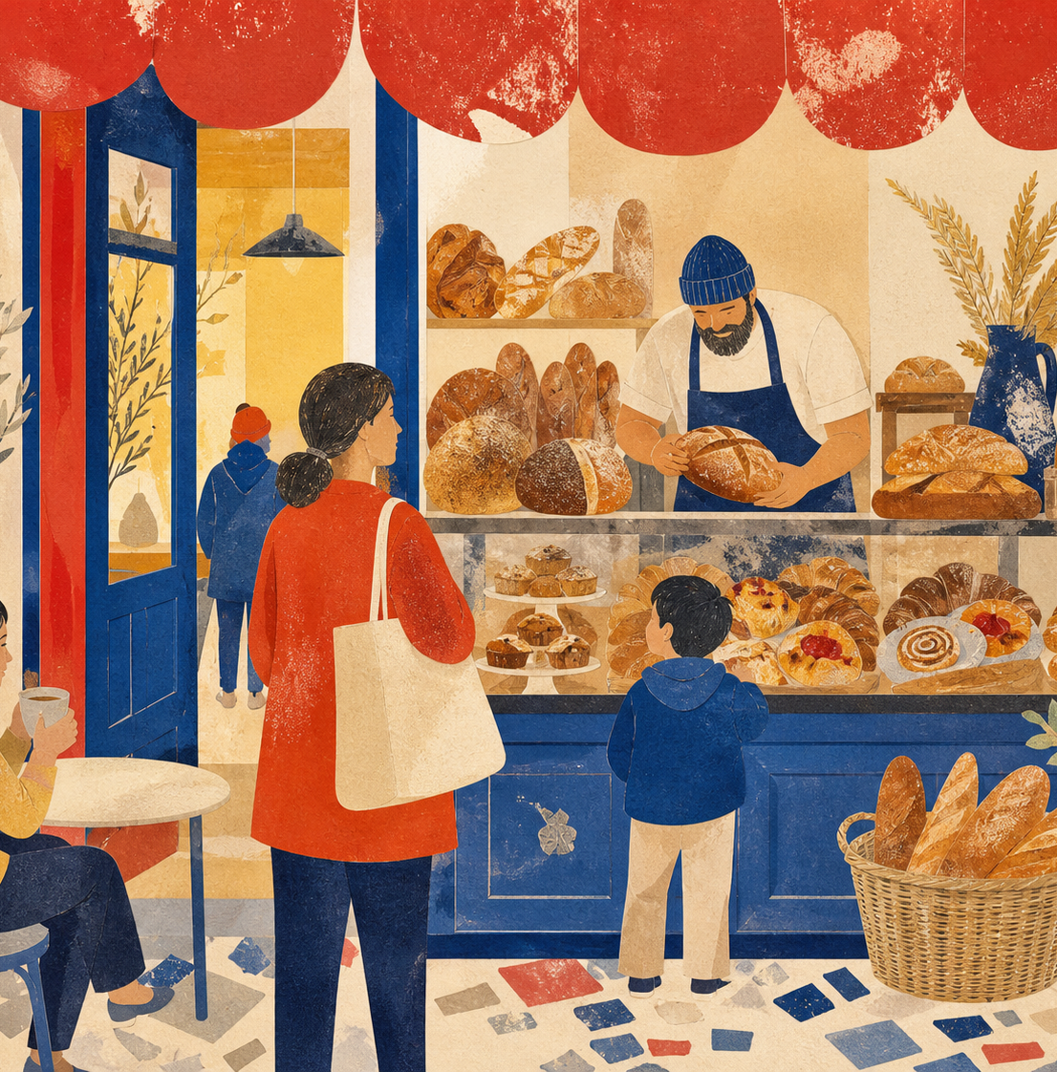
THE STORE
IS A SIGNAL.
Color at the threshold.
Warm light at eye level.
The first tray visible from the street.
ORBITAL BAKERY / 06 / 10
WARM BAKES. BRIGHT DAYS.
Notes:
[Sources]
- User-provided Manor source deck: Source deck: ORBITAL BAKERY — Brand Launch Playbook (Manor AI)..
- Storefront illustration reused from the source deck.

Slide 7
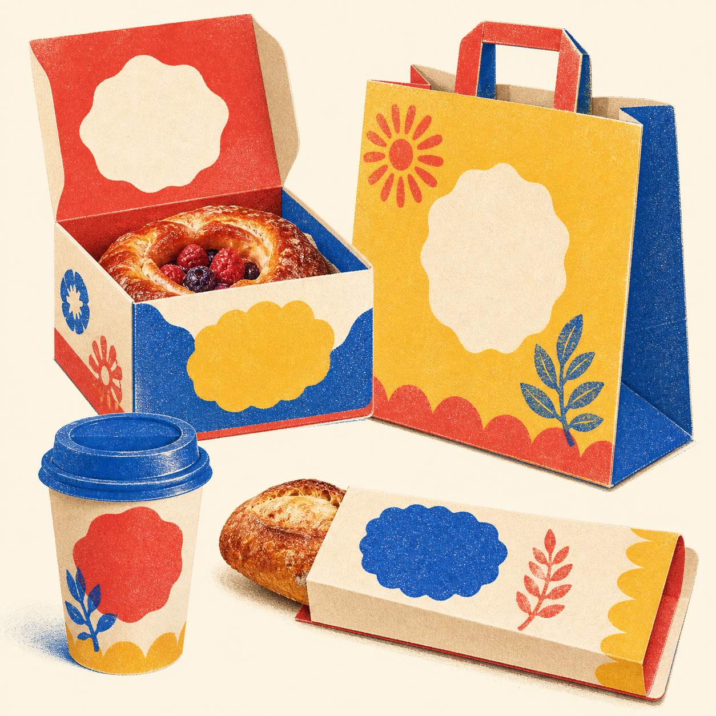
PACKAGING
SHOULD KEEP
THE PARTY GOING.
One-color stamps
Color-coded bands
Handwritten bake time
QR story on the underside
ORBITAL BAKERY / 07 / 10
WARM BAKES. BRIGHT DAYS.
Notes:
[Sources]
- User-provided Manor source deck: Source deck: ORBITAL BAKERY — Brand Launch Playbook (Manor AI)..
- Packaging image reused from the source deck.

Slide 8
SOCIAL, BUT
NOT SMOOTH.
MON
OVEN CAM
WED
BAKER NOTE
SAT
SOLD OUT
Grain, shadow, handwriting, real trays.
ORBITAL BAKERY / 08 / 10
WARM BAKES. BRIGHT DAYS.
Notes:
[Sources]
- User-provided Manor source deck: Source deck: ORBITAL BAKERY — Brand Launch Playbook (Manor AI)..

Slide 9
TWELVE DAYS TO OPEN.
−12
−8
−4
−1
00
TEASE
TASTE
TOUR
PREVIEW
OPEN
Each beat gives the neighborhood one new reason to care.
ORBITAL BAKERY / 09 / 10
WARM BAKES. BRIGHT DAYS.
Notes:
[Sources]
- User-provided Manor source deck: Source deck: ORBITAL BAKERY — Brand Launch Playbook (Manor AI)..

Slide 10
10
WARM
BAKES.
BRIGHT
DAYS.
OPEN THE DOOR
WHILE IT'S WARM.
ORBITAL BAKERY / FICTIONAL LAUNCH PLAYBOOK
Notes:
[Sources]
- User-provided Manor source deck: Source deck: ORBITAL BAKERY — Brand Launch Playbook (Manor AI)..

