Slide 1
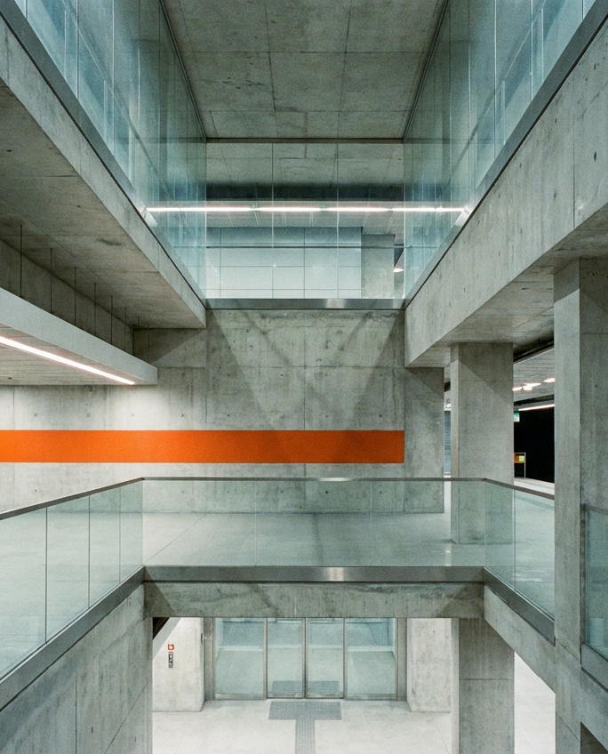
Line 47 · Wayfinding
01 / 08
Transit design · 2026
Line 47 wayfinding
One system for signs, maps and announcements across 18 stations
Proposal to the City Transit Board
Line 47 · Wayfinding
Notes:
Sample deck.

Slide 2
Line 47 · Wayfinding
02 / 08
Riders get lost today
Survey of 2,400 riders across Line 47, spring 2026.
38%
4 min
11
miss a transfer
lost per wrong turn
sign styles in use
Line 47 · Wayfinding
Notes:
Sample deck.

Slide 3
Line 47 · Wayfinding
03 / 08
Four rules fix the journey
01
02
03
04
Number first
Grid first
Access first
Language first
The line number leads every sign
One 12-column panel system
Step-free routes on every map
Two languages, one hierarchy
Line 47 · Wayfinding
Notes:
Sample deck.

Slide 4
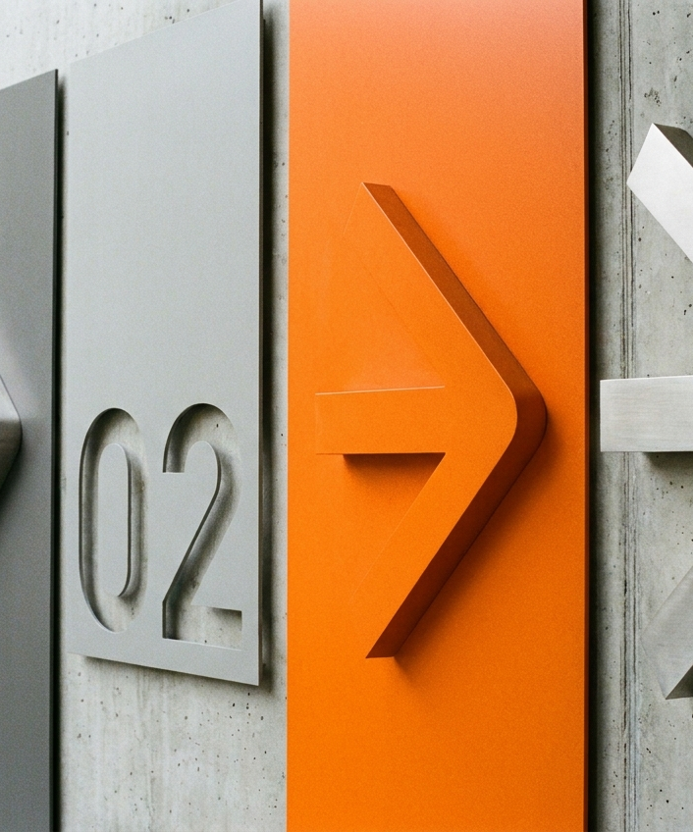
Line 47 · Wayfinding
04 / 08
Signs read in two seconds
Numerals 3x the size of station names
Arrows always on the travel side
Orange only for transfers
Notes:
Sample deck.

Slide 5
Line 47 · Wayfinding
05 / 08
From platform to street
1
2
3
4
Arrive
Orient
Transfer
Exit
Car number and exit board
Map at every stair foot
Orange path to the next line
Street names and landmarks
Line 47 · Wayfinding
Notes:
Sample deck.

Slide 6
Line 47 · Wayfinding
06 / 08
Rollout by phase
Phase | Stations | Signs | Cost
1 · Core | 6 | 420 | $1.2M
2 · Transfers | 5 | 310 | $0.9M
3 · Branch | 7 | 280 | $0.7M
Line 47 · Wayfinding
Notes:
Sample deck.

Slide 7
Line 47 · Wayfinding
07 / 08
Live in 12 months
Q1
Q2
Q3
Q4
Design freeze
Phase 1 install
Phase 2 install
Full line live
Line 47 · Wayfinding
Notes:
Sample deck.

Slide 8
Line 47 · Wayfinding
08 / 08
Approve phase one
$1.2M for six core stations
Rider survey again at month 6
Board review in Q3
Line 47 · Wayfinding
Notes:
Sample deck.

