Slide 1
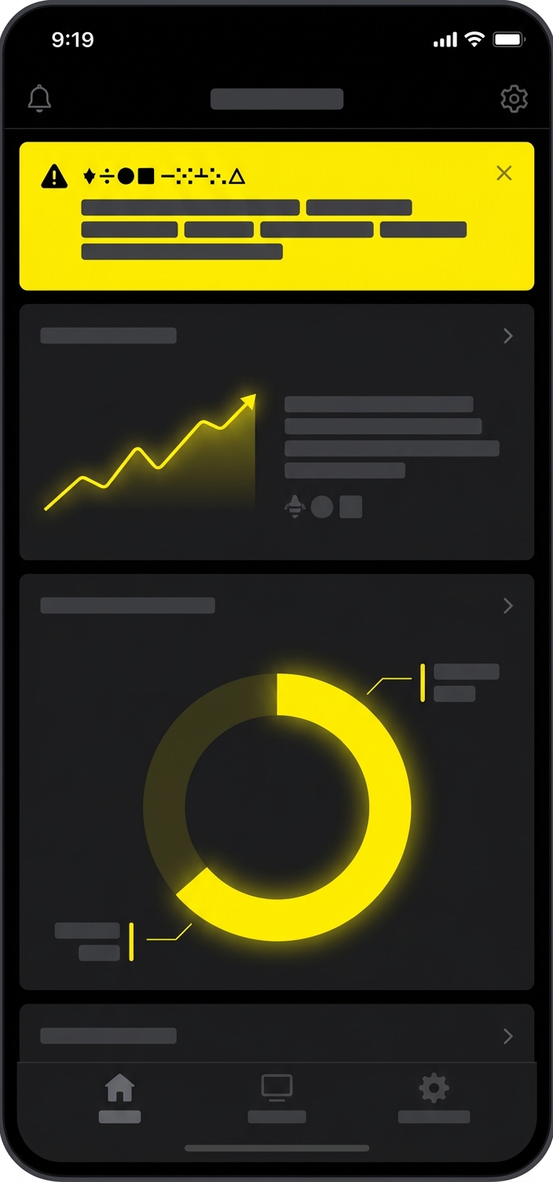
Null Signal · Field manual
01 / 08
Field manual · v3
Incident field manual
What to do in the first hour of a security incident
Security operations · internal
Notes:
Sample deck.

Slide 2
Null Signal · Field manual
02 / 08
The first hour decides
6
72 h
1 h
to contain
to notify
roles on call
Notes:
Sample deck.

Slide 3
Null Signal · Field manual
03 / 08
Five steps, in order
1
2
3
4
5
Detect
Triage
Contain
Eradicate
Recover
Confirm the alert
Set severity
Isolate systems
Remove the cause
Restore and watch
Notes:
Sample deck.

Slide 4
Null Signal · Field manual
04 / 08
Severity at a glance
Level | Signal | Response | Owner
SEV-1 | Data leaving | All hands, 15 min | CISO
SEV-2 | Account takeover | On-call, 30 min | IR lead
SEV-3 | Malware on host | Next business hour | SOC
SEV-4 | Policy breach | Ticket | Team lead
Notes:
Sample deck.

Slide 5
Null Signal · Field manual
05 / 08
Six roles on every call
Incident lead
Comms
Forensics
Owns decisions
One voice out
Keeps evidence
Legal
Engineering
Scribe
Notifications
Fixes systems
Timeline log
Notes:
Sample deck.

Slide 6
Null Signal · Field manual
06 / 08
Every incident feeds the next
01
01
Detect
02
Respond
04
02
03
Review
04
Harden
03
Notes:
Sample deck.

Slide 7
Null Signal · Field manual
07 / 08
Golden rule
Preserve evidence before you contain
Snapshot disks and logs first; a clean wipe destroys the story.
Notes:
Sample deck.

Slide 8
Null Signal · Field manual
08 / 08
Call the lead first
Page the on-call incident lead
Open #incident-room
Start the timeline log
On-call rota · security operations
Notes:
Sample deck.

