Slide 1
Version Control System
Git

Slide 2
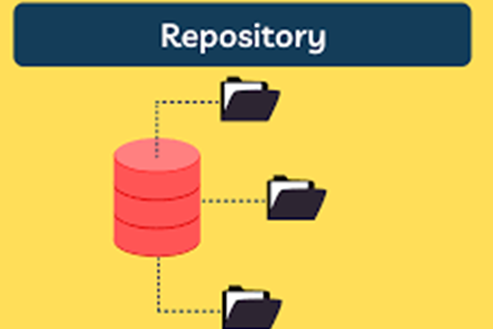
Repo or Repository
A repository is like a digital folder where you store and manage your project's files, documents, and code.

Slide 3
Public vs Private Repo
Feature | Public Repository | Private Repository
Access | Open to the public, anyone can access | Restricted access, only authorized users
Visibility | Visible to anyone on the internet | Not visible to the general public
Collaboration | Open to contributions from anyone | Limited to authorized team members
Security | Less control over who contributes | More control over contributors
Confidentiality | Code and development process open | Code and development process restricted
Usage | Ideal for open-source projects | Suitable for proprietary or sensitive projects
Contributions | Anyone can submit pull requests | Pull requests limited to authorized users
Visibility of Issues and Discussions | Open to the public | Limited to authorized users

Slide 4
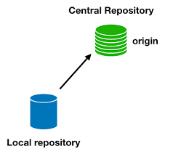
Local vs Remote Repo
Aspect | Local Repository | Remote Repository
Location | On your local machine's file system | Hosted on a remote server (e.g., GitHub, GitLab)
Access | Accessible only by the local user | Accessible by authorized users from various locations
Primary Usage | Individual development and experimentation | Collaboration, sharing, and centralized code management
Collaboration | Doesn't directly facilitate collaboration | Facilitates collaborative development through pull requests, code reviews, and issue tracking
Backup | Acts as a working copy and backup | Acts as a secure and centralized backup
Version Control | Tracks changes, commit history, and versioning | Tracks changes, commit history, and versioning
Isolation | Isolated from network issues | Prone to network issues, requires an internet connection
Initial Setup | Created using git init command | Created by creating a repository on a remote platform and cloning it locally

Slide 5
VERSION CONTROL SYSTEM
A Version Control System (VCS) is a software tool that helps developers track and manage changes to their code and collaborate on projects.
It enables multiple individuals to work on the same codebase simultaneously while keeping track of all modifications, allowing for easy identification of changes, reverting to previous versions, and merging changes from different sources.

Slide 6
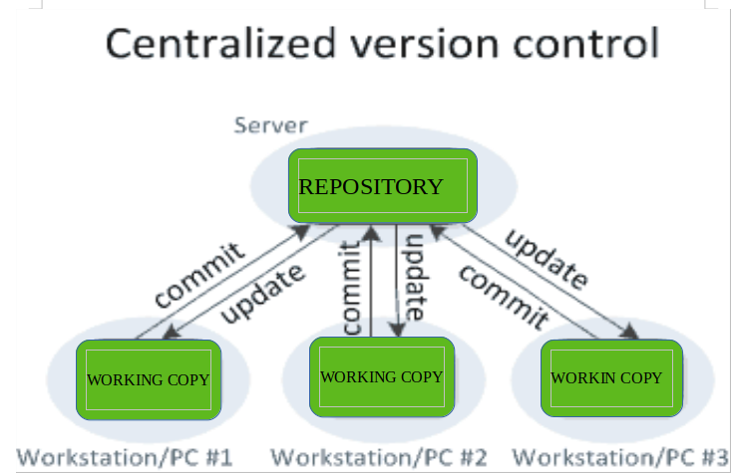
Centralized VERSION CONTROL SYSTEM

Slide 7
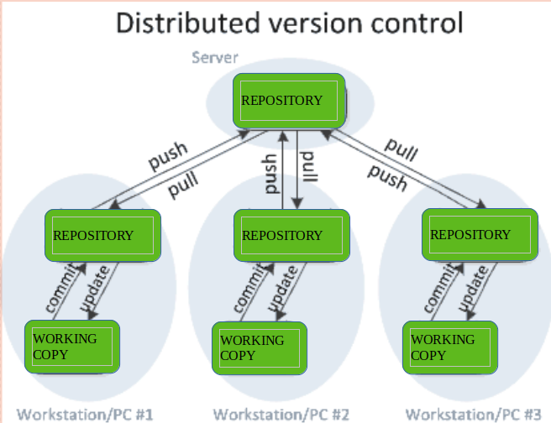
Distributed VERSION CONTROL SYSTEM

Slide 8
TYPES VERSION CONTROL SYSTEM
Aspect | Centralized VCS (CVCS) | Distributed VCS (DVCS)
Central Repository | Central server holds the codebase | Every developer has a complete copy of the repository
Developer's Copy | Developers work with checked-out files from the central repository | Developers have their own local copies of the entire repository
Collaboration | Changes are made directly to the central repository | Developers work independently on their local repositories and can exchange changes later
Synchronization | Developers need to synchronize frequently with the central repository | Developers synchronize their local repositories with each other
Branching and Merging | Branching and merging can be more challenging due to centralization | Branching and merging are more flexible and streamlined
Offline Work | Requires a network connection for most operations | Developers can work offline and sync changes later
Speed | Slower for tasks involving server communication | Faster for most tasks due to local operations
Redundancy | Single point of failure (central server) | No single point of failure; each local repository acts as a backup
Complexity | Generally simpler setup and operations | Can have a steeper learning curve, especially for more complex workflows
Examples | CVS, SVN | Git, Mercurial

Slide 9
Git vs Github
Aspect | Git | GitHub
Definition | Distributed version control system | Web-based platform for Git repositories
Purpose | Managing source code versions and history | Hosting, collaboration, and more for Git
Command-Line Tool | Yes | No
Graphical Interface | No | Yes
Local Repository | Yes | No (Provides remote hosting)
Remote Hosting | No | Yes
Collaboration | Basic (Sharing repositories manually) | Extensive (Pull requests, issues, etc.)
Issue Tracking | No | Yes
Pull Requests | No | Yes
Code Review | Manual (Outside of Git) | Integrated with pull requests
Access Control | Limited (File system permissions) | Yes (Fine-grained repository permissions)
Public/Private Repos | Yes (Based on local repository configuration) | Yes (Public and private repository options)

Slide 10

Install Git
Visit the official Git website: https://git-scm.com/downloads
The website will automatically detect your operating system. Click the "Download" button to download the installer.
Run the downloaded installer executable.
Follow the installation wizard's prompts.
Choose the default options unless you have specific preferences.
Verifying Installation:
git --version

Slide 11
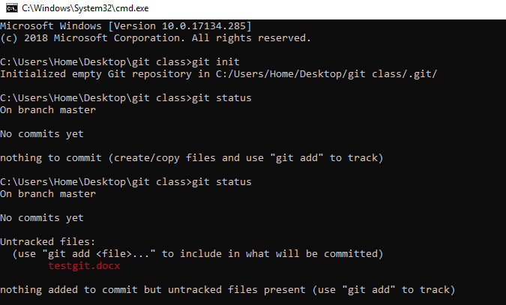
Basic Commands
git init
git status
Now create a file in the folder and execute above command , u can find untracked

Slide 12
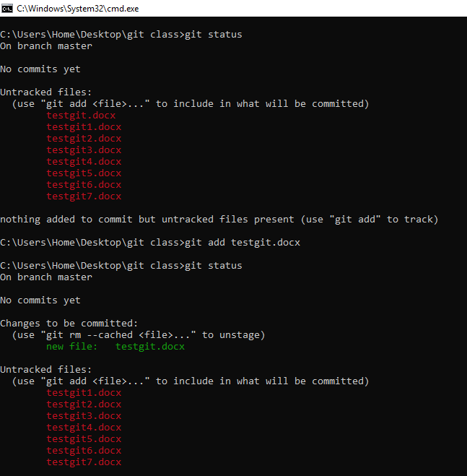
Contd..
git add <file name>
git status

Slide 13
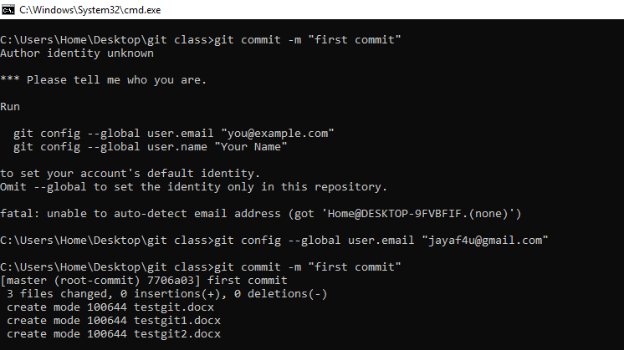
git config --global user.email "you@example.com"
git commit -m "comments"

Slide 14
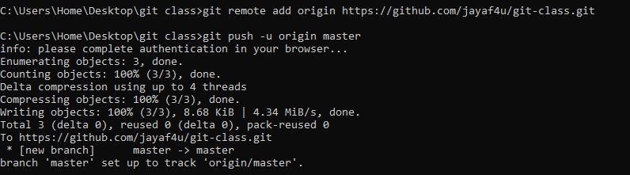
Create a repository(ex: git-class) in the github & execute the commands
git remote add origin https://github.com/jayaf4u/git-class.git
git push -u origin master

Slide 15
Git flow
 | Working Directory | Staging Area | Local Repo | Remote Repo
Process | After creating a file in the folder execute the command you may find untracked files | after creating multiple files in the folder excute the command to add one by one file | connect with github and commit the message with comments using commands | create a repo with name git-class and follow the commands
Commands | git status | git add <file name> | git config --global user.email "you@example.com" | git remote add origin https://github.com/jayaf4u/git-class.git
 |  | git status | git commit -m "comments" | git push -u origin master

Slide 16
Live Environment
Remote to local Repo
git fetch
Identify changes b/w remote and Local Repo
git Pulll
Download the changes done at Remote Repo

Slide 17
Live Environment
local to Remote Repo
git add .
git commit –m “end cmt”
git branch -M main
git push -u origin main

Slide 18
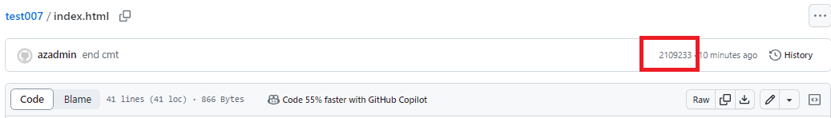
Identifier

