Slide 1
COLLEGE MANAGEMENT SYSTEM
BY TEAM 14
Manorath Bajaj
Aashay Tiwari
Kanika Makhija
Riteeka Ratnakar

Slide 2
DATABASE PURPOSE

Slide 3
The purpose of this database is to maintain the data used to generate and support College Management System.
It allows the College Management to maintain students.
The students will be allowed to take courses based on the maximum credits per semester.
The courses will be assigned to the respective professors.
The course will then be allocated to the specific classrooms.

Slide 4
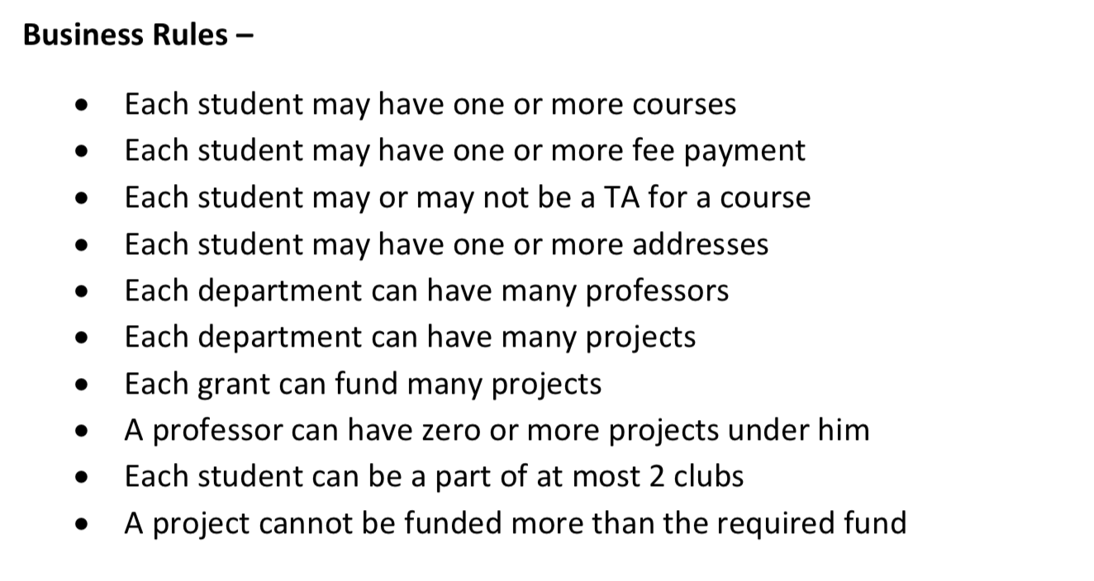

Slide 5
DESIGN HIGHLIGHT

Slide 6
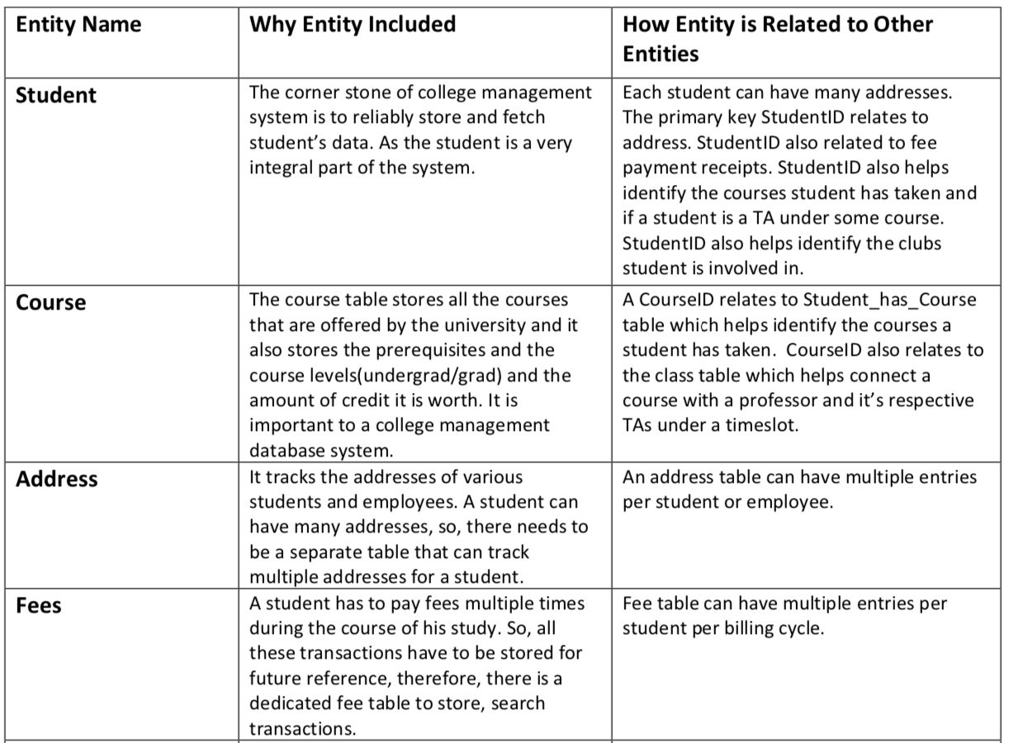

Slide 7
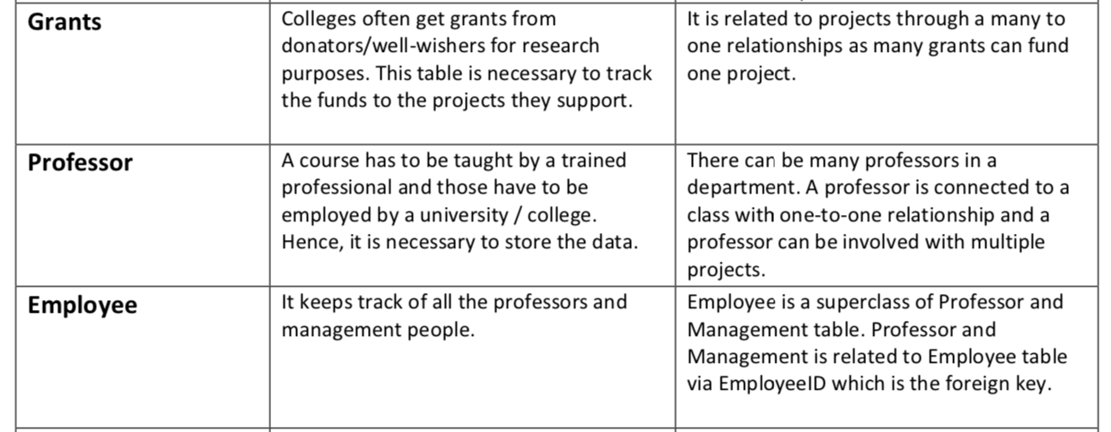

Slide 8
ER DIAGRAM

Slide 9
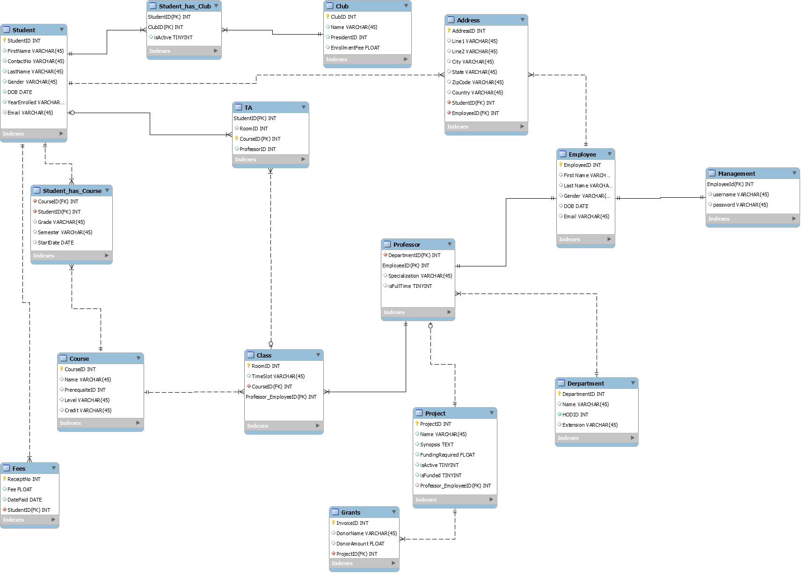

Slide 10
DDL STATEMENTS

Slide 11
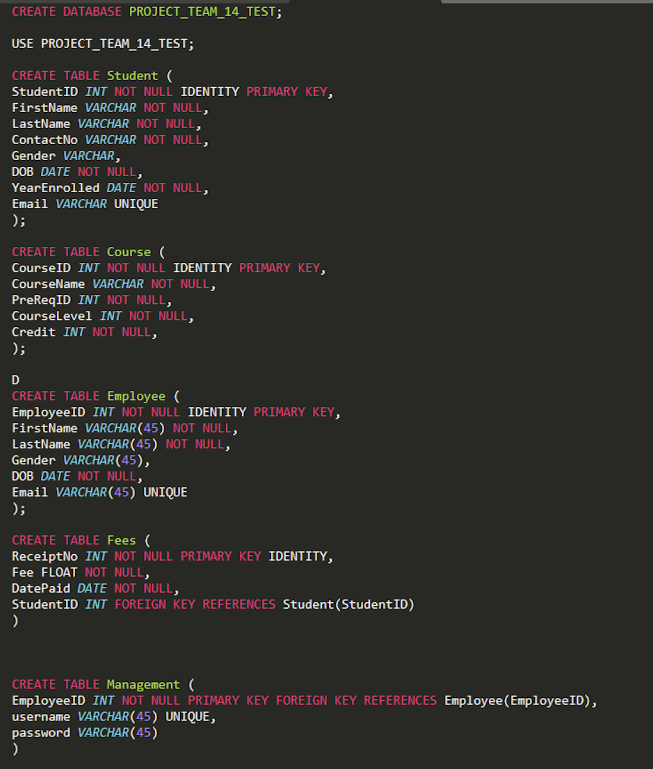
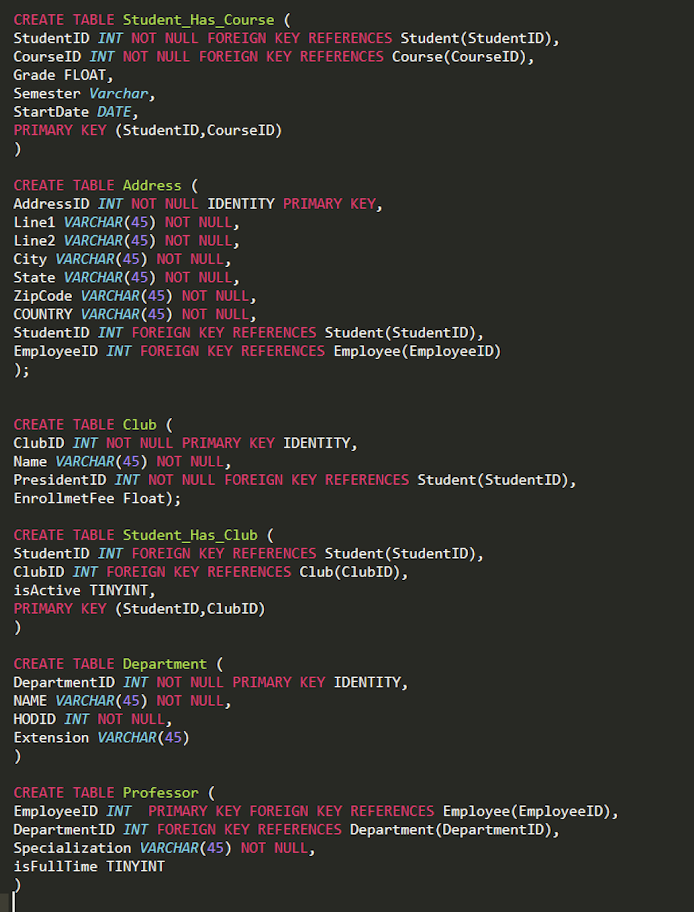

Slide 12
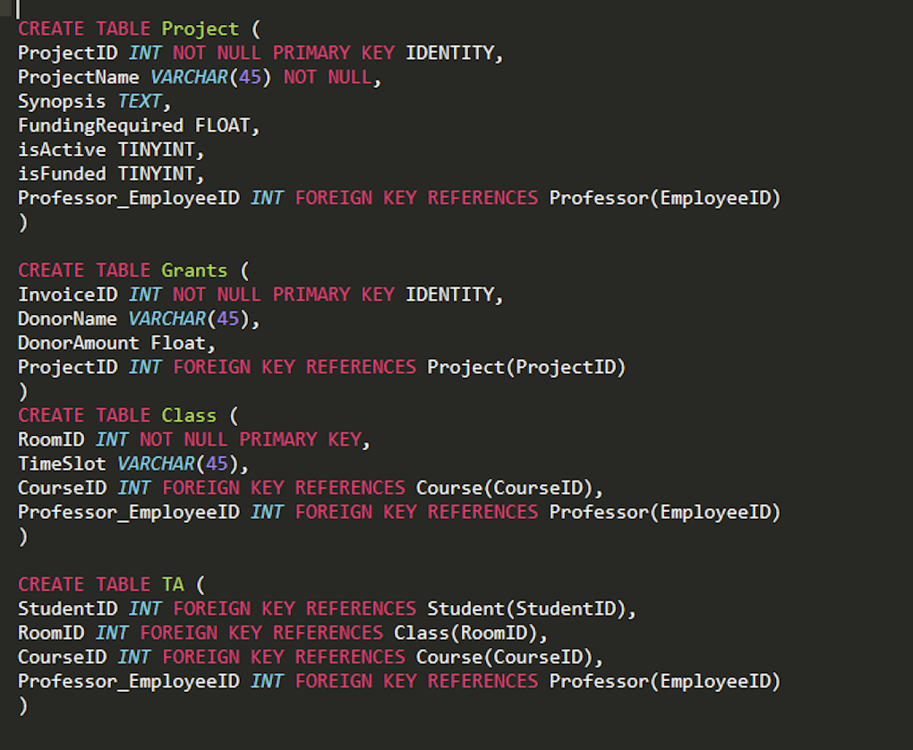

Slide 13
CONSTRAINTS AND ENCRYPTIONS

Slide 14
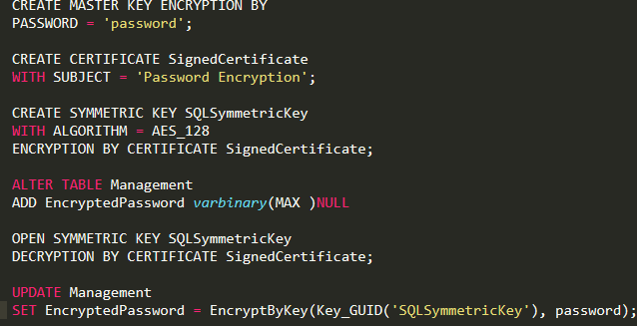
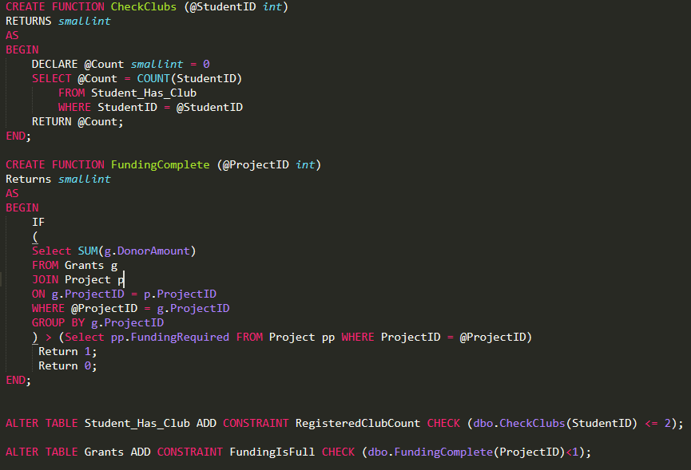

Slide 15
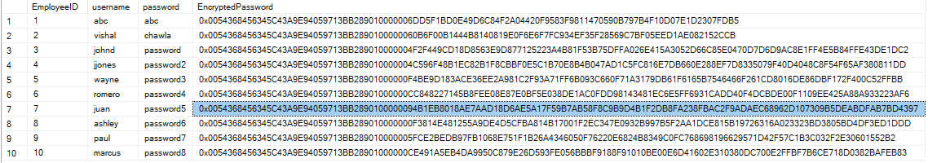

Slide 16
TRIGGERS

Slide 17
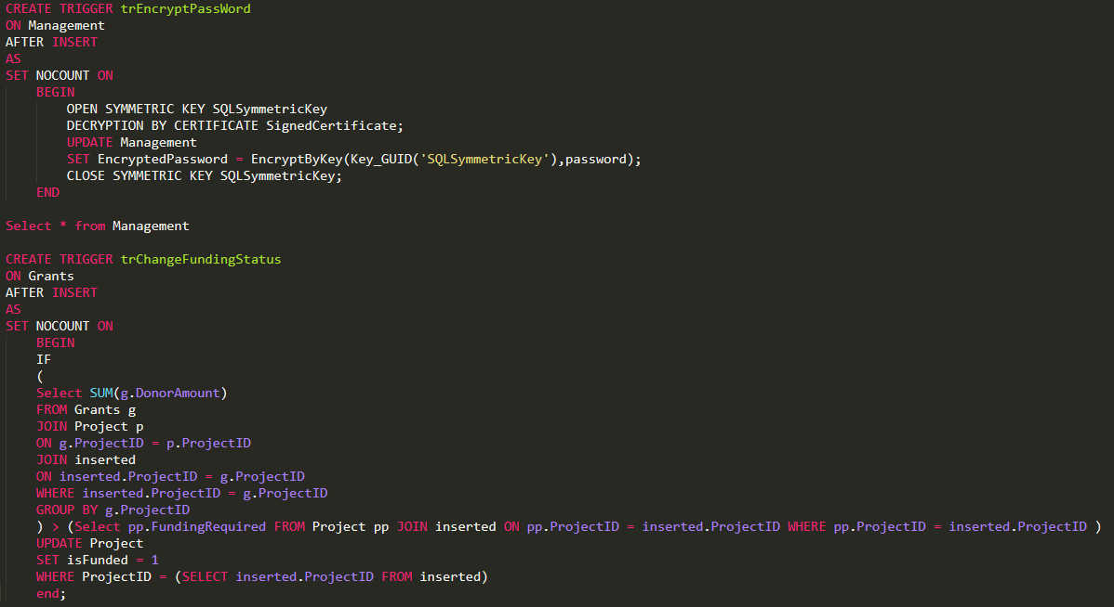
TRIGGERS

Slide 18
VIEWS, REPORTS AND VISUALIZATIONS

Slide 19
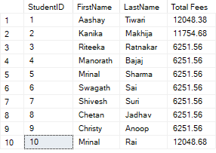
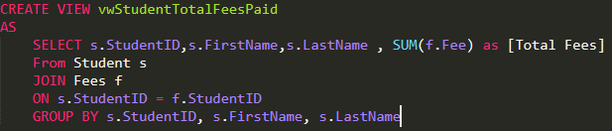
TOTAL FEES PAID BY STUDENT

Slide 20
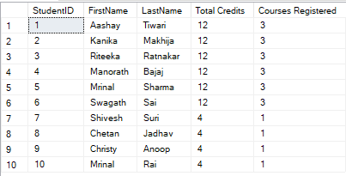
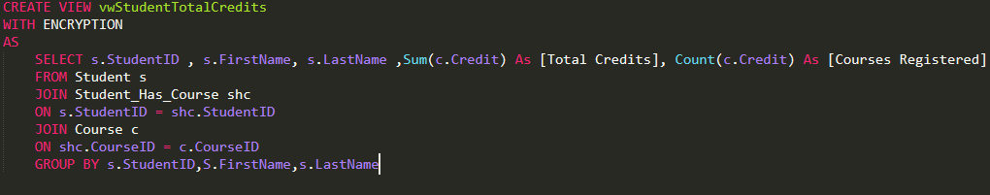
TOTAL CREDITS ENROLLED PER STUDENT

Slide 21

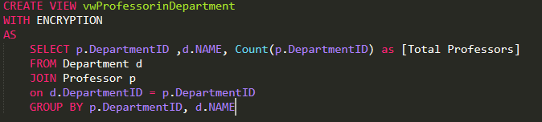
NUMBER OF PROFESSORS PER DEPARTMENT

Slide 22
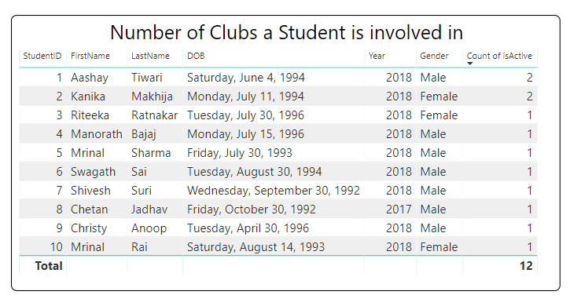
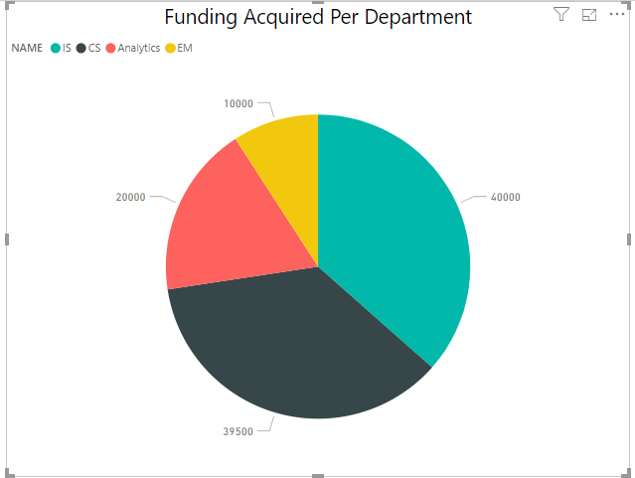
POWER BI REPORTS

Slide 23
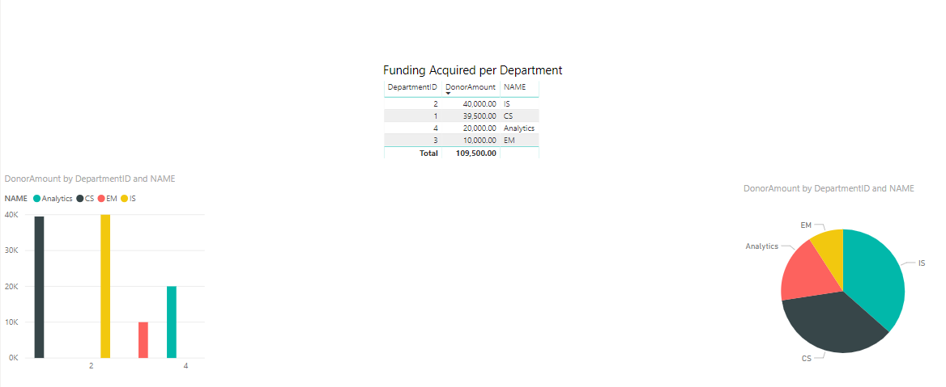

Slide 24
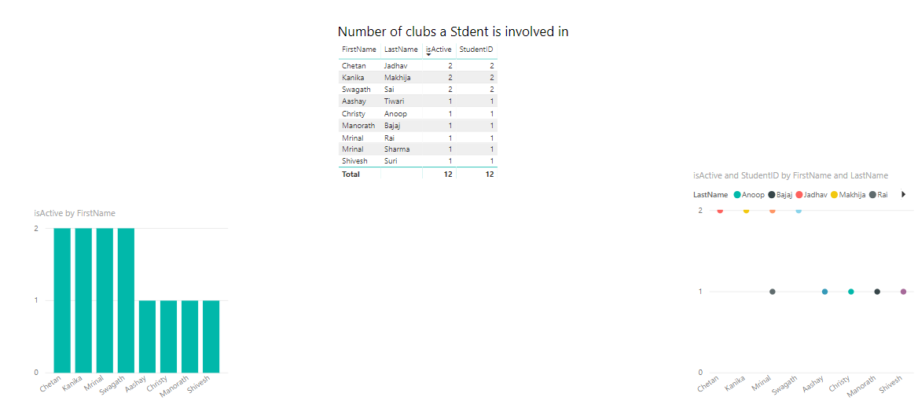

Slide 25
THANK YOU

