Slide 1
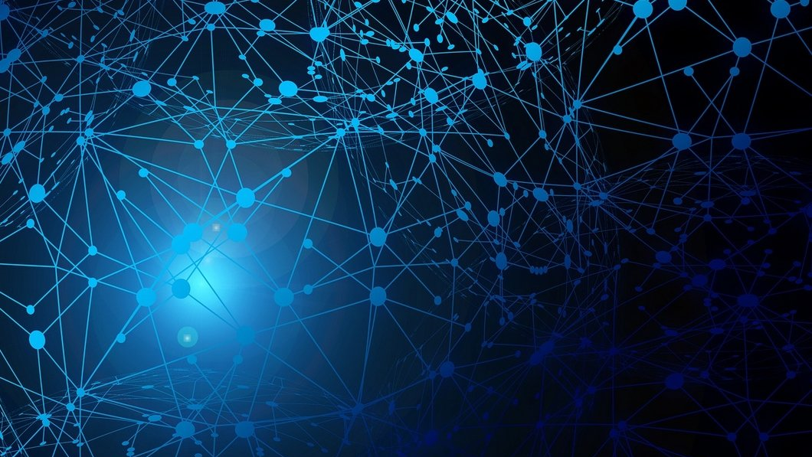
MetaCovid
Emmanouil KOUTOULAKIS​
Emmanouil Markodimitrakis​
Yağmur çiğdem aktaş​

Slide 2

Introduction
Problem Formulation
Motivation & Challenges

Slide 3
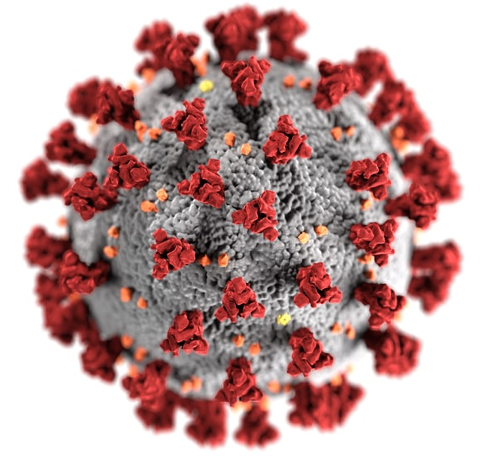
Problem Formulation
Recent identification approaches of coronavirus infection produces high false negative cases
Covid diagnosis is a time-consuming and not affordable
Rapid diagnosis plays a critical roll to reduce the spread of the virus
Notes:
Recent identification of coronavirus inferxction such as PCR (polymerase chain reaction) produces high false negative results
Also it is time consuming and is not affordable for many countries

Slide 4
Motivation & Challenges
Computer Aided Diagnosis systems for processing the Computed Tomography scans
SOTA Deep Learning (DL) methods
DL techniques need a huge amount of data
There is a lack of public datasets
Few-Shot learning with a limited sample size
Notes:
Our motivation to implement this method was simply because the deep learning techniques in medical applications is gained popularity.
There are plenty deep learning based methods that shown beneficial results in medical field
Although it cannot be denied that to train a deep learning model there is a need of a huge ammount of data. Unfortunately, there are not many available public datasets to handle the nessecity of dat.
Many recent approaches, such as n-shot learning have tried to alleviate the lack of public datasets.
More specifically, we used siamese neural network, by separating some samples from each class in order to train our model.

Slide 5
Related Work
Other recent methods

Slide 6
Research SOTA Meta-Learning Papers
We ordered the outputs of databases according to the citation score and the publication date
We selected the most recent approaches about Meta Learning in the following citation databases
Search criteria: “Meta learning” AND “Covid” AND “Diagnosis”
Literature Data-bases | Search Results
Science Direct | 4
Google Scholar | 358
PubMed | 3
Sum | 365

Slide 7
Related work
Publication | Title
[1] Zongwei et al. | UNet++: A Nested U-Net Architecture for Medical Image Segmentation
[2] Xiaowei et al. | A Deep Learning System to Screen Novel Coronavirus Disease 2019 pneumonia
[3] Wang et al. | A deep learning algorithm using CT images to screen coronavirus disease
Notes:
In this table there is the related works about the Covid19 diagnosis
The first approach uses Unet++ architecture using more than 40.000 images from 106 patiens for model training
The second approach implemented a deep learning model to screen Covid disease from viral pneumonia and normal cases with pulmonary CT scans. They used private dataset from the hospitals in China
Wang et al. proposed a robust diagnostic model based on DNN which works based on graphical features generated from CT. For this purpose, they used a fine-tuned Inception pre-trained model.

Slide 8
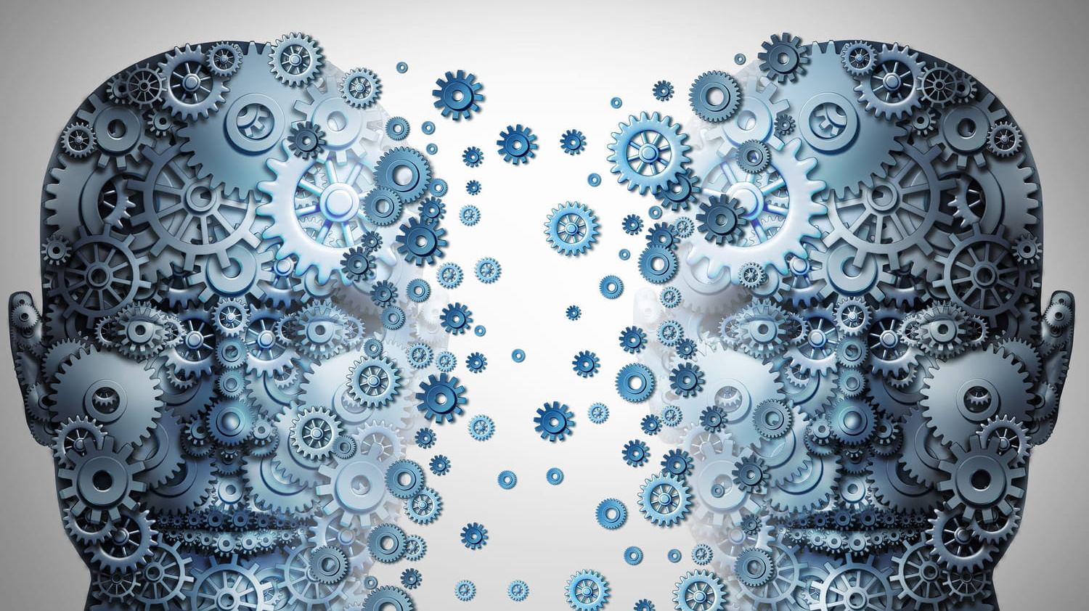
Implementation of MetaCovid
Dataset
Transfer learning – VGG16
Siamese Neural Network
Experiments - Results

Slide 9
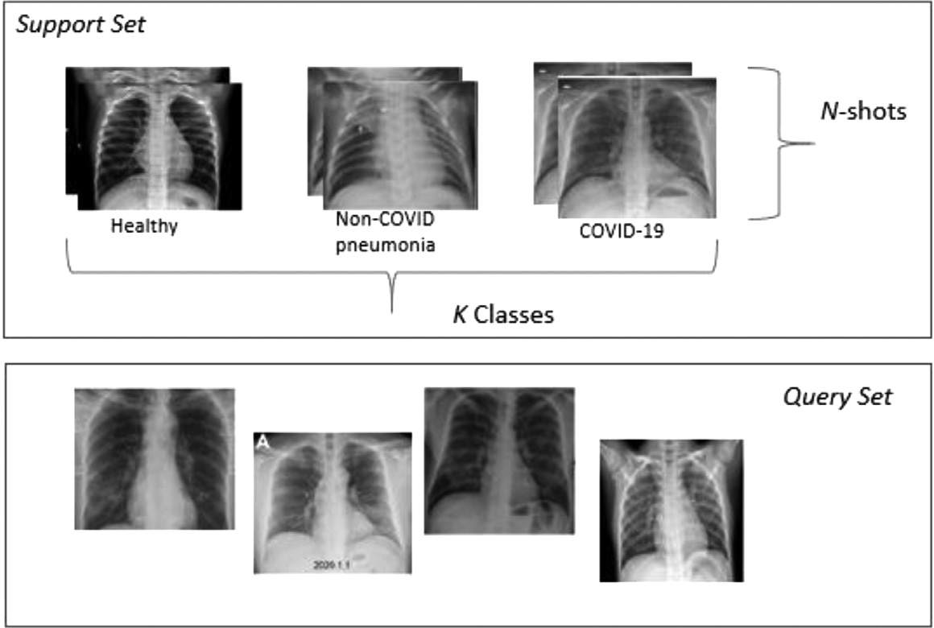
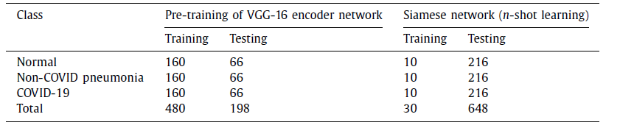
Dataset
CXR (chest x-ray) images from open source database created by Dr. Joseph Cohen which includes COVID-19 examples and a Kaggle repository of CXR images of pneumonia and healthy patients
Classes:
Healthy
Non-Covid Phenomenia
COVID images
Source: https://github.com/ieee8023/covid-chestxray-dataset

Slide 10
Pre-processing
Re-scale all images to a size of 100x100 pixels
Intensity normalization
Image pixel value from [0, 255] to [0, 1] using min-max normalization technique
Notes:
In the first step we rescale the images to get a consistent image dimension for the entire dataset
Then, we perform intensity normalization to expedite model convergence by eliminating feature viases and attaining a uniform distribution for the dataset
Lastly, we convert the pixel values from 0, 255 to 0,1 to obtain a standard normal distribution. For this step we used min-max normalization technique.

Slide 11
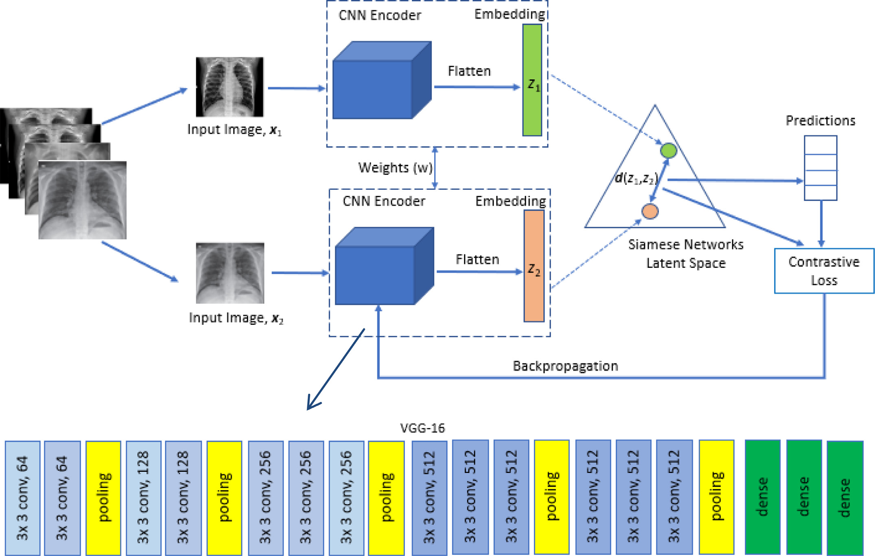
Architecture of MetaCovid
Two identical parallel VGG-16 networks
Sharing the same weights and architecture
Different input images
Combine the output to make the final prediction
Learn a function to produce the similarity output between these two images​
Notes:
A convolutional neural network is used to extract the features from two images and ﬁnds the similarity by computing the distance between features of these two images.

Slide 12

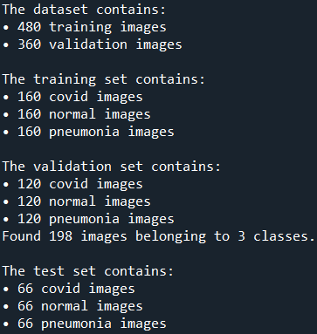
VGG16 – Transfer Learning
Keras vgg16 model without top layers
The same number of images for VGG training with the paper
Adam Optimizer with learning rate = 0.0001, early stop mechanism

Slide 13
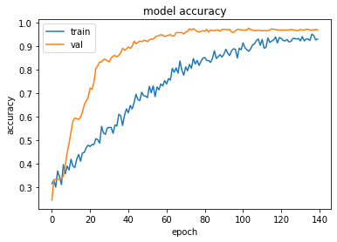
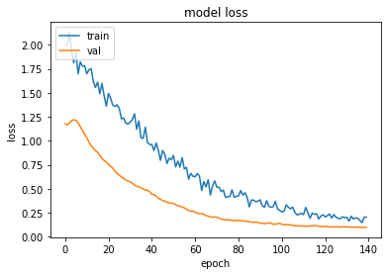

VGG16 – Model accuracy

Slide 14
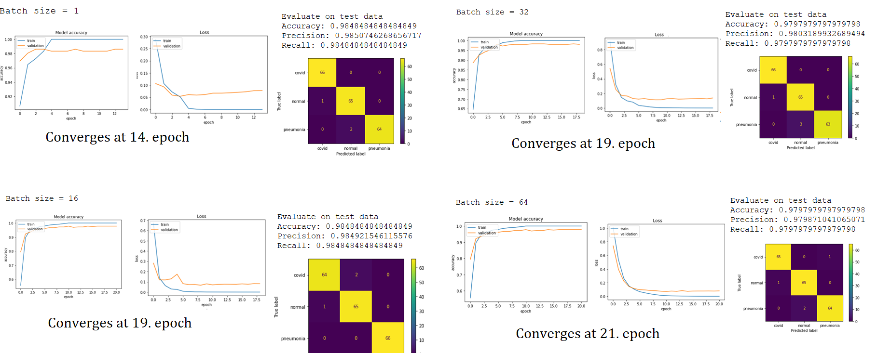
Experiments – VGG Batch Size

Slide 15
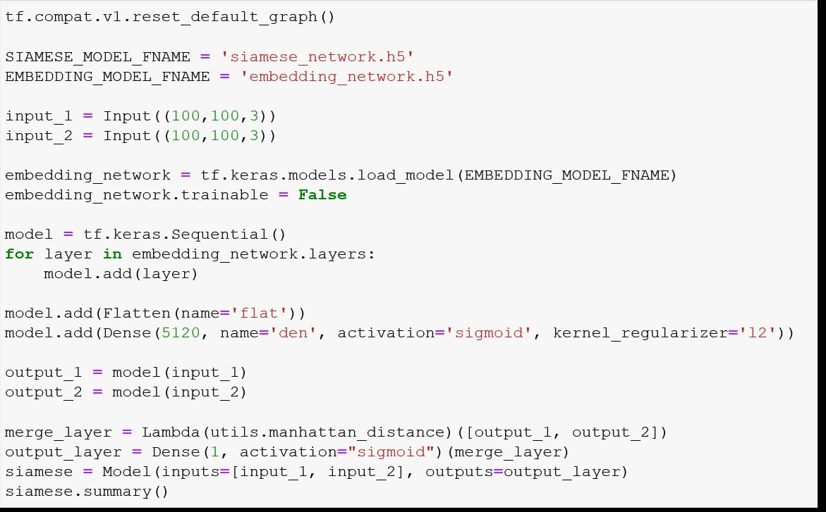
Siamese Training [1/3]

Slide 16
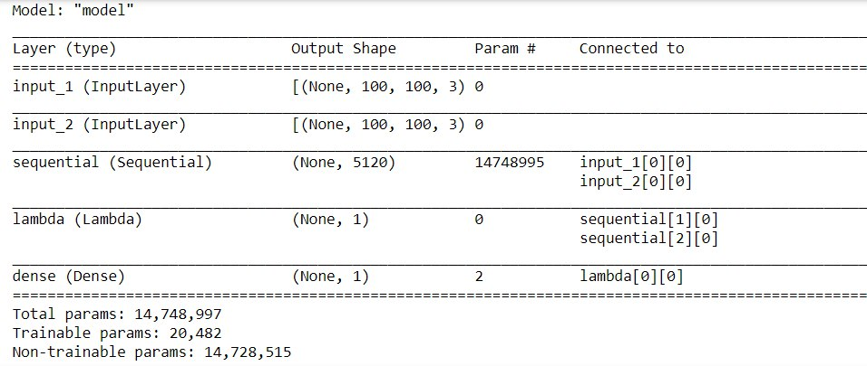
Siamese Training [2/3]

Slide 17
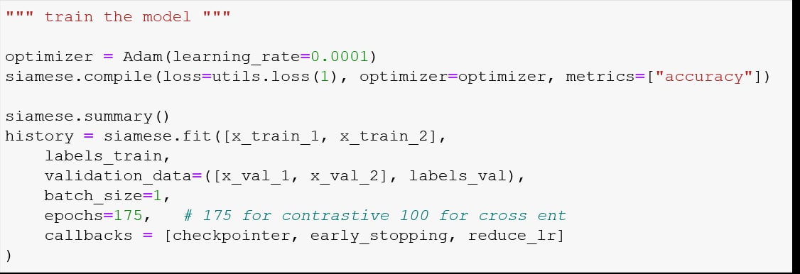
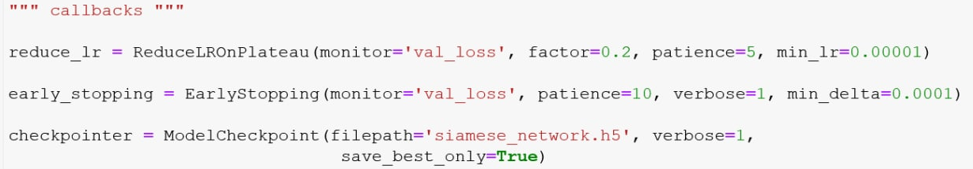
Siamese Training [3/3]

Slide 18
Results (1/3) – Contrastive Loss vs Binary Cross Entropy
Model | Accuracy | Precision | Recall | Specificity | F1-score | AUC
3-way, 7-shot | 0.951 | 0.955 | 0.951 | 1.0 | 0.950 | 0.951
3-way, 8-shot | 0.864 | 0.893 | 0.864 | 1.0 | 0.861 | 0.864
3-way, 9-shot | 0.883 | 0.904 | 0.883 | 0.998 | 0.881 | 0.883
3-way, 10-shot | 0.907 | 0.921 | 0.907 | 1.0 | 0.906 | 0.907
Contrastive
Model | Accuracy | Precision | Recall | Specificity | F1-score | AUC
3-way, 7-shot | 0.906 | 0.921 | 0.906 | 1.0 | 0.905 | 0.906
3-way, 8-shot | 0.915 | 0.927 | 0.915 | 1.0 | 0.915 | 0.915
3-way, 9-shot | 0.826 | 0.871 | 0.826 | 1.0 | 0.821 | 0.826
3-way, 10-shot | 0.916 | 0.928 | 0.916 | 1.0 | 0.915 | 0.916
Binary Cross Entropy
Notes:
Here we can notice that in all tests the specificity is one apart from one experiment. This value can ensure us that the negative test pairs are actually negative.

Slide 19
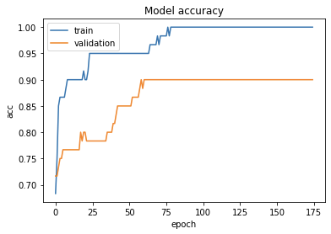
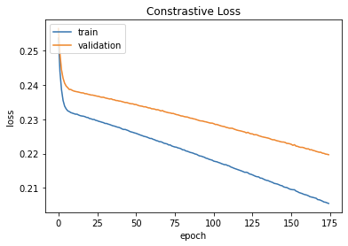
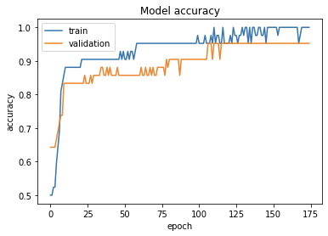
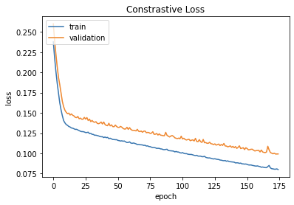
Results (2/3) – Euclidean vs Manhattan Distance
Model | Accuracy | Precision | Recall | Specificity | F1-score | AUC
3-way, 10-shot (Euclidean) | 0.969 | 0.971 | 0.970 | 0.997 | 0.969 | 0.969
3-way, 7-shot (Manhattan) | 0.951 | 0.955 | 0.951 | 1.0 | 0.950 | 0.951
Notes:
The plots are train and validation accuracy …. The table is about the test stats

Slide 20
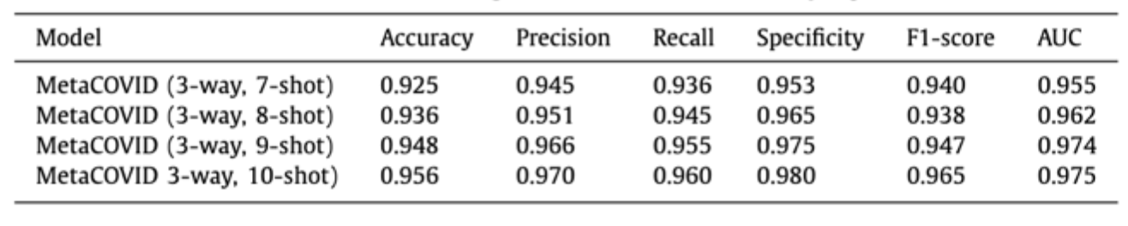
Results (3/3) – Comparison using Contrastive loss
Model | Accuracy | Precision | Recall | Specificity | F1-score | AUC
3-way, 7-shot | 0.951 | 0.955 | 0.951 | 1.0 | 0.950 | 0.951
3-way, 8-shot | 0.864 | 0.893 | 0.864 | 1.0 | 0.861 | 0.864
3-way, 9-shot | 0.883 | 0.904 | 0.883 | 0.998 | 0.881 | 0.883
3-way, 10-shot | 0.907 | 0.921 | 0.907 | 1.0 | 0.906 | 0.907
Notes:
The model training and validation with contrastive loss function appears to be more stable and further shows better convergence even though with longer training epochs

Slide 21
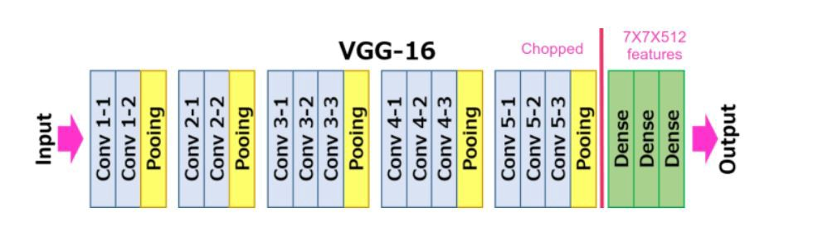
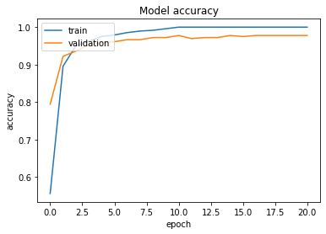
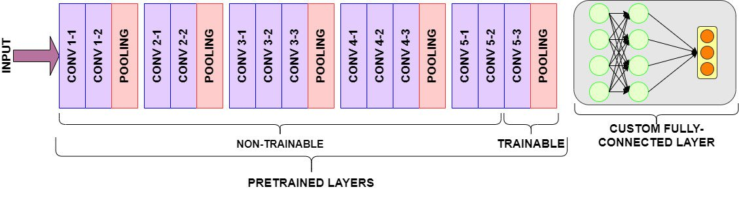
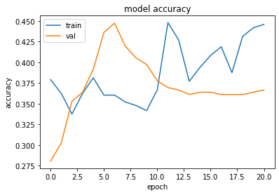
Additional Notes to Share
Custom Layers 2. Console restart
3. Step decay Learning rate destroys the pretrained weights

Slide 22
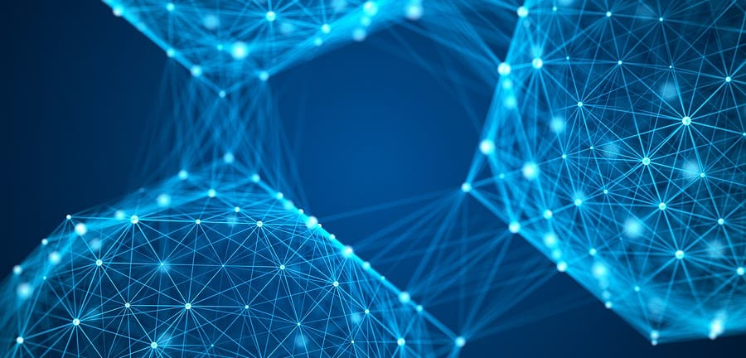
Conclusion
The architecture is constructed successfully
The results of the model are not stable
It may depend on the image selection and the dataset size

Slide 23
Thank you!
https://github.com/manos-mark/metacovid-siamese-neural-network

Slide 24
Resources
Shorfuzzaman, M., & Hossain, M. S. (2021). MetaCOVID: A Siamese neural network framework with contrastive loss for n-shot diagnosis of COVID-19 patients. Pattern Recognition, 113, 107700. https://doi.org/10.1016/J.PATCOG.2020.107700
Xu, X., Jiang, X., Ma, C., Du, P., Li, X., Lv, S., Yu, L., Ni, Q., Chen, Y., Su, J., Lang, G., Li, Y., Zhao, H., Liu, J., Xu, K., Ruan, L., Sheng, J., Qiu, Y., Wu, W., Liang, T., … Li, L. (2020). A Deep Learning System to Screen Novel Coronavirus Disease 2019 Pneumonia. Engineering (Beijing, China), 6(10), 1122–1129. https://doi.org/10.1016/j.eng.2020.04.010
Wang, S., Kang, B., Ma, J., Zeng, X., Xiao, M., Guo, J., Cai, M., Yang, J., Li, Y., Meng, X., & Xu, B. (2021). A deep learning algorithm using CT images to screen for Corona virus disease (COVID-19). European radiology, 31(8), 6096–6104. https://doi.org/10.1007/s00330-021-07715-1
Zheng, W., Yan, L., Gou, C., Zhang, Z., Zhang, J. J., Hu, M., & Wang, F. (2021). Learning to learn by yourself: Unsupervised meta‐learning with self‐knowledge distillation for COVID‐19 diagnosis from pneumonia cases. International Journal of Intelligent Systems, 36(8), 4033-4064. https://doi.org/10.1002/int.22449
Simonyan, K., & Zisserman, A. (2014). Very Deep Convolutional Networks for Large-Scale Image Recognition. 3rd International Conference on Learning Representations, ICLR 2015 - Conference Track Proceedings. https://arxiv.org/abs/1409.1556v6
Deng, J., Dong, W., Socher, R., Li, L.-J., Kai Li, & Li Fei-Fei. (2010). ImageNet: A large-scale hierarchical image database. 248–255. https://doi.org/10.1109/CVPR.2009.5206848
Hadsell, R., Chopra, S., & LeCun, Y. (2006). Dimensionality reduction by learning an invariant mapping. Proceedings of the IEEE Computer Society Conference on Computer Vision and Pattern Recognition, 2, 1735–1742. https://doi.org/10.1109/CVPR.2006.100

