Slide 1

Report on Software
MaZda SDK
Piotr M. Szczypiński, Michał Strzelecki
Institute of Electronics, Technical University of Łódź
COST B21, 2007.03.30

Slide 2
MaZda
Software Development Kit
What is MaZda SDK?
MaZda, plugins and executable modules
Class of 8-bit, grey-scale image:
  memory allocation for region masks,
  loading from a file (*.bmp),
  modifying image,
  saving to a file (*.bmp)
Class of ROI:
  memory allocation for region masks,
  loading from a file (*.roi, *.bmp),
  modifying regions,
  saving to a file (*.roi, *.bmp)
memory allocation, loading from a file, modifying, saving
Examples:
  Low pass filter example
  Image grey-scale thresholding example

Slide 3
What is MaZda SDK?
MaZda SDK is an open source C++ class library.
It includes C++ sources for loading, processing and saving various MaZda file formats. The library is intended to be linked with C++ programs that are written to share or exchange data files with MaZda.
Such programs run from MaZda via script files may expand MaZda capabilities by providing new ways of data processing not yet implemented in main MaZda program.
MaZda SDK includes two C++ files:
  MaZdaSDK.h – header file with class declarations
  MaZdaSDK.cpp – sources of procedures to load, access and save various MaZda’s data formats

Slide 4
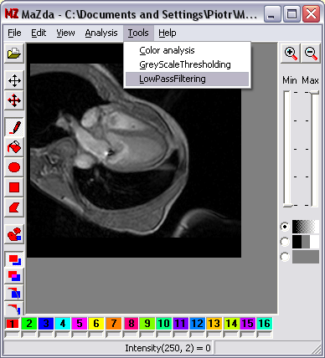

MaZda, plugins and executable modules
Plugins are accessible from MaZda’s Tools menu option
…
SaveImage __TEMP__.bmp
Execute LowPassFiltering.exe __TEMP__.bmp
LoadImage __TEMP__.bmp
…
Selecting an option starts MaZda’s script file
Within a script, an external program module is executed
#include "MaZdaSDK.h"
int main(int argc, char* argv[]){
//Creates the image object and loads data from a file
IntImage* image = new IntImage(input_image_filename);
//Processing the image
{...}
//Saves a result to a file
image->IntSave(output_image_filename);
//Frees memory
delete image;
return 0;
}

Slide 5
Class of 8-bit, grey-scale image
class IntImage
{
public:
IntImage(unsigned int width, unsigned int height);
IntImage(char* filename);
BYTE GetPixel(unsigned int x, unsigned int y);
void SetPixel(unsigned int x, unsigned int y, BYTE intensity);
unsigned int GetWidth(void);
unsigned int GetHeight(void);
int IntSave(char* filename);
~IntImage();
private:
...
};
functions to create
and load image
functions to access image
functions to save results and destroy image

Slide 6
Region of interest class
class RoiImage
{
public:
RoiImage(unsigned int width, unsigned int height);
RoiImage(char* filename);
WORD GetPixel(unsigned int x, unsigned int y);
void SetPixel(unsigned int x, unsigned int y, WORD allroi);
bool IsRoi(unsigned int x, unsigned int y, BYTE roinumber);
void SetRoi(unsigned int x, unsigned int y, BYTE roinumber);
void ClearRoi(unsigned int x, unsigned int y, BYTE roinumber);
void ClearAll(unsigned int x, unsigned int y);
unsigned int GetWidth(void);
unsigned int GetHeight(void);
int SetClassName(BYTE roi, char* classname);
int GetClassName(char* buffer, int buffersize, BYTE roi);
int RoiSave(char* filename);
~RoiImage();
private:
...
};
functions to create
and load image
functions to access and modify regions
functions to access and modify class names
functions to save results and free memory

Slide 7
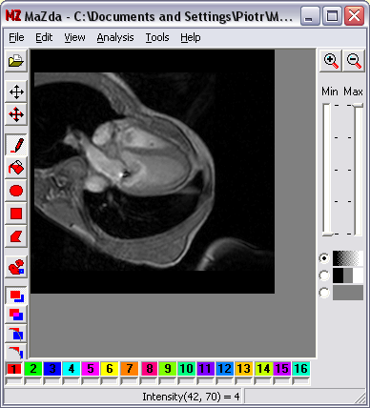

Low-pass filter example
LowPassFiltering.plugin is a sample module for MaZda software. It shows how to use MaZdaSDK classes to load image, create buffer of image and perform simple filtering (grey-scale averaging).
To use the module, compile its sources and link with MaZdaSDK. Copy an executable file LowPassFilter.exe and associated script LowPassFilter.plugin to the MaZda folder. Run MaZda. The new menu option LowPassFiltering will then appear in Tools. After you load an image to MaZda run the plugin by Clicking on Tools->LowPassFiltering. The plugin will save an image, run the sample module LowPassFiltering.exe and then will load the filtered image back to MaZda main window.

Slide 8
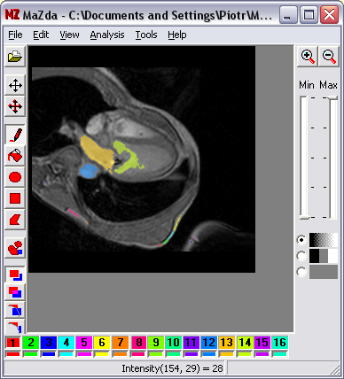
Gray-scale thresholding
GrayScaleThresholding sample shows how to use MaZdaSDK
classes to load image, create regions of interest based on grey-scale image thresholding and how to save regions of interest to a file.
To use the module, compile its sources and link with MaZdaSDK. Copy an executable file GrayScaleThresholding.exe and associated script GrayScaleThresholding.plugin to the MaZda folder. Run MaZda. The new menu option GrayScaleThresholding will appear in Tools. After you load an image to MaZda run the plugin by Clicking on Tools-> GrayScaleThresholding. The plugin will save an image, run the sample module and then will load the resulting regions to MaZda.

Slide 9
Caution!
The Gray-scale thresholding and the low-pass filter samples were not intended as useful tools for image analysis. They are to show how to use MaZda SDK classes IntImage and RoiImage.
The sample sources were also not optimized for performance. They were written to be simple and easy to understand.
!

Slide 10

Future work
To implement classes for other file formats

