Slide 1
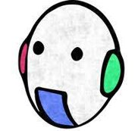
Visual Servoing Project
Emmanouil Markodimitrakis
Emmanouil Koutoulakis
Visual Servoing 2021

Slide 2
OUTLINE
Introduction
Camera Calibration
Implementation
Demo - Videos
Conclusion

Slide 3
Introduction
The purpose of this project is to implement an end-to-end visual servoing project using a fish-eye camera and a Turtlubot3 with ROS. ​
Move the robot from the current position to the target position.
01
Obstacle avoidance that is specified using red color obstacles.
02
Parking Operation when the robot is on target.
03

Slide 4
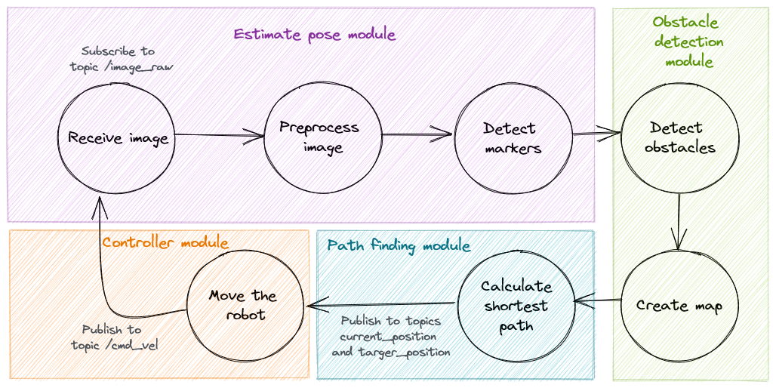
Workflow

Slide 5



Introduction
This project used ROS to demonstrate a simple line following Turtlebot3 in both Gazebo and real environment using Ubuntu 20.04, ROS Noetic and OpenCV 3
The Turtlebot3 is used as the vehicle to demonstrate the concept which uses simple Image Processing Techniques
The main decider of the robot’s trajectories is the camera looking parallel at the robot and the target position.

Slide 6



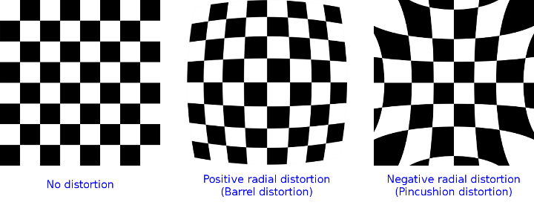
Camera Calibration
We fix the distortion of the acquired images
The camera_calibration package contains the method to undistort the frames
Checkerboard used for the intrinsic calibration

Slide 7
Implementation

Slide 8
First Objective - Move from current to target position
Calculate the α angle and distance ρ
Receive image & Preprocessing
Convert rotational and translational vectors to homogeneous matrices
Detect Markers & Pose estimation
Move robot to target

Slide 9
First Objective – Receive image & Preprocessing
Subscribe to "/image/raw" ROS topic to receive image
Crop the image
Undistort the image using camera matrix and distortion coefficients

Slide 10
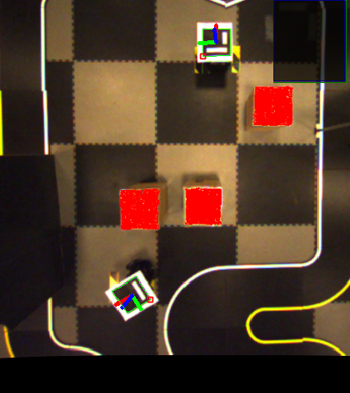
First Objective – Detect markers & Pose estimation
Use cv2.detectMarkers and calibration matrices
Using cv2.estimatePoseSingleMarkers we receive one rotational and one translational matrix for each marker
Generate a custom message and publish the vectors as ROS topics, current_position and target_position
Vector shape: [X, Y, Z]

Slide 11
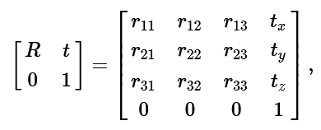

First objective - Convert rotational and translational vectors to homogeneous matrices
The controller subscribes to the position topics and receive the above mentioned vectors
Rodrigues function converts rotational vectors to rotational matrices
Combination of them used to calculate the homogeneous matrices

Slide 12
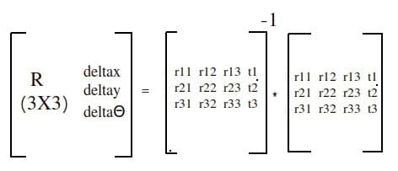
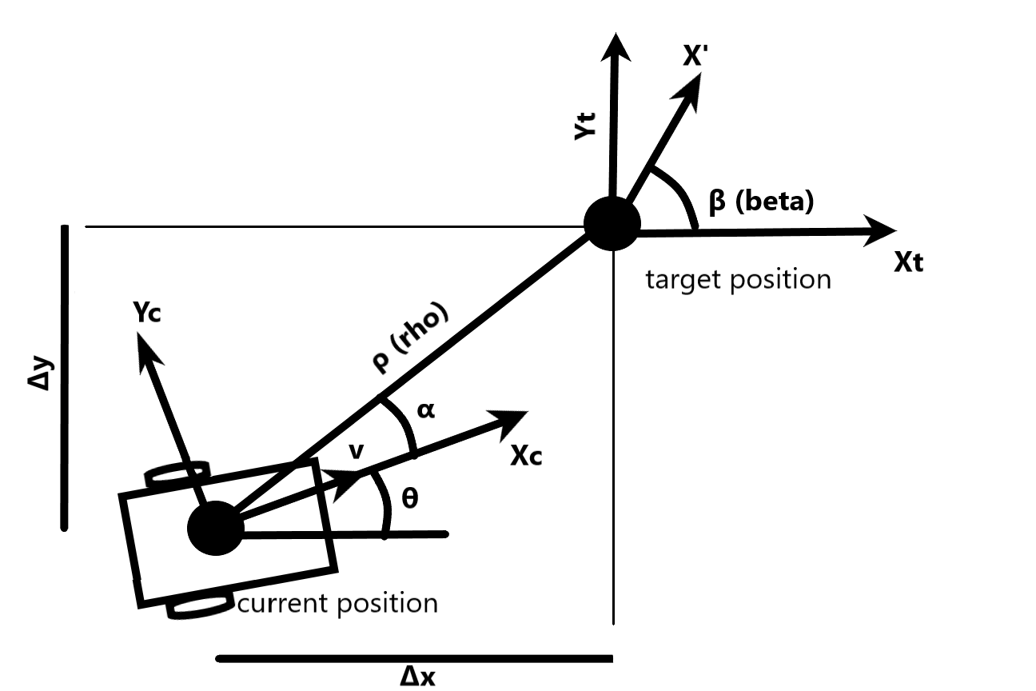
First objective - Calculate the α angle and distance ρ between current and target positions
The homogeneous matrices describes the position of each position in respect with the camera's frame. ​
We need to combine them in order to receive the position from one position in respect to the other position. ​
We multiply the inverse of the current homogeneous matrix with the target homogeneous matrix to receive the combined homogeneous matrix (t)​
alpha = math.atan2(dy, dx)​
Lastly ,we get the distance to target (ρ) by applying the Euclidean distance on Δx, Δy

Slide 13
First Objective - Move robot to target
Fix the beta angle by publishing to the ROS topic cmd_vel only angular velocity
When the angle is correct according to the target angle, we publish again to the same topic only linear velocity until the distance to target is near to zero.
Proportional controller used, so the velocities that are given to the robot are multiplied by two constants, one for angular and one for linear velocity.

Slide 14
Second Objective - Avoid obstacles
Obstacle detection & path planning
Estimate middlepoint pose

Slide 15
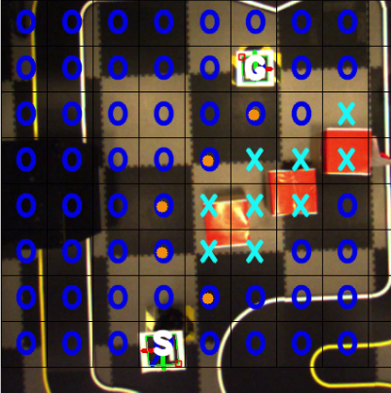
Obstacle detection & path planning
Convert the image to HSV
Mask the image if the box contains any pixels in the range of red color
Apply the bitwise mask
If the box contains red pixels, we assume that it is an obstacle.
Find shortest path using A-star Algorithm

Slide 16
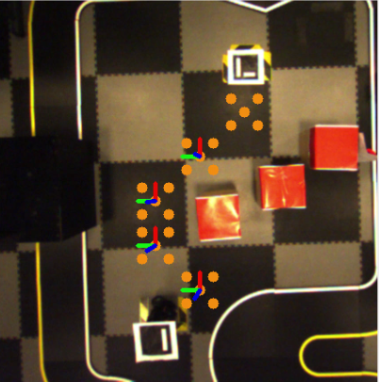
Estimate middle-point pose

Slide 17
Third Objective - Parking
Calculate Euler angle
Move the robot to fix the β angle error

Slide 18
Calculate Euler angle
From the final rotational matrix, we obtain the Δθ
Performing conversion to the rotation matrix to Euler angles, we obtain the β angle
Then, the robot corrects its position according to the β

Slide 19
Demo
Execute Roscore:
>roscore
Launch the camera:
>roslaunch ueye_cam rgb8.launch
Remote monitor and control:
>ssh ubuntu@192.168.0.200
On the turtlebot run:
>roslaunch turtlebot3_bringup turtlebot3_robot.launch
On the remote computer launch our implementation:
>roslaunch visual_servoing visual_servoing.launch

Slide 20
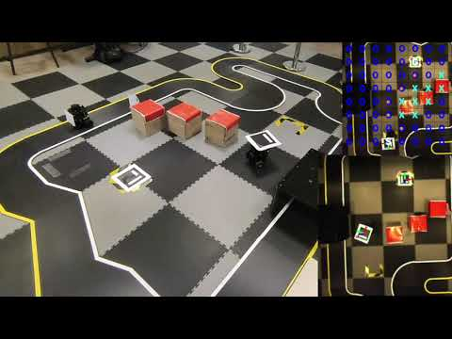

Slide 21
Thank you!
Project repo: https://github.com/manos-mark/visual_servoing

