Slide 1

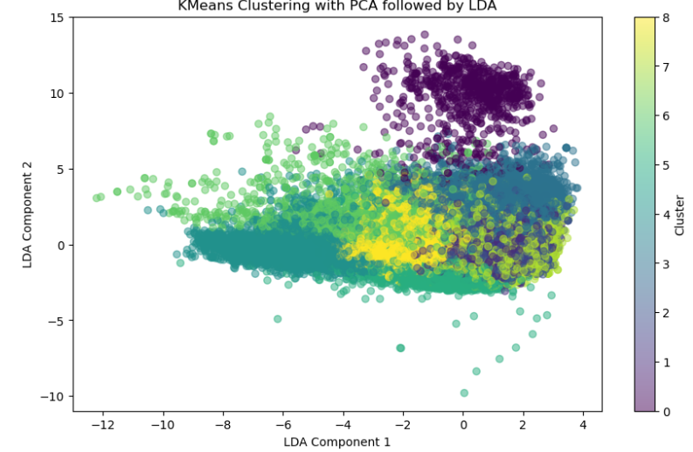
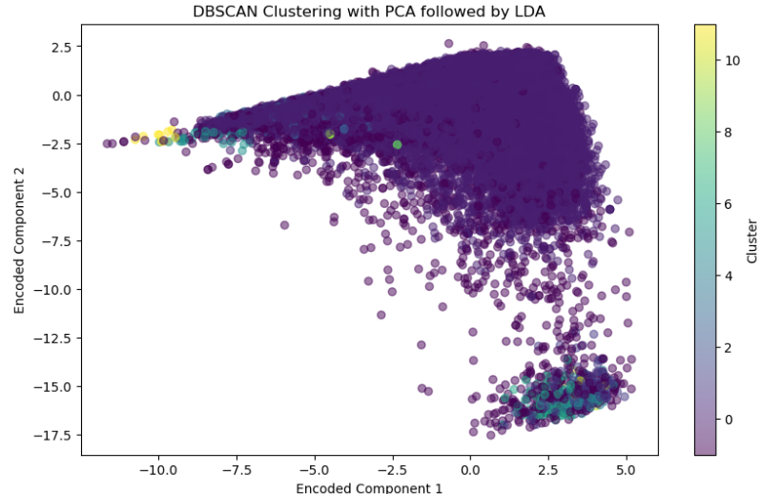
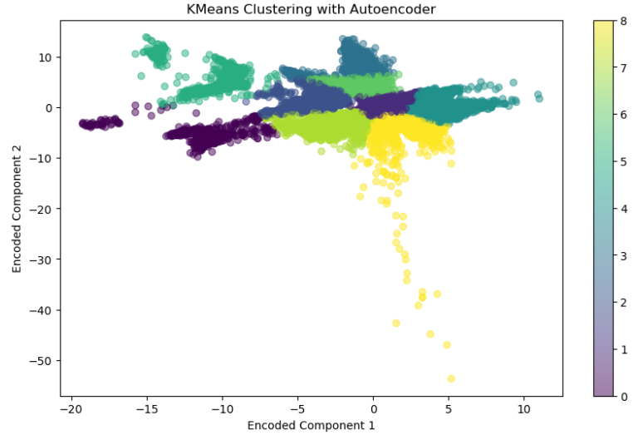
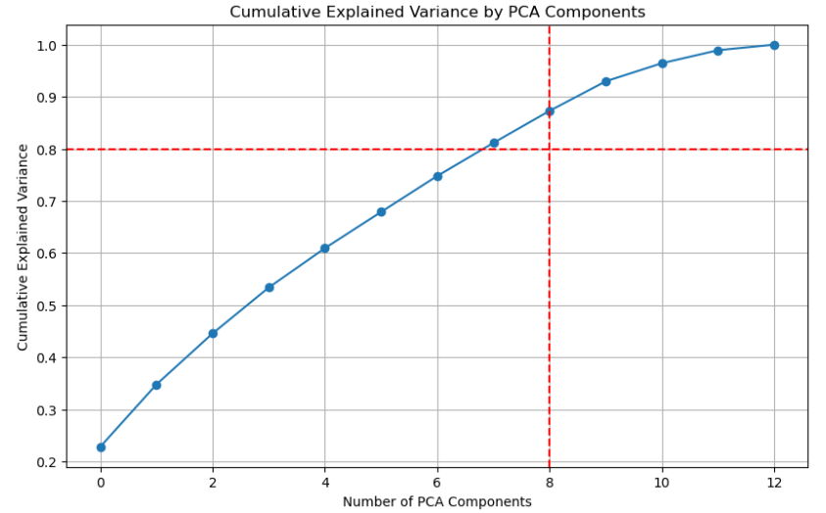
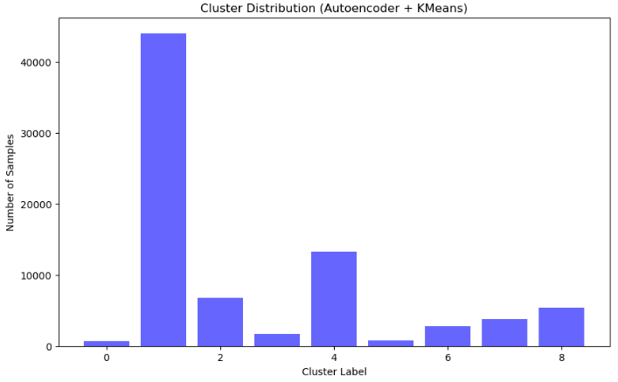
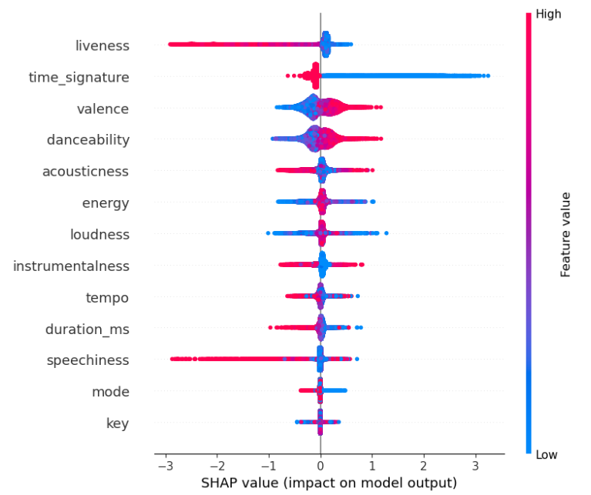
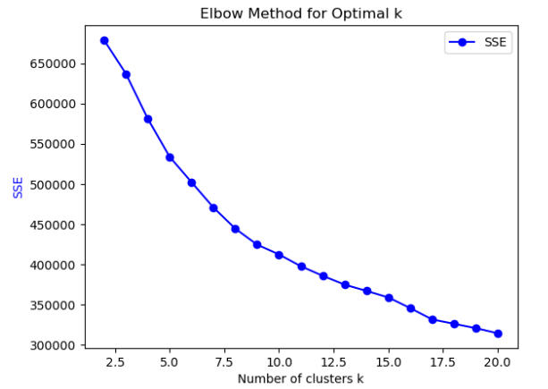
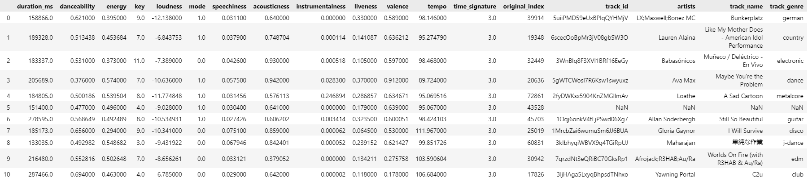
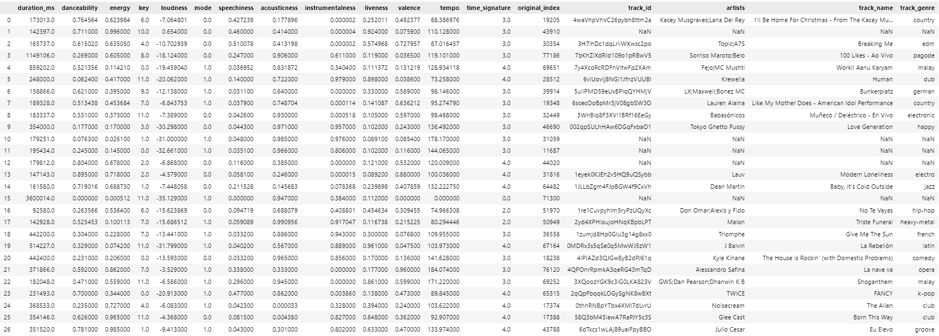
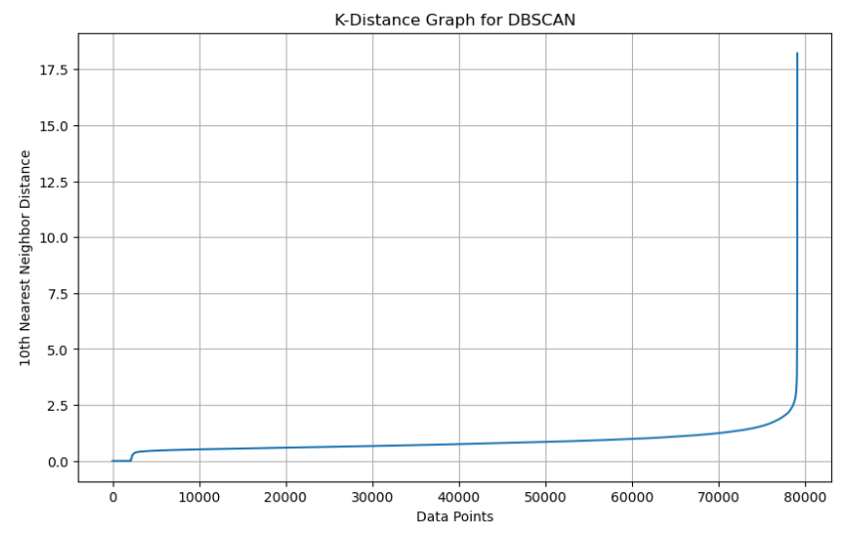
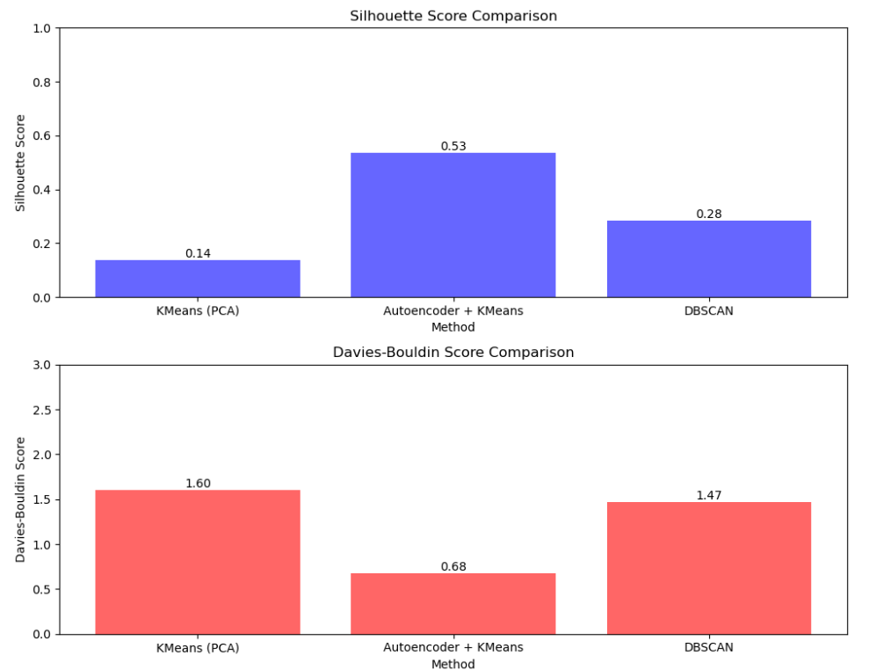
Enhancing Music Clustering and Recommendation with Advanced Machine Learning
DAMIANAKIS EMMANOUIL
PLIAKIS ARISTOTELIS
Introduction
Evaluation: The clustering algorithms were evaluated using Silhouette Score and Davies-Bouldin Score. SHAP values were computed to interpret feature importance.
Recommendation: The best-performing algorithm was used to identify and recommend similar songs for a given test song.
The music industry, with its diverse range of genres and vast number of tracks, presents a unique challenge for data analysis and classification. The purpose of this project is to develop a robust method for clustering songs into distinct genres using various machine learning techniques to create an effective music recommendation system. This system not only aids in organizing and recommending music but also provides insights into the underlying patterns and characteristics that define different music genres, enhancing the listening experience for users.
Results
Motivation
The Autoencoder-based KMeans achieved the highest Silhouette Score and the lowest Davies-Bouldin Score, indicating superior clustering performance compared to traditional KMeans and DBSCAN.
SHAP analysis revealed significant features contributing to the clustering, providing interpretability to the clustering results.
A recommendation system was created to recommend the 11 nearest songs of the same category, and 3 nearest songs from every category, demonstrating the practical application of the clustering results in real-world scenarios.
With the rapid growth of digital music libraries, traditional recommendation systems struggle to manage and categorize the vast and complex audio data. This project aims to enhance music clustering and recommendation using advanced machine learning techniques. By applying autoencoders and dimensionality reduction, we seek to improve the accuracy and personalization of music recommendations, helping users discover new tracks that align with their tastes. This approach not only advances music data analysis but also benefits artists, producers, and streaming services.
Dataset
The dataset used in this study is sourced from Kaggle and contains over 300,000 Spotify tracks with detailed audio features. This extensive collection includes information such as track name, artist, genre, and various audio attributes like tempo, energy, danceability, and more. By leveraging this comprehensive dataset, we can apply advanced machine learning techniques to enhance music clustering and recommendation systems, providing more personalized and accurate suggestions for listeners. The dataset's rich feature set and diversity make it an ideal foundation for exploring and improving music data analysis.
Example
The following array contains the data of a random music track from the dataset, showcasing its various audio features and metadata.
The following array contains the data of the 11 closest tracks of the previous track from the same cluster, demonstrating the effectiveness of our clustering and recommendation system in grouping similar music tracks based on their audio features.
Methods
The following array contains the data of the 3 closest tracks for every cluster.
Data Preprocessing: The dataset was preprocessed by removing duplicates and irrelevant features, followed by handling class imbalance using SMOTE (Synthetic Minority Over-sampling Technique).
Feature Scaling: StandardScaler was used to standardize the features.
Dimensionality Reduction: PCA was employed to reduce the feature space, ensuring at least 80% variance retention. Linear Discriminant Analysis (LDA) was used for further dimensionality reduction and visualizations.
Clustering:
  KMeans: Applied on the original scaled data and PCA-reduced data.
  DBSCAN: Applied on the PCA-reduced data, with parameters tuned using the k-distance graph.
  Autoencoder-based KMeans: An autoencoder was trained to learn a compressed representation of the data, followed by KMeans clustering on the encoded space.
Conclusion
The analysis demonstrated that combining Autoencoders with KMeans provided the most effective clustering solution, capturing intricate relationships within the data that traditional methods might miss. This method achieved high Silhouette and low Davies-Bouldin scores, indicating well-defined and distinct clusters. The developed recommendation system successfully identified 11 songs from the same category as a randomly selected song and 3 nearest songs from other categories. This shows the system's capability to provide diverse yet relevant music recommendations.
References
Pandya, Maharshi. "Spotify Tracks Dataset." Kaggle, 2020.
Chawla, N. V., Bowyer, K. W., Hall, L. O., & Kegelmeyer, W. P. (2002). "SMOTE: Synthetic Minority Over-sampling Technique." Journal of Artificial Intelligence Research, 16, 321-357
Jolliffe, I. T. (2002). "Principal Component Analysis." Springer.
Davies, D. L., & Bouldin, D. W. (1979). "A Cluster Separation Measure." IEEE Transactions on Pattern Analysis and Machine Intelligence, PAMI-1(2), 224-227.
Rousseeuw, P. J. (1987). "Silhouettes: A Graphical Aid to the Interpretation and Validation of Cluster Analysis." Journal of Computational and Applied Mathematics, 20, 53-65.
Hinton, G. E., & Salakhutdinov, R. R. (2006). "Reducing the Dimensionality of Data with Neural Networks."

