Slide 1

Turtlebot3 Line Following Mission
Robotics Project
Emmanouil Koutoulakis
Emmanouil Markodimitrakis
December 2021

Slide 2
OUTLINE
Overview
Project Structure
Calibration
Algorithm
Demo -Videos
Limitations

Slide 3



Overview
This project used ROS to demonstrate a simple line following Turtlebot in both Gazebo and real environment using Ubuntu 20.04, ROS Melodic and OpenCV 3
The Turtlebot3 is used as the vehicle to demonstrate the concept which uses simple Image Processing Techniques
The main decider of the robots trajectories is the camera which is integrated on the robot

Slide 4
Project Structure
Camera Calibration
Intrinsic Calibration
Detect Lane Calibration
Results
Extrinsic Calibration

Slide 5
Camera Calibration
It is an optional step
Only if the image is not clear
Parameters able for modifications:
Contrast
Brightness
Sharpness
Saturation
Zoom
Etc.

Slide 6
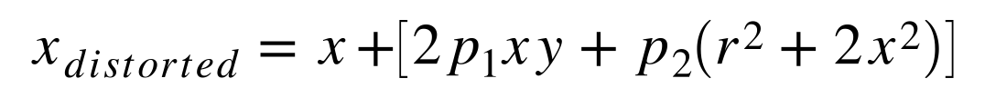
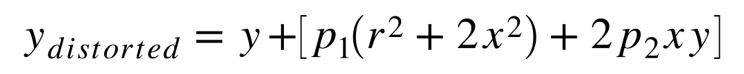
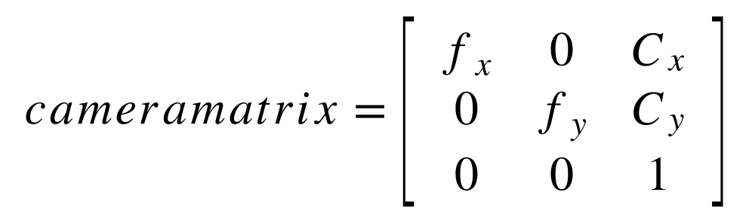
Intrinsic Calibration
In this phase, we tried to fix the distortion of the acquired images
The camera_calibration package [1] contains the method to undistort the frames
We used a checkerboard for the intrinsic calibration
Notes:
https://www.mathworks.com/help/vision/ug/camera-calibration.html notes to explain the formulas

Slide 7
Image Projection - Extrinsic Calibration
Get 4 coordinates which corresponds to the projected frame
Find the homography according to the projected frame and the image that will be transformed
The image transformation established using homography transformation
The functions that used for this are in OpenCV:
cv2.findHomography()
cv2.warpPerspective()
Notes:
https://www.mathworks.com/help/vision/ug/camera-calibration.html notes to explain the formulas
To calculate the homography we need at least 4 corresponding points of the original image.

Slide 8
Image Compensation - Extrinsic Calibration
Image Compensation used for the ground-projected image
A grayscaled version of the projected frame used
Histogram Equalization performed according to the grayscaled frame
Notes:
Show the output of the image compensation

Slide 9
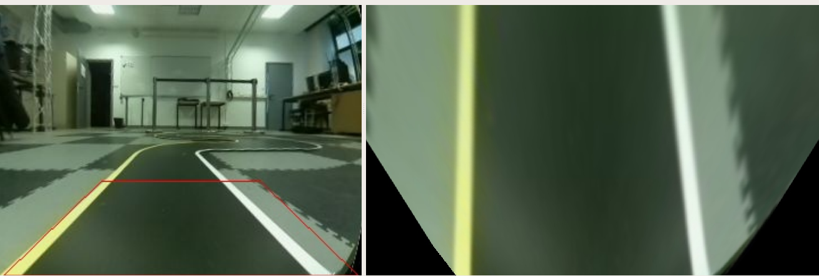
Extrinsic Calibration
Notes:
https://www.mathworks.com/help/vision/ug/camera-calibration.html notes to explain the formulas
To calculate the homography we need at least 4 corresponding points of the original image.

Slide 10
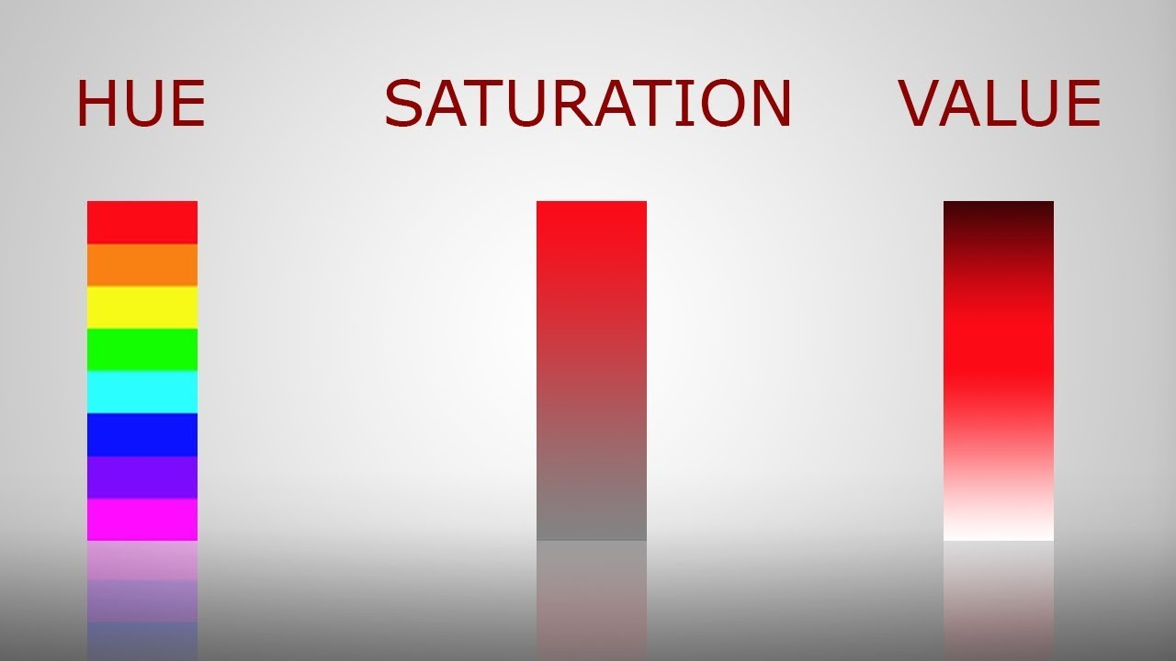
Detect Lane calibration
After the image compensation, two identical images used for yellow and white lines
We convert the image to HSV
Hue is the colour region
Saturation is the ration of colourfulness to brightness
Value (or Lightness) is the average of the largest and smallest colour components

Slide 11

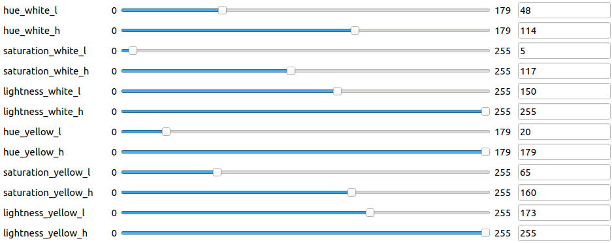
Detect Lane calibration

Slide 12
AlgorithM – Detect lanes
Get the current image
Find the white and yellow lines
Auto-adjust lightness according to the fraction number of the lines (the sum of the non zero pixels)
If the fraction number > 35000 then:
Increase lightness
Else If the franction number < 35000 then:
Decrease lightness
Get the franction number and the Mask of the lane
This procedure is produced for both yellow and white line
Return the centered lane according to the yellow and white lines
Notes:
It need more about the center that it gets for the control lane

Slide 13
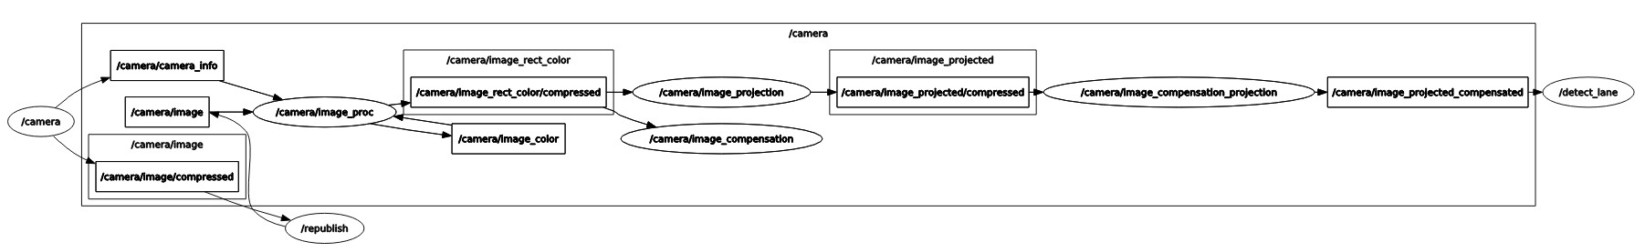
Graph of camera

Slide 14

Lane Controller
It is based on PD (Proportional & Derivative) Controller
Stabilizes the oscilation
Reduces the influence of delay in vision processing
Set the PD coefficients
It works only for the Z- axis in order to manipulate the angular velocity
The procedure is update every time when it gets response from the corresponding topic (/detect/lane)

Slide 15
DEMO
https://drive.google.com/file/d/18MEHNkZ5sAiVhV4xFWQW4ufk0lJ2UDF5/view?usp=sharing

Slide 16
Limitations
Lighness and Noise:
There is automatic method for lightness-adjustment which provokes wrong colour recognition
Tunnel Problem
Lack of lightness – Missing lines

Slide 17
Thank YOU
https://github.com/manoskout/robotics_project

