Slide 1
Structure of implementation

Slide 2
Server inner structure

Slide 3
1. Server-Service communication
The server owns two main buffers for the internal communication with its services
Proccessing buffer, stores packets, currently used by the application.
Application replies buffer, has writting access by the application, and reading access by the server.

Slide 4
2. Server storage structure
Client storage buffer
Remove unnecessary information,store the clients packets.
Proccessing buffer
Packets that are currently used by the services, among with the request id’s.
Reply buffer
Ready to send packets

Slide 5
3. Server flow
When started,
tell everyone, and wait for a response, repeat for a few times.
If no response begin.
If the response is negative change to idle mode.
Else begin.
Store the leftover messages in the reply buffer (at most once)
Bind to the server-server , server-client multicast addresses.
Start the packet analyser thread.
Wait for clients or new servers, act accordingly.

Slide 6
4. Analyser thread
Append new clients, create exclusive sockets for each.
Check for application requests and fulffil them.
Transfer application replies to the reply buffer, send those.
Check if each client is delaying, note it. Stop the communication if necessary (too much delay).
Decode the packets you receive (heartbits, duplicates, new ones, cancellations-new sessions)
If duplicate resend the reply if possible, else check the buffers, store it if you do not find it (the first one never arrived).
New session packet means restart the sequence number clear your buffers from this client.

Slide 7
Multi-server strategy
Concept of acyclic lists.s
If you are the first one, listen the channel, store the newest as your possible child. Wake him up when neccessary. You can only have one child
The child stores the address of his father and listens for other possible childs, repeat the procedure.
After your job is done notify father if possible, go to idle mode.
Heartbits are send to each server's family throughout his life, act accordingly if no heartbits received.
The first one never goes to idle mode, if you die wake the next one up and explain him that he is the first one now.

Slide 8
SERVER1
No response,im first
Multicast Channel

Slide 9
Listen the channel
SERVER1
Multicast Channel

Slide 10
SERVER2
Listen the channel
SERVER1
Multicast Channel

Slide 11
SERVER2
SERVER1
Wake up
Too much work,i need help
Multicast Channel

Slide 12
Listen the channel
SERVER1
Listen the channel
SERVER2
Multicast Channel

Slide 13
Listen the channel
SERVER1
Bye
Listen the channel
SERVER2
Finished serving,no new clients,going to sleep
Multicast Channel

Slide 14
SERVER2
Listen the channel
SERVER1
I can handle it alone
Multicast Channel

Slide 15
SERVER2
SERVER1
Wake up,you are the first now
I have to die
Multicast Channel

Slide 16
Listen the channel
SERVER2
Multicast Channel

Slide 17
Client inner structure

Slide 18
Client Application
Initializes middleware thread and gets it started it.
Enters UI loop for:
Sending requests (as many as middleware buffer-size).
Getting replies.
Exit UI and terminate middleware thread.
Keeps given request in a list so that it can get their replies later.
Replied requests and requests that are discarded from middleware are removed from the list.
Getting replies with “block” enters a loop until the list is empty.

Slide 19
Client Middleware Initialization
Has limited buffer size.
Acquire memory for buffers.
Create new socket.
Try to find a server via multicast
If succeeded, keep server’s socket address and reset delays.
Else abort and terminate app.

Slide 20
Client Middleware Storages
Storage map for keeping total requests from APP and their ID.
“Sending” arrays, take from storage and send to server
Array for binding sequence number to total request ID.
Array for service ID requested.
Array for payload of the request.
Array for keeping track of sending tries of a request.
Storage map for saving replies from server, requests and their IDs for returning them to APP.

Slide 21
Client Middleware Thread
Enters a while loop for receiving and sending packets autonomously.
Tries to receive so many packets as sent to server and haven’t been answered plus a minimum amount (for ACKs).
If sending buffers are empty, fills them from storage and starts sending packets.
There is a mutex-like flag so that middleware won’t reach storage when the APP is adding requests.
If sending buffers are not empty, keeps sending the unanswered packets keeping track of each try so that it can discard them.
Before each group sending session, send beacons to confirm server is on.
Waits a delay time before resending.

Slide 22
Client Middleware Thread
Whenever it receives a reply, it removes its request entry from sending buffers.
When all entries are removed from sending buffers, either from getting replied or discarded, middleware tries establishing a “new session” with the server.
It either gets an ACK and succeeds.
Or fails and tries establishing a connection with a new server via multicast
Sending buffers are refilled from storage (if possible) and repeats the process (unless it never finds a new server).

Slide 23
Communication Protocol

Slide 24
Packets' structure
Client payload packet
svcID | sequence | try | Request payload
1 byte | 1 byte | 1 byte | N bytes
Serverpayload packet
sequence | Reply payload
1 byte | N

Slide 25
Normal situation,(fast application , good network, enough storage capacity)
M2
M1
Client1
R1
R2
NewS
NewS
Server
Client2
M2
M1
R1
R2
NewS
NewS

Slide 26
Client gets no replies (Bad server, Bad network)
Client1
M3
Server
M2
M1
R1
M3
M2
Slow processing Slow replying
Bad Server discard messages
R2
NewSession
Discard replies
NewSession
Can't listen server Find new one
Multicast

Slide 27
Server gets no requests (Bad client, Bad network)
Client1
M3
Server
M2
M1
M3
M2
M1
Bad Server discard messages
Find new Server
Client died
Flushing
Multicast
Multicast
Drinking coffee
Beacon
Client died
Flushing
Beacon
Beacon
Bad server
Find new Server
Multicast

Slide 28


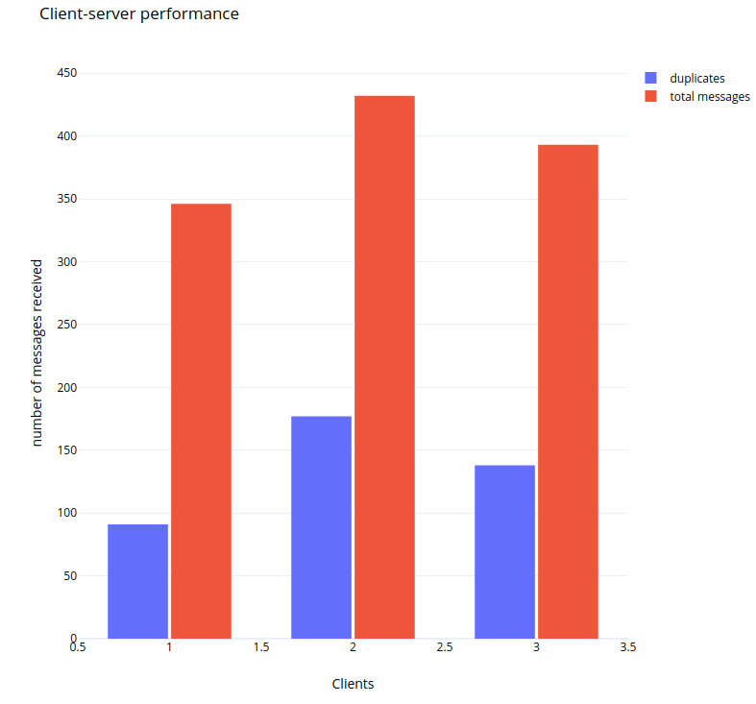



One or two clients,dont fill server's buffers.Clients keep resending the same request because no busy message is received
Three clients fill the server buffer's quickly and get busy messages so they delay the resend

Slide 29
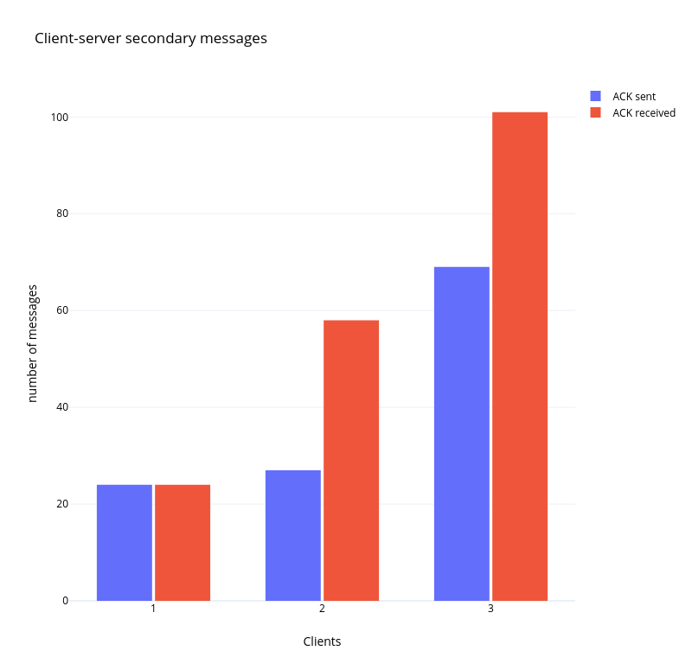
(ACK includes beacons, new sessions-cancelations,multicast,busy messages)
- More clients more traffic on the network..

