Slide 1


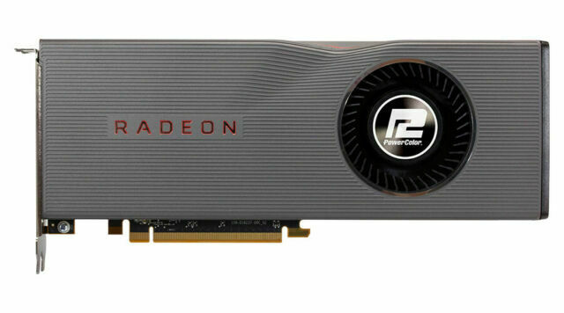
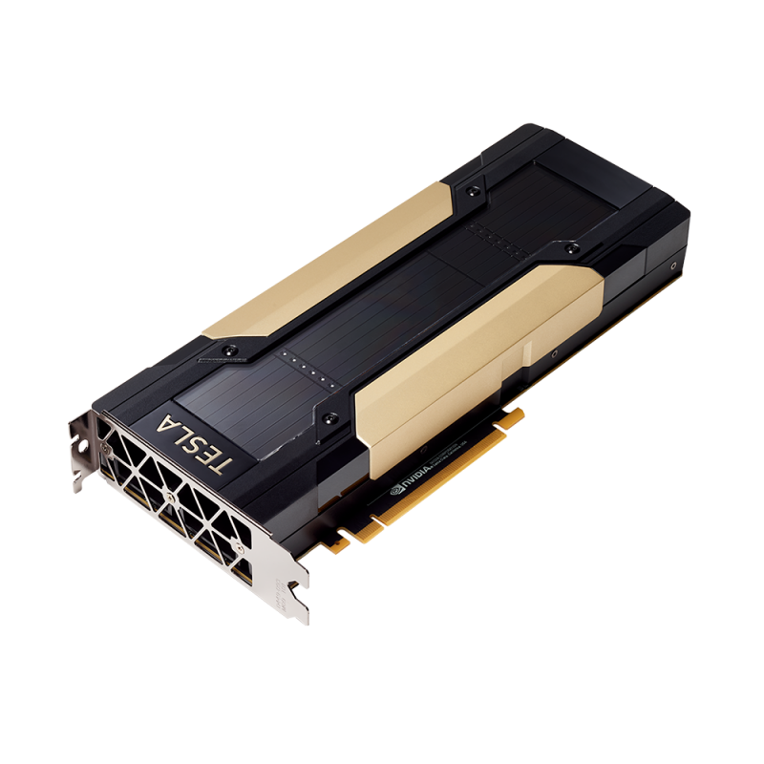
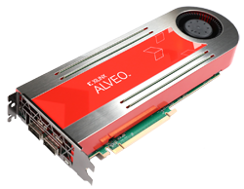
Why accelerators?
Manos Pavlidakis^{1,2}
Antonis Chazapis¹
manospavl@ics.forth.gr
chazapis@ics.forth.gr
¹ Institute of Computer Science, Foundation for Research and Technology - Hellas, Greece
² Computer Science Department, University of Crete, Greece

Slide 2
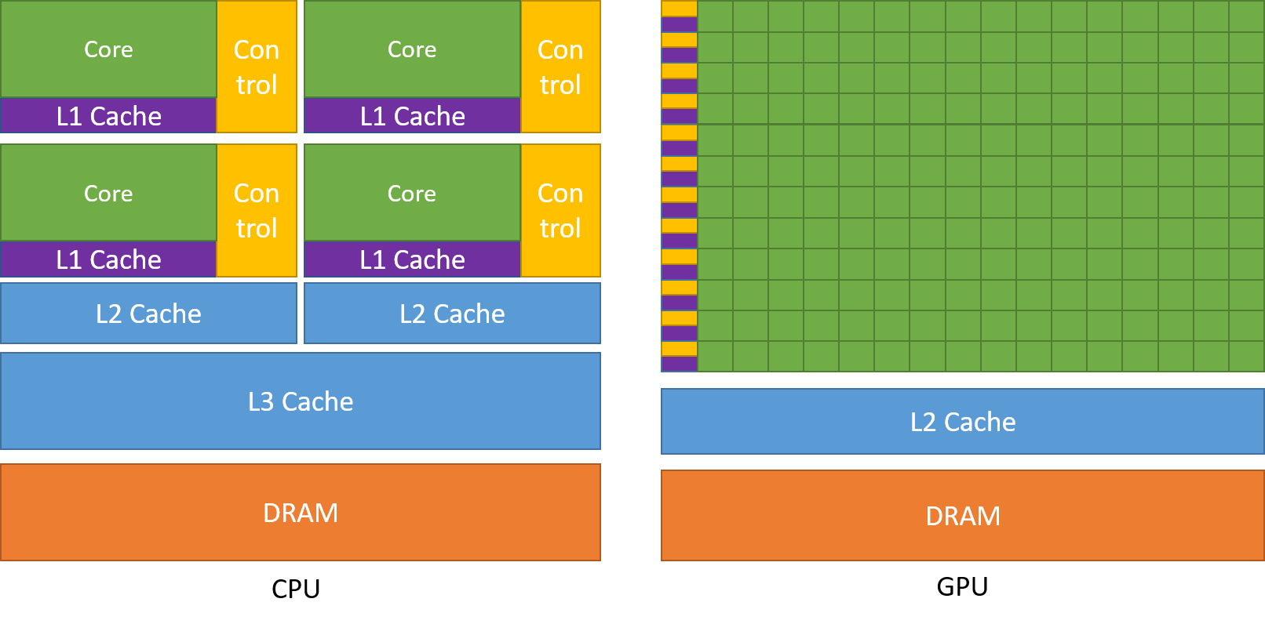
What is an accelerator?
A device that performs some functions more efficiently than general-purpose CPU
CPUs have to be good at all functions
E.G. GPUs are perfect for M.M.
Programming Guide :: CUDA Toolkit Documentation (nvidia.com)
All about accelerators
EuroHPC 2021

Slide 3
Typical accelerators
GPGPUs General Purpose Graphic Processing Unit (NVIDIA, AMD)
FPGA: Field-programmable gate array (Xilinx, Intel Altera)
ASIC: Application-Specific Integrated Circuit
TPU: Tensor Processing Unit (Google)
Accelerators fit perfectly to accelerate compute intensive applications as:
Financial
Face detection
Autonomous driving
Language translation
Genomics
All about accelerators
EuroHPC 2021
All about accelerators

Slide 4
Why accelerators are better than CPUs?
Accelerators can process data several orders of magnitude faster than CPUs
Due to massive parallelism
CPU | GPU
Central Processing Unit | Graphics Processing Unit
Several Cores | Many Cores
Complex/Larger cores | Simpler/smaller cores
Low latency | High throughput
Good for serial processing | Good for parallel processing
Good for almost all operations | Perfect for some operations
All about accelerators
EuroHPC 2021

Slide 5
How to select the optimal accelerator?
Application type | Processing speed | Processing/ Watt | Training | Inference
Speech processing | ++ | ++ | GPU, ASIC | CPU, ASIC
Face detection | ++ | ++ | GPU, FPGA | CPU, ASIC
Financial risk stratification | ++ | + | GPU, FPGA | CPU
Route planning | + | + | GPU | CPU
Dynamic pricing | ++ | + | GPU | CPU, ASIC
Autonomous driving | ++ | ++ | ASIC | GPU, ASIC, FPGA
https://www.mckinsey.com/industries/semiconductors/our-insights/artificial-intelligence-hardware-new-opportunities-for-semiconductor-companies#
All about accelerators
EuroHPC 2021
Notes:
Since each use case has different compute requirements, the optimal AI hardware architecture will vary. For instance, route-planning applications have different needs for processing speed, and other performance features than applications for autonomous driving or financial risk stratification
https://inaccel.com/cpu-gpu-fpga-or-tpu-which-one-to-choose-for-my-machine-learning-training/
https://inaccel.com/cpu-gpu-or-fpga-performance-evaluation-of-cloud-computing-platforms-for-machine-learning-training/

Slide 6
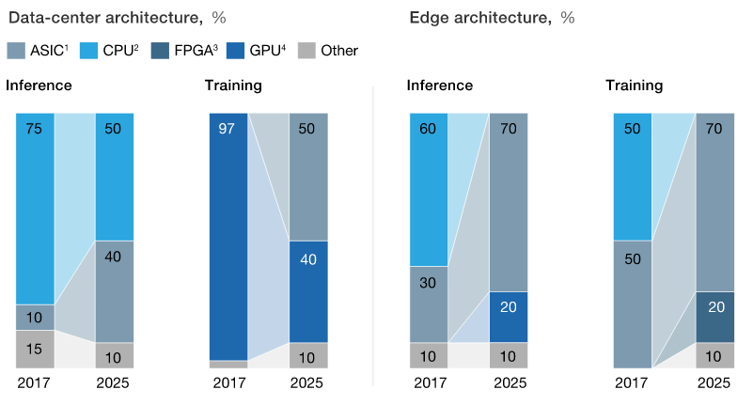
Preferred architectures are shifting!
https://www.mckinsey.com/industries/semiconductors/our-insights/artificial-intelligence-hardware-new-opportunities-for-semiconductor-companies#
All about accelerators
EuroHPC 2021

Slide 7

How to use an accelerator?
Use the accelerator programming language and libraries
CUDA → NVIDIA GPUs, OpenCL → Intel Altera FPGAs
cuDNN, cuBLAS → NVIDIA GPUs, clBLAS → Intel Altera FPGAs
Generic Programming languages
OneAPI, OpenCL
High level languages
Python, Java
For instance CUDA offers plugins for high-level languages (PyCUDA, JCUDA)
Frameworks
TensorFlow, PyTorch, MatLab, Caffe, Wolfram Language, mxnet etc.
Have implementations for different accelerator types
Have simple and flexible APIs that simplify their use (e.g. Keras)
All about accelerators
EuroHPC 2021

Slide 8
Machine learning stack
Keras
PyTorch
TensorFlow
Theano
CNTK
Backend:
CUDA, cuDNN
BLAS, Eigen
Low-level lib:
GPU
CPU
FPGA
Hardware:
All about accelerators
EuroHPC 2021

Slide 9
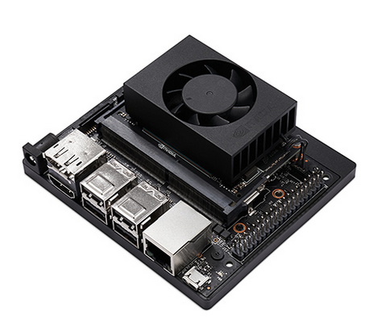
MLPerf Data-center benchmarks
JETSON XAVIER NX
20x
314x
NA
NA
NA
NA
NA
NA
NA
NA
NA
NA
NA
NA
https://inaccel.com/cpu-gpu-or-fpga-performance-evaluation-of-cloud-computing-platforms-for-machine-learning-training/
All about accelerators
EuroHPC 2021
Notes:
https://www.hpcwire.com/2021/04/21/mlperf-issues-new-inferencing-results-adds-power-metrics-nvidia-wins-again/
The results that you see here (below) are normalized to Jetson Xavier NX

Slide 10
Thank you
Questions?
Manos Pavlidakis
manospavl@ics.forth.gr
Notes:
Thank you very much for you attention I will be happy to answer any questions.

