Slide 1


Programming Languages for Accelerators
Manos Pavlidakis^{1,2}
manospavl@ics.forth.gr
¹ Institute of Computer Science, Foundation for Research and Technology - Hellas, Greece
² Computer Science Department, University of Crete, Greece

Slide 2
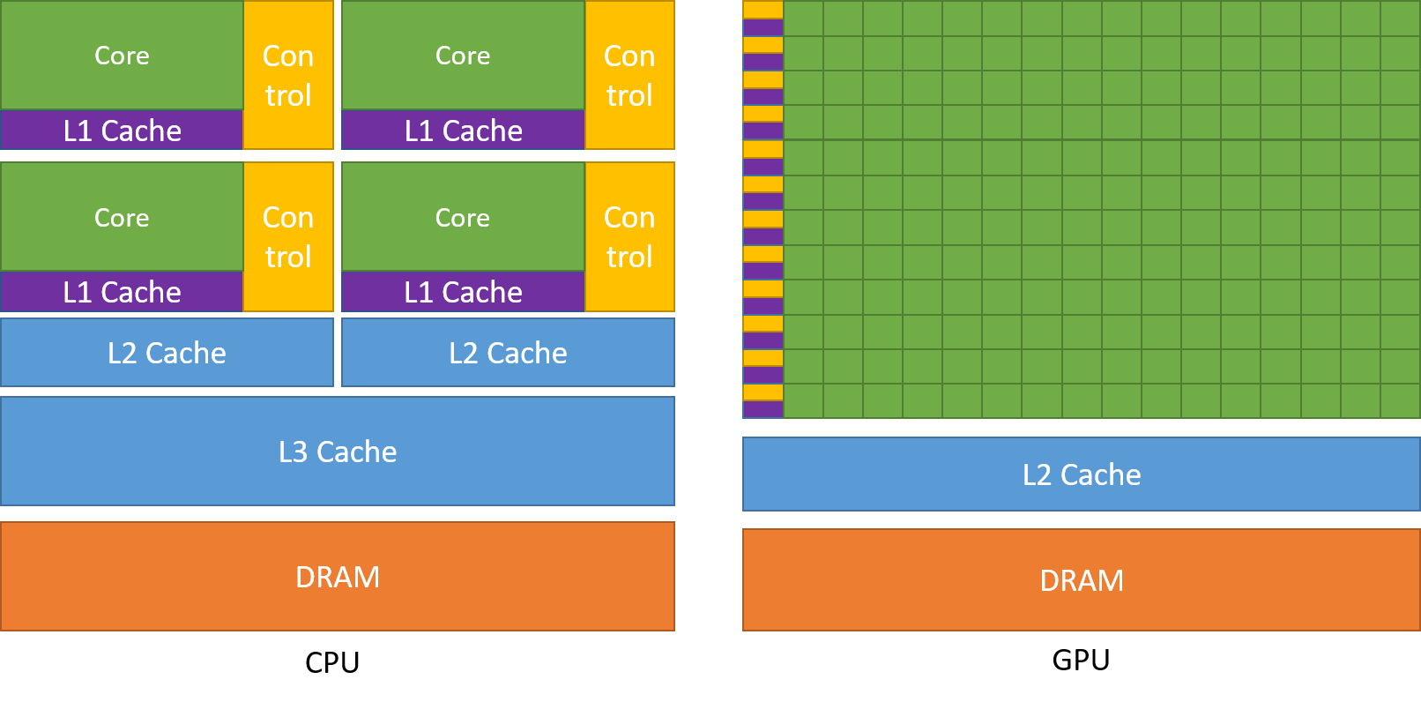
What is an accelerator?
A device that performs some functions more efficiently than general-purpose CPU
Due to massive pallelism
GPUs are perfect for Vector Add
General Purpose Graphic Processing Unit (NVIDIA, AMD)
Field-Programmable Gate Array (Xilinx, Intel Altera)
Application-Specific Integrated Circuit
TPU: Tensor Processing Unit (Google)
Programming languages for accelerators
EuroHPC 2022
Programming Guide :: CUDA Toolkit Documentation (nvidia.com)

Slide 3
How we program accelerators?

Slide 4
Well known programming languages
CUDA → NVIDIA GPUs
HIP:
ROcM → AMD GPUs
CUDA → NVIDIA GPUs
oneAPI/SYCL → Heterogeneous accelerators
Programming languages for accelerators
EuroHPC 2022

Slide 5

CUDA: Compute Unified Device Architecture

Slide 6
What is CUDA?
CUDA
Based on industry-standard C/C++
Small set of extensions to enable heterogeneous programming → Kernel code
APIs to manage devices → Transfers, Allocations etc.
Programming languages for accelerators
EuroHPC 2022

Slide 7
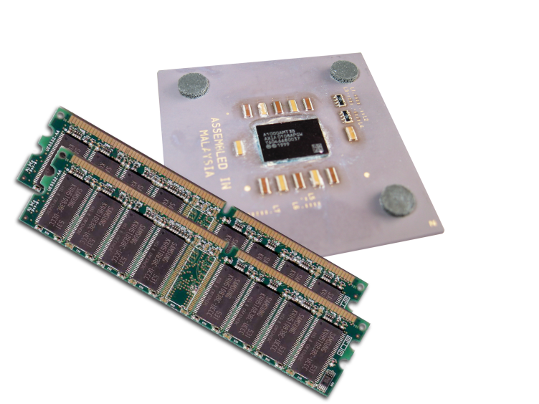
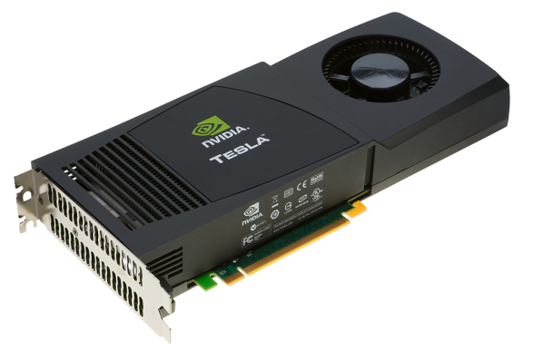
Terminology
Host: The CPU and its memory
Device: The GPU/Accelerator and its memory
Host
Device
Programming languages for accelerators
EuroHPC 2022

Slide 8
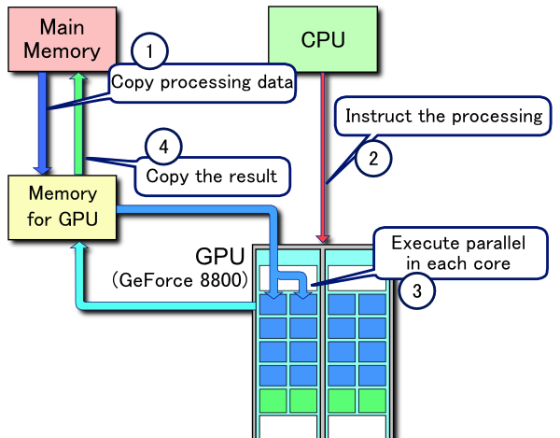
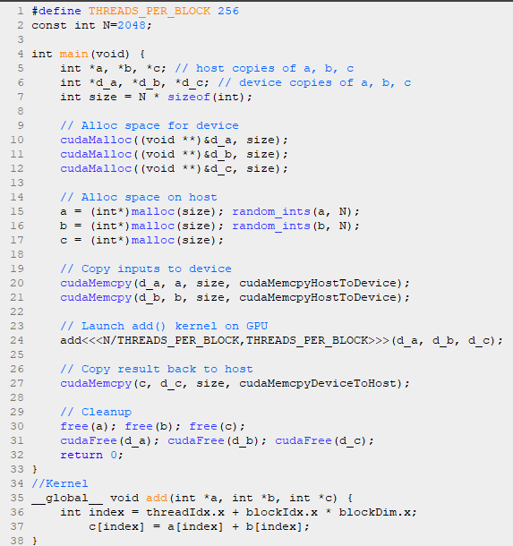
Host and Device code
Host code
Executed by one Host Thread
1
2
Device code
(CUDA kernel)
4
Executed by multiple CUDA Threads
3
Programming languages for accelerators
EuroHPC 2022

Slide 9
CUDA by an example

Slide 10
Add two integers with CUDA
A simple kernel to add two integers
__global__ void add(int *a, int *b, int *c) {
*c = *a + *b;
}
__global__ is a CUDA C/C++ keyword meaning:
add() will execute on the device
add() will be called from the host
Programming languages for accelerators
EuroHPC 2022

Slide 11
Add two integers with CUDA
Note that we use pointers for the variables
__global__ void add(int *a, int *b, int *c) {
*c = *a + *b;
}
add() runs on the device, so a, b and c must point to device memory
We need to allocate memory on the GPU for a, b, c
Programming languages for accelerators
EuroHPC 2022

Slide 12
Memory Management
Host and device memory are separate entities
Device pointers point to GPU memory
May be passed to/from host code
Host pointers point to CPU memory
May be passed to/from device code
Simple CUDA API for handling device memory
cudaMalloc(), cudaFree(), cudaMemcpy()
Similar to the C equivalents malloc(), free(), memcpy()
Programming languages for accelerators
EuroHPC 2022

Slide 13
Add two integers: main()
int main(void) {
int a, b, c; // host copies of a, b, c
int *d_a, *d_b, *d_c; // device copies of a, b, c
int size = sizeof(int);
// Allocate space for device copies of a, b, c
cudaMalloc((void **)&d_a, size);
cudaMalloc((void **)&d_b, size);
cudaMalloc((void **)&d_c, size);
// Setup input values
a = 2;
b = 7;
Programming languages for accelerators
EuroHPC 2022

Slide 14
Add two integers: main()
// Copy inputs to device
cudaMemcpy(d_a, &a, size, cudaMemcpyHostToDevice);
cudaMemcpy(d_b, &b, size, cudaMemcpyHostToDevice);
// Launch add() kernel on GPU
add<<<1,1>>>(d_a, d_b, d_c);
// Copy results back to host
cudaMemcpy(&c, d_c, size, cudaMemcpyDeviceToHost);
// Free device memory
cudaFree(d_a); cudaFree(d_b); cudaFree(d_c);
return 0;
} // End of main()
Programming languages for accelerators
EuroHPC 2022

Slide 15
Use parallelism
Performance gain of GPUs is based on massive parallelism
CPUs have several cores (i.e. hundreds)
GPUs have many cores (i.e. thousands)
How we run the add() kernel on many cores?
add<<< 1, 1 >>>();
add<<< N, 1 >>>();
Instead of executing add() once, execute N times in parallel!
Programming languages for accelerators
EuroHPC 2022

Slide 16
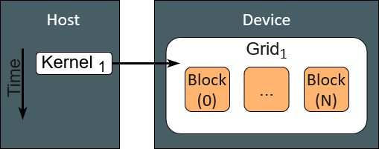
Vector addition on the Device
With add() running in parallel we can do vector addition
Each parallel invocation of add() is referred to as a Block
The set of Blocks is referred to as a Grid
Each invocation can refer to its block index using blockIdx.x
__global__ void add(int *a, int *b, int *c) {
c[blockIdx.x] = a[blockIdx.x] + b[blockIdx.x];
}
By using blockIdx.x to index into the array, each block handles a different index
Programming languages for accelerators
EuroHPC 2022

Slide 17
Sequential Vector Addition using C++
int main(void) {
int a, b, c;
int size = sizeof(int);
// Allocate and initialize a, b, c
a = (int*)malloc(size); random_ints(a, N);
b = (int*)malloc(size); random_ints(b, N);
c = (int*)malloc(size);
for (int i =0; i<size; i++) // Add arrays
c[i] = a[i] + b[i];
free(a); free(b); free(c);
return 0;
}
Programming languages for accelerators
EuroHPC 2022

Slide 18
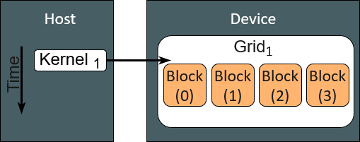
Vector addition with 4 blocks
If we want to create 4 parallel blocks
We will call the kernel from host with N=4
add<<< 4, 1 >>>(…);
On the device the kernel code
__global__ void add(int *a, int *b, int *c) {
c[blockIdx.x] = a[blockIdx.x] + b[blockIdx.x]; }
c[0]=a[0]+b[0]
for (int i =0; i<size; i++)
c[i] = a[i] + b[i];
c[1]=a[1]+b[1]
c[2]=a[2]+b[2]
c[3]=a[3]+b[3]
Programming languages for accelerators
EuroHPC 2022

Slide 19
Vector addition main()
#define N 4
int main(void) {
int *a, *b, *c; // host copies of a, b, c
int *d_a, *d_b, *d_c; // device copies of a, b, c
int size = N * sizeof (int);
// Alloc space for device copies of a, b, c
cudaMalloc((void **)&d_a, size);
cudaMalloc((void **)&d_b, size);
cudaMalloc((void **)&d_c, size);
// Alloc space for host copies of a, b, c, and setup random input values
a = (int *)malloc(size); random_ints(a, N);
b = (int *)malloc(size); random_ints(b, N);
c = (int *)malloc(size);
Programming languages for accelerators
EuroHPC 2022

Slide 20
Vector addition main()
// Copy inputs to device
cudaMemcpy(d_a, a, size, cudaMemcpyHostToDevice);
cudaMemcpy(d_b, b, size, cudaMemcpyHostToDevice);
// Launch add() kernel on GPU with N blocks
add<<<N,1>>>(d_a, d_b, d_c);
// Copy result back to host
cudaMemcpy(c, d_c, size, cudaMemcpyDeviceToHost);
// Free device and host memory
free(a); free(b); free(c);
cudaFree(d_a); cudaFree(d_b); cudaFree(d_c);
return 0;
}
Programming languages for accelerators
EuroHPC 2022

Slide 21
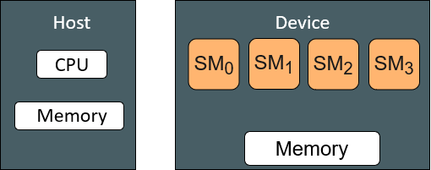
More parallelism using CUDA cores
Hardware
NVIDIA GPUs consists of:
Streaming Multiprocessors (SM)
An SM consists of CUDA cores
Programming languages for accelerators
EuroHPC 2022

Slide 22
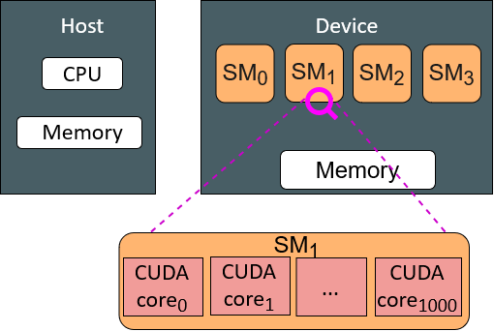
More parallelism using CUDA cores
Hardware
NVIDIA GPUs consists of:
Streaming Multiprocessors (SM)
An SM consists of CUDA cores
A CUDA core is like a thin processor
A GPU has:
Hundreds of SMs (e.g. A100 GPU has 128)
Thousand CUDA cores (e.g. A100 GPU has 7000)
Programming languages for accelerators
EuroHPC 2022

Slide 23
More parallelism using CUDA cores
NVIDIA GPUs consists of:
Streaming Multiprocessors (SM)
An SM consists of CUDA cores
A CUDA core is like a thin processor
A GPU has:
Hundreds of SMs (e.g. A100 GPU has 128)
Thousand CUDA cores (e.g. A100 GPU has 7000)
In our example we use only Blocks
A Block is assigned to an SM
Blocks in the same SM execute concurrently!
Not in parallel!!
If we have 4xSMs only 4xBlocks run in parallel
Why not use CUDA cores !
Hardware
Programming languages for accelerators
EuroHPC 2022

Slide 24
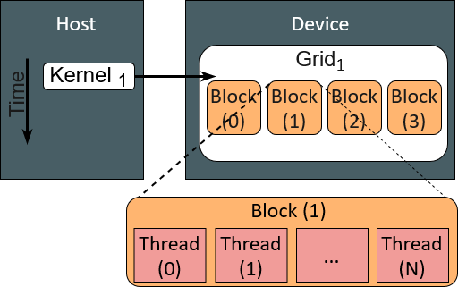
CUDA Threads → CUDA cores
A Block can be split into parallel Threads
Threads in the same block can cooperate
Threads have unique ids (i.e. threadId.x)
Programming languages for accelerators
EuroHPC 2022

Slide 25
CUDA Threads → CUDA cores
A Block can be split into parallel Threads
Threads in the same block can cooperate
Threads have unique ids (i.e. threadId.x)
Threads are assigned to CUDA cores
Hardware
Programming languages for accelerators
EuroHPC 2022

Slide 26
CUDA Threads → CUDA cores
A Block can be split into parallel Threads
Threads in the same block can cooperate
Threads have unique ids (i.e. threadId.x)
Threads are assigned to CUDA cores
Hardware
We have to modify kernel code to use Threads, instead of blocks:
__global__ void add(int *a, int *b, int *c) {
c[threadId.x] = a[threadIdx.x] + b[threadIdx.x]; }
We use the threadId.x instead of blockIdx.x
In main we have to change the kernel call: add<<<1,N>>>(...);
Programming languages for accelerators
EuroHPC 2022

Slide 27
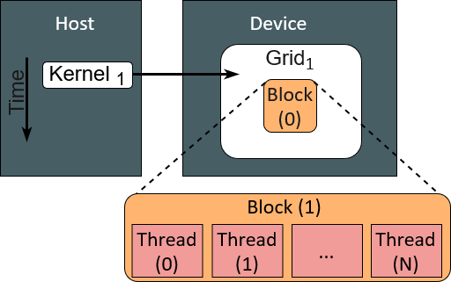
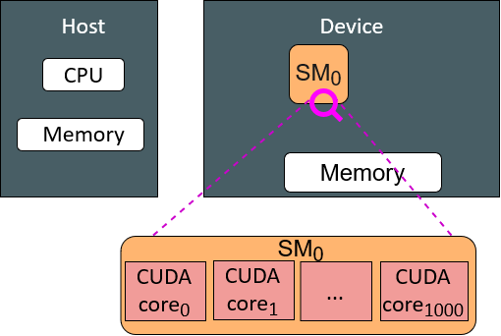
CUDA Threads → CUDA cores
A Block can be split into parallel Threads
Threads in the same block can cooperate
Threads have unique ids (i.e. threadId.x)
Threads are assigned to CUDA cores
Hardware
We have to modify kernel code to use Threads, instead of blocks:
__global__ void add(int *a, int *b, int *c) {
c[threadId.x] = a[threadIdx.x] + b[threadIdx.x]; }
We use the threadId.x instead of blockIdx.x
In main we have to change the kernel call: add<<<1,N>>>(...);
Now we call the kernel with 1xBlock and NxThreads
Programming languages for accelerators
EuroHPC 2022

Slide 28
Combining Threads & Blocks
Until now we have seen parallel vector addition using
Many Blocks with one Thread each
One Block with many Threads
Now let’s get more parallelism (= performance) by using
Many Blocks with many Threads
But before let’s discuss data indexing
Programming languages for accelerators
EuroHPC 2022

Slide 29
Indexing Arrays with Blocks & threads
Consider indexing an array with one element per thread (8 threads/block)
threadid.x
threadid.x
threadid.x
threadid.x
0 | 1 | 2 | ... | 7 | 0 | 1 | 2 | ... | 7 | 0 | 1 | 2 | ... | 7 | 0 | 1 | 2 | ... | 7
blockid.x = 0
blockid.x = 1
blockid.x = 2
blockid.x = 3
With M threads per block, a unique index for each thread is given by:
int index = threadIdx.x + blockIdx.x * M;
M = Number of threads per block or block size
Use the built-in variable blockDim.x for threads per block
int index = threadIdx.x + blockIdx.x * blockDim.x;
Programming languages for accelerators
EuroHPC 2022

Slide 30
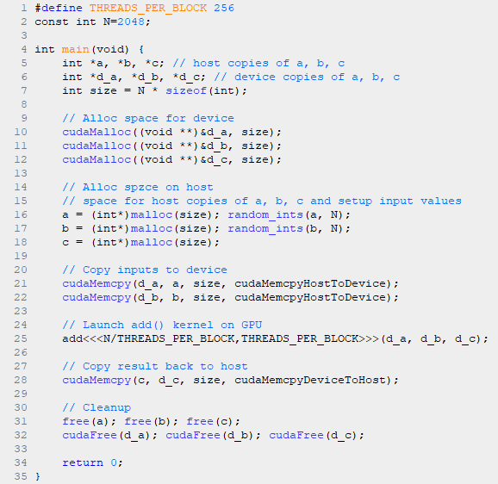

Vector addition with Blocks & Threads
Host code
Kernel code
Block size: 256
Array size: 2048
8 x Blocks, 256 x Threads/Block = 2048
add <<< 8, 256 >>> (…);
Programming languages for accelerators
EuroHPC 2022

Slide 31
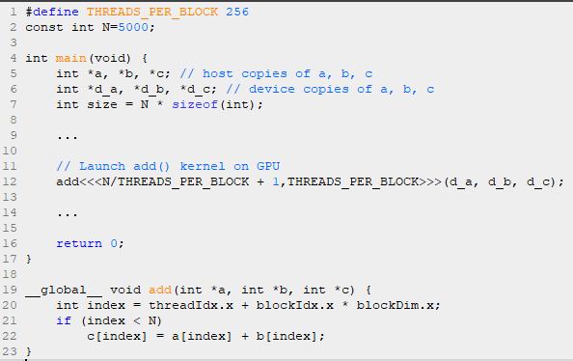
Handling arbitrary vector sizes
Typical problems are not friendly multiples of blockDim.x (e.g. N = 5000)
Array size: 5000
Update kernel launch
Avoid accessing beyond the end of arrays
Programming languages for accelerators
EuroHPC 2022

Slide 32
Compile a CUDA program
nvcc is the CUDA compiler
With CUDA both Host and Device code can be in the same file
With suffix “.cu”
nvcc separates source code into host and device components
Device functions (e.g. add()) processed by NVIDIA compiler
Host functions (e.g. main()) processed by standard host compiler (g++/gcc)
Compile vector addition example:
nvcc vectorAdd.cu –o vectorAdd
Run:
./vectorAdd
Programming languages for accelerators
EuroHPC 2022

Slide 33
Thank you
Questions?
Manos Pavlidakis
manospavl@ics.forth.gr
Find the example in: https://github.com/manospavlidakis/VectorAdditionCUDA.git
Notes:
Thank you very much for you attention I will be happy to answer any questions.

Slide 34
A simple example
Which thread element will operate on the blue cell?
0 | 1 | 2 | ... | 7 | 8 | 9 | 10 | ... | 15 | 16 | 17 | 18 | ... | 23 | 24 | 25 | 25 | ... | 31
Programming languages for accelerators
EuroHPC 2022

Slide 35
A simple example
Which thread element will operate on the blue cell?
threadid.x = 7
0 | 1 | 2 | ... | 7 | 8 | 9 | 10 | ... | 15 | 16 | 17 | 18 | ... | 23 | 24 | 25 | 25 | ... | 31
blockid.x = 2
0 | 1 | 2 | ... | 7 | 0 | 1 | 2 | ... | 7 | 0 | 1 | 2 | ... | 7 | 0 | 1 | 2 | ... | 7
blockid.x = 0
blockid.x = 1
blockid.x = 2
blockid.x = 3
With M threads per block = 8
int index = threadIdx.x + blockIdx.x * M = 7 + 2 * 8 = 23;
Programming languages for accelerators
EuroHPC 2022

