Slide 1
Towards Greener AI for Privacy Preserving Record Linkage
Thesis Presentation: Emmanouil Sokorelis
Department of Applied Informatics
Advisor: Alexandros Karakasidis
13/02/2025

Slide 2
Objectives
Investigate the convergence of accuracy, privacy, and energy efficiency in a novel ER process.
Analyzing CPU energy consumption and total RAM usage impact of integrating differential privacy and deep learning into an ER workflow using Bloom filters.

Slide 3


Technology Used
PyRAPL (Python Energy Profiling)
Purpose: Used for energy consumption measurements.
Functionality: Monitors and measures the energy usage of various computational operations, focusing on CPU energy consumption and RAM usage.
PyTorch
Purpose: Deep learning framework used for training the neural network.
Functionality: Provides tools for building, training, and evaluating models.

Slide 4
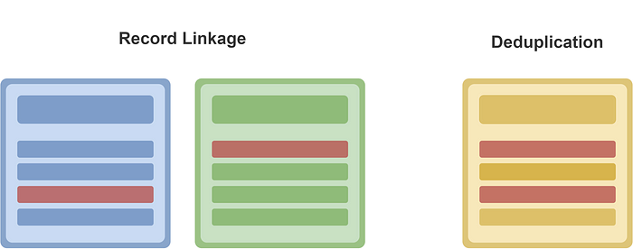
Overview of Entity Resolution
Targets
Ensure that unique entities are accurately represented across various databases.
Challenges
Data quality, scalability, ambiguity & uncertainty etc.
Privacy concerns, especially when handling sensitive personal information.
Relative Concepts
Record linkage, data matching etc.

Slide 5
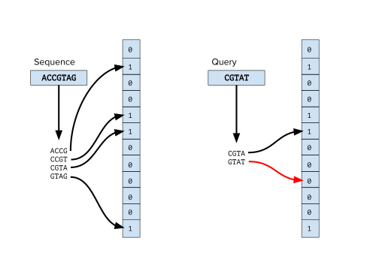
Privacy Protection Methods
Bloom Filters
Compact data structures for privacy-preserving entity resolution.
Risks of inference attacks or reverse engineering with weak hash functions.
Differential Privacy
Adds noise to protect individual records while preserving data utility.
Balances privacy and accuracy through parameter tuning.

Slide 6
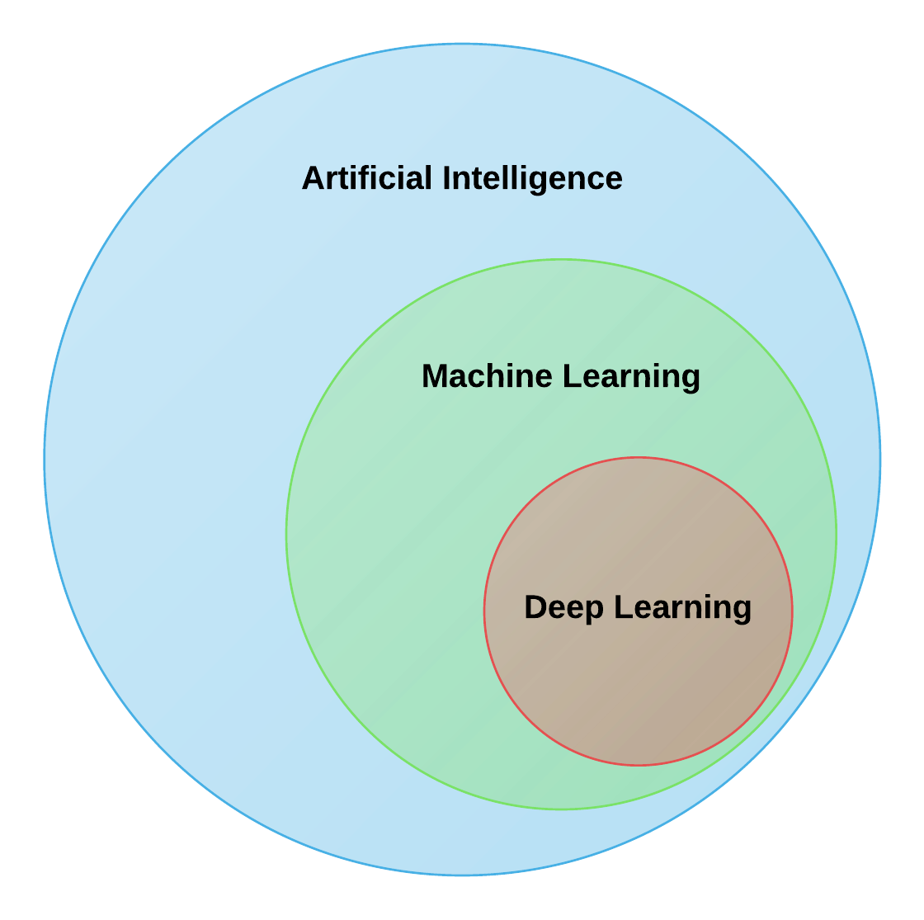
Deep Learning for Entity Resolution
Gaining Momentum in Recent Years
Deep learning techniques have gained significant attention for entity resolution due to their ability to learn complex patterns from data.
Automated Feature Learning
Learns representations directly from raw data, reducing the need for manual feature engineering.

Slide 7
Workflow Overview
Raw Datasets (A & B)
Data Encoding into Bloom Filters
Goal
Efficiently and effectively identify matching records across two datasets while maintaining data confidentiality.
Differential Privacy Noise Addition
Generating Record Pairs and Computing Similarity Scores
Training and Evaluating Neural Networks

Slide 8
Data encoding into Bloom filters
Raw Datasets (A & B)
Data Encoding into Bloom Filters
Break down records into smaller substrings (e.g., bigrams, trigrams)
Initialize Bloom filters:
Capacity: Max number of elements stored
Error Rate: Probability of false positives
Insert the generated q-grams into the filters
Differential Privacy Noise Addition
Generating Record Pairs and Computing Similarity Scores
Training and Evaluating Neural Networks

Slide 9

Data encoding into Bloom filters
 | Col 0 | Col 1 | … | Col N
Row 0 | … | … | … | …
Row 1 | … | … | … | …
… | … | … | … | …
Row M | … | … | … | …
Dataset B
 | Col 0 | Col 1 | … | Col N
Row 0 | … | … | … | …
Row 1 | … | … | … | …
… | … | … | … | …
Row M | … | … | … | …
Dataset A

Slide 10
Data encoding into Bloom filters
Ghost | Tommy
GH
HO
OS
ST
TO
OM
MY
 | Col 0 | Col 1 | … | Col N
Row 0 | … | … | … | …
Row 1 | … | … | … | …
… | … | … | … | …
Row M | … | … | … | …
1
0
1
0
1
1
0
0
0
0
1
1
0
1

Slide 11

Data encoding into Bloom filters
 | Bit 0 | Bit 1 | … | Bit K
Row 0 | … | … | … | …
Row 1 | … | … | … | …
… | … | … | … | …
Row M | … | … | … | …
Encoded Dataset B
 | Bit 0 | Bit 1 | … | Bit K
Row 0 | … | … | … | …
Row 1 | … | … | … | …
… | … | … | … | …
Row M | … | … | … | …
Encoded Dataset A

Slide 12


Data encoding into Bloom filters
Capacity (n) | Error Rate (p) | Bloom Filter Size (m) | Number of hash functions (k)
100 | 0.01 | 959 | 7
100 | 0.1 | 480 | 4
200 | 0.01 | 1918 | 7
200 | 0.1 | 959 | 4
Capacity ⬆, Bloom filter size ⬆
Error rate ⬇, Bloom filter size ⬆
Error rate ⬇,
Number of hash functions ⬆
Bloom filter size:
Number of hash functions:

Slide 13
Differential privacy noise addition
Raw Datasets (A & B)
Data Encoding into Bloom Filters
Randomly alter bits to obscure original data
Bit Flip Probability: The likelihood of flipping a bit in the Bloom filter.
Differential Privacy Noise Addition
1
0
0
Generating Record Pairs and Computing Similarity Scores
1
0
1
0
1
1
0
0
0
0
1
1
0
1
Training and Evaluating Neural Networks

Slide 14
Generating record pairs and
computing similarity scores
Raw Datasets (A & B)
Data Encoding into Bloom Filters
Use Cartesian product to create all possible record pairs
Calculate similarity and difference metrics
Jaccard Similarity: Proportion of shared elements.
Dice Similarity: Similar to Jaccard, but gives higher weight to the intersection.
Hamming Distance: Counts the number of differing positions between two strings.
Differential Privacy Noise Addition
Generating Record Pairs and Computing Similarity Scores
Training and Evaluating Neural Networks

Slide 15

Generating record pairs and
computing similarity scores
 | Bloom Filter A |  |  |  | Bloom Filter B
 | Bit 0 | Bit 1 | … | Bit N | Bit 0 | Bit 1 | … | Bit N
Row 0 | … | … | … | … | … | … | … | …
Row 1 | … | … | … | … | … | … | … | …
… | … | … | … | … | … | … | … | …
Row M*M | … | … | … | … | … | … | … | …
Record Pairs

Slide 16
Generating record pairs and
computing similarity scores
1
0
1
1
0
1
1
0
1
0
1
0
1
1
Jaccard Similarity = 3/6=0.5
Dice Similarity = 2*3/14=0.429
Hamming Distance = 3

Slide 17
Training and Evaluating
Neural Networks
Raw Datasets (A & B)
Data Encoding into Bloom Filters
Normalize similarity and difference features and feed them into a neural network
Neural Network Architecture: hidden layers, number of neurons, etc.
Training Parameters: learning rate, loss function, optimizer.
Differential Privacy Noise Addition
Generating Record Pairs and Computing Similarity Scores
Training and Evaluating Neural Networks

Slide 18
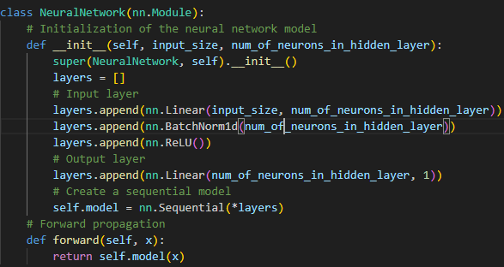
Training and Evaluating
Neural Networks
Parameters
Learning rate: 0.001.
Loss function: BCEWithLogitsLoss.
Optimizer: Adam.

Slide 19
Training and Evaluating
Neural Networks
Configuration | Weights (Input to Hidden) | Biases (Hidden) | Batch Norm Parameters | Weights (Hidden to Output) | Bias (Output) | Total Parameters
16 | 48 | 16 | 32 | 16 | 1 | 113
8 | 24 | 8 | 16 | 8 | 1 | 57
4 | 12 | 4 | 8 | 4 | 1 | 29

Slide 20
Experimental Approach
Exhaustive training
Few-shot learning
Cross dataset evaluation
Split data: 60% training, 20% validation, 20% test.
Train a neural network with a batch size 8192 for 5, 10 and 20 epochs.
Objective: Assess trade-offs between accuracy, privacy, and energy efficiency by varying different parameters.
Train on smaller datasets (sample sizes: 10, 100, 1,000) with a patience of 20 until validation loss stop decreasing.
Objective: Evaluate performance with limited data, saving energy by training on smaller set.
Train a neural network with a batch size 8192 for 20 epochs.
Objective: Evaluate model performance across different datasets, saving energy by reusing models.

Slide 21
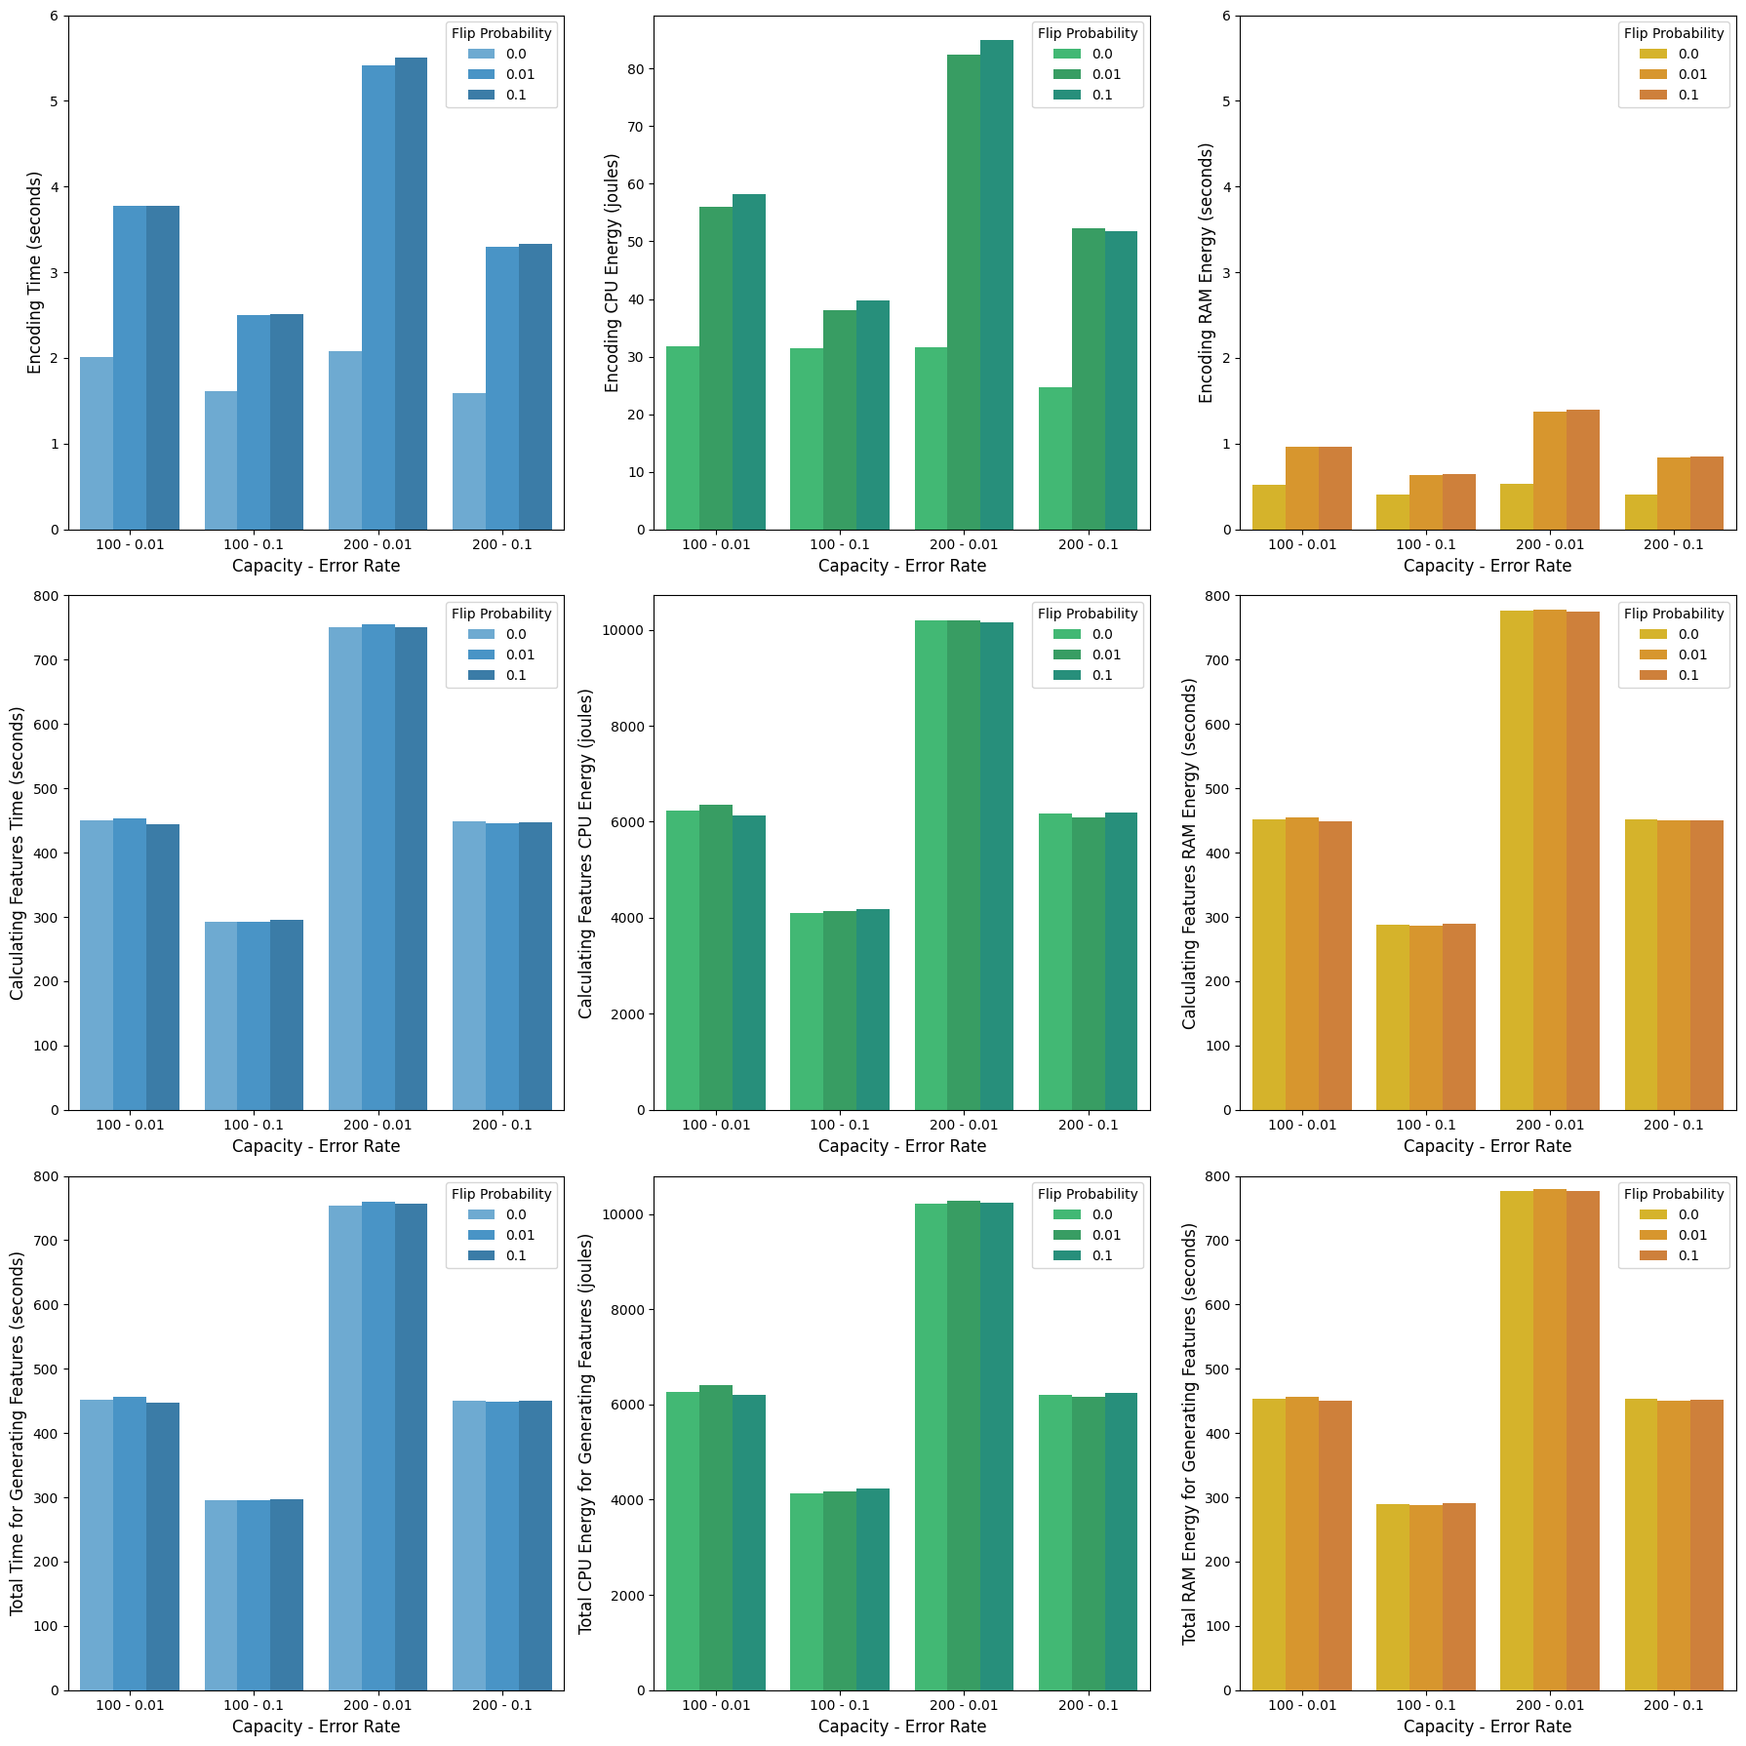
Impact of Capacity, Error Rate and Flip Probability on Time and Energy on Feature Generation

Slide 22
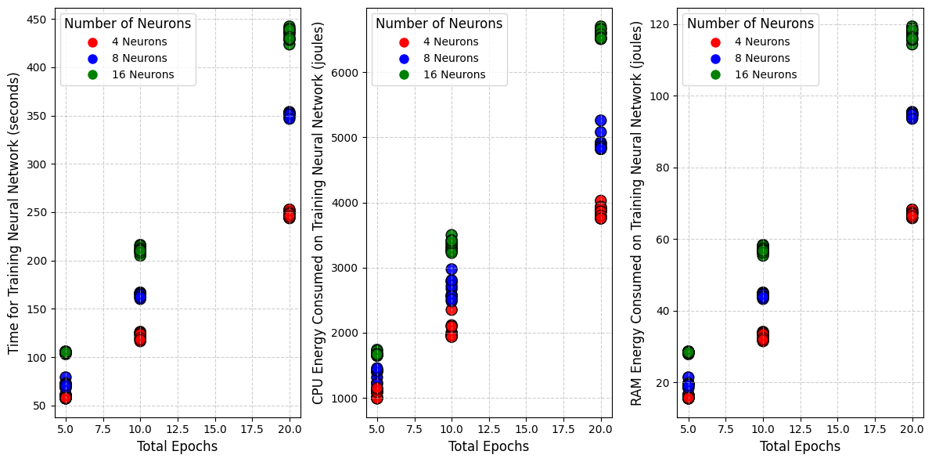
Impact of Number of Neurons and Total Epochs on Time on Training Phase

Slide 23
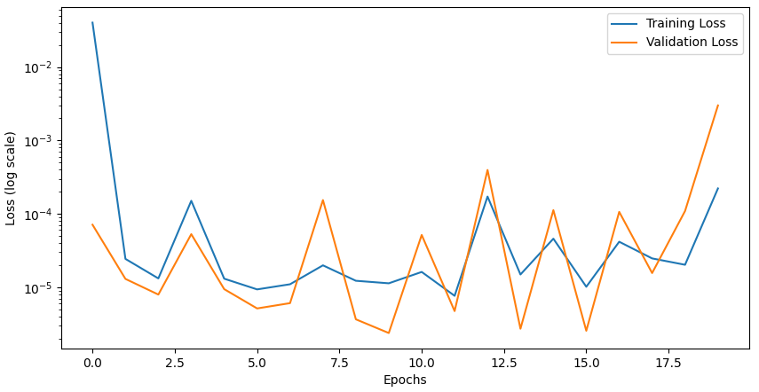
Potential overfitting
Loss vs Val Loss

Slide 24
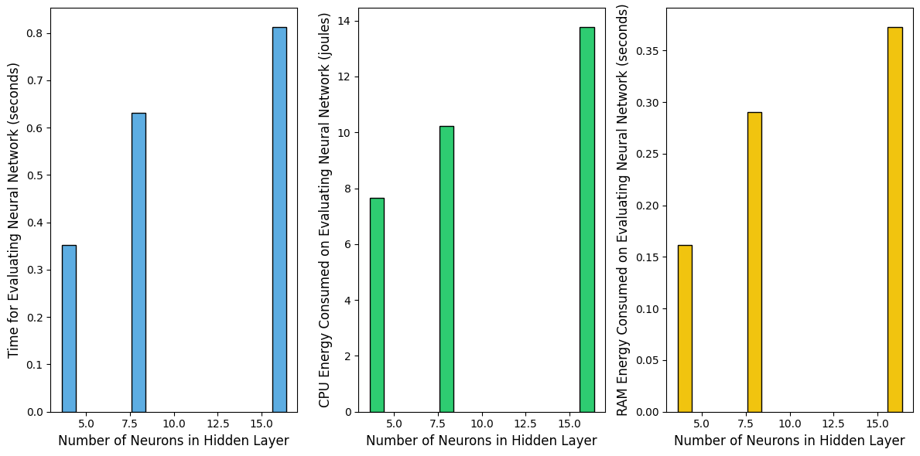
Impact of Number of Neurons on Time on Evaluation Phase

Slide 25
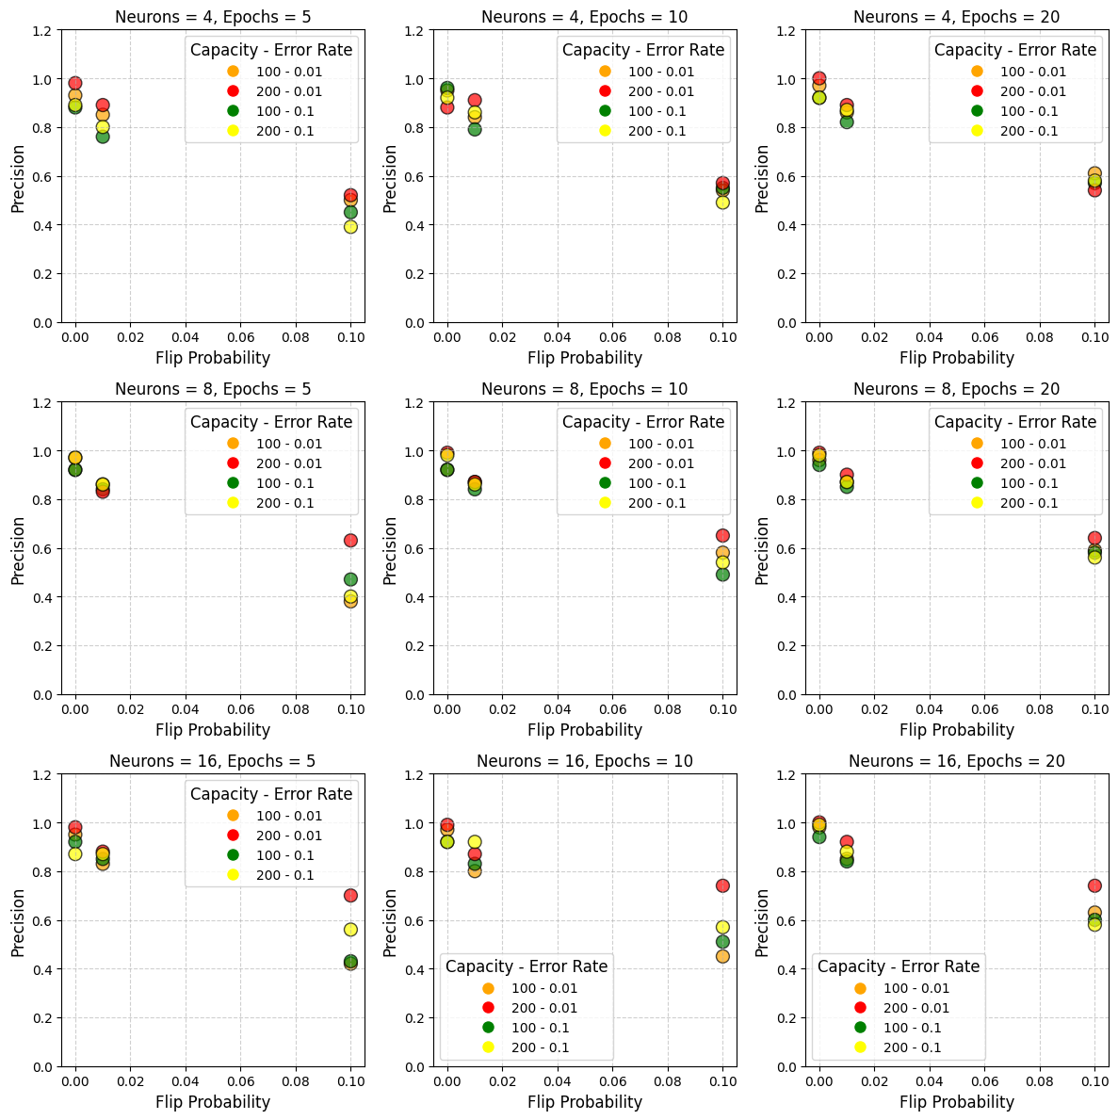
Precision vs Privacy trade-off

Slide 26
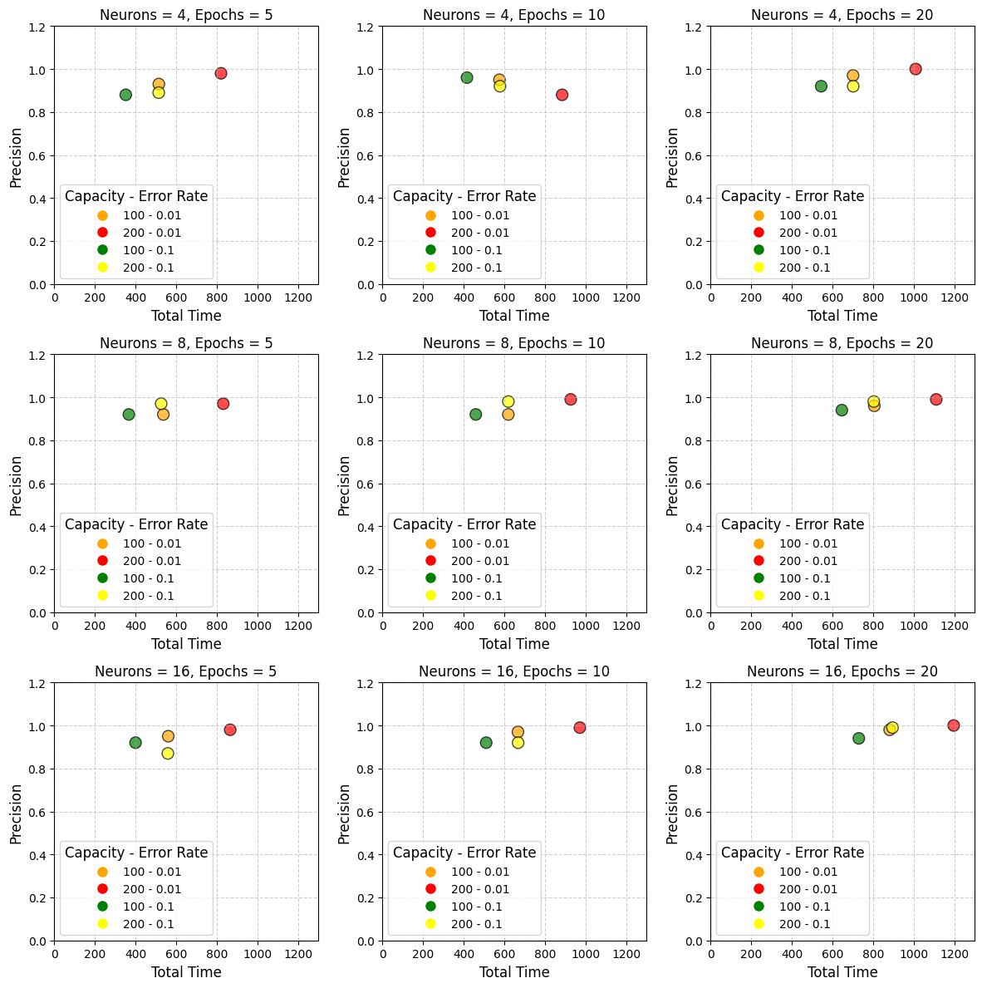
Precision vs Time trade-off

Slide 27
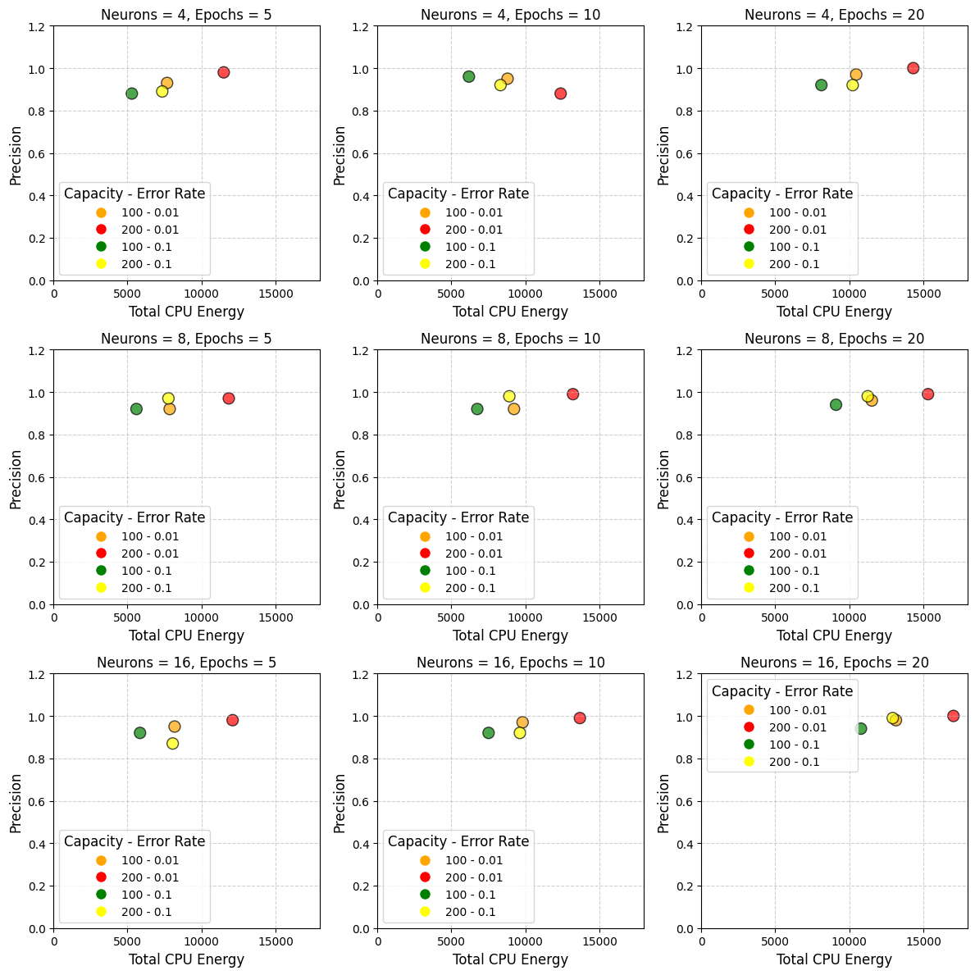
Precision vs CPU Energy trade-off

Slide 28
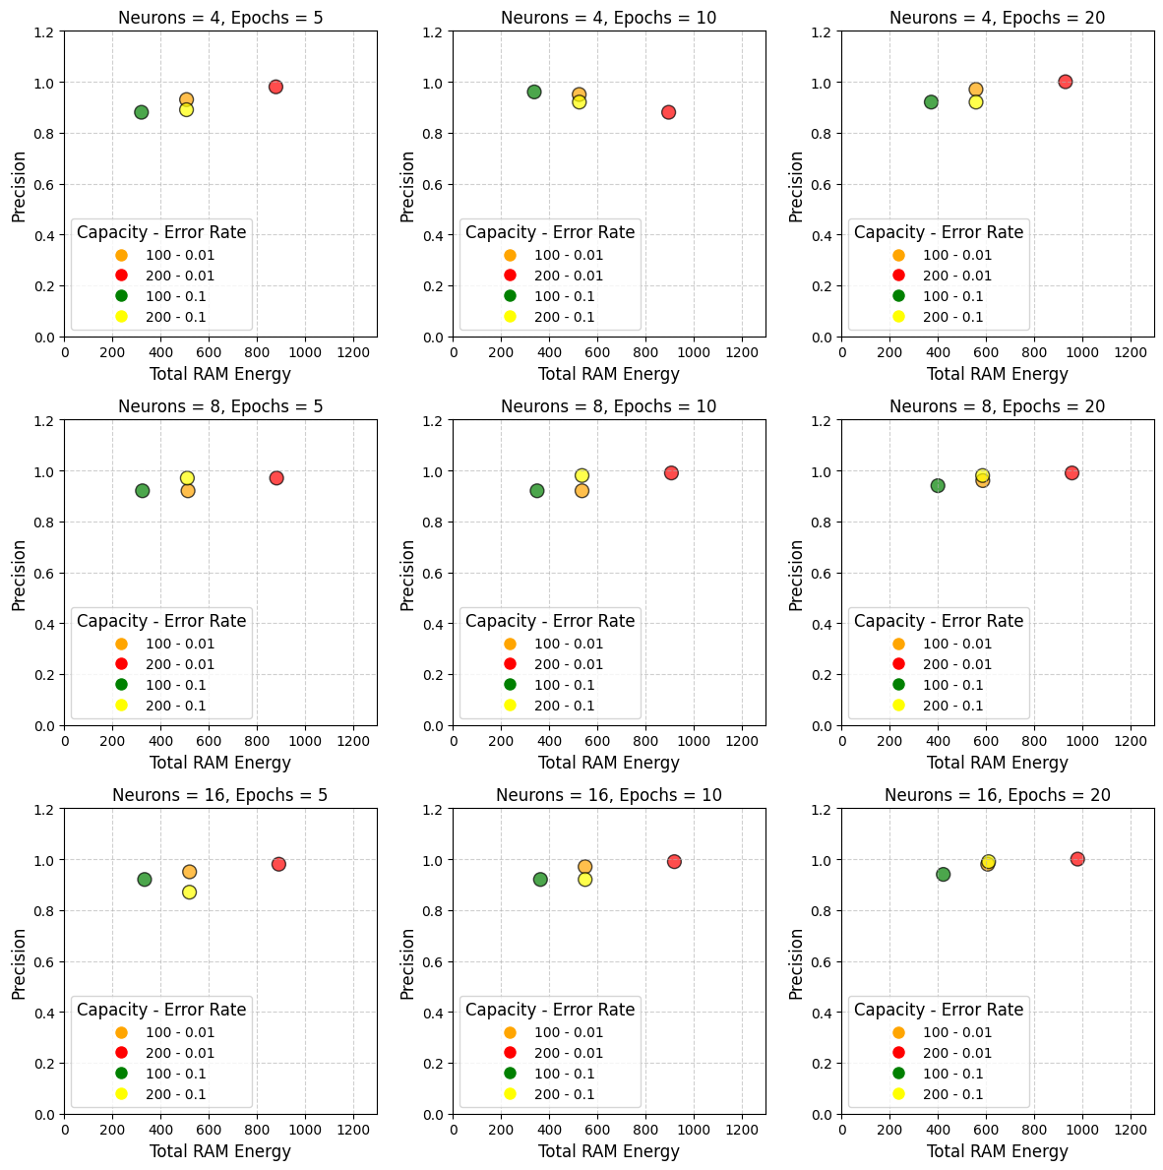
Precision vs RAM Usage trade-off

Slide 29
Faults per Record | Size of Training Set | Capacity | Error Rate | Flip Probability | Number of Neurons | Precision | Recall
1 | 10 | 200 | 0.01 | 0.01 | 16 | 0.11 | 1
1 | 100 | 200 | 0.01 | 0.01 | 16 | 0.62 | 1
1 | 1000 | 200 | 0.01 | 0.01 | 16 | 0.76 | 1
1 | 60 M | 200 | 0.01 | 0.01 | 16 | 0.92 | 1
5 | 10 | 200 | 0.01 | 0.01 | 16 | 0.01 | 1
5 | 100 | 200 | 0.01 | 0.01 | 16 | 0.32 | 1
5 | 1000 | 200 | 0.01 | 0.01 | 16 | 0.41 | 1
5 | 60 M | 200 | 0.01 | 0.01 | 16 | 0.72 | 1
Results of Few-Shot Experiments

Slide 30
Training Dataset | Evaluation Dataset | Flip Probability | Capacity | Error Rate | Flip Probability | Number of Neurons | Precision | Recall
B with 1 error | A with 1 error | 0.01 | 200 | 0.01 | 0.01 | 16 | 0.98 | 1
B with 1 error | A with 5 errors | 0.01 | 200 | 0.01 | 0.01 | 16 | 0.77 | 1
B with 5 errors | A with 1 error | 0.01 | 200 | 0.01 | 0.01 | 16 | 0.95 | 1
B with 5 errors | A with 5 errors | 0.01 | 200 | 0.01 | 0.01 | 16 | 0.79 | 1
Results of Cross Dataset Evaluation

Slide 31
Conclusions
Summary of Findings
Impact of Bloom Filter Size
Neural Network Complexity & Energy Trade-offs
Few-Shot Learning & Model Reuse
Balancing Accuracy, Privacy & Energy

Slide 32
Impact of Bloom Filter Size and Privacy
Neural Network & Energy Trade-offs
Strategies for Energy Efficiency
Larger Bloom filters → Higher accuracy but increased energy and time consumption.
Smaller Bloom filters → Lower energy usage but potentially less accurate results.
Flip probability minimally affects energy but slightly reduces accuracy by introducing noise.
More neurons & layers → Improved accuracy but higher energy cost.
More epochs during training → Higher accuracy but longer processing time and energy consumption.
Few-shot learning: Reduces training data to save energy but risks lower accuracy.
Model reuse: Saves computation by reusing trained models but may not generalize well to different datasets.

Slide 33

Balancing Accuracy, Privacy & Energy Efficiency
Key Takeaways
Increasing privacy can lower accuracy.
Boosting accuracy (larger models, more training) increases energy consumption.
Users must balance privacy, energy efficiency, and accuracy based on application needs.
No one-size-fits-all: The optimal configuration depends on priorities.

Slide 34



Thanks!
Do you have any questions?
ics21087@uom.edu.gr

