Slide 1
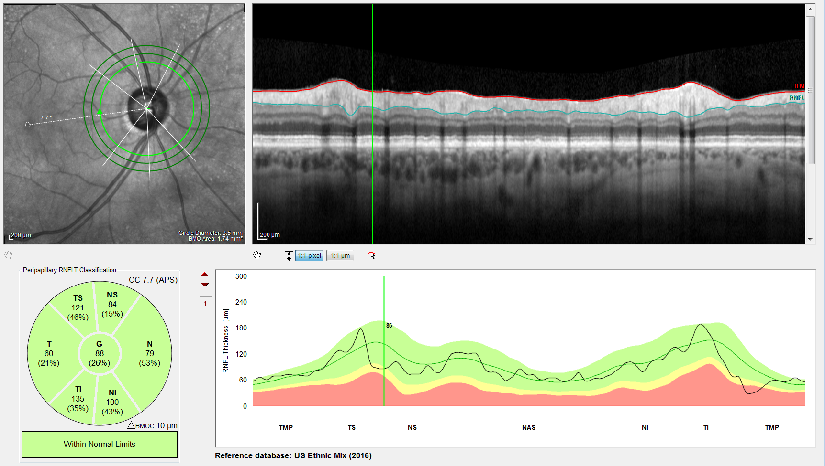
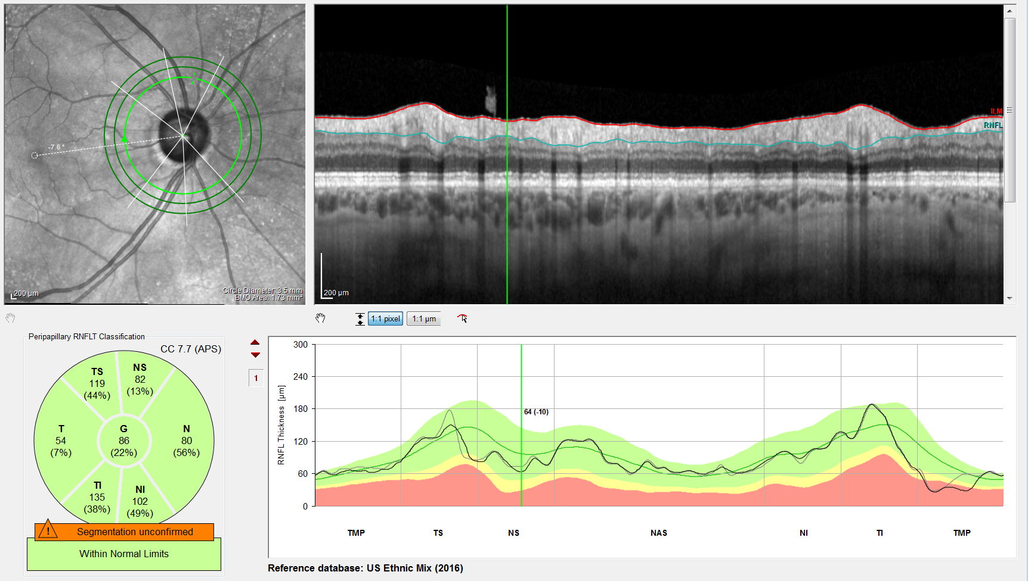
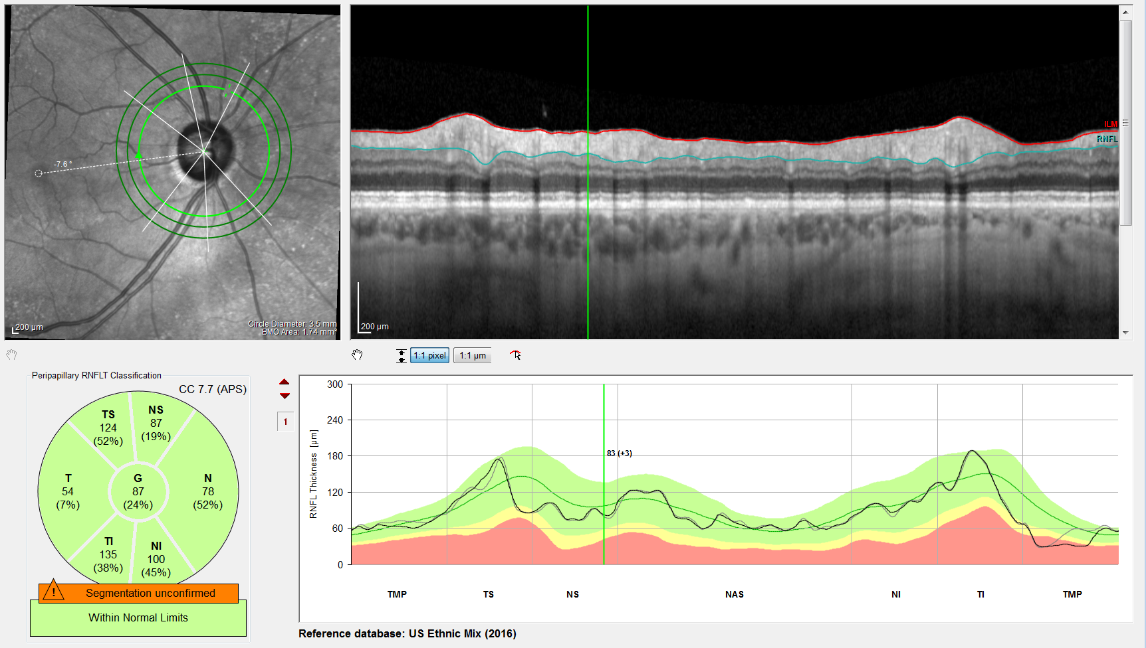
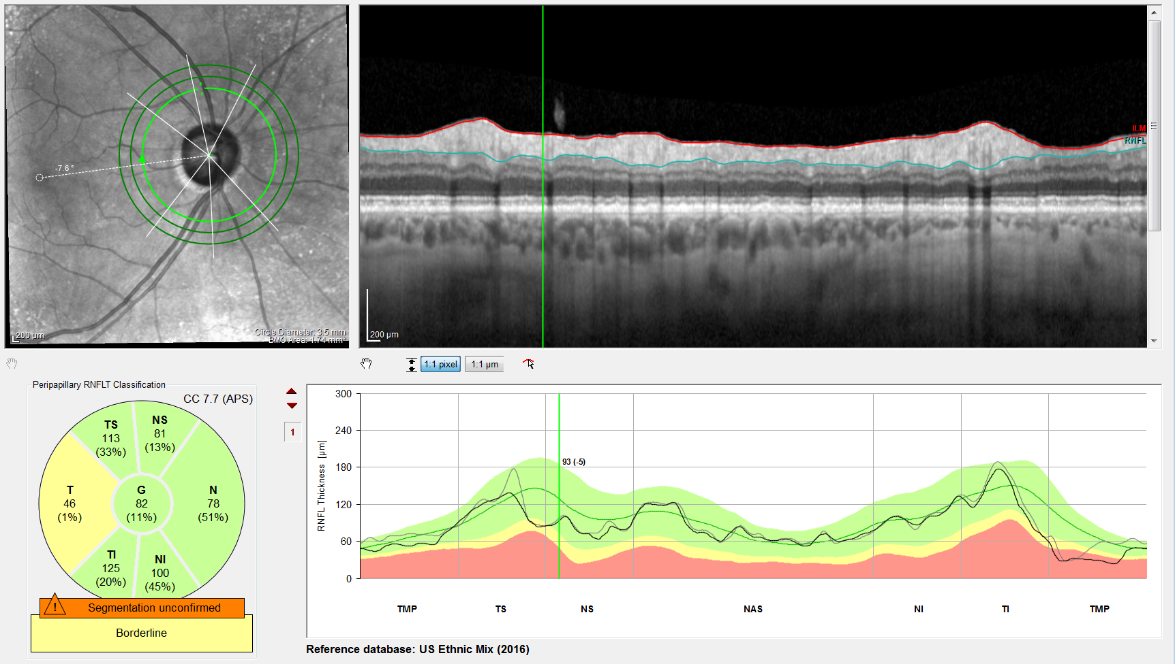
01/11/16
11/06/17
04/26/18

Slide 2
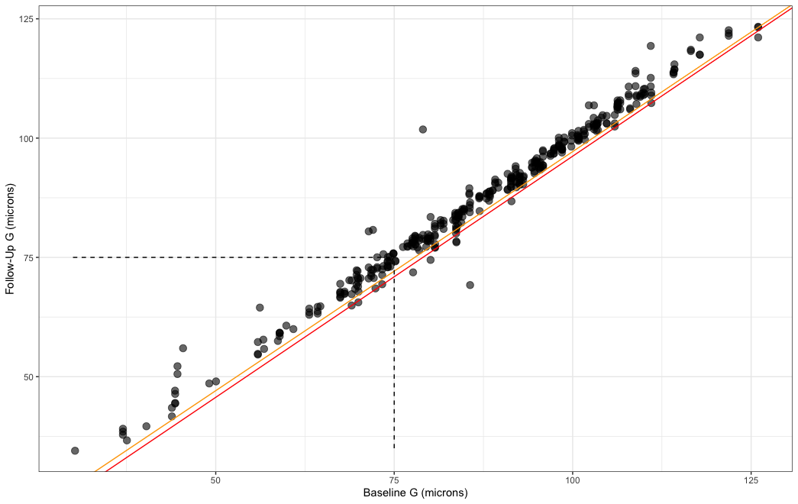
Event Analysis
95th (orange) and 97.5th (red) percentile thresholds are estimated from ~550 short-term scans.

Slide 3
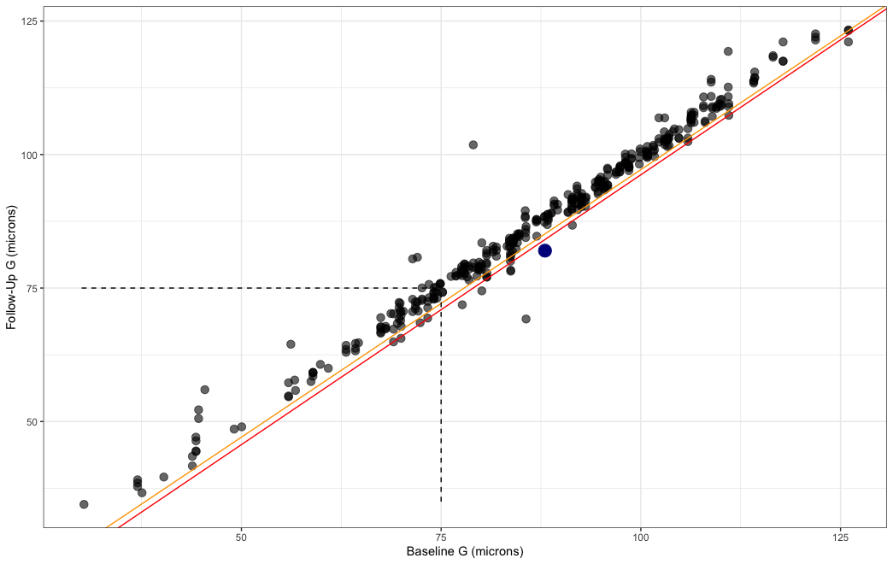
Event Analysis
If the Follow-Up measure was lower than this threshold, the eye is considered a ‘Progressor’.
See blue point

Slide 4
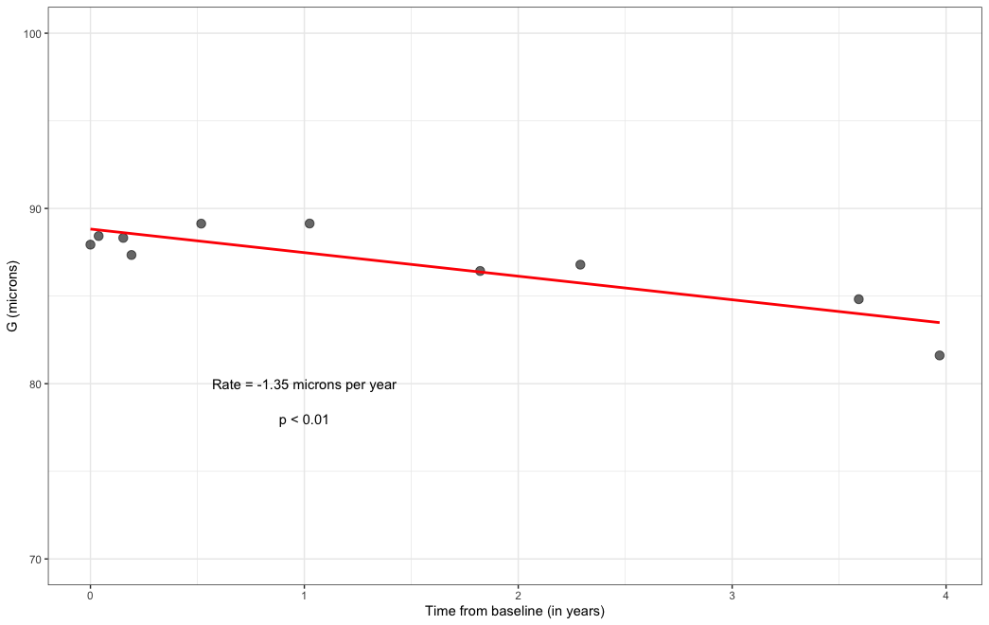
Trend Analysis

