Slide 1
Auto ai model for crop-recommendation
IBM HACKATHON PROJECT
Presented By: Manotosh Maity
Faculty name : Deepneel Majumdar
College Name & Department : Brainware University, B.TECH CSE(AIML)

Slide 2
OUTLINE
Problem Statement
Technology used
Wow factor
End users
Result
Conclusion
Git-hub Link
Future scope
IBM Certifications

Slide 3
Problem Statement
Maximizing agricultural yield requires selecting the most suitable crops for given soil and climatic conditions. Farmers often lack data-driven tools to decide what to cultivate, leading to lower productivity. This project aims to build a machine learning model that recommends the appropriate crop based on soil nutrients (N, P, K), pH, temperature, humidity, and rainfall. The solution will empower farmers with actionable insights, supporting precision agriculture and sustainable farming practices.
Proposed Solution: The solution leverages the Crop Recommendation dataset to train a machine learning model using IBM Watson Studio’s AutoAI for automated pre-processing and model selection. The best-performing model is deployed on IBM Watson Machine Learning, exposing a secure API endpoint. A Streamlit web application is developed to interact with this deployment, allowing users to input soil and climate parameters. This integrated pipeline enables real-time, data-driven crop recommendations to maximize yield and support farmers’ decision-making.

Slide 4
Technology used
IBM Cloud Lite Services (Watson Studio, Watson Machine Learning, Cloud Object Storage)
IBM AutoAI (automated model building & selection)
Python (Streamlit, Requests, Pandas, Scikit-learn)
Streamlit Cloud (for hosting the web app)

Slide 5
IBM cloud services used
IBM Watson Studio (AutoAI) – for automated model training & pipeline generation
IBM Watson Machine Learning (WML) – for deploying and hosting the trained model
IBM Cloud Object Storage (COS) – for storing the dataset securely
IBM Watson Machine Learning Model- to make the ML model on the basis of dataset for prediction basis task.
Streamlit (hosted on Streamlit Cloud) – for building the user-facing web application

Slide 6
Wow factors
Real-time crop prediction powered by IBM Cloud API & AutoAI
Farmer-friendly web app hosted on Streamlit Cloud with simple input fields
Data-driven recommendations based on soil nutrients, pH, weather, and rainfall
Supports sustainable farming by optimizing crop selection and yield
Scalable solution that can be expanded with IoT sensors and multilingual support

Slide 7
End users
Farmers and Farming Communities – to get real-time crop recommendations.
Agricultural Extension Officers – to guide farmers with data-driven advice.
Government Agencies & Policymakers – to support sustainable agriculture planning.
AgriTech Companies & Startups – to integrate recommendations into digital farming solutions.
Researchers & Educators – to study precision agriculture and improve models.

Slide 8
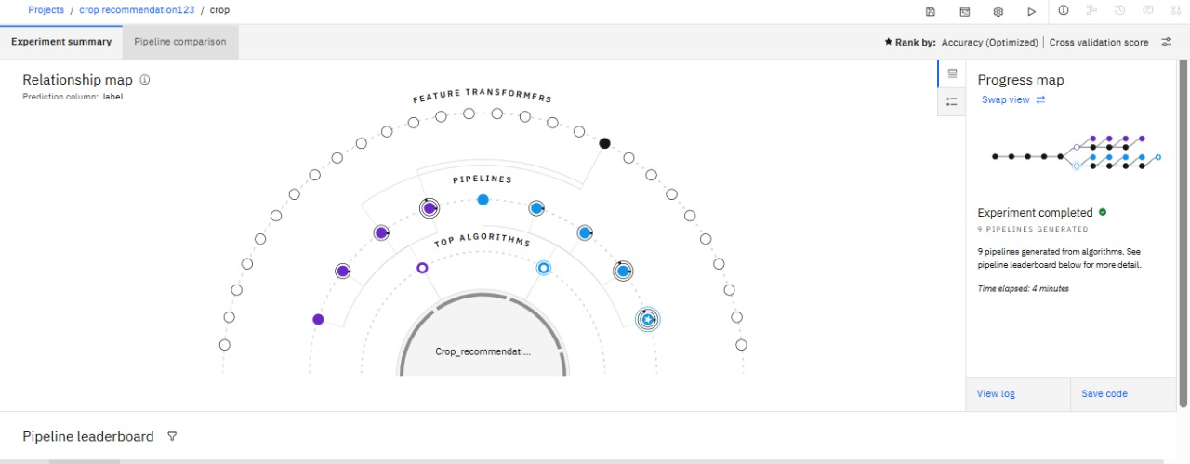
Results
Experiment Summary – Relationship Map.

Slide 9
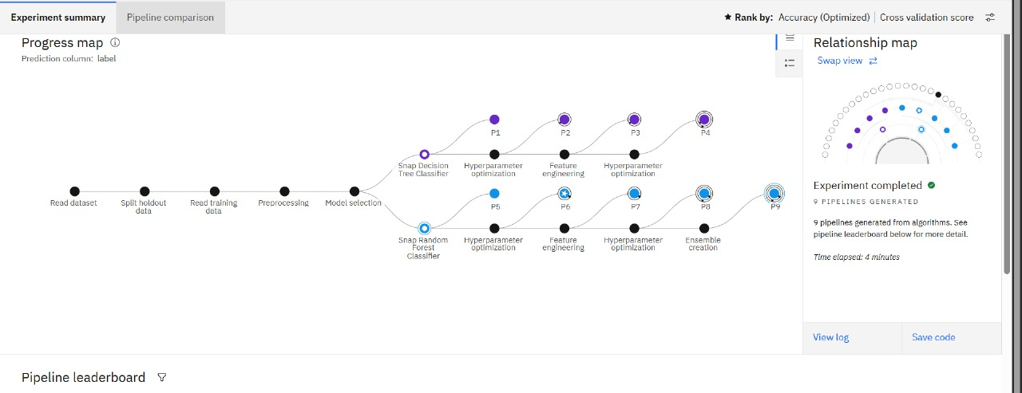
Results

Slide 10
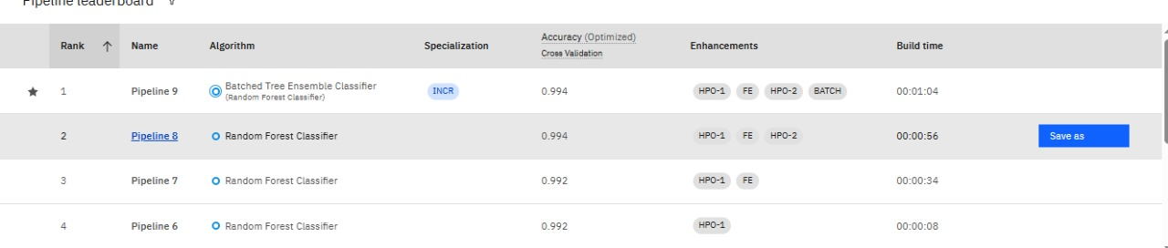
Results

Slide 11
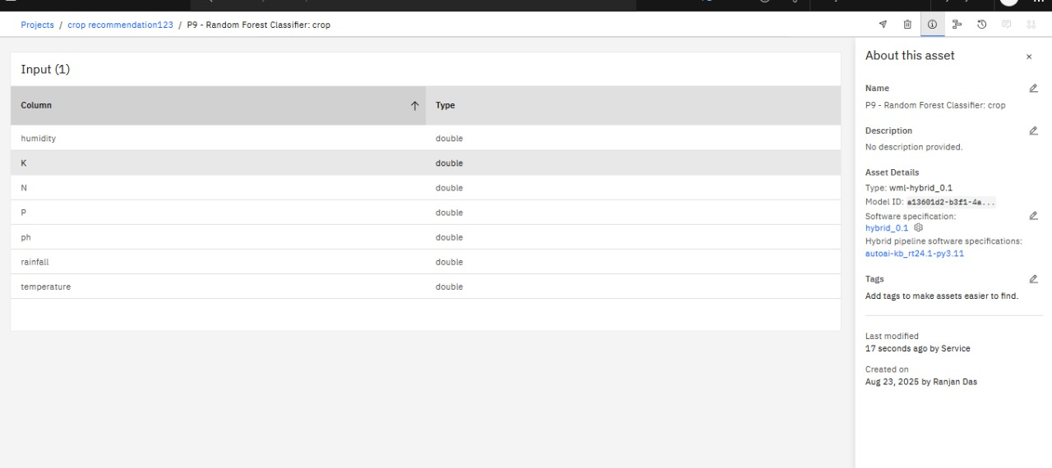
Results

Slide 12
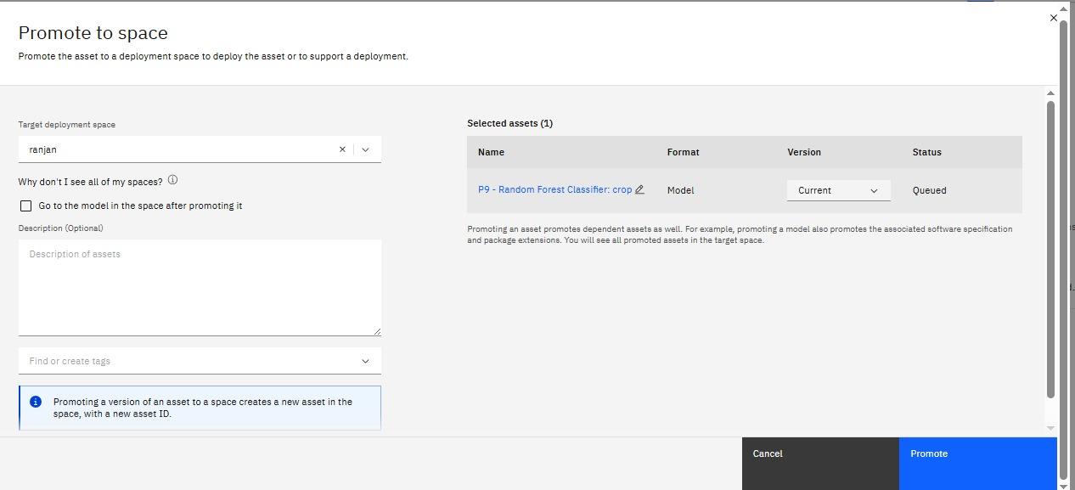
Results

Slide 13
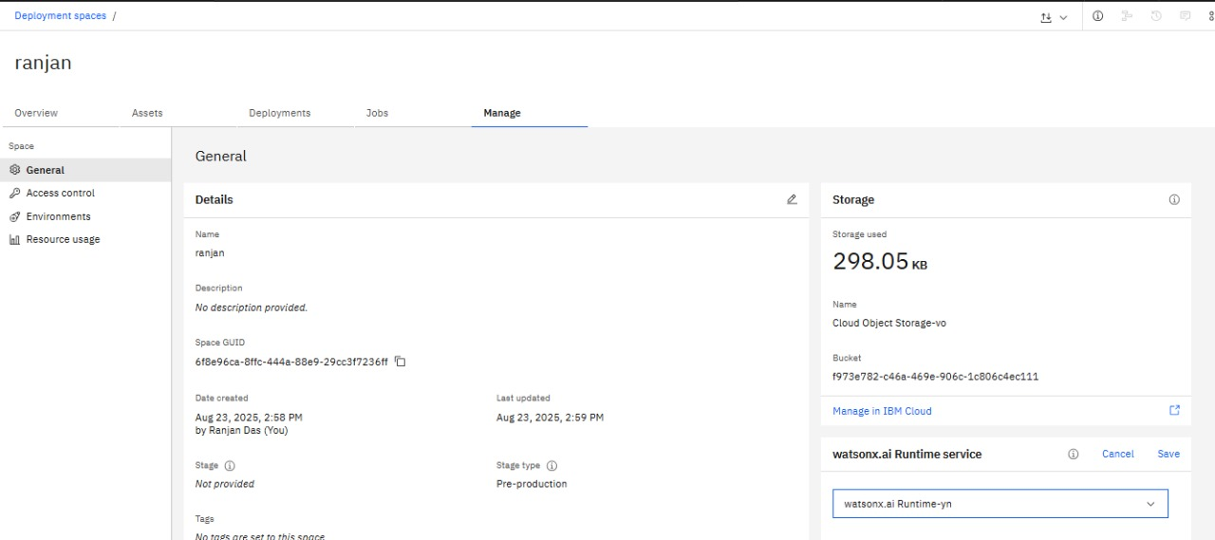
Results

Slide 14
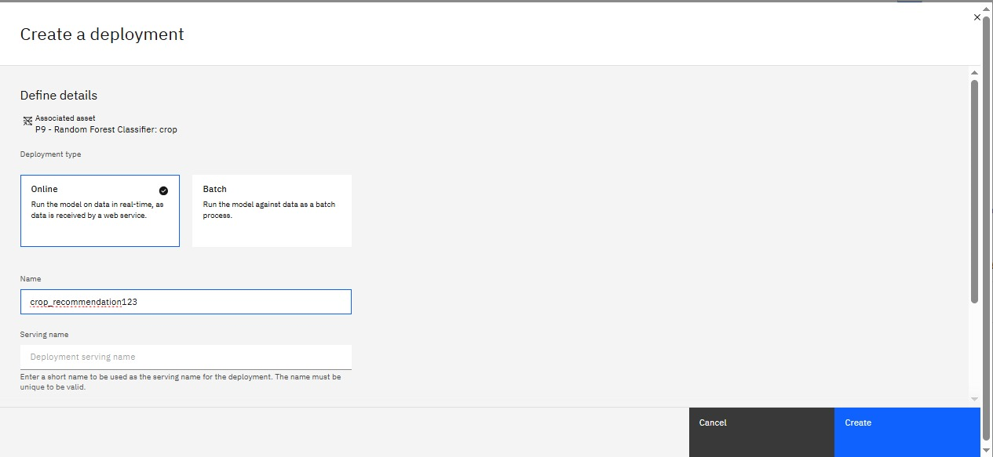
Results

Slide 15
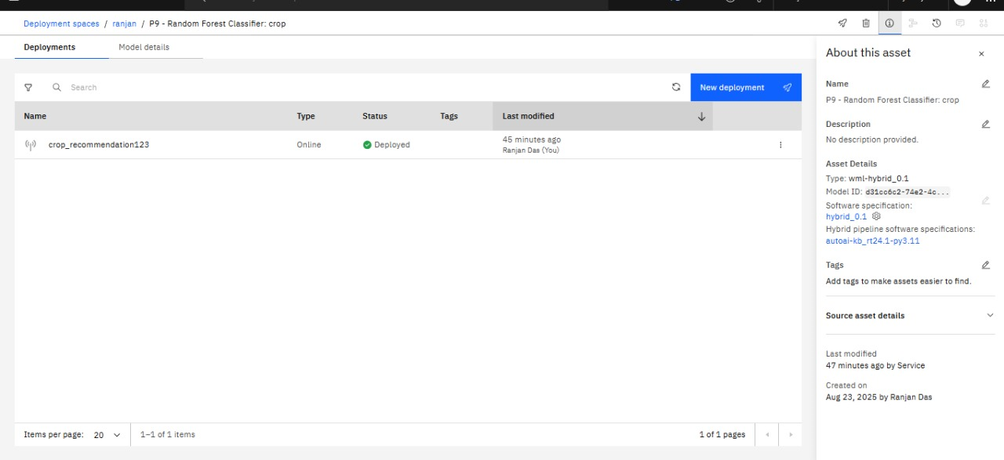
Results

Slide 16
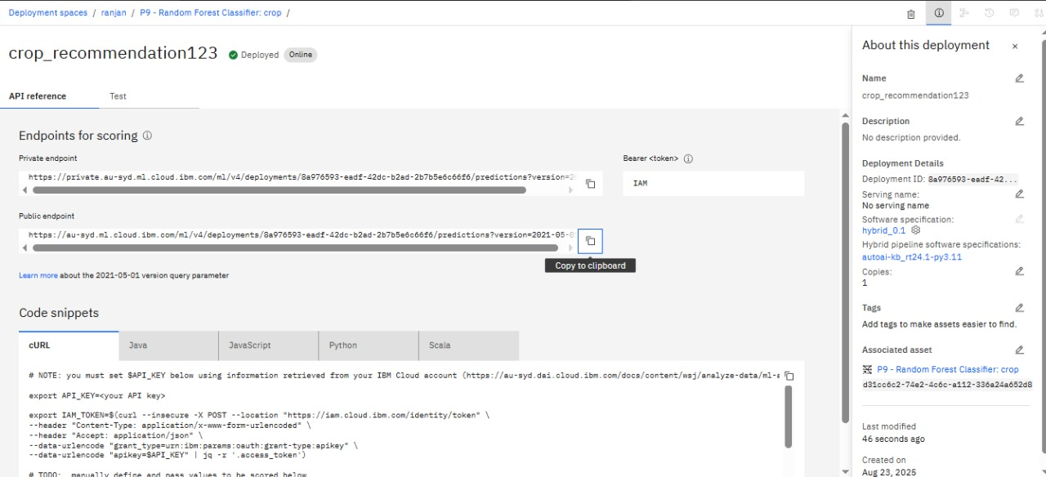
Results

Slide 17
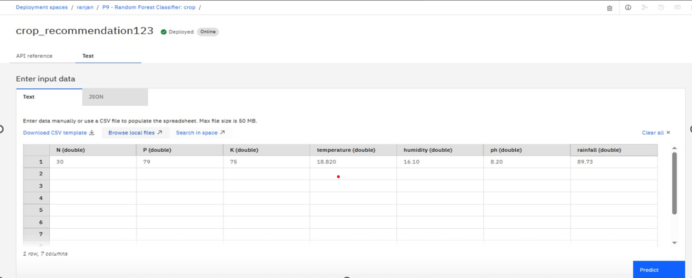
Results

Slide 18
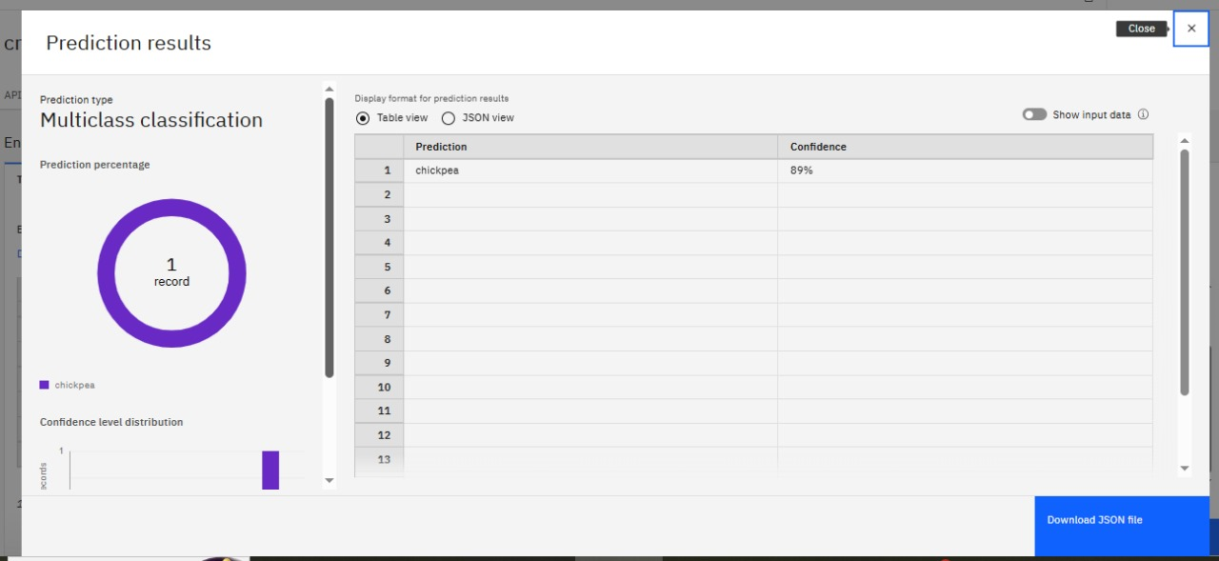
Results

Slide 19
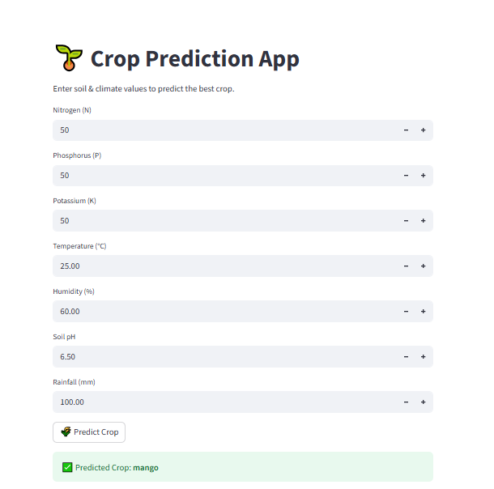
Results
I have developed the Crop Prediction App by integrating an IBM Cloud–deployed machine learning model through the IBM API key and deployment endpoint URL using Python, and hosted it on Streamlit Cloud. The application takes soil nutrients (N, P, K), weather conditions, and soil pH as inputs to recommend the most suitable crop. With its user-friendly interface, the app empowers farmers and stakeholders to make data-driven decisions, maximize yield, and promote sustainable agriculture.

Slide 20
Conclusion
A machine learning model was successfully built using the Crop Recommendation dataset on IBM Watson Studio (AutoAI).
The best-performing model was deployed on IBM Watson Machine Learning, enabling real-time predictions through an API.
A Streamlit application was developed to provide an easy-to-use interface for farmers and stakeholders.
The solution demonstrates how cloud-based AI can support precision agriculture, improve decision-making, and maximize crop yield.

Slide 21
GitHub Link
GITHUB REPOSITORY LINK- https://github.com/manotoshmaity/crop_production
DEPLOYMENT LINK : https://cropappuction-j9q28ufjvmwfait7stxxkp.streamlit.app/

Slide 22
Future scope
Real-time crop recommendation using IoT and weather APIs
Mobile and multilingual farmer-friendly application
Integration with government & AgriTech platforms
Predictive analytics for yield and risk management
Scalable cloud deployment for nationwide adoption

Slide 23
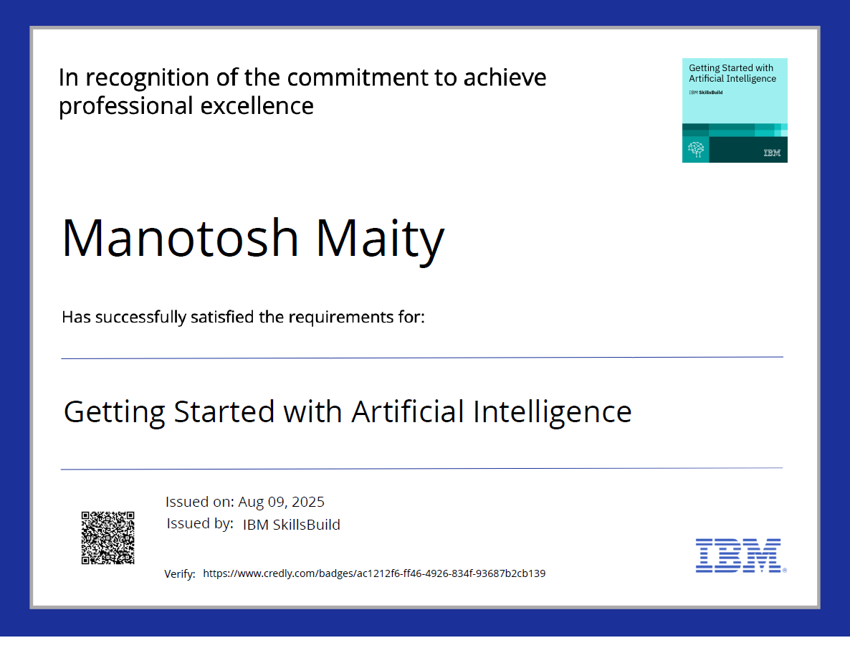
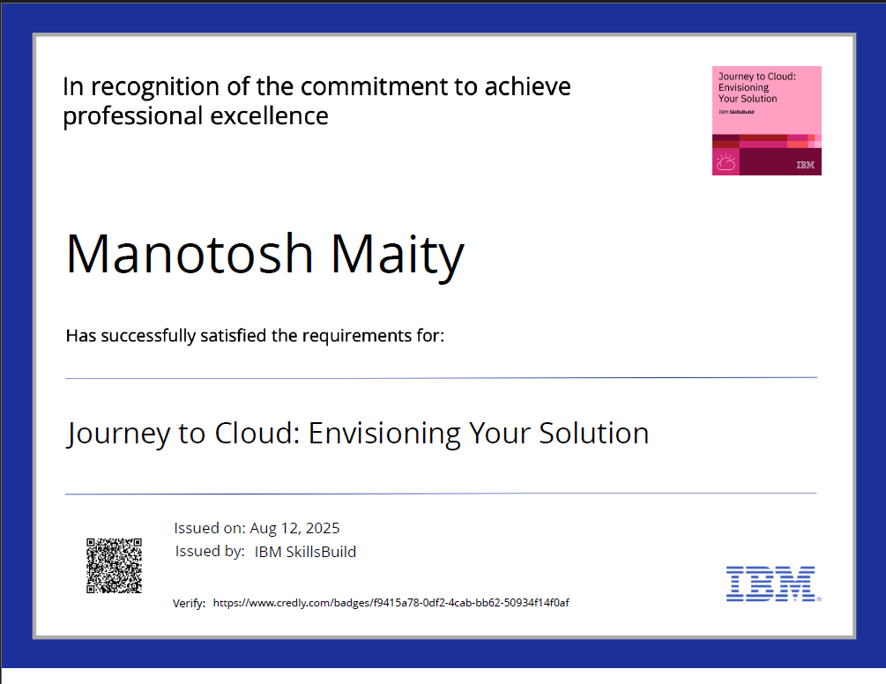
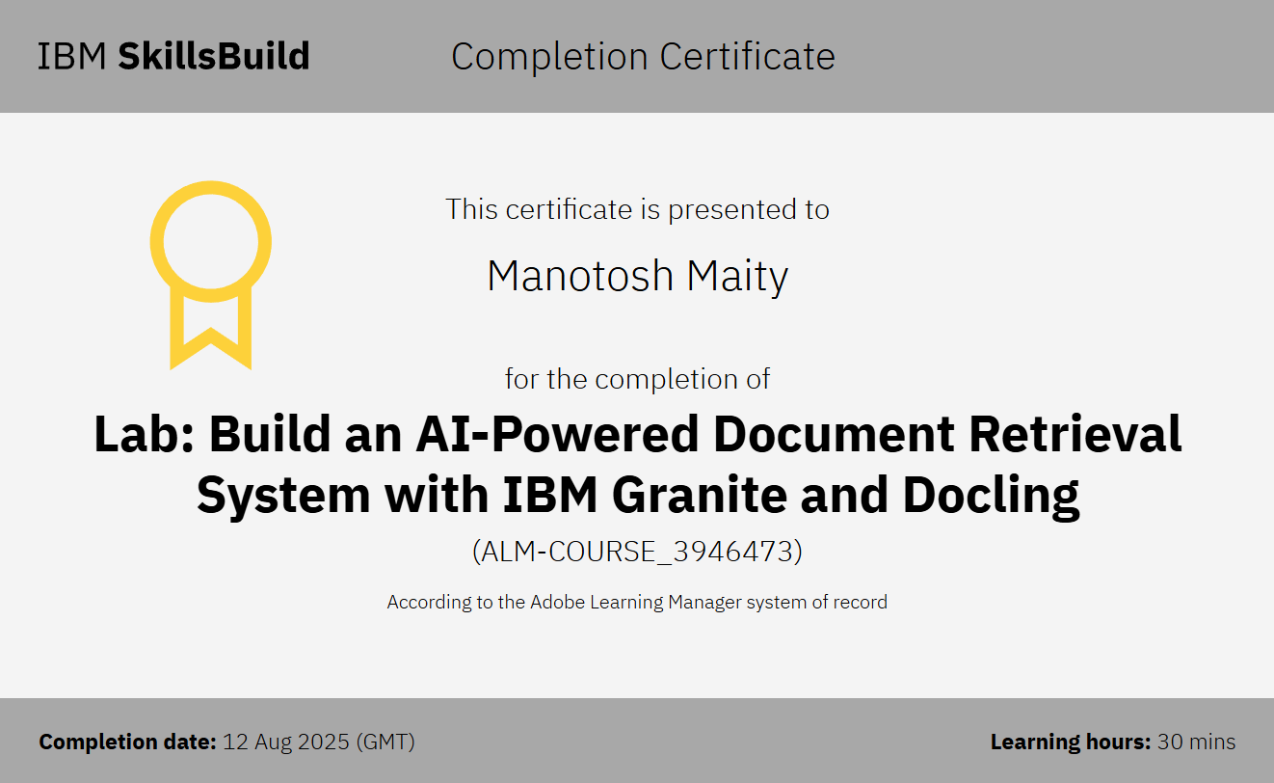
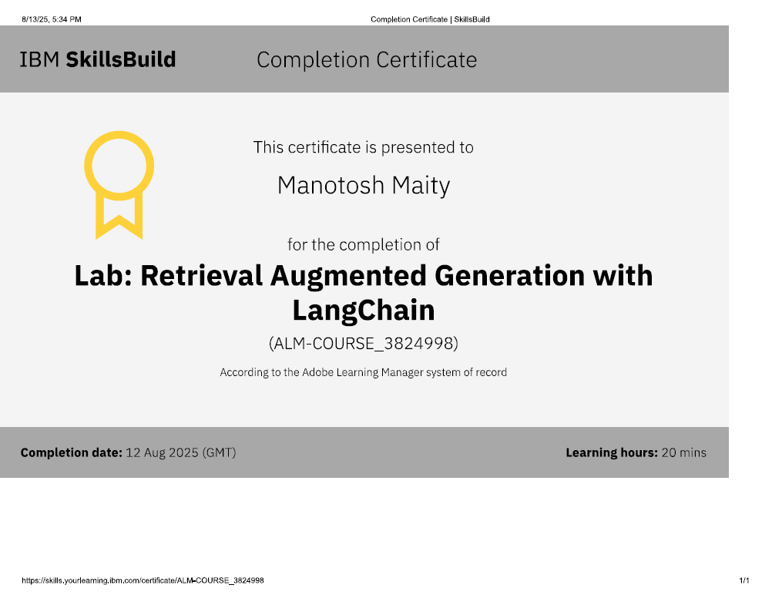
IBM Certifications

Slide 24
THANK YOU

