Slide 1
KNX Advanced Course Informative Appendix
ETS Apps

Slide 2
Introduction
ETS: Engineering Tool Software to create, edit, configure and manage projects
Two types of extensions are distinguished:
ETS Plug-in:
ETS App

Slide 3
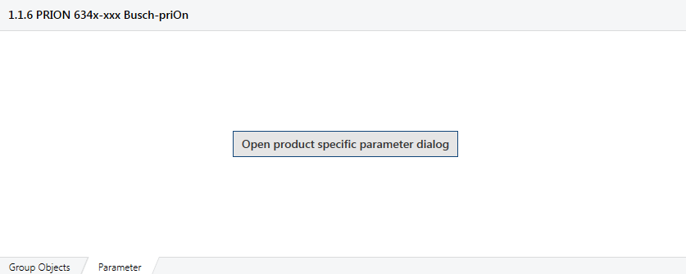
Definition
ETS Plug-in: Product-related extension, made available by the manufacturer of the device, allowing a specific configuration or commissioning, deviating from the standard ETS
ETS App: Extension to the standard functional scope of ETS, not limited to a specific device. It is normally not included in the standard ETS software as shipped to the customer

Slide 4
ETS Apps
In most cases, the ETS program offer all functionality necessary to design and configure KNX projects
ETS Apps customize the ETS to individual needs while maintaining the KNX “one tool” approach
KNX members can offer ETS Apps, tailored to the needs and features of their products and/or specific markets
ETS Apps are part of the KNX Licensing Scheme. ETS Users can see all available Apps via the MyKNX platform
ETS Apps are validated and signed by KNX

Slide 5
System requirements
An installed and operational ETS 4.1 (or higher)
An installed ETS Professional, Home or Lite license. ETS Apps cannot be run in a Demo environment
Each ETS App requires a specific license
Some ETS App can be called directly in ETS whereas other Apps must be installed first and then activated in the ETS software

Slide 6
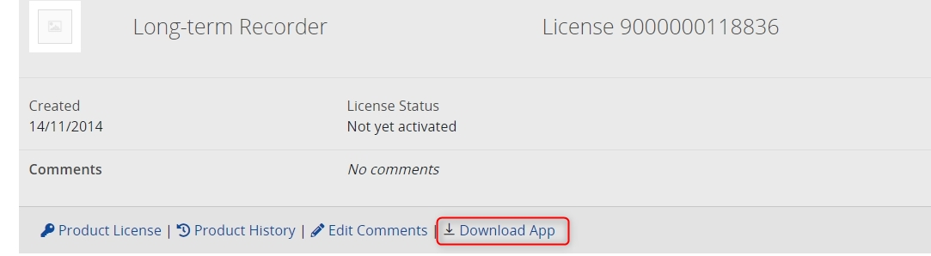
Licensing
To get hold of a license of an ETS App, you need to:
Log in to your MyKNX account
Select the menu Shop and the submenu ETS Apps
Select the ETS App within the different categories
Some App extensions must be extra installed (marked with a download icon in the “My Products” menu)
If download icon is missing, the App is already contained in the ETS and only needs to be released
Further information with regard to ETS6 Licensing can be found in our help centre: https://support.knx.org/hc/en-us/articles/7393992314770-ETS6-App-licensing

Slide 7
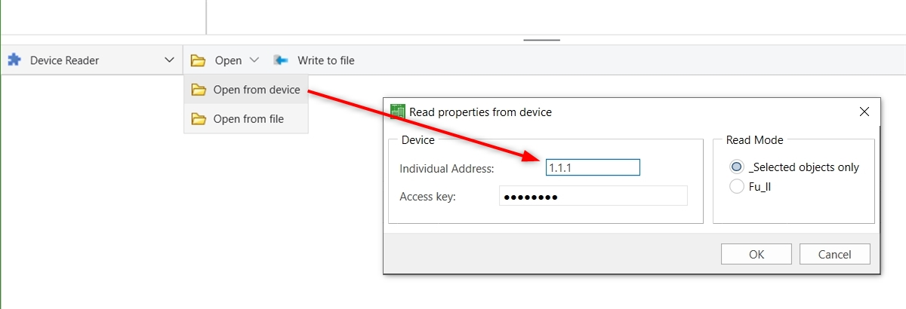
Reading out the property of a device
Read properties without knowing the internal memory structure or storage location of the data
1. Individual Address of the device to read
2. Access key: BCU Key in the Details menu of the corresponding project in the ETS Dashboard.
3. Read Mode:
Selected object only: Only read out the properties selected individually in the left panel → slow reading
Full : Read out all properties of all available interface objects ➔ fast reading

Slide 8
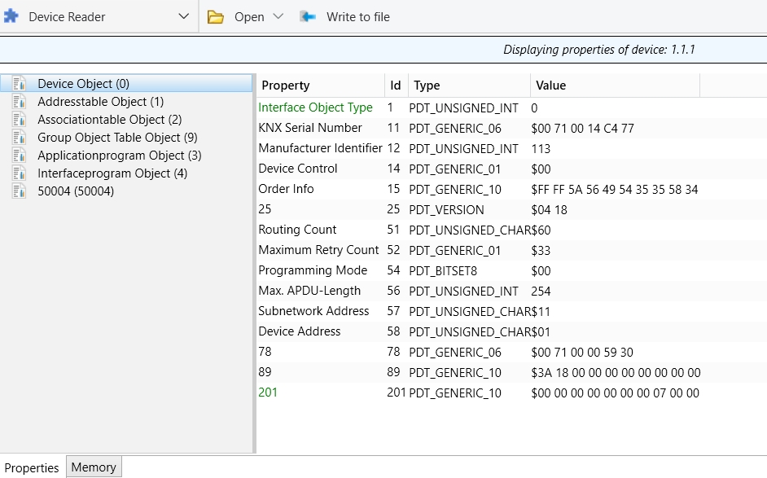
Reading out the property of a device
Example of property read

Slide 9
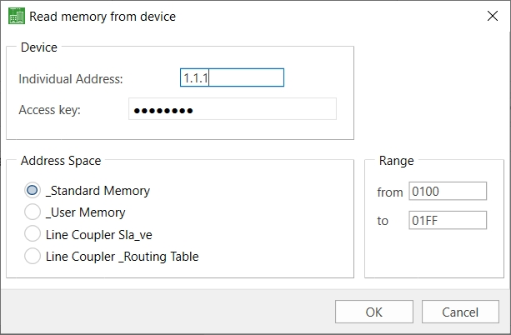
Reading out the memory of a device
Read memory from device
1. Individual Address of the device to read
2. Access key: BCU Key in the Details menu of the corresponding project in the ETS Dashboard.
3. Address Space: Standard Memory, others are User Memory, Line Coupler Slave, Line Coupler Routing Table
4. Range: Memory block to read out by entering the memory range.
Default value: 0100 to 01FF

Slide 10
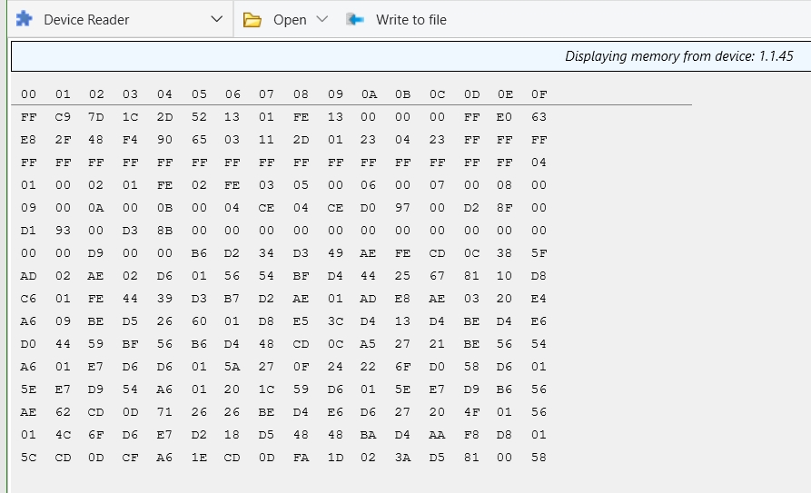
Reading out the memory of a device
Example of memory read of a system 1 device → individual address 1.1.45

Slide 11
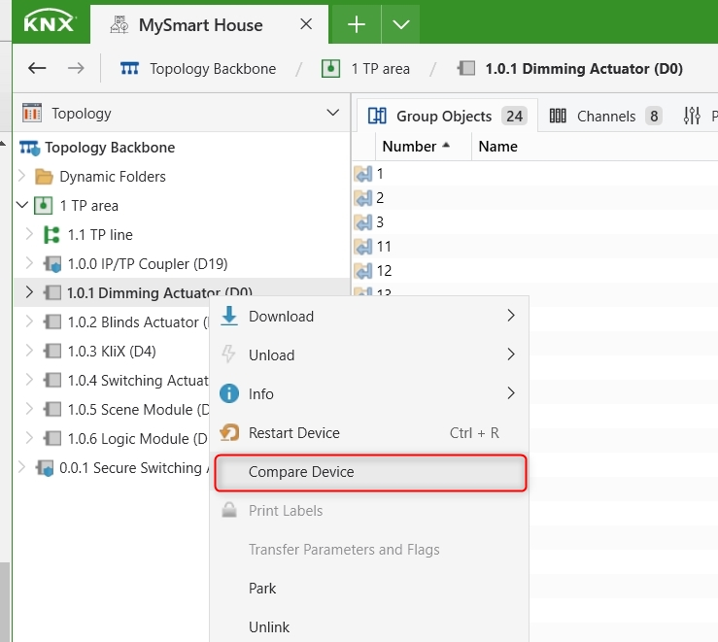
Compare Device
Enables the integrator to compare the data in the ETS project to the individual devices in the installation

Slide 12
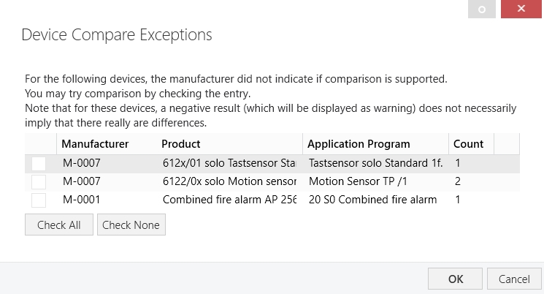
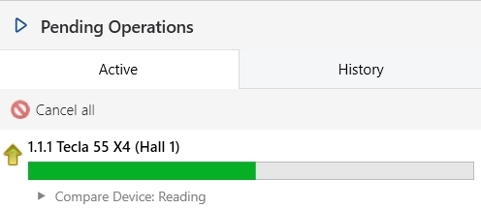
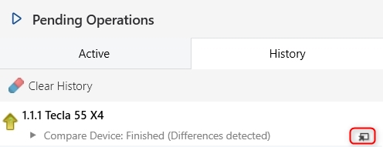
Compare Device Process
Device Compare Exceptions
Comparison Process

Slide 13
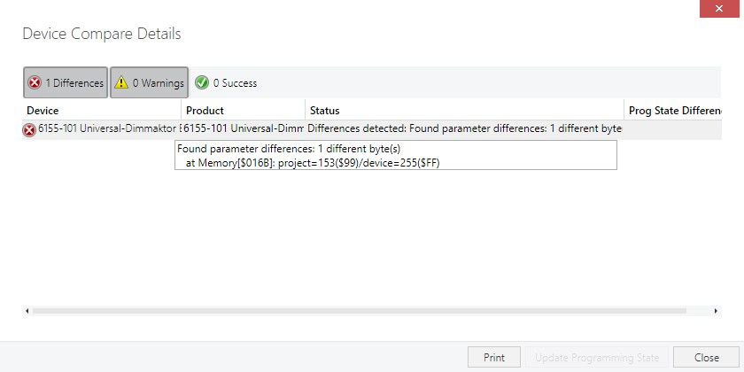
Compare Device Process
Device Compare Details
Note: If a warning is displayed this does not necessarily mean that there is a difference

Slide 14
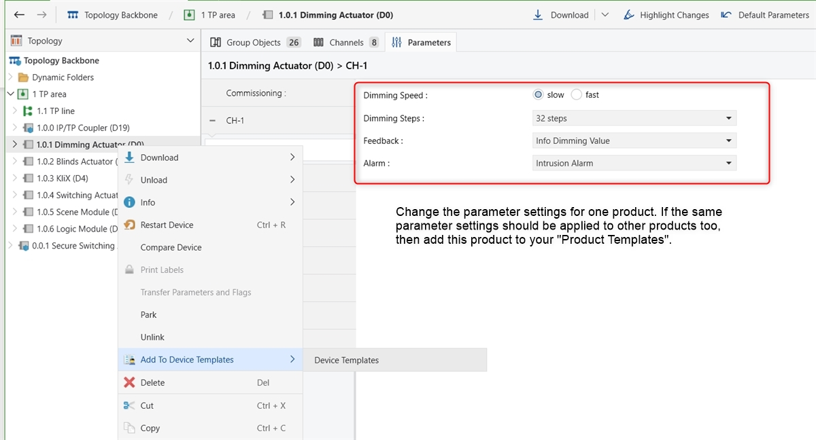
My Device Templates
It allows to have parameterizing Product Templates for further use

Slide 15
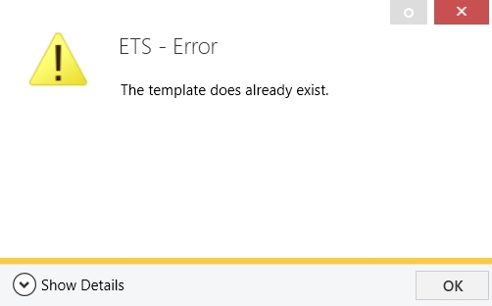
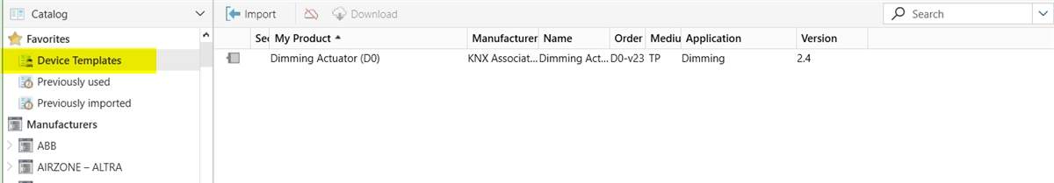
My Device Templates Process
Template already exists
Location of My Device Templates
Note: Deleting a product template does not mean that the products are deleted from the project.

