Slide 1
KNX Advanced Course
Interworking

Slide 2
Introduction
KNXA takes care of the standardisation of the protocol and laid down rules for the encoding of the useful data inside telegrams
The most common data types are standardized on a European level and integrated into the EN 50090 series as Part 3-3
Standardized formats for functions are mandatory for certification. Compliance of format is checked during the KNX interworking tests as carried out by KNX accredited test labs
Notes:
Introduction
Already under the predecessor system to KNX, i.e. EIB, the Association not only took care of the standardisation of the protocol but also laid down rules for the encoding of the useful data inside telegrams.
Without standardisation of this aspect, devices of different manufacturers would be able to talk KNX but could still code the useful data contained in the tail of the telegram differently, e.g. manufacturer A would code temperatures as 1 byte and another as 3 bytes.
For a start such group objects could then not be linked by means of ETS and secondly, these devices would not understand one another.
In order to ensure interworking between manufacturers and even products of different application domains, KNX Association therefore laid down formats for common functions like switching, dimming, blinds control, integer and float values, percentage, date/time, HVAC modes, scene control, …. These formats are referred to as “KNX standardized Data types”.
The most common data types were also standardized on a European level and integrated into the EN 50090 series as Part 3-3.
If a standardized format for a certain function exists, for certification the KNX manufacturer is obliged to use this format. Compliance to the format is also checked during the KNX interworking tests as carried out by KNX accredited test labs.

Slide 3
Advantages of Interworking
When a product line A is defective but Manufacturer A has discontinued product line, the end user can find a replacement at Manufacturer B
OEM market: what Manufacturer A does not produce himself, he can find at another HBES manufacturer and relabeling the products he buys from Manufacturer A
All products of all manufacturers can be linked to one working installation is the corner stone of the KNX one configuration tool (ETS) approach
KNX worldwide standardized training scheme
Notes:
Advantages of Interworking
The benefits of Home and Building Control only become truly visible when devices of different manufacturers and different application domains interwork:
Presence detector is part of the alarm system at night;
Room thermostat of Manufacturer A sets position of valves of Manufacturer B;
“All off” button of Manufacturer A switches the lights off, controlled by switching actuators of Manufacturer B, C, D, …;
Scheduler of Manufacturer A ensures presence simulation, thereby controlling blinds of Manufacturer B
It goes without saying that this is an enormous benefit to end users. When a product line A is defective but Manufacturer A has discontinued product line, the end user can find a replacement at Manufacturer B.
A system with true interworking also attracts manufacturers of niche products, as one single manufacturer can simply not offer all possible HBES solutions, from lighting to HVAC to Load management, etc.
This in turn boosts the OEM market: what Manufacturer A does not produce himself, he can easily find at another HBES manufacturer and complete his offer by relabeling the products he buys from Manufacturer A.
Gateway solutions between KNX and proprietary or other standardized systems (e.g. DALI, BACnet, …) are easier to develop, as the proprietary encoding can be easily mapped to common KNX data formats as described in the KNX standard.
Last but not least, it would have been impossible for KNX to establish the common market infrastructure that exists today:
the fact that all products of all manufacturers can be linked to one working installation is the corner stone of the KNX one configuration tool (ETS) approach.
It would have been impossible to establish the common training scheme for the training of persons interested in using the KNX technology in home or commercial projects. The training scheme of Basic, Advanced and Tutor courses is worldwide standardized. In contrast to that, manufacturers of proprietary systems must establish each individually their own training schemes and users of such material must visit several courses if they wish to combine material of several manufacturers into an installation.
OEM: Original Equipment Manufacturer

Slide 4
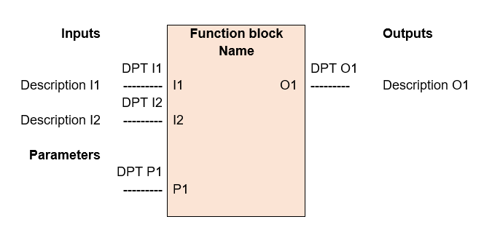
Principles of KNX Interworking
KNX group objects are coded according to KNX standardized data types. The encoding of parameters can be manufacturer specific
Functional blocks group inputs, outputs and parameters. For this combination, a precise function description is provided
Notes:
Principles of KNX Interworking
Introduction
For KNX devices that are programmed with the ETS, KNX requires that at least the group objects are coded according to KNX standardized data types. The encoding of parameters that are described in the product data descriptions can be manufacturer specific.
For some of the device types (e.g. like dimming, blind control or switching with priority), it is however necessary that actuators show a certain behaviour when data is sent to the available group objects. In this case, the specification of functional blocks becomes necessary and needs to be complied with during KNX product certification.
Functional blocks group a number of inputs, outputs and parameters. For this combination, a precise function description is provided.
Especially when devices support Easy installation, a clear definition of the description of each channel in the device in the form of functional blocks is necessary.

Slide 5
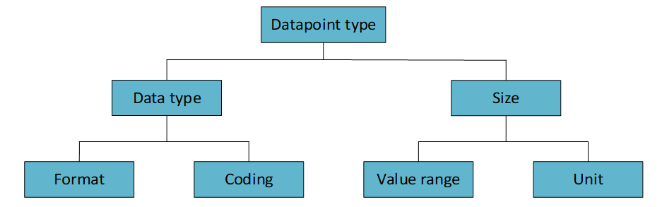
Coding of Datapoint types
Format: Sets the fields that compose the Datapoint type. Each field can consist of one or several bits
Coding: Sets the data encoding
Value range: Sets the range limitations and valid values
Unit: Sets the data unit
Notes:
Coding of Datapoint types
Introduction
A group object is regarded as a certain type of datapoint. Also parameters can be regarded as datapoints.
The Datapoint type is determined by the following four elements
Format: Which fields is the Datapoint type composed of? Each field can consist of one or several bits.
Coding: How is the data encoded?
Value range: Are there any limitations to the value range? There may be different minimum and maximum values or valid values for each field or lists of valid values.
Unit: Which units does the data of the individual fields have?

Slide 6
Principle Datapoint types classes
Simple types: Example: boolean, pure numeric values
Enumerated Types: limited number of values and no precise hierarchical order. All states shall be described. If invalid/undefined values are sent, no malfunctions may occur. Examples: operating modes in room thermostats
Structured Type: several parts which are combined in a datapoint. Examples: KNX relative dimming (3.007 DPT_Control_Dimming)
Status Types: Used when a device is able to report its operating mode and to be switched to a specific mode. Sent as a mask. Primarily used in heating technology
Notes:
Principle Datapoint types classes
Introduction
Five classes can be distinguished according to their internal structure. More explanation is given in the next clauses.
Simple Types
Examples of simple types are: boolean values, pure numerical values.
Enumerated Types
Enumerations are used for datapoints with a clearly limited number of values and no precise hierarchical order. If a datapoint uses an enumerated data type, all possible states shall be described. If invalid / undefined values are sent, no malfunctions may occur.
Examples are: Toggling between “Comfort”, “Standby” “Night”,… operating modes in room thermostats.
Structured Types
Structured Datapoint types consist of several parts which are combined in a datapoint. Only fields which cannot be interpreted meaningfully on their own can be combined to a structured Datapoint type.
Examples are : KNX relative dimming (3.007 DPT_Control_Dimming)
Status Types
Datapoint types for transmitting status information should meet two goals:
A device should be able to report its operating mode to other devices.
A device should be able to be switched to a specific operating mode.
To achieve this, further bits are sent as a mask in addition to the actual status information. The mask determines whether the data of the status fields should be used as valid commands or only for information purposes.
These Datapoint types are primarily used in the area of heating technology.

Slide 7

Principle Datapoint types classes
“Multi-state” Types: meaningful encodable values following a hierarchical sequence. Example: the 5 speed positions of a fan controller (motor)
To cover operating with different steps, sender and receiver must convert the steps to a range between 0 and 255
These Datapoint types can only be used if
the states have a clearly defined sequence,
no exact linear conversion of the is required
Sender:
Receiver:
Notes:
Principle Datapoint types classes
“Multi-state” Types
Multi-state Datapoint types are intended for transmitting data
of which the encodable values follow a hierarchical sequence and
of which all encodable values are meaningful
Examples: a fan controller (motor) can drive the fan from standstill over 5 positions up to a maximum speed.
Definition
To be able to cover all cases in which senders and receivers operate with many different steps, they both convert their steps to a range between 0 and 255.
The following applies for the sender:
This value is rounded up or down and sent as a byte without a sign.
The following applies for the receiver:

Slide 8
“Multi-state” Types Example
A sender with 3 steps (NS=3) controls a receiver with 5 steps (NR=5).
Step 2 (S x=2) of the sender is thus transmitted as = 170
The receiver interprets this as and moves to its level 3
Notes:
“Multi-state” Types Example
Example: A sender with 3 steps (N_{S}=3) controls a receiver with 5 steps (N_{R}=5). Step 2 (S _{x}=2) of the sender is thus transmitted as = 170. The receiver interprets this as and moves to its level 3.
These Datapoint types can only be used if
the states have a clearly defined sequence,
no exact linear conversion of the steps between sender and receiver is required

Slide 9
KNX common datapoint types
All Datapoint types have a unique identification consisting of two digits:
Digit 1 : Format and Codification
Digit 2 : Range and Unit
Group Objects with DPT types with a size:
6 bits or less: only use the bits directly following the APCI (bits not used are null)
greater than 6 bits: the 6 bits following the APCI are set to zero and the useful data padded after these bits
Datapoint types are responsibility of the KNX working group ‘WGI’ (Working Group Interworking)
Notes:
KNX common datapoint types
Introduction
This section lists some common KNX Datapoint types.
All Datapoint types have a unique identification consisting of two digits. The first digit denotes the format and the encoding. The second digit represents the value range and the unit.
In the course of technical development, KNX members may submit suggestions for new Datapoint types to the KNX Association. New Datapoint types are also drawn up by the responsible KNX working group ‘WGI’ (Working Group Interworking) when elaborating new application descriptions and corresponding KNX standardised functional blocks.
Group objects complying to DPT types with a size of 6 bits or less only use the bits directly following the APCI (any unused bits are set to zero) in the KNX telegram. Any group objects complying to DPTs with a size greater than 6 bits will result in telegrams, where the 6 bits following the APCI are set to zero and the useful data padded after these unused bits.

Slide 10
Boolean Data: DPT B1
Format: |  | 1 bit: B₁
octet nr |  |  | 1
field names |  |  |  |  |  |  |  |  |  | b
encoding |  |  |  |  |  |  |  |  |  | B
Range: |  | b = {0,1}
Unit: |  | None.
Resol.: |  | (not applicable)
Datapoint types
ID: | Name: |  |  |  |  |  |  |  |  |  |  |  | Encoding: b
1.001 | DPT_Switch |  |  |  |  |  |  |  |  |  |  |  | 0 = Off 1 = On
1.002 | DPT_Bool |  |  |  |  |  |  |  |  |  |  |  | 0 = False 1 = True
1.003 | DPT_Enable |  |  |  |  |  |  |  |  |  |  |  | 0 = Disable 1 = Enable
1.004 | DPT_Ramp |  |  |  |  |  |  |  |  |  |  |  | 0 = No ramp 1 = Ramp
1.005 | DPT_Alarm |  |  |  |  |  |  |  |  |  |  |  | 0 = No alarm 1 = Alarm
1.006 | DPT_BinaryValue |  |  |  |  |  |  |  |  |  |  |  | 0 = Low 1 = High
1.007 | DPT_Step |  |  |  |  |  |  |  |  |  |  |  | 0 = Decrease 1 = Increase
1.008 | DPT_UpDown |  |  |  |  |  |  |  |  |  |  |  | 0 = Up 1 = Down
1.009 | DPT_OpenClose |  |  |  |  |  |  |  |  |  |  |  | 0 = Open 1 = Close
1.010 | DPT_Start |  |  |  |  |  |  |  |  |  |  |  | 0 = Stop 1 = Start
1.011 | DPT_State |  |  |  |  |  |  |  |  |  |  |  | 0 = Inactive 1 = Active
1.012 | DPT_Invert |  |  |  |  |  |  |  |  |  |  |  | 0 = Not inverted 1 = Inverted
1.013 | DPT_DimSendStyle |  |  |  |  |  |  |  |  |  |  |  | 0 = Start/stop 1 = Cyclically
1.014 | DPT_InputSource |  |  |  |  |  |  |  |  |  |  |  | 0 = Fixed 1 = Calculated
1.015 | DPT_Reset |  |  |  |  |  |  |  |  |  |  |  | 0 = no action (dummy) 1 = reset command (trigger)
1.016 | DPT_Ack |  |  |  |  |  |  |  |  |  |  |  | 0 = no action (dummy) 1 = acknowledge command (trigger), e.g. for alarming
1.017 | DPT_Trigger |  |  |  |  |  |  |  |  |  |  |  | 0, 1 = trigger
1.018 | DPT_Occupancy |  |  |  |  |  |  |  |  |  |  |  | 0 = not occupied 1 = occupied
1.019 | DPT_Window_Door |  |  |  |  |  |  |  |  |  |  |  | 0 = closed 1 = open
1.021 | DPT_LogicalFunction |  |  |  |  |  |  |  |  |  |  |  | 0 = logical function OR 1 = logical function AND
1.022 | DPT_Scene_AB |  |  |  |  |  |  |  |  |  |  |  | 0 = scene A 1 = scene B
1.023 | DPT_ShutterBlinds_Mode |  |  |  |  |  |  |  |  |  |  |  | 0 = only move Up/Down mode (shutter) 1 = move Up/Down + StepStop mode (blind)
Used for applications with two different values
Notes:
Boolean Data
General
DPT ID 1.xxx is used for all possible applications in which two different values are to be set or sent.
Datapoint types B₁

Slide 11
Bit with priority control
Intended for applications offering a priority control that has precedence over the normal (manual) operation.
Notes:
Bit with priority control
General
These Datapoint types are intended for applications offering a priority control that has precedence over the normal (manual) operation. In other words, if an actuator is switched via its priority datapoint, switching via its usual DPT 1.xxx group objects is disabled.
Switching with priority is ensured via 2-bit Datapoint types.
The interaction between the 2 and the 1 bit datapoint functions according to the underneath diagram.

Slide 12
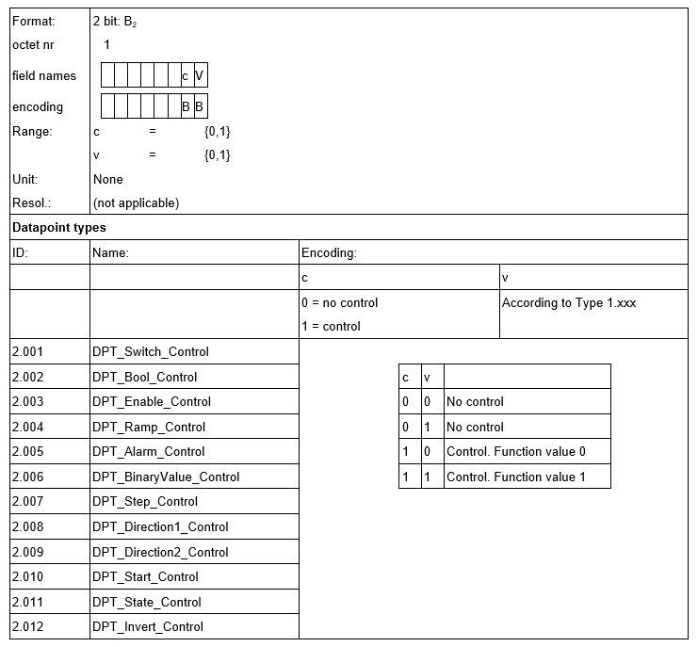
Bit with priority control: DPT B2
Notes:
Bit with priority control
Datapoint types B₂

Slide 13
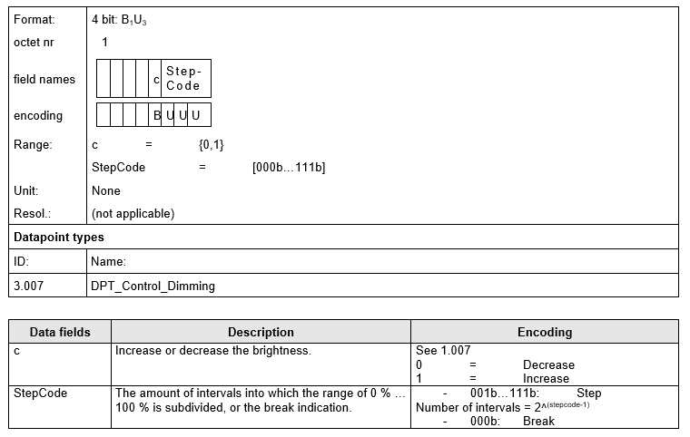
3 Bit with Control: DPT_Control_Dimming
Relative dimming or moving blinds relative to a certain position
Notes:
3 Bit with Control
General
These Datapoint types are amongst others used to realize relative dimming or moving blinds relative to a certain start position.
Datapoint DPT_Control_Dimming

Slide 14
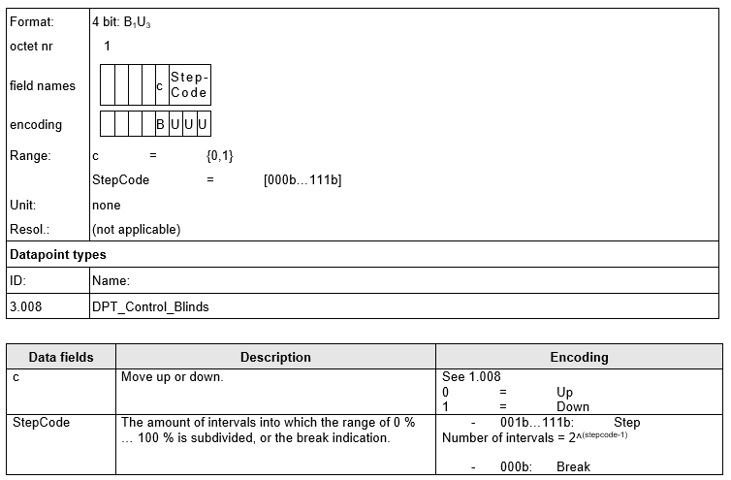
3 Bit with Control: DPT_Control_Blinds
Relative positioning of the vertical blinds as well as for the angle of the slats
Notes:
3 Bit with Control
Datapoint DPT_Control_Blinds
NOTE: This DPT can be used both for the relative positioning of the vertical blinds positions as well as for the relative positioning of the angle of the slats.

Slide 15
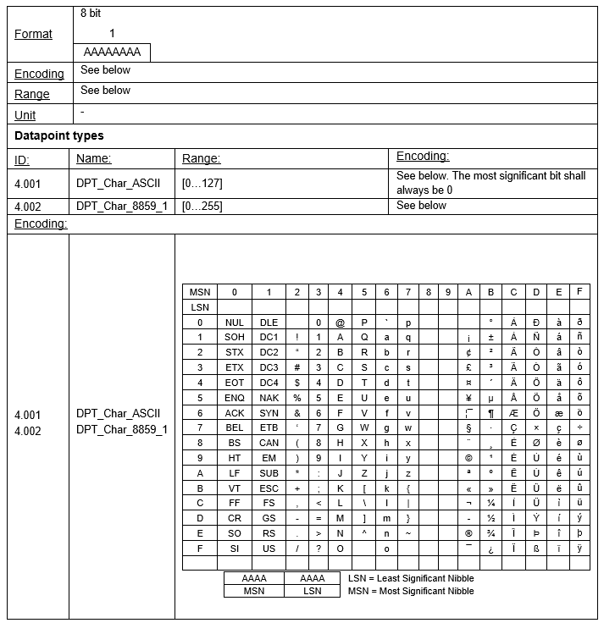
Datapoint types Character Set
Transmission of individual (text) characters
The encoding corresponds to the coordinates of a look up table, containing the different characters
Notes:
Character Set
General
DPT 4.xxx is defined for transmitting individual (text) characters. The encoding sent on the bus corresponds to the coordinates of a look up table, containing the different characters.
Datapoint types Character Set

Slide 16
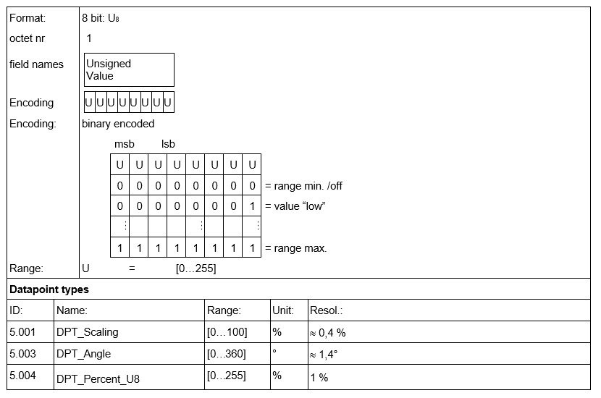
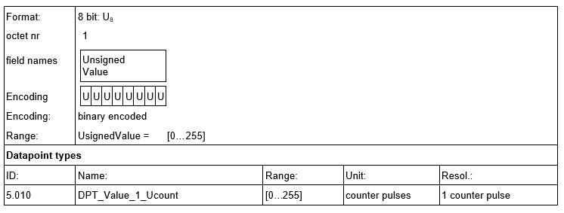
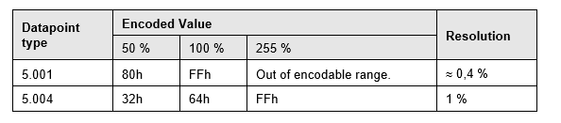
8 Bit without Sign
Transmission of unsigned values up to 255
Scaled Values
Non Scaled Values
Example:
Notes:
8 Bit without Sign
General
DPT 5.xxx is defined for transmitting unsigned values up to 255.
Scaled values
Non-Scaled values

Slide 17
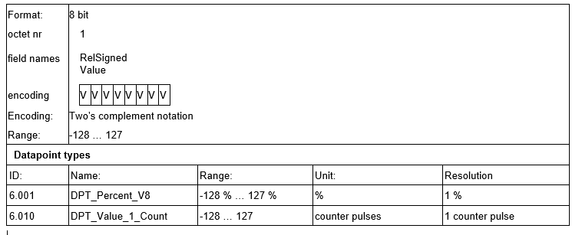
8 Bit with Sign
Transmission of values from -128 up to +127
Negative numbers are represented as two’s complement
Signed Relative Value:
Notes:
8 Bit with Sign
General
DPT 6.xxx is defined for transmitting values from -128 up to +127.
Negative numbers are represented as two’s complement. To do so, the binary representation of the positive number is inverted and 1 is added.
Datapoint types V8 - Signed Relative Value

Slide 18
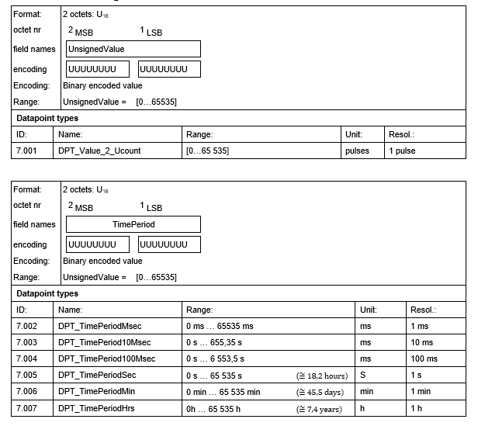
2 Octet without Sign
Transmission of values up to 65.535
Notes:
2 Octet without Sign
General
DPT 7.xxx is defined for transmitting values up to 65535.
2‑octet unsigned counter value

Slide 19
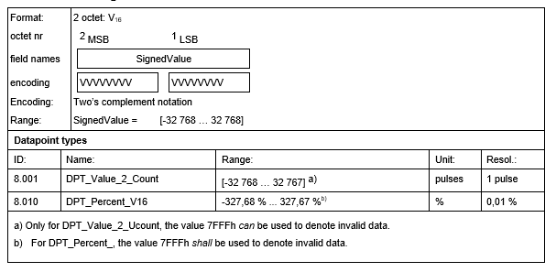
2 Octet with Sign
Transmission of values from -32.768 up to +32.767
Negative numbers are represented as two’s complement
Notes:
2 Octet with Sign
General
DPT 8.xxx is defined for transmitting values from -32768 up to +32767. As for 1 octet with sign, negative values are transferred as two’s complement.
2‑octet signed counter value

Slide 20
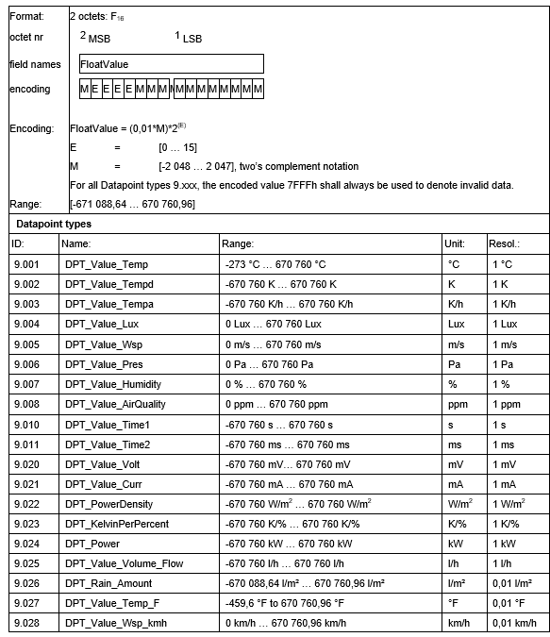
Octet Floating Point Number
Transmission of floating point values
Example: -30ºC
Resolution = 0,01 → Mantis = 3.000
Mantissa > 2047 → Exponent = 2¹
Mantissa = 1500 x 2¹
Value to represent < 0 → Two’s Complement
Code the mantis: 101 1101 1100
Two’s Complement: 010 0010 0100
Value to represent < 0 → Sign = 1
Coded exponent with four bits= 0001
Result (Sign | Mantis | Exponent):
-30 ºC = 1 0001 010 0010 0100 = 8A24h
Notes:
Octet Floating Point Number
General
DPT 9.xxx is defined for transmitting floating point values. Various Datapoint types have been defined for different physical variables.
Not all Datapoint types use the maximum value range. Devices shall ignore invalid or undefined values.
The value to be transferred shall be coded in the mantissa. If the value multiplied by 100 (because of the resolution of 0,01) does not fit in the range of –2048 and +2047, the mantissa shall be divided by a factor, which constitutes the exponent. The sign bit indicates whether the value is a negative (S bit = 1) or a positive value (S bit =0). In case of negative values, the mantissa shall moreover be the two’s complement of the corresponding positive value.
Example
A temperature value of - 30 degrees C can be calculated according DPT 9.001 as follows:
Step 1: Calculate the mantissa
Due to the resolution of 0.01, the value to be coded must be multiplied by 100:
30 x 100 = 3000
Step 2: Check if exponent is required
Mantissa is 11 bits, range is from + 2047 to -2048.
3000 is larger, therefore exponent is required.
Which exponent? 2¹ = 2 is sufficient as 3000 : 2 = 1500, and this number can be coded in the mantissa.
Step 3: Code the mantissa:
Value:
1024 | 512 | 256 | 128 | 64 | 32 | 16 | 8 | 4 | 2 | 1
Number:
1 | 0 | 1 | 1 | 1 | 0 | 1 | 1 | 1 | 0 | 0
If the number is negative, then create a two’s complement!
Output value: 101 1101 1100
Invert: 010 0010 0011
+1 1
-------------------------------------------------
010 0010 0100
Step 4: Code sign and exponent
Number is negative, therefore the S bit = 1
Exponent = 1, coded in four bits = 0001
Step 5: Final result
-30 = 1 0001 010 0010 0100

Slide 21
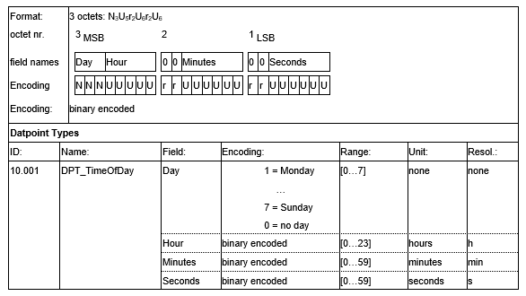
Time
Transmission of the time of the day
Notes:
Time
General
DPT 10.001 is defined for transmitting the time of the day (e.g. cyclically by a system clock).
Datapoint type Time

Slide 22
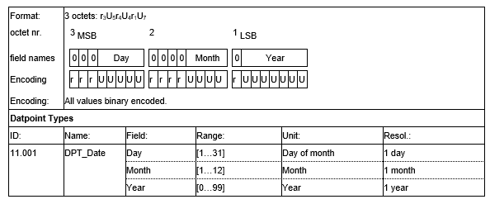
Date
Transmission of the date of the day
Year data >= 90 signifies year in the 20th century
Year data < 90 signifies year in the 21st (this) century
Notes:
Date
General
DPT 11.001 is defined for transmitting the date of the day (e.g. cyclically by a system clock). Please note that the day of the week is not transmitted in DPT 11.001.
It shall be noted that values shall be interpreted as follows by a receiver:
Year data >= 90 signifies year in the 20th century.
Year data < 90 signifies year in the 21st (this) century.
The encoding therefore covers years between 1990 and 2089.
Example:
YYYYYYY = 99d equals 1999
YYYYYYY = 0d equals 2000
YYYYYYY = 4d equals 2004
Datapoint type Date
Datapoint types V8 - Signed Relative Value

Slide 23
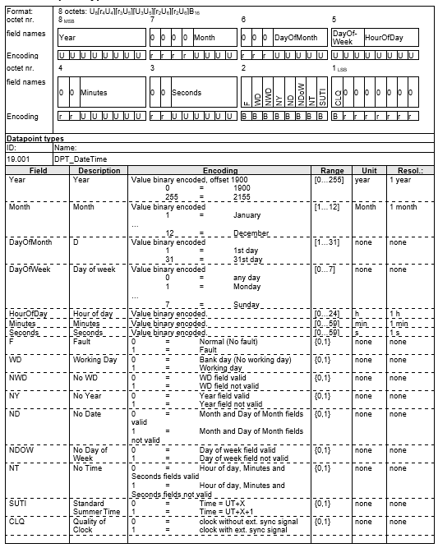
Date and Time
Transmission of the date and time of the day
Combines and extends the DPT_TimeOfDay (10.001) and DPT_Date (11.001)
Year is encoded as an unsigned byte and calculated as an offset to the year 1900. Covered period: 1900 - 2155
Notes:
Date and Time
DPT 19.001 is defined for transmitting the date and time of the day. The Datapoint type combines and extends the DPT_TimeOfDay (10.001) and DPT_Date (11.001) and has a size of 8 bytes.
In this Datapoint type, the year is encoded as an unsigned byte and calculated as an offset to the year 1900. The period between 1900 and 2155 is thus covered with this Datapoint type.
Datapoint type Time and Date

Slide 24
Date and Time Comments
Year field: encoded on 8 bits
Hour field: encoding is within the range [0…24]. It is possible to use this type to encode schedule programs
Fault field: is set if one or more supported fields of the Date & Time information are corrupted
SUTI field: attribute for information / visualization. In the hour field, summer-time correction is considered
NDoW field: Support of the Day of Week (NDoW = 0)
CLQ field: Bit 7 of the 1st byte is used for “Quality of Clock” bit. ( 1 = Clock with an external synchronisation)
Notes:
Date and Time
Comments
Year field
The year is encoded on 8 bits instead of on 7 bits as in DPT_Date.
Hour field
The encoding of the hour is within the range [0…24] instead of [0…23].
When the hour is set to "24", the values of octet 3 (Minutes) and 2 (Seconds) shall be set to zero. Messages with invalid values ("Hour = 24", Minutes and Seconds not zero) have to be ignored by the receiver. In this way, it is possible to use this Datapoint type to encode e.g. schedule programs. In daily schedule programs usually "end of day" is encoded as 24:00:00 and not 23:59:59; otherwise there would be a 1 s "break" at midnight.
Without the value 24:00:00 one can not differentiate between a full 24 h period and a 0 h period.
Examples:
A daily program with 24 h comfort level is encoded as "start comfort: 00:00:00" and "end of comfort: 24:00:00".
A daily program with 0 h comfort level (⇒ all day economy level) is encoded as "start comfort: 00:00:00" and "end of comfort: 00:00:00".
Fault field
"Fault" is set if one or more supported fields of the Date & Time information are corrupted. This is not the same as when the NY, ND, NW etc. attributes would be set (in this case the corresponding fields are not supported).
"Fault" is set e.g.
After power-down, if battery backup of the clock was not sufficient
After 1st start-up of the device (clock unconfigured)
Radio-clock (DCF 77) had no reception for a very long time
"Fault" is usually cleared automatically by the device (producer) if the local clock is set or clock data is refreshed by other means (e.g. by reception of system clock message, reception of DCF 77 radio message etc.).
The receiver (e.g. the user interface of a room unit) will interpret Date & Time with "Fault" as corrupted and will either ignore the message or show --:--:-- or blinking 00:00:00 (as known from video recorders after power-up).
SUTI field
SUTI is only an attribute for information / visualisation. In the hour field, summer-time correction is already considered. Therefore no hour offset shall be added by the receiver if SUTI is set.
SUTI = 0 standard time
SUTI = 1 summer daylight saving time
NDoW field
NDoW = 1 means that the “Day of Week”-field ddd is invalid and the ddd information shall be ignored. A Clock not supporting Day of Week information shall set NdoW = 1.
NDoW = 0 and ddd = 0 means that the ddd-field is valid and that ddd is a wildcard. This encoding feature is thought for use in for instance scheduling information.
CLQ field
Bit 7 of the 1st byte is used for “Quality of Clock” bit (CLQ). The other bits of this byte are reserved for future extensions. Their values shall be 0. If this Datapoint typeDatapoint type is used for transmitting data, transmitters shall set the lower 7 bits to 0. Receivers shall check these bits to be 0.
Encoding
0: Clock without an external synchronisation signal. The device sending date & time information has a local clock, which can however be inaccurate !
1: Clock with an external synchronisation signal (like DCF77, videotext, etc.). The device sending date & time information sends signals which are synchronised (time to time) with external date & time information.
The default value is 0.
Also an externally synchronised clock should send CLQ = 0 after start-up (until reception of first synchronisation signal) or after a synchronisation timeout.

Slide 25
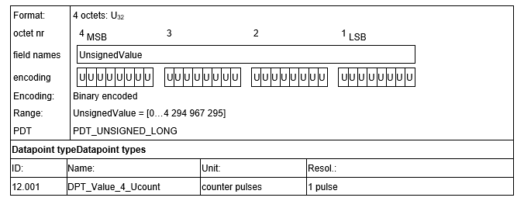
4 Octet without Sign
Transmission of unsigned counter values up to 4.294.967.295
Notes:
4 Octet without Sign
General
DPT 12.xxx is defined for transmitting unsigned counter values up to 4294967295.

Slide 26
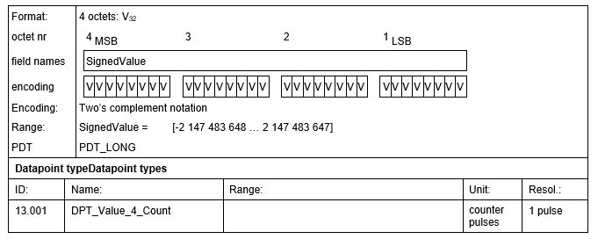
4 Octet with Sign
Transmission of values from -2.147.483.648 up to +2.147.483.647
Negative numbers are represented as two’s complement
Notes:
4 Octet with Sign
General
DPT 13.xxx is defined for transmitting signed counter values from -2147483648 up to +2147483647, where negative values are transmitted as 2’s complement.
2‑octet signed counter value

Slide 27
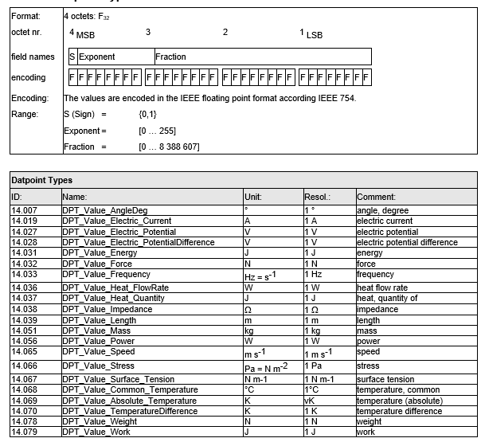
4 Octet Floating Point Number
Transmission of floating point values with greater accuracy
It is used in accordance with IEEE 754
Notes:
4 Octet Floating Point Number
General
DPT 14.xxx is defined for floating point values with greater accuracy. Various Datapoint types have been defined depending on the different physical variables.
The IEEE floating point format is used in accordance with IEEE 754 so that
higher values than for DPT 9.xxx can be transferred,
compatibility to other systems using this format is ensured.
79 different Datapoint types have been defined, of which some are given in the underneath paragraph.

Slide 28
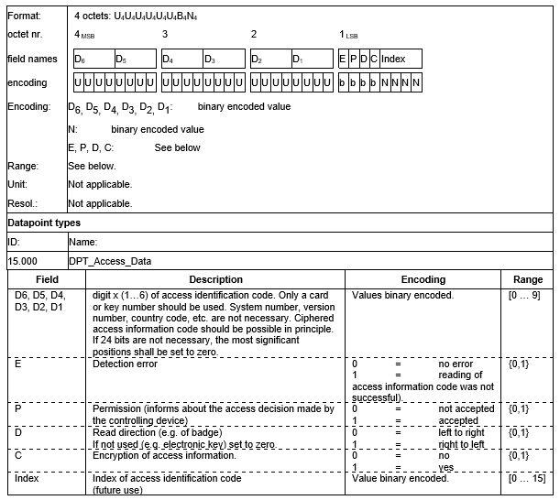
Access Control
Represent or log access procedures
Notes:
Access Control
General
DPT 15.000 is defined to represent or log access procedures.
Datapoint type DPT_Access_Data

Slide 29
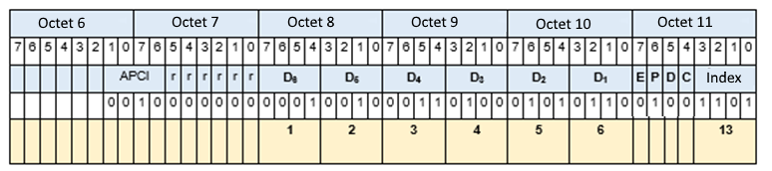
Access Control Example
Transmission of the Access ID code "123456", without error display, permission accepted, card reading from left to right, not encrypted, match with 13
Notes:
Access Control
EXAMPLE 1: Transmission of the access identification code “123456”, without error indication, permission accepted, badge read from left to right, no encryption and index 13.

Slide 30

Character String
Transfer strings of characters, Datapoint types 16.000 and 16.001 allow sending text of up to 14 characters
Encoding of the individual characters corresponds to the Datapoint types 4.001 and 4.002
The contents in both cases starts with the MSB
Example:
Notes:
Character String
General
To transfer strings of characters, Datapoint types 16.000 and 16.001 allow sending text of up to 14 characters. The encoding of the individual characters corresponds to the Datapoint types 4.001 and 4.002. The contents in both cases starts with the MSB.
Two data types exist: DPT 16.001 (DPT_String_ASCII – unused characters are set to value 00h) and DPT 16.002 (DPT_String_8859_1).

Slide 31
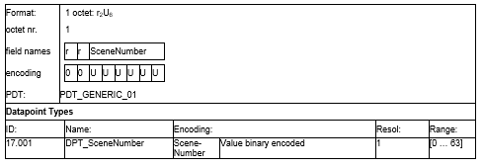
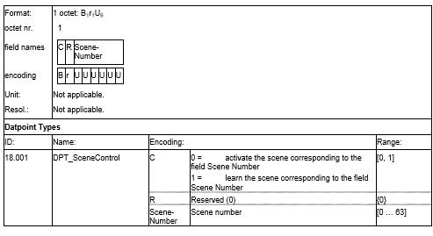
Scene Control
Approaches:
Setting the scene by using the DPT_Scene_AB (1.022). it is not possible that the user changes the scene
Setting and storing the scene as a number by using the DPT_Scene_Control. Scenes can be set and called
By using the DPT_SceneNumber: identical to the DPT_Scene_Control, however it does not allow to store new scenes
Scene Number:
Scene Control:
Notes:
Scene Control
General
In KNX three different approaches exist for setting scenes
Setting the scene conditions via ETS parameters and calling the desired parameterized scene by using the DPT_Scene_AB (1.022) 1 bit Datapoint type. In this case, it is not possible that the user changes the scene.
Setting the scene conditions of the connected actuators and storing this scene as a scene number in the connected actuators by using the DPT_Scene_Control. With the same DPT, scenes can thus be set and called.
By using the DPT_SceneNumber: this DPT is identical to the DPT_Scene_Control, however it does not allow to store new scenes.
Datapoint type Scene Number
Datapoint type DPT_SceneControl

Slide 32
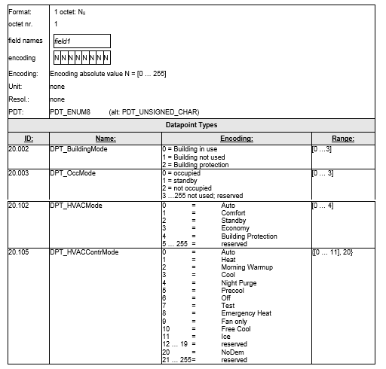
Common HVAC Datapoint types
New DPT: DPT_HVACMode
Room thermostats inform on their status with the standardised DPT_HVACContrMode
Notes:
Common HVAC Datapoint types
General
In earlier developments, the operating mode of room thermostat was set by one bit Datapoint types.
Since some years, a general new DPT_HVACMode has been introduced, of which the use has become obligatory for new developments. The operating mode may be additionally set by single bit DPTs.
Next to this, a number of enumerations have been standardised for amongst others building occupancy and building mode. Room thermostats inform on their status with the standardised DPT_HVACContrMode.

Slide 33
Combination of DPTs into devices
Combination of DPTs into devices has been standardized and is obligatory for certification
These standards called ‘functional blocks’ are respectively the “Dimming actuator basic” and the “Sunblind Actuator basic”
Dimming Actuator Basic
Switch, DPT 1.001
Relative dimming, DPT 3.007
Absolute dimming, DPT 5.001
Sunblind Actuator Basic
Step/Stop (DPT 1.007)
Up/Down (DPT 1.008)
Notes:
Combination of DPTs into devices
General
For two very common device types, the combination of DPTs into devices has been standardized and is obligatory for certification.
These standards called ‘functional blocks’ are respectively the “Dimming actuator basic” and the “Sunblind Actuator basic”.
Functional Block – Dimming Actuator Basic
General
A dimming actuator shall per channel at least support three group objects complying to the underneath stated DPTs:
Switch, DPT 1.001
Relative dimming, DPT 3.007
Absolute dimming, DPT 5.001
Any other group objects are optional.

Slide 34
Dimming Actuator Basic – Status Diagram
Notes:
Dimming Actuator Basic – Status Diagram
The basic function of the dimming actuator is described in the following status diagram.
A dimming actuator can find itself in one of three states – depending on which telegram(s) it receives:
State
Description
Off
Dimming actuator is switched off
On
Dimming actuator is switched on,
at least the lowest possible brightness is set
Dimming
Dimmer controller is enabled, brightness is adjusted in the direction of the setpoint
The change from one state to another is triggered by so-called “events”. Events include:
Name
Meaning
OFF command
Switching object receives value 0
ON command
Switching object receives value 1
Dimming up
Dimming object receives a new value, upward dimming direction
Dimming down
Dimming object receives a new value, downward dimming direction
Stop
Dimming object receives value ‘Stop’
Dimming value OFF
Brightness object receives value 0
Dimming value x %
Brightness object receives value > 0
Value reached
Brightness has reached setpoint
The event “Value reached” is an internal event. The function of the application software of a dimming actuator is illustrated by the following status diagram. The ellipses represent the states while the arrows represent the events.
This behaviour is checked during KNX certification tests.

Slide 35
Sunblind Actuator Basic – Status Diagram
Notes:
Functional Block – Sunblind Actuator Basic
General
The function “Drive Control” is used primarily for controlling blind and roller shutter motors.
A sunblind actuator shall per channel at least support two group objects complying to the underneath stated DPTs:
Step/Stop (DPT 1.007)
Up/Down (DPT 1.008)
Any other group objects are optional.
Important: Group objects using this function shall not reply to read requests through the bus (Group Value Read messages). This restriction ensures that drives are not inadvertently set into motion. The READ flag of the group objects shall therefore be reset! This applies both to sensors AND actuators!
If devices are not of the type BCU 1, the above is not needed, provided that the update flag in the respective group objects are not set.
This behaviour is checked during KNX certification tests.
Sunblind Actuator Basic – Status Diagram
An actuator for the control of blinds and shutters may be in one of four states, depending on the type of telegram(s) received:
Status
Description
Stopped
No movement
In motion
The connected drive moves upwards or downwards
Step UP
The drive is in the step mode and is moved upwards by one step
Step DOWN
The drive is in the step mode and is moved downwards by one step
(Depending on the type of application, it is of course possible to declare other directions of movement than those stated above, e.g. right/left or forwards/backwards. Example: motor-driven sliding door.)
The following events trigger the changeover from one status to another:
Name
Meaning
Move UP
Move object receives value ‘0’
Move DOWN
Move object receives value ‘1’
Step UP
Step object receives value ‘0’
Step DOWN
Step object receives value ‘1’
Time elapsed
Time limit defined for the motion of one step or for the entire range of motions has run out.
The event ‘Time elapsed’ is an internal event. The operation of an actuator for the control of blinds and shutters is illustrated by the following status diagram. The ellipses represent the states whereas the arrows indicate the events. This behaviour is checked during KNX certification tests.

