Slide 1
KNX Advanced Course
IP Communication

Slide 2
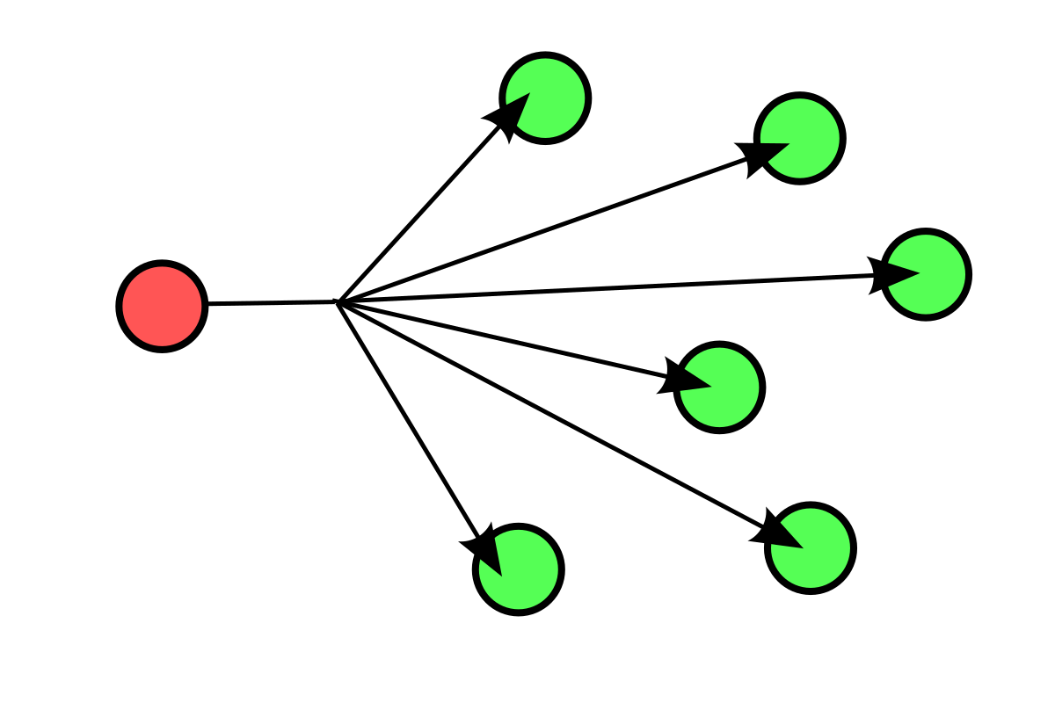
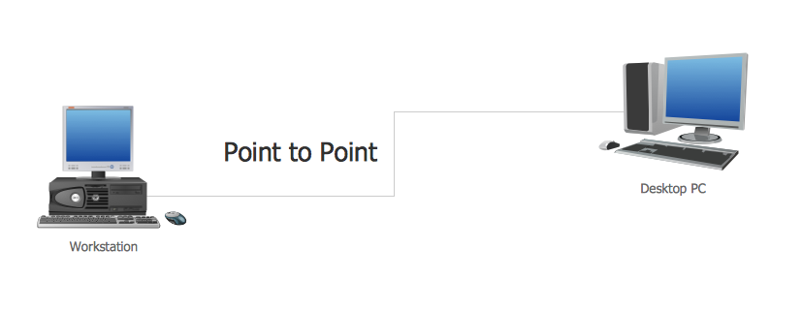
Network classes
By transmission Technology:
Point to point transmission - Broadcast networks
(unicasting) (broadcasting and multicasting)

Slide 3
Network classes
By scale:
Interprocessor distance | Processors located in same | Example
1 m | Square meter | PAN (Personal Area Network)
10 m | Room | LAN (Local Area Network)
100 m | Building
1 km | Campus
10 km | City | MAN (Metropolitan Area Network)
100 km | Country | WAN (Wide Area Network)
1.000 km | Continent
10.000 Km | Planet | Internet

Slide 4
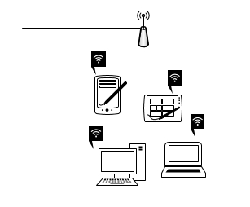
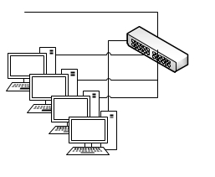
Basic structure of a Wireless and a Wired LAN
To wired network
To rest of network
Access point
Ethernet switch

Slide 5
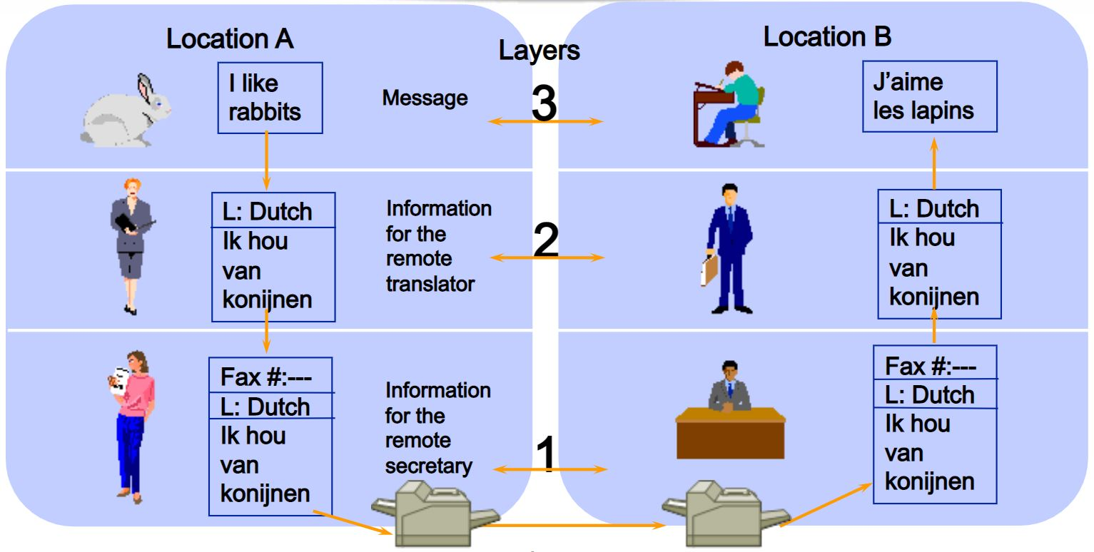
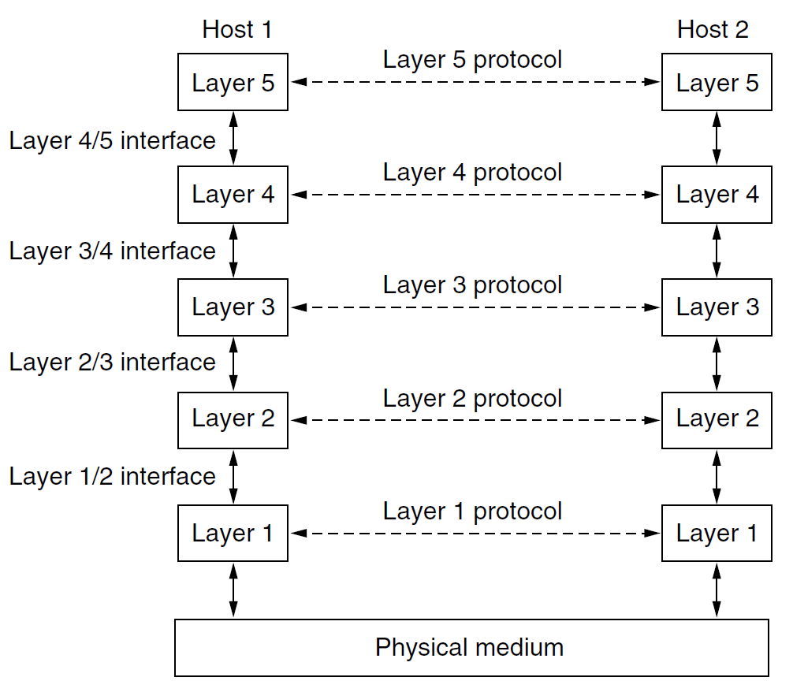
Layered communication
Advantages of layered communications:
Reduces complexity
Helps to standardize interfaces
Ensures interoperable technologies
Accelerates Systems evolution
Eases teaching and learning of this systems

Slide 6
OSI Model
Layer |  | Protocol data unit (PDU)
Host layers | 7 | Application | Data
 | 6 | Presentation
 | 5 | Session
 | 4 | Transport | Segment, Datagram
Media layers | 3 | Network | Packet
 | 2 | Data link | Frame
 | 1 | Physical | Bit, Symbol

Slide 7
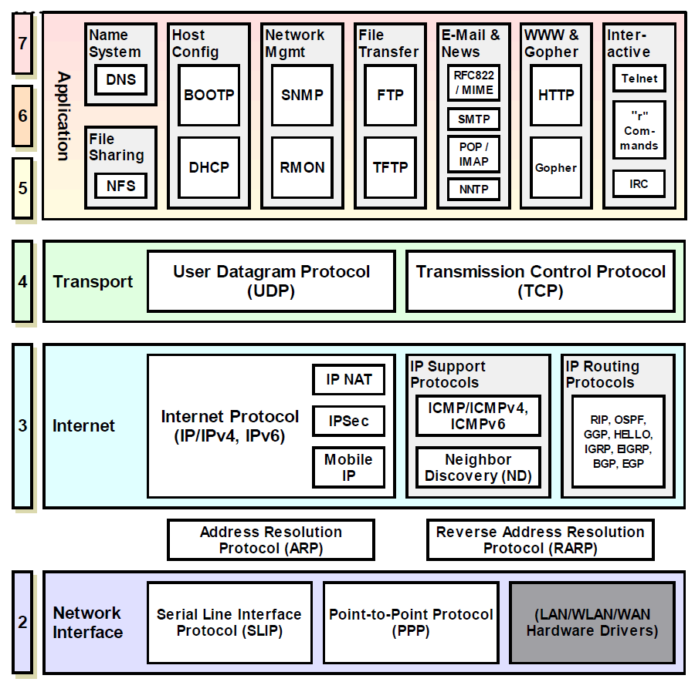
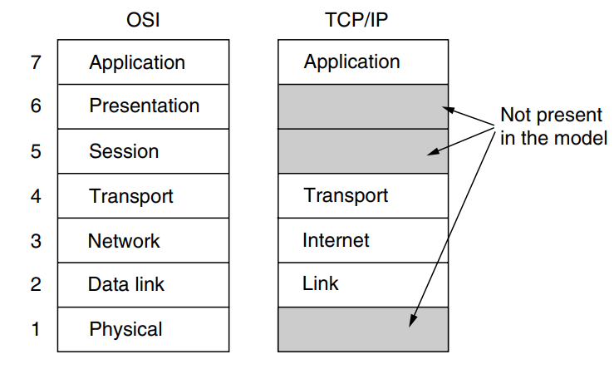
TCP/IP Model

Slide 8
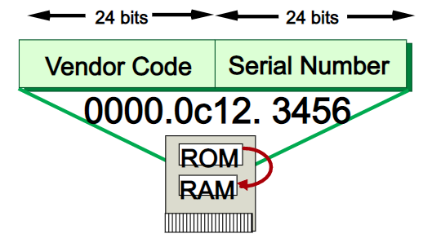
The Link Layer at the TCP/IP Stack
Media Access Control (MAC)

Slide 9
The Internet Layer at the TCP/IP Stack
ICMP (Internet Control Message Protocol)
IGMP (Internet Group Management Protocol)
ARP (Address Resolution Protocol)

Slide 10
The Internet Layer: TCP/IP Addressing
IPv4: The IPv4 address consist of 4 octets and is represented in dotted decimal. E.g. 192.168.1.1. This address is divided in 2 parts:
Network Identifier (Network ID): Also called Network prefix. Made by a certain number of bits starting at the leftmost bit.
Host Identifier (Host ID): The rest of the bits are used to uniquely identify the respective host.
0 | 8 | 16 | 24 | 32
Binary | 11100011 | 01010010 | 10011101 | 10110001
Dotted Decimal | 227 | 82 | 157 | 177
 | Network ID | Host ID
IPv6: The IPv6 address consist of 16 octets and is represented in hexadecimal. E.g. C0A8:164

Slide 11
TCP/IP Addressing
IPv4: Private / Public addresses and Classes
Private IP Addresses: are used for data transmission within private networks and can be freely chosen by the network operator within certain rules.
Public IP addresses: assigned by the Internet Assigned Numbers Authority (IANA), which is part of the Internet Corporation for Assigned Names and Numbers (ICANN).
Class | Public IP Range | Private IP Range | Subnet Mask | number of Networks | number of Hosts per Network
A | 1.0.0.0 to 127.0.0.0 | 10.0.0.0 to 10.255.255.255 | 255.0.0.0 | 126 | 16,777,214
B | 128.0.0.0 to 191.255.0.0 | 172.16.0.0 to 172.31.255.255 | 255.255.0.0 | 16,382 | 65,534
C | 192.0.0.0 to 223.255.255.0 | 192.168.0.0 to 192.168.255.255 | 255.255.255.0 | 2,097,150 | 254
D | N/A | 224.0.0.0 to 239.255.255.255 | N/A | N/A | Multicasting
E | N/A | 240.0.0.0 to 255.255.255.255 | N/A | N/A | Research / Reserved/ Experimental

Slide 12
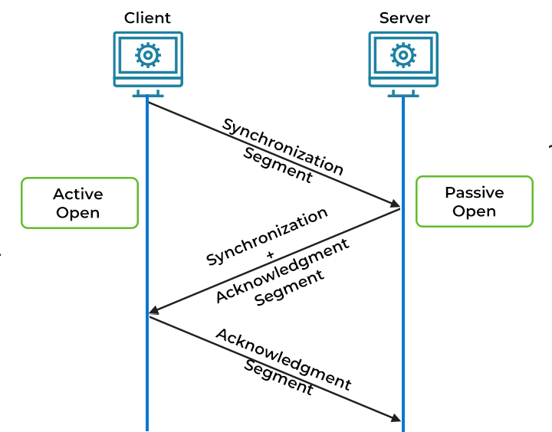
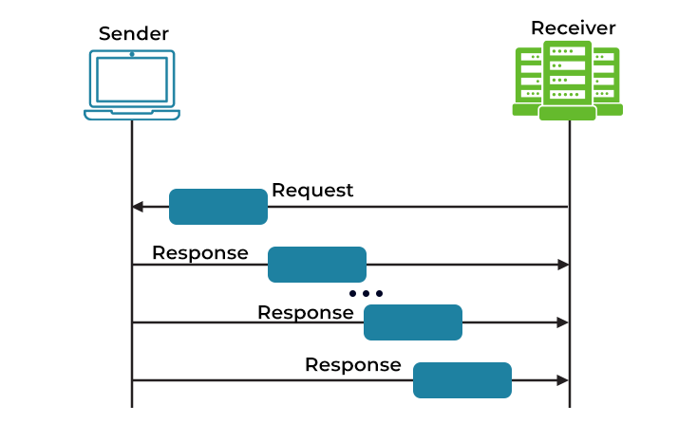
The transport Layer at the TCP/IP stack
TCP: Transmission Control Protocol
UDP: User Datagram Protocol

Slide 13
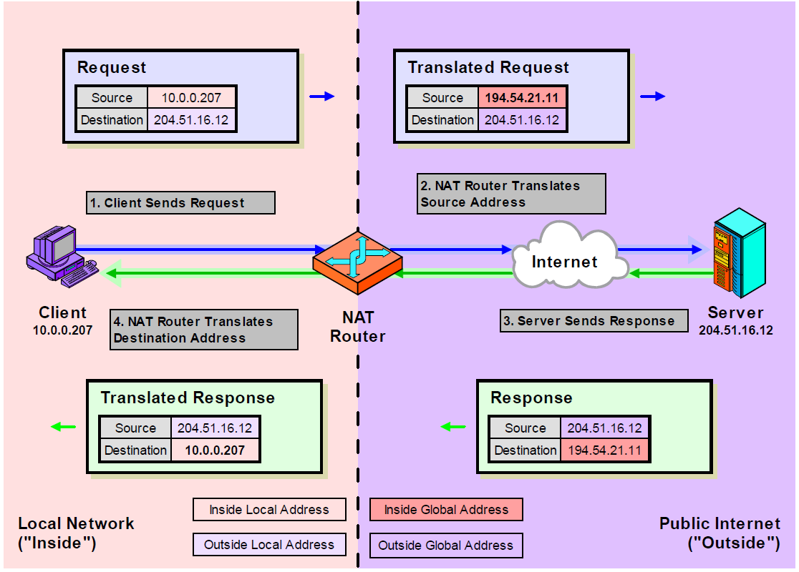
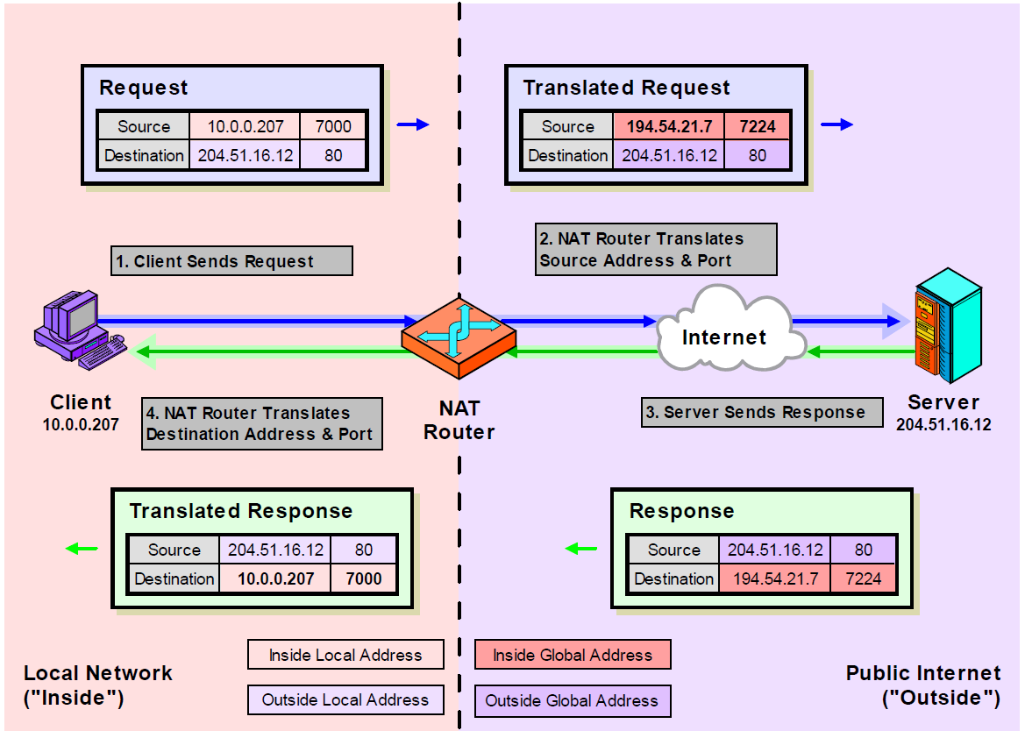
The Application Layer at the TCP/IP stack
Many protocols (+500) at this Layer:
TELNET, FTP, SMTP, HTTP, MQTT,…
Protocols interesting for Network Administrators:
SNMP: Simple Network Management Protocol
DNS: Domain Name System
DHCP: Dynamic Host Configuration Protocol
NAT: Network Address Translation
NAT example
NAPT example
(NAPT: Network Address and Port translation)

Slide 14
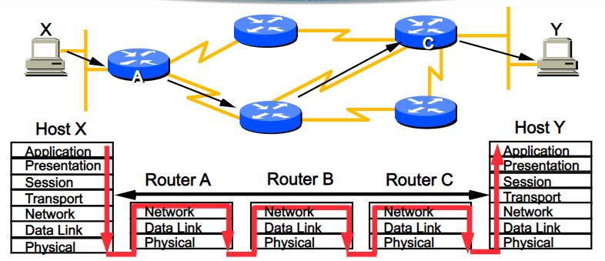
Equipment related to layers
Router
Switch
Bridge
Repeater
Hub

Slide 15

IP Communication in KNX Systems
Communication takes place via the:
Application layer which generates the KNXnet/IP telegram
Transport layer (UDP)
Network layer (IP)
Ethernet as a physical layer
Additional information for the respective layer (the header) is always added to the KNXnet/IP information

Slide 16
IP Communication in KNX Systems

Slide 17
Addressing of Network Devices
A network device has at least two addresses:
MAC address (Media Access Control)
Linked to the hardware and cannot be modified
It is a globally unique “serial number”
It consists of 6 bytes with the format: 00-50-C2-55-40-00
IP address (Internet Protocol)
Assigned by the administrator or via DHCP
It consists of 4 bytes (IPv4) with the format: 192.168.1.1
IPv6 is currently not used
Similar to the KNX physical address
Entered in the memory of the network device

Slide 18
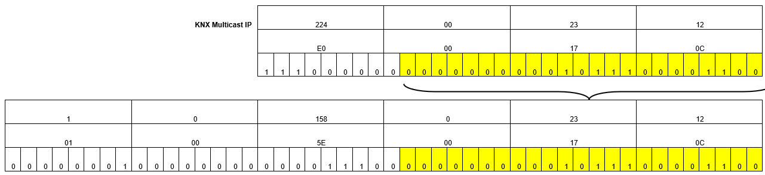
KNX Multicast address
A defined MAC address consisting of 6 bytes is sent in the network layer as destination address. It starts with 01-00-5E- and is supplemented by a 4-byte long multicast IP
Several multicast IP addresses can be mapped on the same MAC address
Multicast IP address: 224.0.23.12
Multicast MAC address: 01-00-5E--00-17-0C

Slide 19
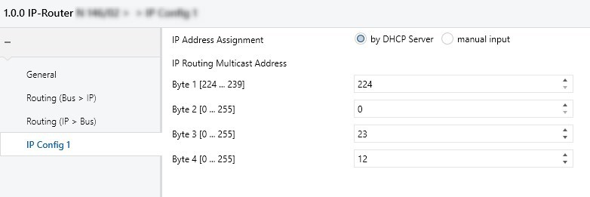
KNX Multicast address
It is possible to change the predefined KNX multicast IP addresses in the parameters of KNXnet/IP devices
It is possible to establish communication between separated KNX installations within the same IP network
All IP routers of an installation are listening in on the same multicast IP address

Slide 20
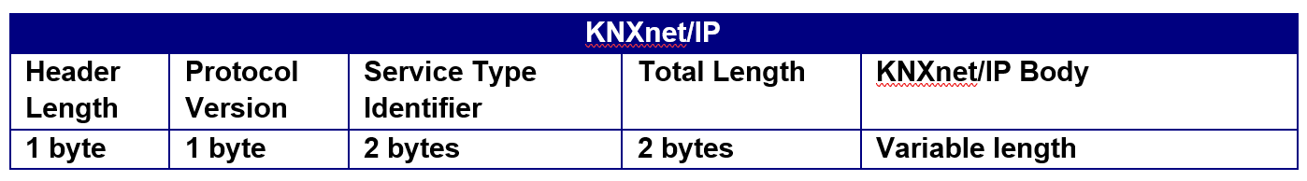
KNXnet/IP Protocol
Header Length : Start of KNXnet/IP frame (Value = 06h)
Protocol Version: Status of the KNXnet/IP protocol (Value = 10h)
Service Type Identifier: Action to be carried out
Total Length: Length in bytes of the KNXnet/IP
KNXnet/IP Body: Useful data within a KNXnet/IP frame. The useful data adopts a different structure depending on the information content

Slide 21
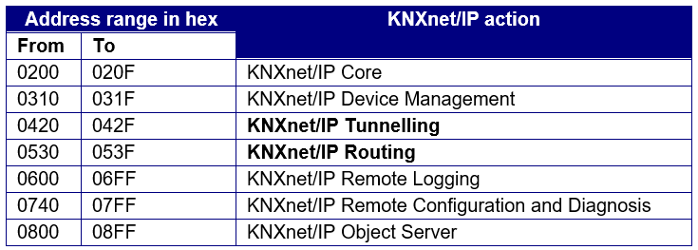
KNXnet/IP - Service Type Identifier
Service Type Identifier ranges and actions:

Slide 22
KNXnet/IP - Body
It consists of:
Connection header, including: Message Code (1 byte) and an additional length information (1 byte)
IP Body contains the so-called cEMI frame that contains the TP1 telegram structure
Check field is not used. Error detection is done via the IP protocol
Second control field (1 byte) included behind the TP1 control field with: type of destination address (1 bit) + routing counter (3 bits) + Extended Frame format (4 bits):
0000bin: for standard frames
01xxbin: for LTE frames

Slide 23
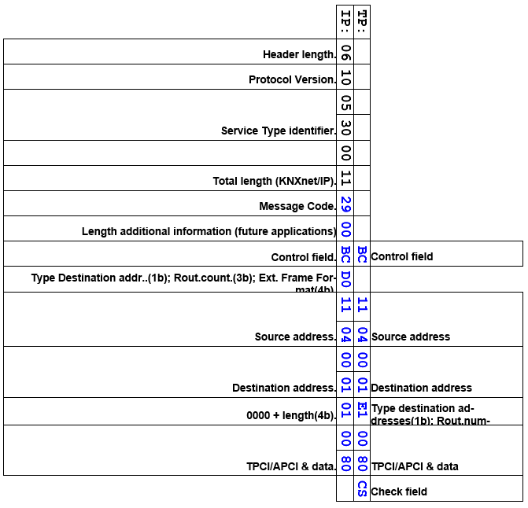
TP1 compared to KNXnet/IP telegrams
KNXnet/IP Telegram
KNX TP Telegram

Slide 24
Tunnelling
Enables the connection-oriented transmission of KNX telegrams in an IP frame with ETS
Used when a KNXnet/IP device should be addressed directly via Ethernet (e.g. loading the application into a device)
Address range of 0420h to 042Fh in the type identifier field. Predefined addresses:
0420h : TUNNELLING_REQUEST:
Used to send and receive individual telegrams between KNXnet/IP Client and Server
0421h : TUNNELLING_ACK:
Sent to confirm the receipt of TUNNELLING_REQUEST information

Slide 25
Tunnelling Examples
IP gateway in the main/backbone line as a universal coupler
IP router as a coupler between TP lines

Slide 26
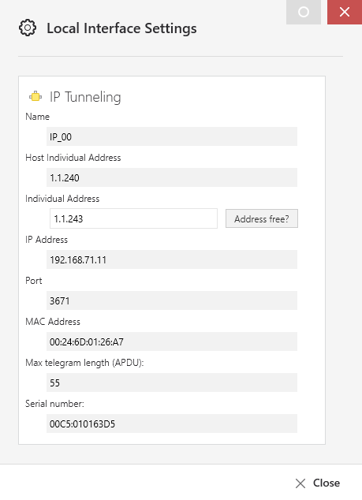
Tunnelling Settings
1 | Name | Enter a user-friendly name for the interface
2 | Host Individual address | Individual address of the host device
3 | Individual address | Individual address to be selected for the host device
4 | IP address | IP address found for the interface; if recognized/resolved
5 | Port | 3671 (default)
6 | MAC | MAC hardware address of the interface, as far as can be determined
7 | APDU | Maximum telegram length (payload)
8 | Serial number | Only visible after the device have been programmed

Slide 27
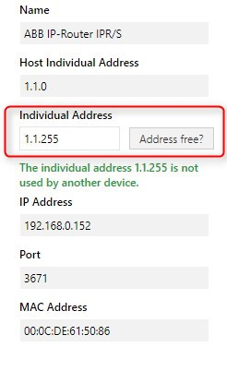
Tunnelling Settings
Local individual address shall match the line or area of the device to be addressed and not be used in the installation or project.
Example: KNXnet/IP router of line 1.1 thus has individual address 1.1.0 as coupler address and address 1.1.255 as local individual address

Slide 28
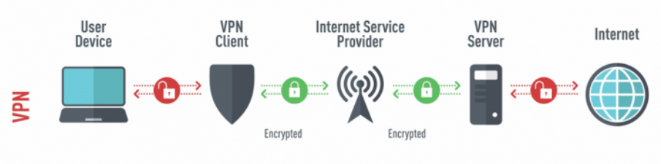
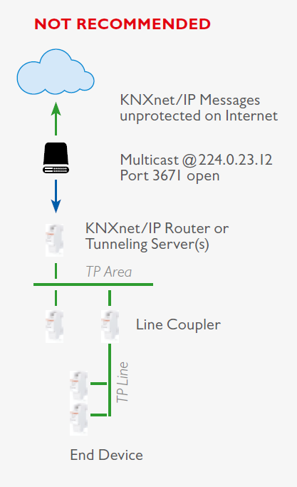
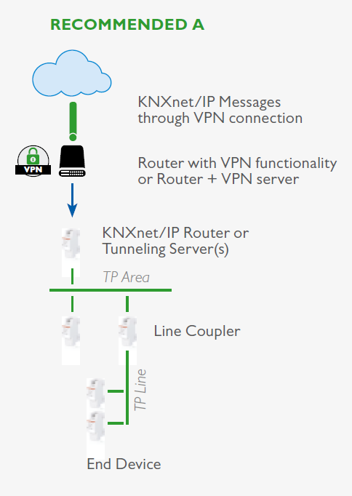
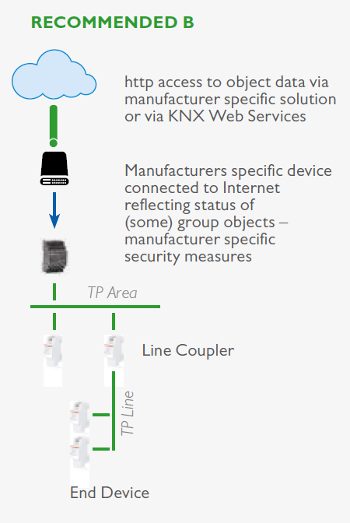
Remote access to a KNX installation via Tunnelling connection

Slide 29
Routing
Enables the connectionless and simultaneous transmission of KNX telegrams between networks via an IP coupler or IP router
Address range of 0530h to 053Fh in the type identifier field. Predefined addresses:
0530h : ROUTING_INDICATION:
Used to send KNX telegrams via IP networks without a connection
0531h : ROUTING_LOST_MESSAGE:
Used to display any KNXnet/IP routing information that has been lost

Slide 30
Routing Example
IP routers used as line or backbone couplers
Telegram sent via UDP with the multicast address 224.0.23.12 (port 3671)
A successful transmission is not confirmed. Data loss on the IP side is unlikely
An IP router that receives a KNXnet/IP telegram only route it on its TP side if the corresponding group address is in the filter table and the parameter is set to “filter”

Slide 31
Routing Notes
Direct communication between two IP devices is normally only possible via the respective IP addresses (Destination address is IP address of the recipient )
In the case of KNXnet/IP routing, the network structure which was pre-assigned by the IP and subnet addresses is removed by using the multicast IP
If two networks should now be linked together via the KNX multicast IP, it should be ensured that intermediate routers also let the multicast IP through

