Slide 1
KNX Advanced Course
KNX Secure

Slide 2
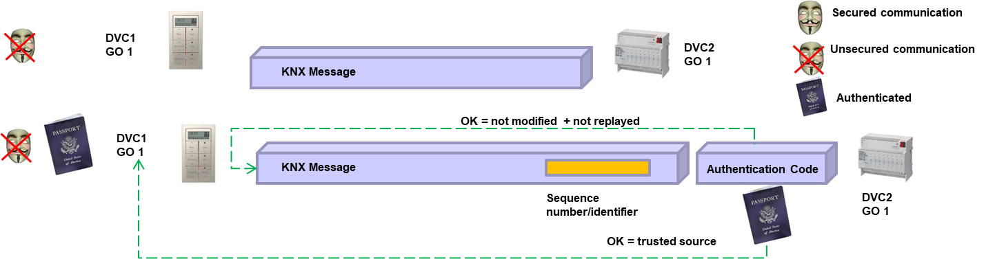
KNX insecure telegram – KNX telegram with authentication

Slide 3
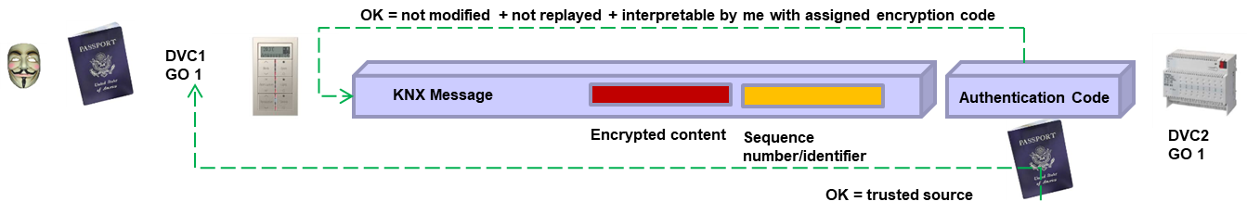
KNX telegram with additional encryption of user data

Slide 4
KNX IP Secure
Notes:
S

Slide 5
KNX Data Secure

Slide 6
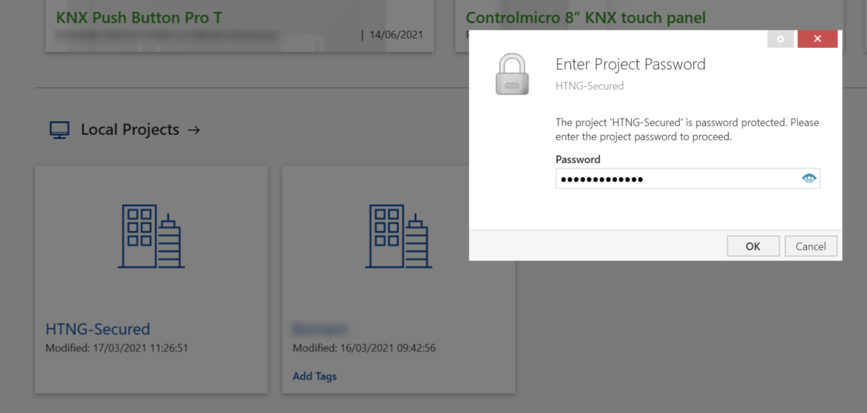
Opening a Password-protected ETS project

Slide 7
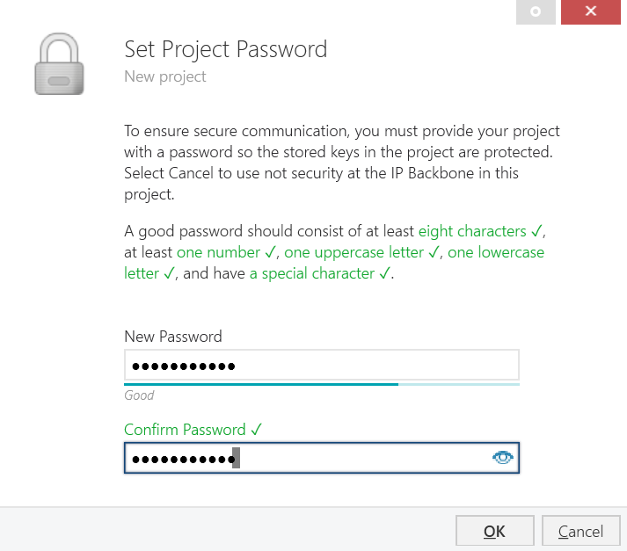
Allocation of a project password that has the right combination of letters, numbers and characters

Slide 8
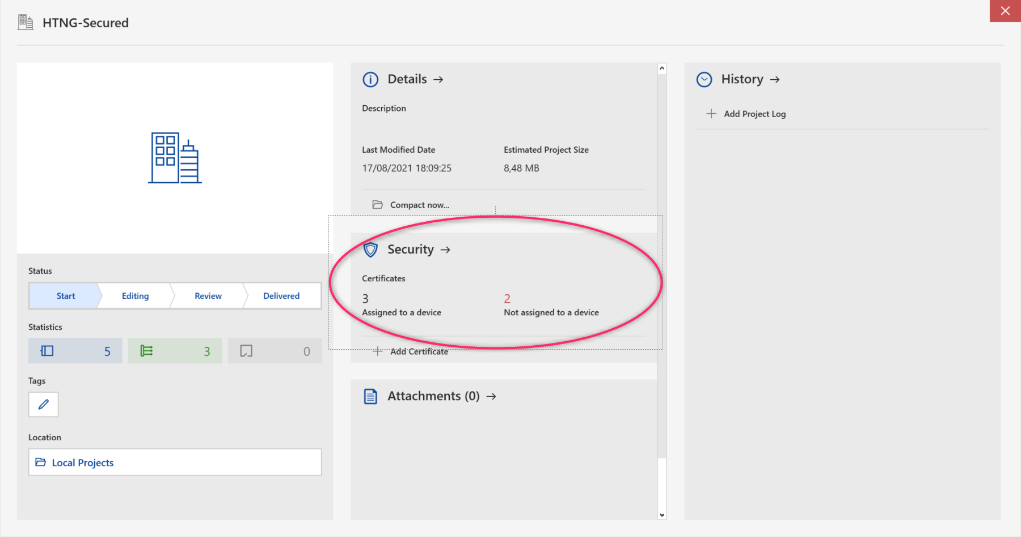
Project details of a project containing secure devices

Slide 9
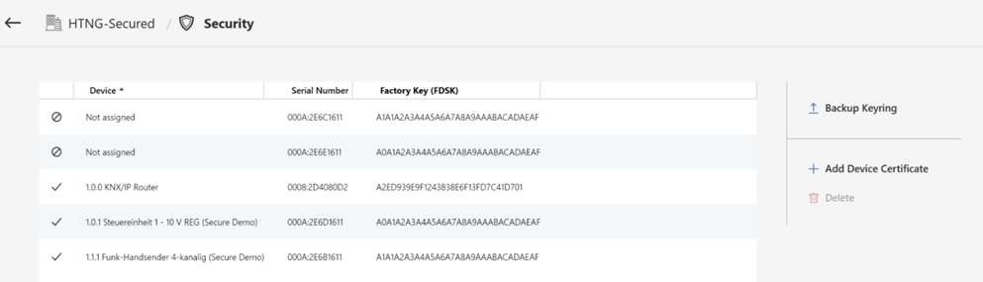
"Security" tab of an ETS project with KNX Secure devices
Possibility to export key information
Possibility to add another device certificate

Slide 10
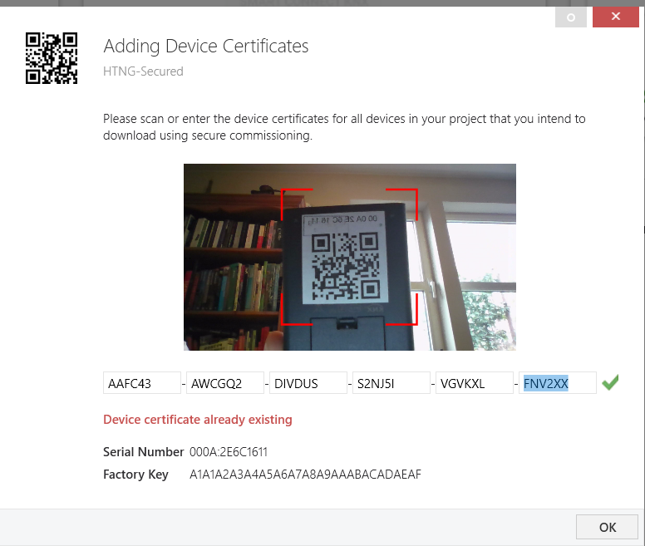
Reading in/entry of device certificates of KNX Secure devices
QR code
PC Webcam display that can be used for scanning the QR code (if available)
Indication that certificate was already scanned and is part of the project
Input field for FDSK key manual entry

Slide 11
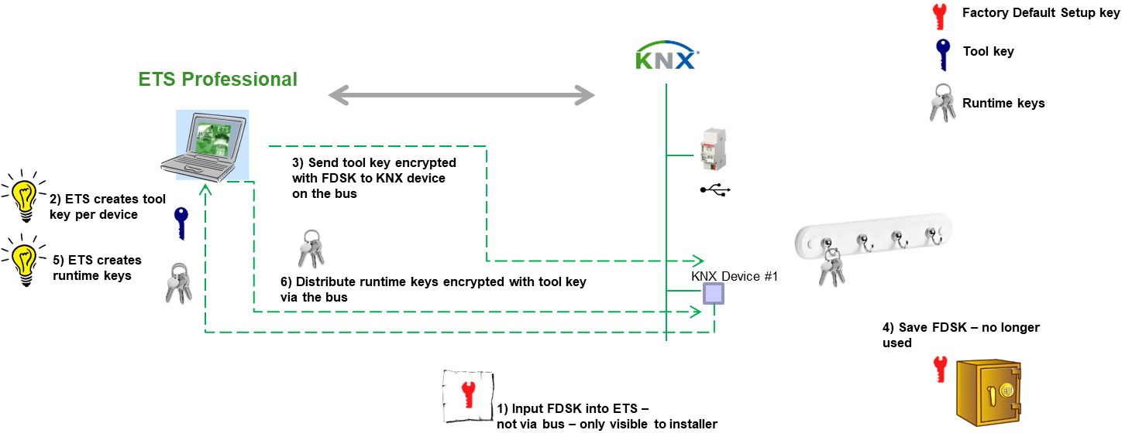
Method of generating and downloading security keys

Slide 12
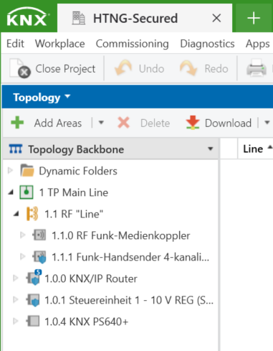
Illustration of KNX Secure devices in the topology
Non secure KNX device
KNX secure device

Slide 13
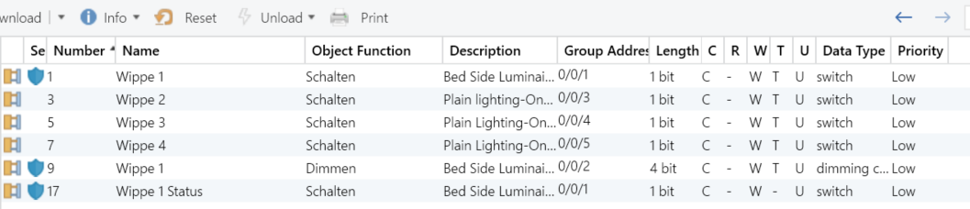
Selecting a KNX Secure device – Group object list
Group object with secure group address
Group object with plain group address

Slide 14
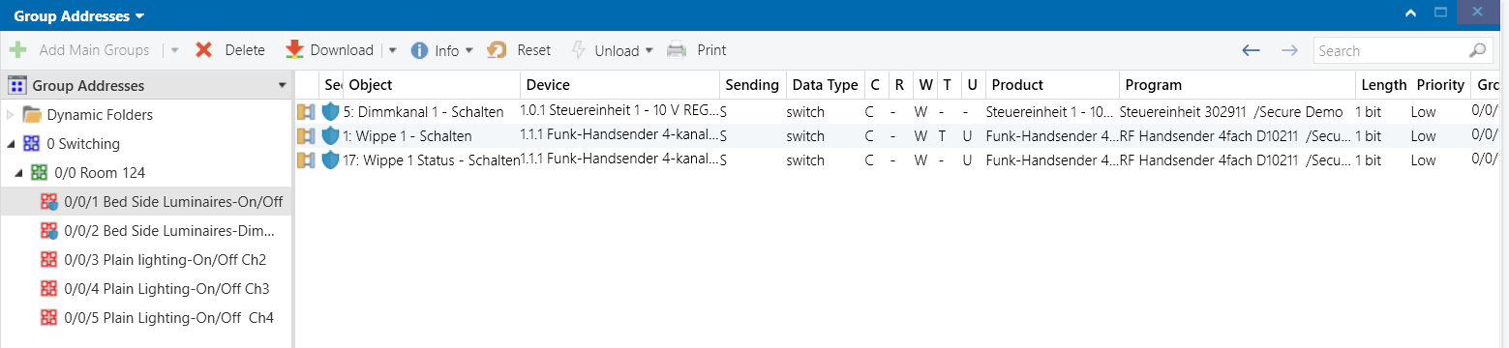
Selecting a secure group address and the corresponding associations
Secure Group Address
Plain Group Address

Slide 15
Group address security setting

Slide 16
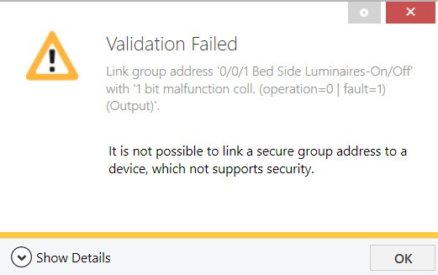
Validation failed

Slide 17
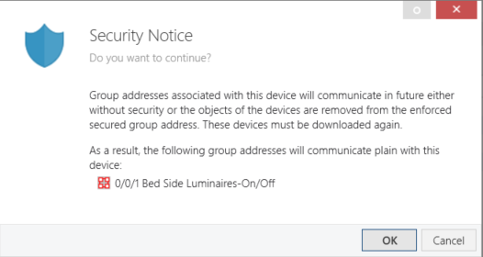
Security Notice

Slide 18
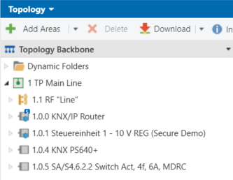
IP Backbone settings (1)
Click on the word ‘Topology Backbone’

Slide 19
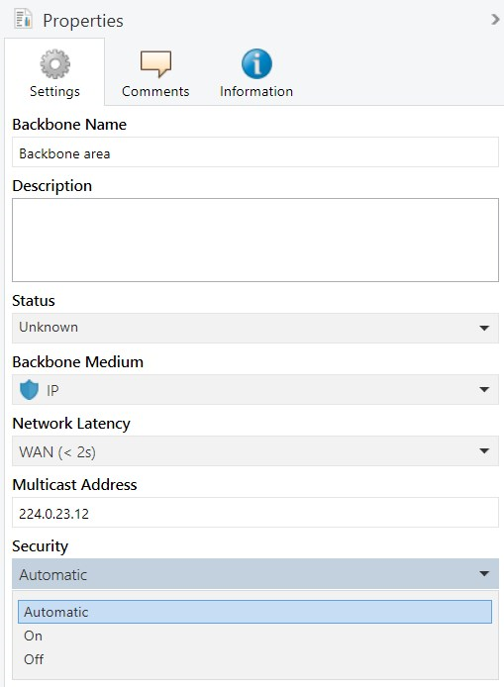
IP Backbone settings (2)

Slide 20
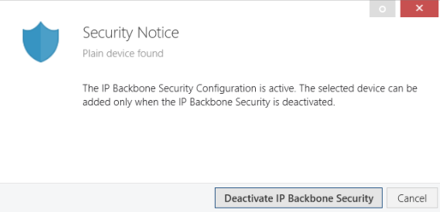
Security Notice

Slide 21
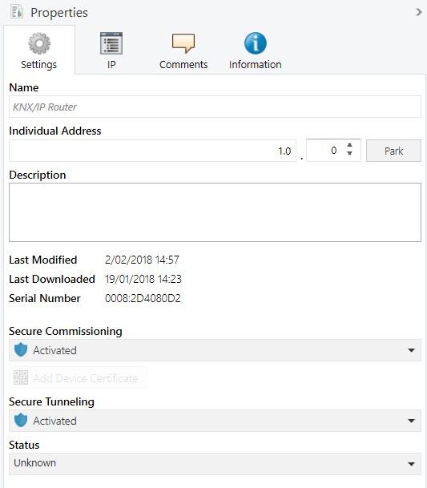
Selecting a KNX IP Secure device – Properties – Settings

Slide 22
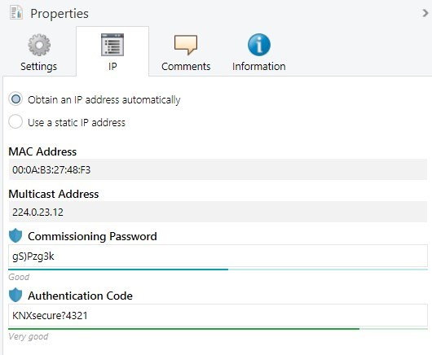
Selecting a KNX IP Secure device – Properties – IP

Slide 23
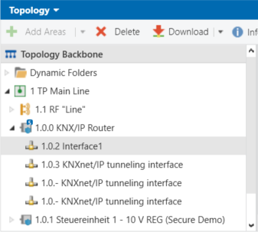
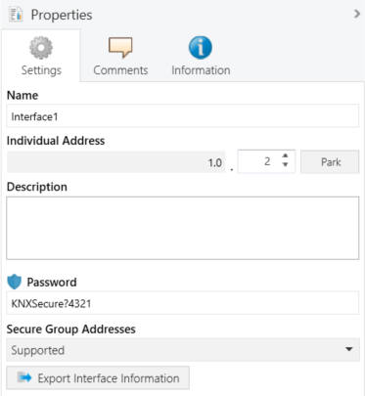
Selecting a KNX IP tunnelling interface in the topology

Slide 24
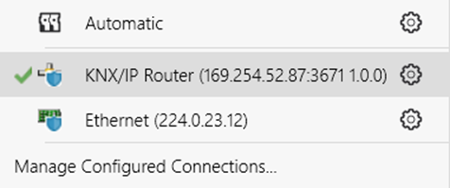
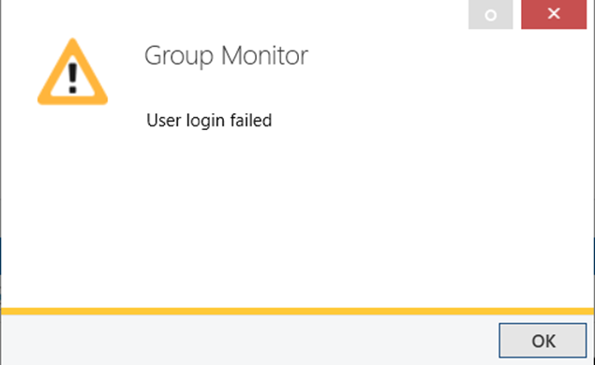
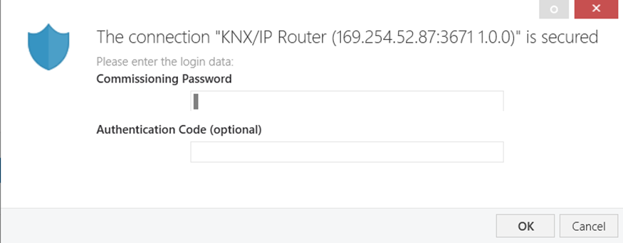
Error message - failed connection with KNX Secure IP tunnelling interface

Slide 25
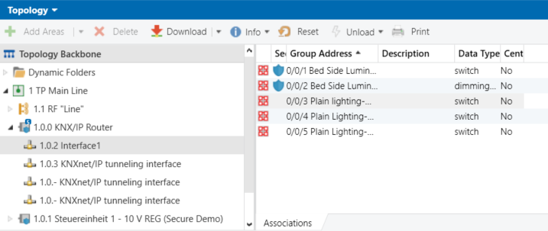
Allocating secure group addresses to an IP tunnelling interface

Slide 26
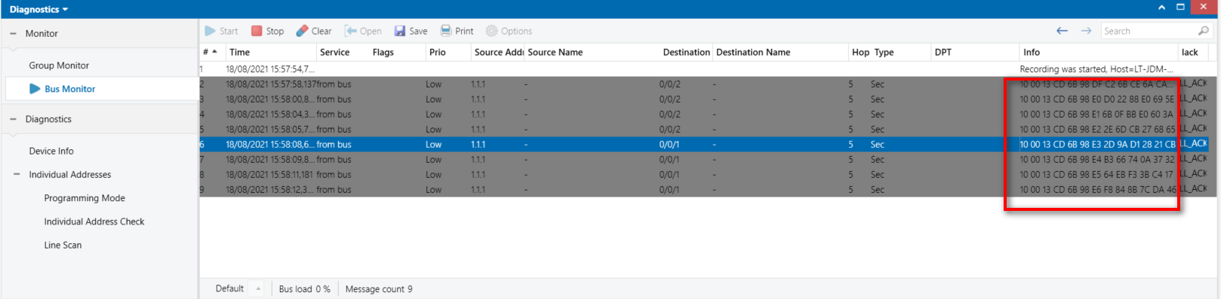
Monitoring the telegram traffic without matching ETS project open
User Data not interpretable

Slide 27
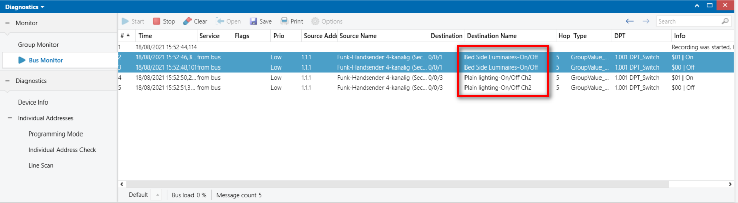
Monitoring the telegram traffic with matching ETS project open
User Data interpretable

Slide 28
Security settings printing options

Slide 29



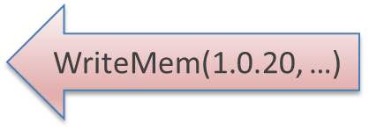
Security Proxy
1/1/1 Plain
1/1/1 Secure
1.0.20Plain
Security Proxy
1.1.30Secure

Slide 30
Security Domains
1.0.0 IP Router without security proxy
0.0 IP Backbone
1.0 TP Area
1.0.7 TP Actuator
1.1 RF Line
1.1.2 RF Sensor
1.1.0 Media Coupler with security proxy
Security domain

Slide 31
Transfer Domains
Examples
A group address is linked to a secure object in line 1.1 and a plain object in line 2.1
A group address is linked to a secure object in line 1.1 and a plain object in lines 2.1 and 1.0
A group address is linked to a secure object in lines 1.1 and 3.1 a plain object in lines 2.1 and 1.0
1.1 S
1.0 ?
0.0 ?
2.0 ?
2.1 P
1.1 S
1.0 S
0.0 S
2.0 S
2.1 P
1.1 S
1.0 P
0.0 ?
2.0 ?
2.1 P
1.1 S
1.0 P
0.0 P
2.0 P
2.1 P
2.0 ?
2.1 P
2.0 S
2.1 P
1.1 S
1.0 P
0.0 ?
1.1 S
1.0 P
0.0 S
3.0 ?
3.1 S
3.0 S
3.1 S

Slide 32
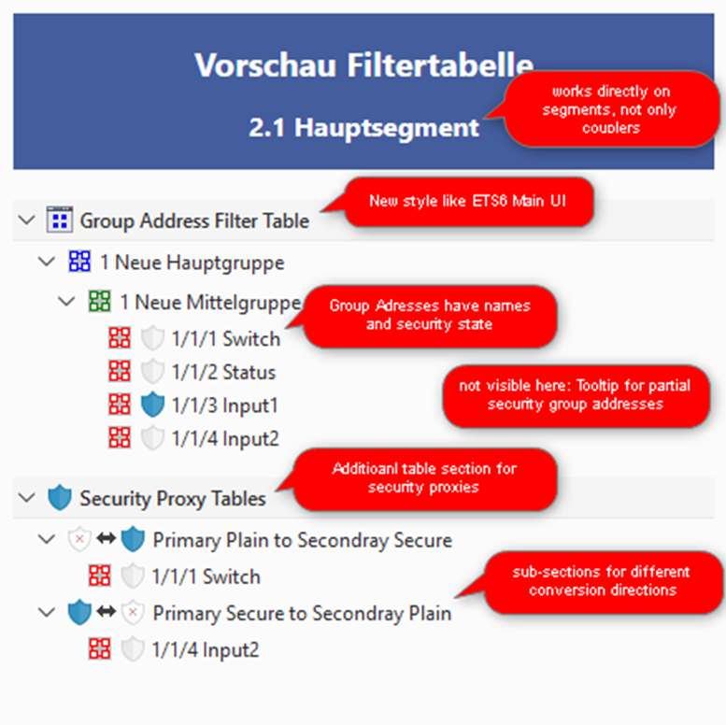
Preview Filter Table

Slide 33
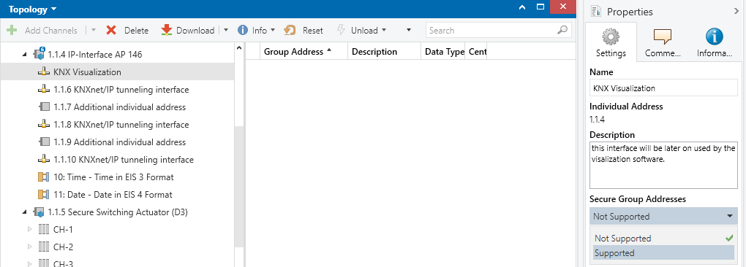
Security support of software on interfaces

Slide 34
Summary
In a KNX installation, KNX IP Secure and KNX Data Secure devices can be used in parallel.
In a KNX system, secure and plain applications can be used in parallel. Not all devices have to be secure.
If several IP routers are used in a system and one of these is changed to KNX IP Secure, all the others must also be changed to IP Secure.
A group object in a device that is already connected to a secure group address, can no longer be connected with a different non-secure group object. Without security proxies in the installation, this rule applies for the entire installation. With a security proxy in the installation, this applies to the relevant security domain.
Within a same security domain, a group address needs to be either plain or secure for all connected group objects. If one device does not offer security and security is indispensable, this non-secure KNX device may have to be exchanged for a KNX Secure device.
The new security functions can be integrated seamlessly into existing systems. KNX Secure is an upward-compatible extension: existing devices ignore KNX Secure messages.

