Slide 1
KNX Advanced Course
Visualization Systems

Slide 2
General
Representation of functions in graphical format, both as remote operating elements and display elements
Requirements for a central display
Have collective status of functions or devices
Be aware of any alarms or faults
Have operational data displayed independent from hardware / software platforms
Communication channels independent from environment

Slide 3
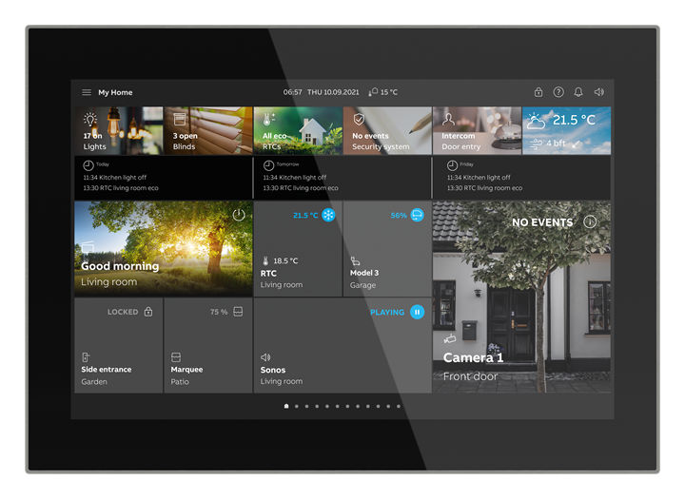
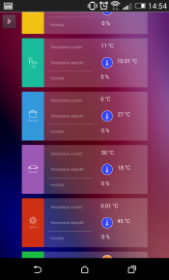
Terms
Visualisation: Representation of states (observation) and “Control” the selection of states (operation)
Datapoint Type: Determines the format of information to be displayed. Not only include the value, comprises its further interpretation
Process point: Interface between the information for display or selection and their graphical representation

Slide 4
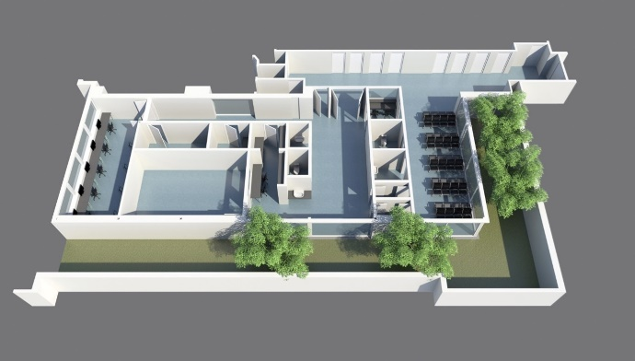
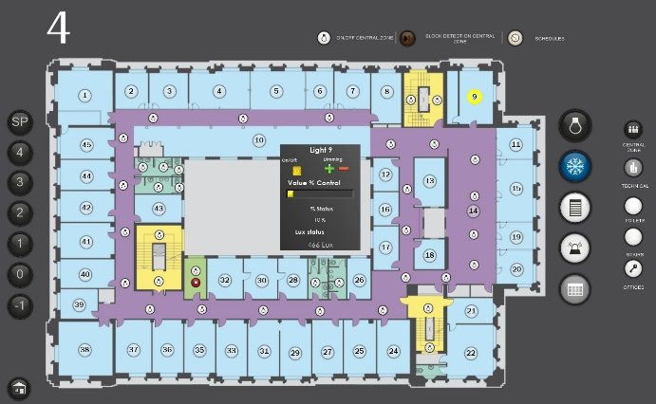
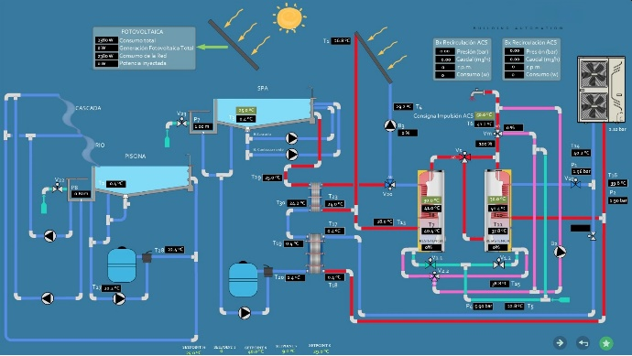
Terms
Static Images: Visual aid is used as static background images
Dynamic Image Elements: Used for display the required information/states.
A process point must be assigned to each variable

Slide 5
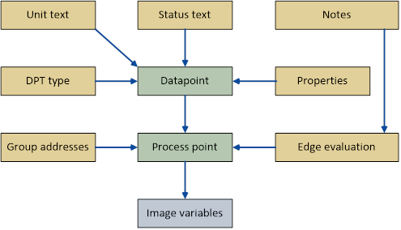
Transfer the KNX Project Design Data
Structured Project Design

Slide 6
Visualisation Notes
Notes for Recording the Status with the Visualization
States are detected by listening to the bus telegrams
If status are not transmitted on change, they must be read cyclically
Read flag must be set in the status to respond to read requests
Notes for Starting the Visualisation
After a restart, the current device states must be requested (enabling the ‘sending group address’ )
Important: A central address or used by several devices may never be implemented as a sending group address.
The response of a read request will be interpreted as a normal write telegram

Slide 7
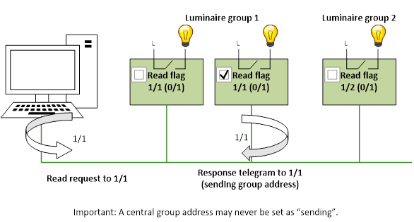
Types of Bus Communication
Program Start-up: When starting, all groups should be read out. Read flags may be set only once per group address

Slide 8
Types of Bus Communication
Normal Operation: Update of the process image
permanently listening into the bus
Mirroring and reading back after transmitting (this method becomes obsolete with automatic responding status objects)
cyclic read back: keep status information as current as possible is only used. Methods:
Automatic status transmission after change
Cyclical update of status

Slide 9
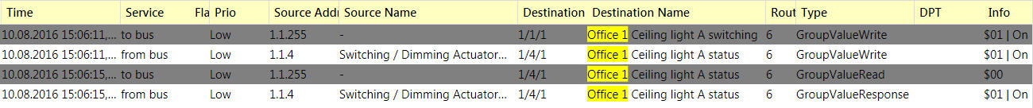
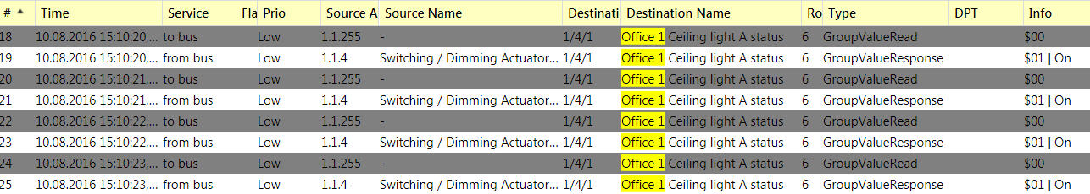
Types of Bus Communication
Visualisation: Reading back after sending
Visualisation: Reading out cyclically

Slide 10
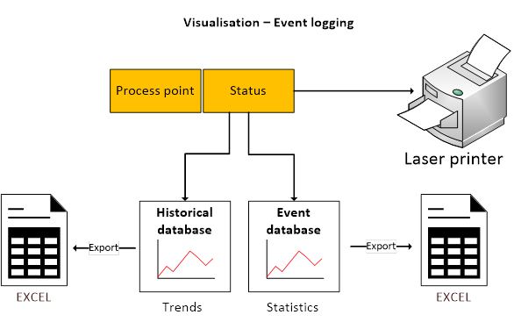
Types of Bus Communication
Data Recording Modes: Data tracking operations to analyse and draw decisions

Slide 11
Connection of the Visualisation
Direct Connection via Hardware Interface
Indirect Connection via Gateway (Hardware) or Server (Software, e.g. OPC):
Connection via Gateway
Connection via OPC Server
Webserver and HTML - Bus access can be:
local via a webserver embedded in a KNX device
distributed via the KNXnet/IP services

Slide 12
OPC server operation concept
Software program for data transfer, intermediate saving (buffering the process image) and if necessary conversion
Process image is stored in memory and is always up to date

Slide 13
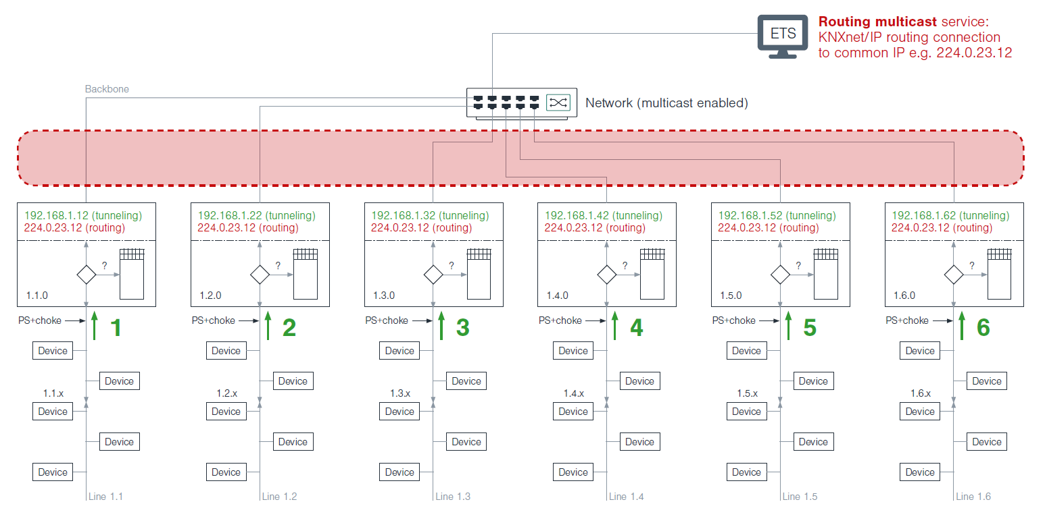
Bus Access via KNXnet/IP Server
Location independent KNX network access via Ethernet:
Routing: Communication via IP multicast address. KNX Multicast address 224.0.23.12. Not suitable to be used via the Internet

Slide 14
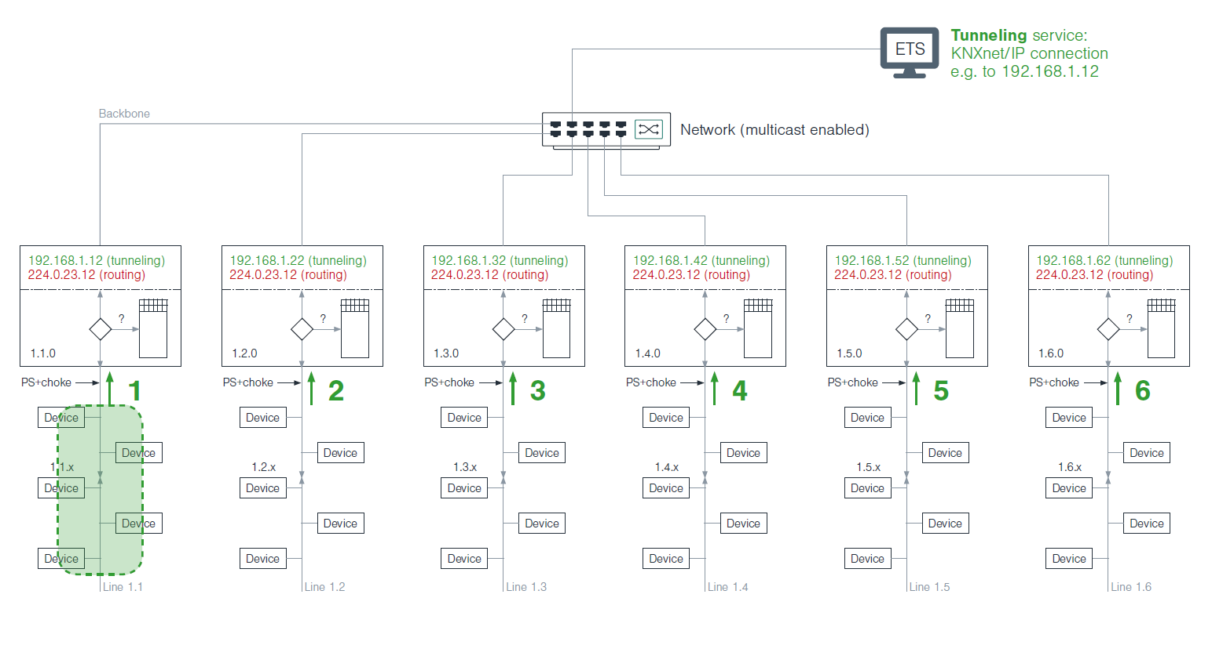
Bus Access via KNXnet/IP Server
Location independent KNX network access via Ethernet:
Tunnelling: unlimited, direct access via IP gateway. Filter tables are ignored; telegrams are “tunnelled” through the filter table of router. Benefit: the filter tables do not have to match. Disadvantage: Only one line is addressed. Suitable for remote access via the Internet

Slide 15
Bus Access via KNXnet/IP Server
Location independent KNX network access via Ethernet:
Object server: tunnel access but only for group communication. Used for large distances during remote access. It should be used if ping response time > 1.000 ms

Slide 16
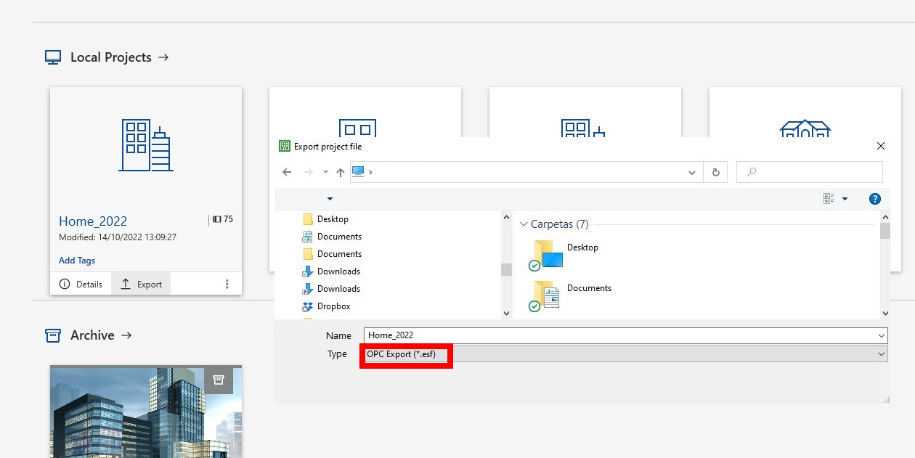
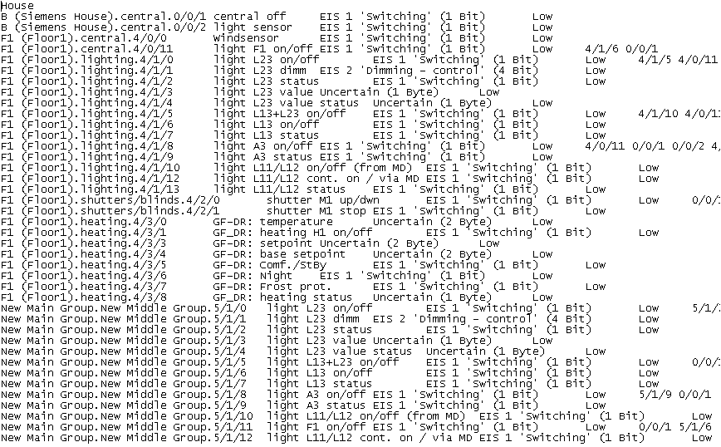
Exporting Project Data
Data: Group addresses + datapoint format + comm. flags

Slide 17
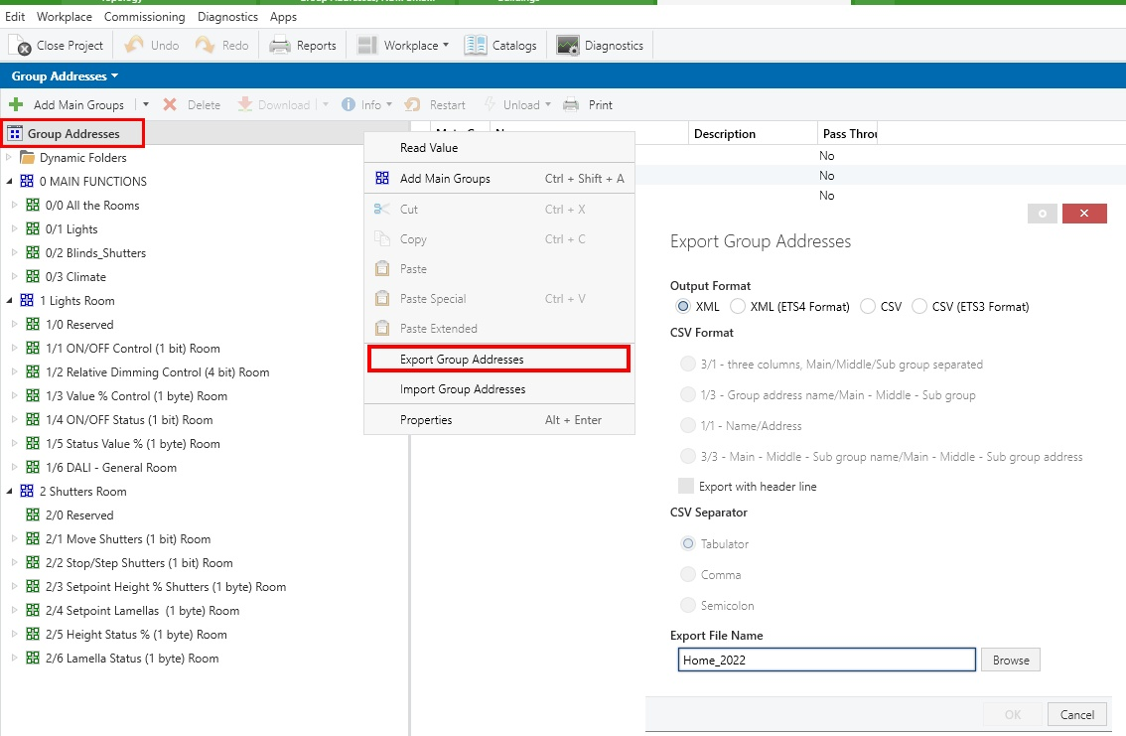
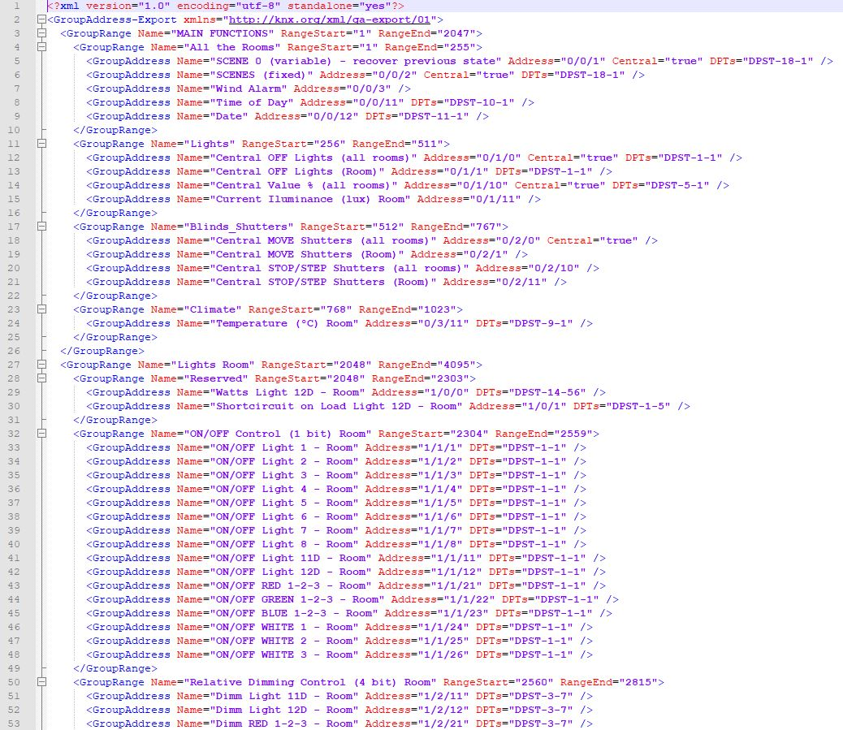
Exporting Project Data
Group export in ETS6

Slide 18
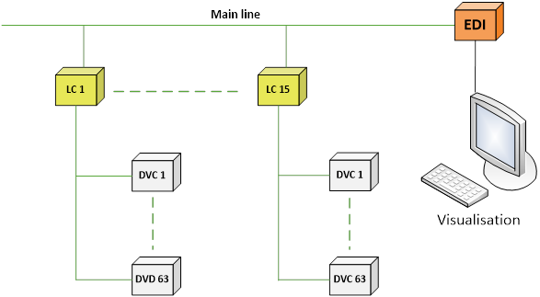
Physical Access Point in Bus System
If the bus system consists of several lines, visualisation shall be connected to the main line to enable optimum access

Slide 19
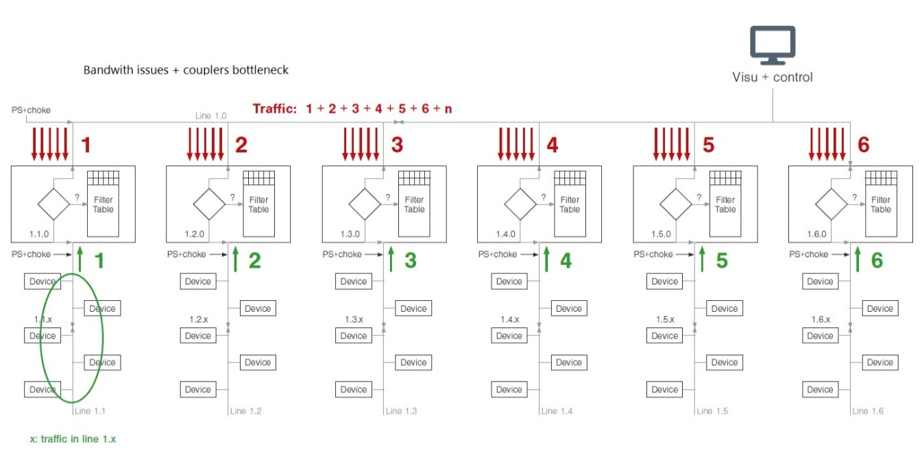
Physical Access Point in Bus System
Scenario with a central visualization in a big installation

Slide 20
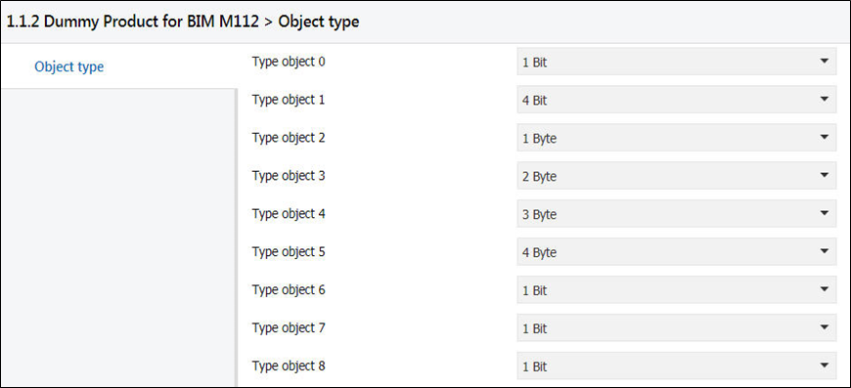
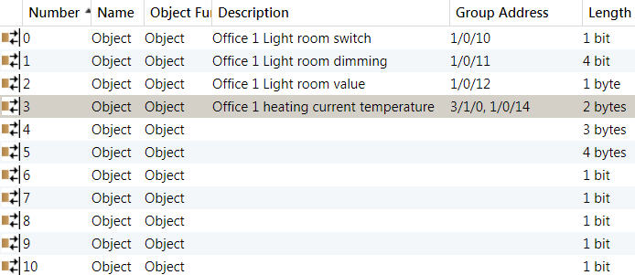
Telegrams sent across Lines/Areas
Relevant information for the visualization across lines or areas depend on the behaviour of the coupler
Enabling the Filter Table
Use of IP Routers instead of Line Couplers
Correcting the Filter Table via Dummy Devices
Parameters and objects of a dummy application

Slide 21
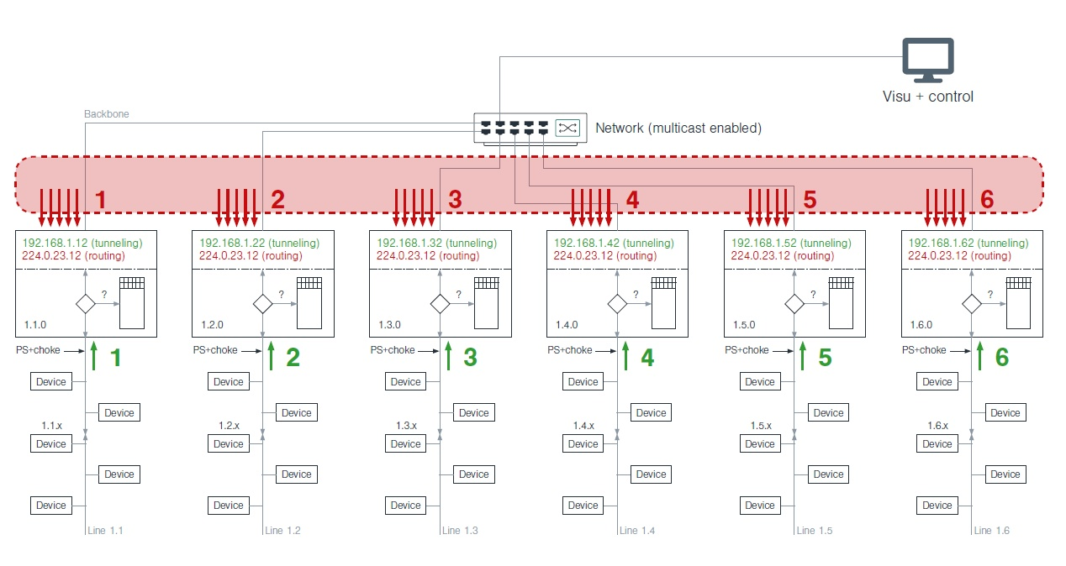
Use of IP Routers instead of TP Couplers
Backbone OK but maybe still a problem with coupler´s buffers

Slide 22
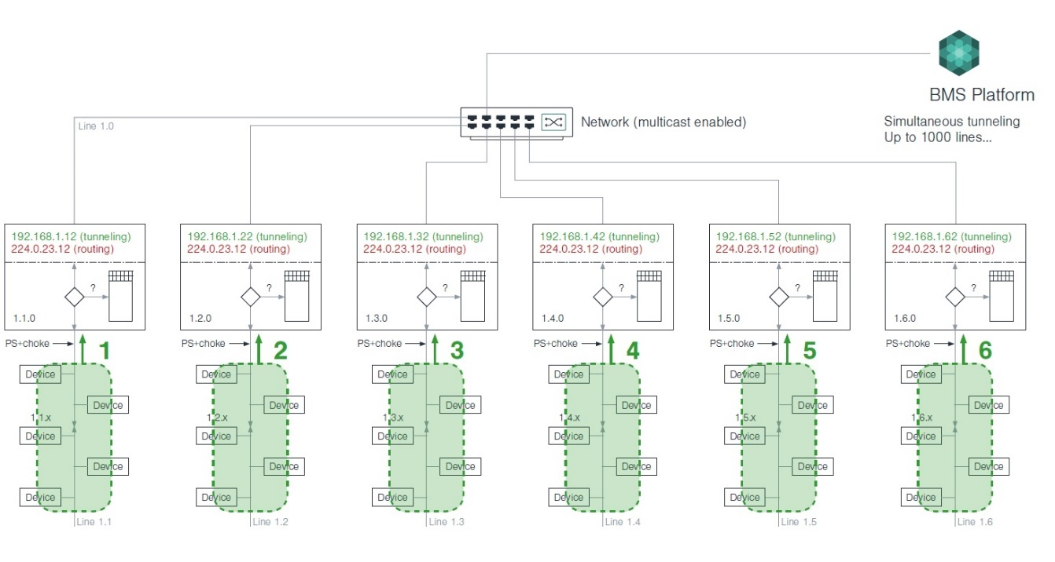
Use of IP Routers instead of TP Couplers
Solution for massive KNX installations using BMS software

Slide 23
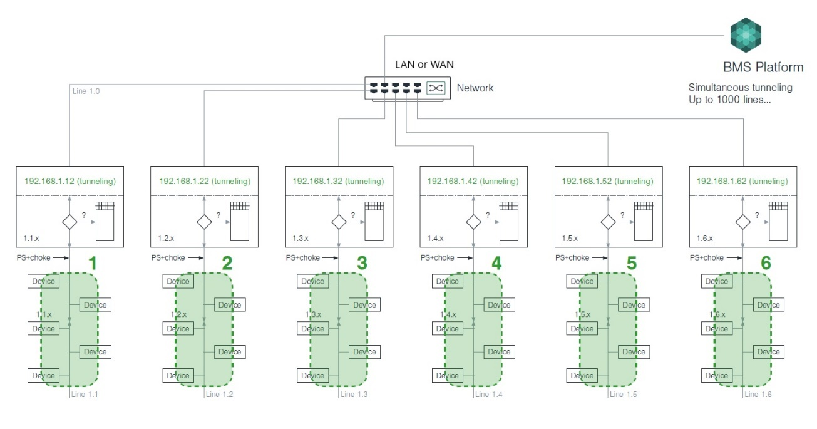
Use of IP Interfaces instead of TP Couplers
Solution for multi-site visualization using BMS software and IP Interfaces instead of IP Routers

Slide 24
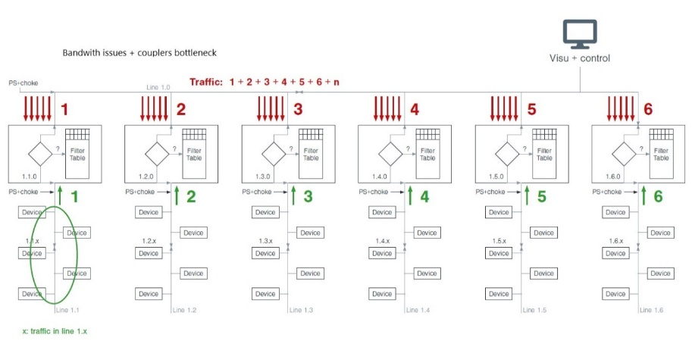
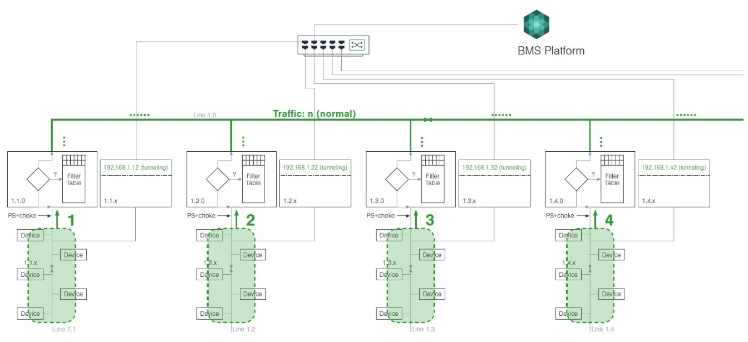
Use of IP Interfaces and TP Couplers
Solution for old KNX TP installations using BMS software and IP Interfaces

Slide 25
Types of Visualization
KNX device with embedded visualization software: Such as a touch panel with an embedded configurable KNX BCU
Mobile device: Such as a smartphone or a tablet, which has the software installed on it. Usually, the connection is achieved via WiFi using a KNXnet/IP router/interface
Client/Server based visualization: Software runs on a central device as server and can be accessed by other devices as clients

Slide 26
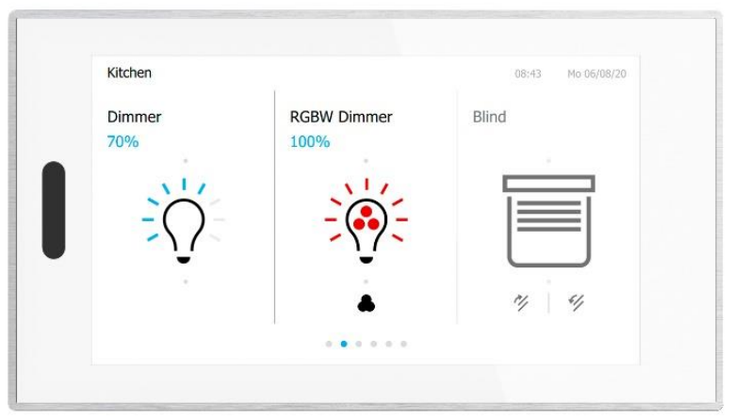
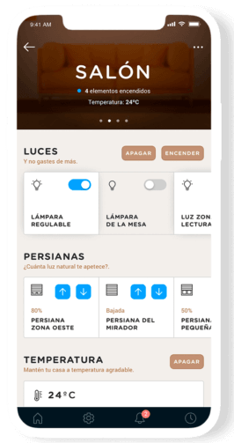
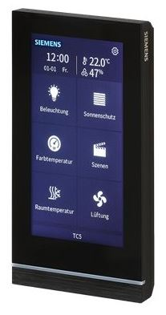
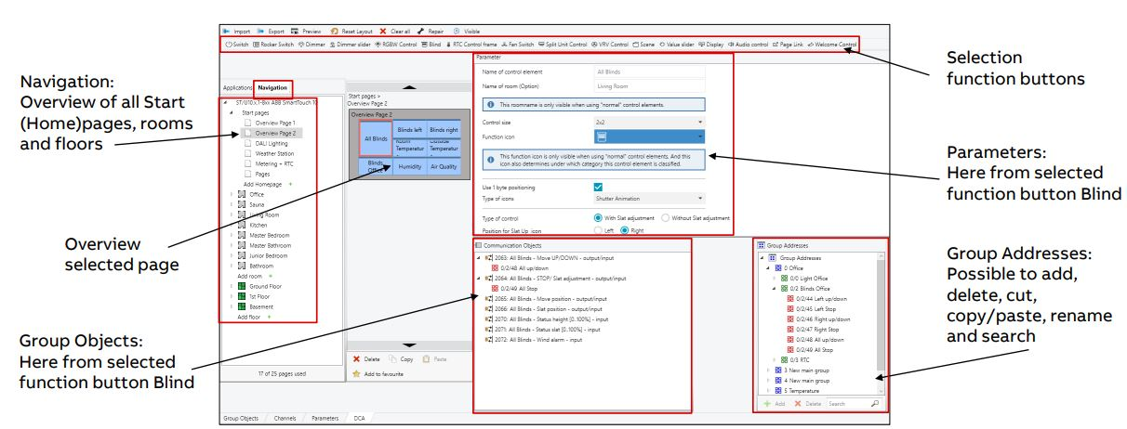
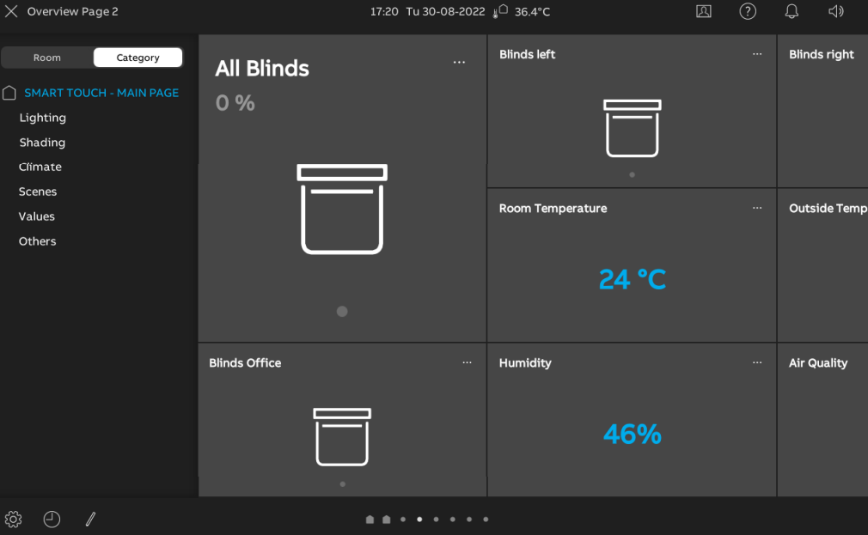
KNX Device with Embedded Software
It is usually a display unit or touch panel, with an embedded KNX controller, to connect to the bus and monitor and control the KNX installation.
Configured and commissioned with KNX “S-mode” by ETS, sometime using DCA Apps or plug-ins.

Slide 27
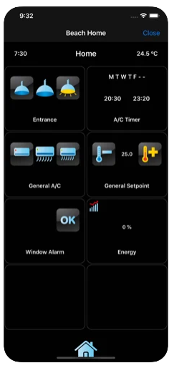
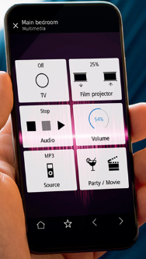
KNX Device with Embedded Software
Touch screen with additional smartphone/tablet access
Allow local or secured remote access to the device
No networking configuration is needed

Slide 28
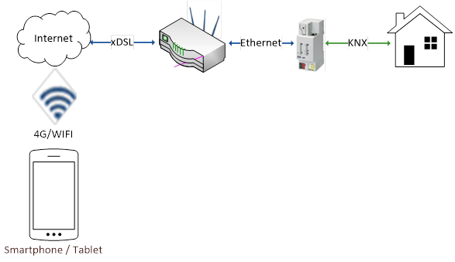
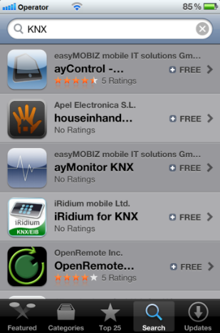
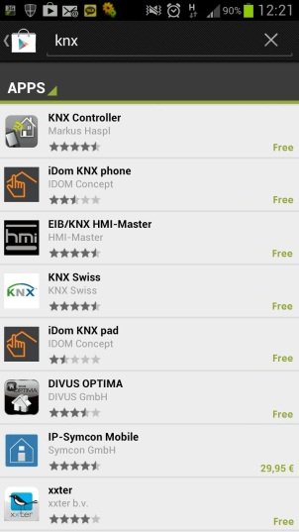
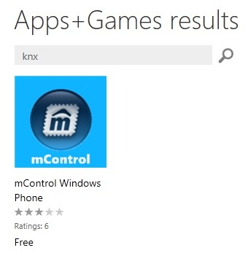
Mobile Visualization Software
Mobile device, usually equipped with WiFi adapter and using a visualization app accessing data via KNXnet/IP

Slide 29
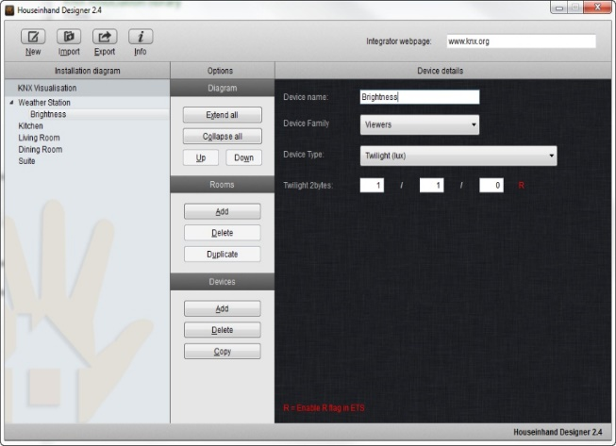
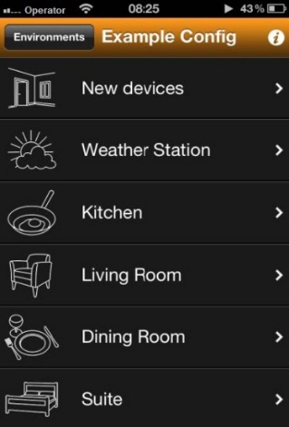
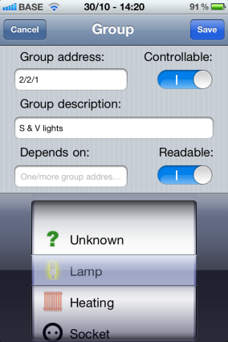
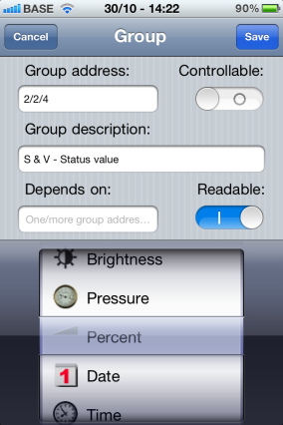
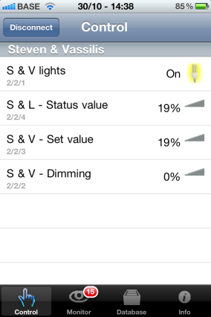
Configuring a Mobile Visualization Software
Use of external configuration software
Use of the embedded configurator of the app
Configuration tool and preview
Embedded configurator. Adding group addresses manually

Slide 30
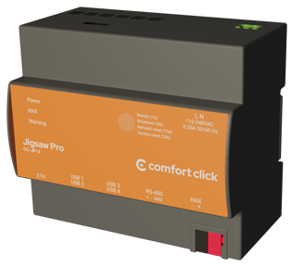
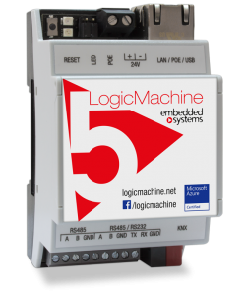
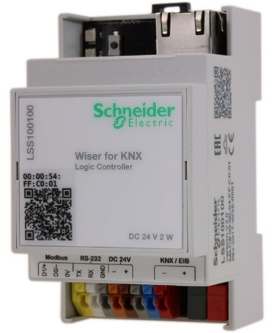
Webservers and Logic controllers
Embedded devices, usually for DIN rail installation.
Not limited only to visualization:
Allow Configuration of alarms, scenes, macros and schedules
Allow recording of data for their representation in graphs.
Can be used as IP Router and coupler
Tunneling connection
Secure VPN access configuration to the installation through the device
Include a logic engine and a script engine for more complex configurations
Voice control and integration with smart assistants like Alexa or Google Home.
Integration with sound systems like Sonos®.
Direct integration of KNX with other field buses and with other protocols such as Modbus RTU, Modbus TCP, BACnet IP, MQTT, LORA, Zigbee, etc.

Slide 31
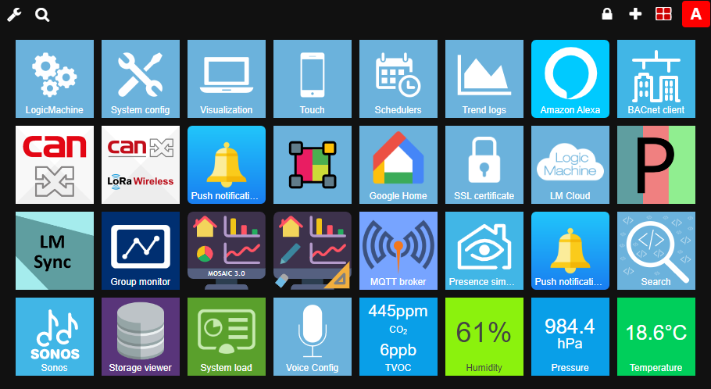
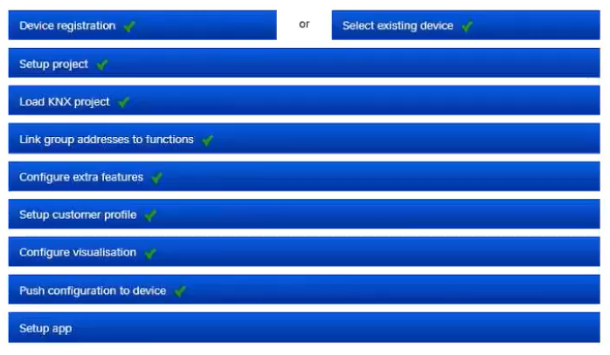
Webservers and Logic controllers
Configuration made via web. Wizzard/assistant sometimes also available

Slide 32
Client/Server based Visualization
Central units with the ability to access them by several users and in many cases with different privileges
Models:
standalone software tool, installed on a PC with access to the bus and other clients
Compact computer with an embedded, freely configurable visualization software and a KNX interface to the bus
Configuration can differ from one manufacturer to another

Slide 33
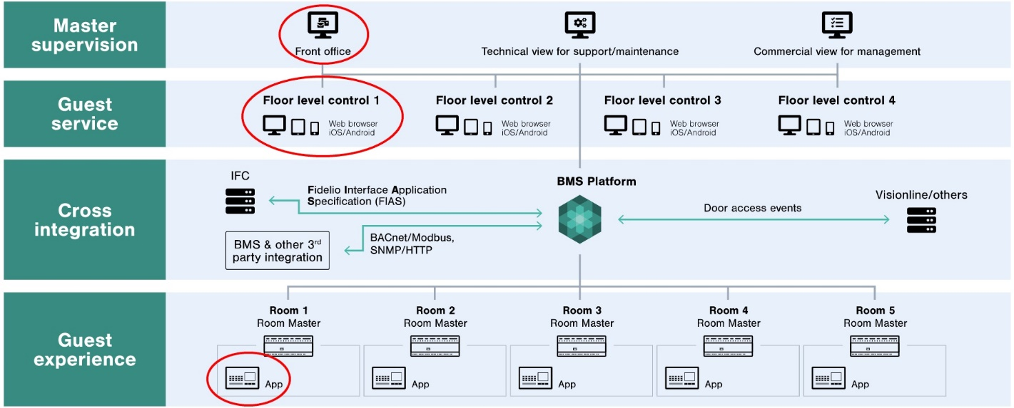
Client/Server based Visualization
For big projects, usually as a client of a BMS.
Allow different levels of visualization (central, partial, per user,…)

Slide 34
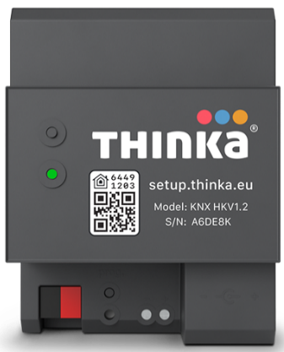
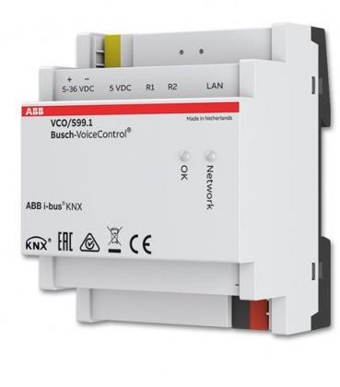
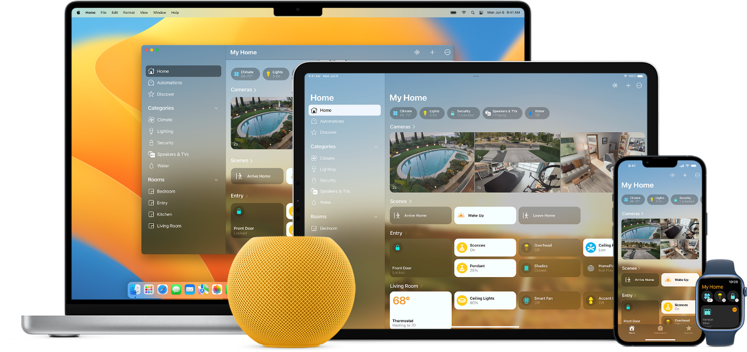


New user interfaces. Voice control and intelligent assistants

Slide 35


Configuring a Smart Assistant for a KNX installation

Slide 36

Comparison between Smart Assistants
Voice control service
ON/OFF Lights
Dimmable Lights
RGB coloured lights
Switchs
Sockets
Thermostats
Speakers
Vacuum cleaners
TV
Cameras
Locks
Shutters / Blinds
Temperature sensors
Thermovalve
Humidity sensors
Magnetic contacts
Smoke Sensors
CO₂ Sensors
Leak sensors
v* : only voice control

