Slide 1
Continuous Integration
Course : Open Source Software
Instructor: Dr. Peter Rigby
Presented by:
Shahla Noori
Hamid Mehr
Manouchehr Azizi
November 29, 2013

Slide 2
Agenda
  What is CI?
  Benefits
  Why CI?
  Agile, TDD and CI
  Implementation Models Introduction
  Summary
  Conclusion

Slide 3
Traditional Methodologies
Traditional approaches like waterfall process rely on regimented flow of development
- Although waterfall development was the standard for large, complex system development for many years, it has several notable flaws.

Slide 4
Waterfall flaws
  - Wasting time to complete documents before design and design before code
  Testing and integration are held off until end of the project

Slide 5


Waterfall flaws (Cont.)
These flaws could be tolerable in a world that moved at a slower pace
But as the pressure to create innovative systems has increased, this approach wont work properly

Slide 6
Agile software development
Group of software development methods based on iterative and incremental development
It promotes:
  Adaptive planning
  Evolutionary development and delivery
  A time-boxed iterative approach
  Encourages rapid and flexible response to change

Slide 7
Extreme programming
A type of agile software development.
It advocates frequent "releases" in short development cycles

Slide 8
Extreme programming practices
Extreme programming has been described as having 12 practices, grouped into four areas:
These12 practices are applied in order to make sure that XP works as an alternative for traditional methodologies.
These are the 2 of 12 best practices that work together:
- Test-driven development
- Continuous integration

Slide 9
What is CI
It was first named and proposed as part of extreme programming (XP)
Its main aim is to prevent integration problems, referred to as "integration hell" in early descriptions of XP.
Avoiding long periods between build and test runs
Simplify and automate the execution of many otherwise tedious tasks

Slide 10
Agile, TDD and CI
CI was originally intended to be used in combination with automated unit tests written through the practices of TDD
Initially this was conceived of as running all unit tests and verifying they all passed before committing to the mainline
Later elaborations introduced build servers, which automatically run the unit tests periodically
It replaces the traditional practice of applying quality control after completing all development

Slide 11
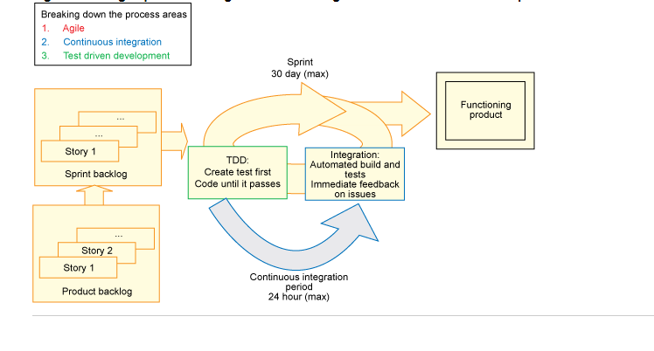
An agile practice using continuous integration and test-driven development

Slide 12

Martin Fowler of ThoughtWorks
Continuous integration is a software development practice that requires team members to integrate their work frequently

Slide 13
What Does Continuous Integration Software Do?
- The core functionality of a continuous integration system is simple:
  - Build software
  - Run tests
  - Report the results

Slide 14
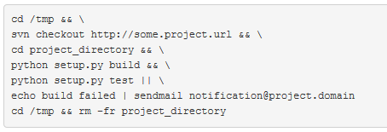
A UNIX Script Example

Slide 15
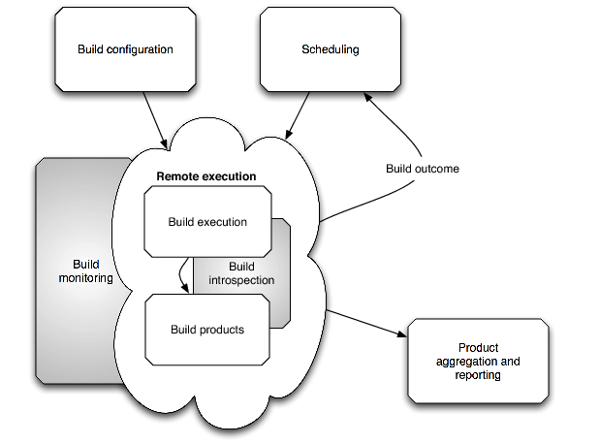
Internals of a CI System

Slide 16
Additional Features of CI
Checkout and update
Abstract build recipes
Storing checkout/build/test status
Release packages
Multiple architecture builds
External resource coordination
Progress reports

Slide 17
Implementation Models
Master/Slave Architecture
Reporting Server Architecture

Slide 18
Master/Slave Architecture
Central server
Directing and control
Remote builds

Slide 19
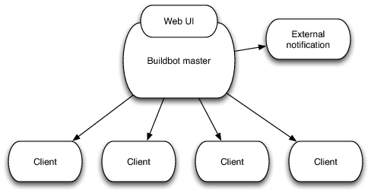
Master/Slave - Example
Buildbot

Slide 20
Buildbot
Real time Remote Execution by master
Build requests coordinated and directed by master
Robust constant network connection
Slaves are added explicitly

Slide 21
Buildbot - Limitations
No mechanism to return build products to master
No mechanism to balance load among slaves
Centralized configuration causes problems for distributed model
No mechanism to dynamically add slaves

Slide 22
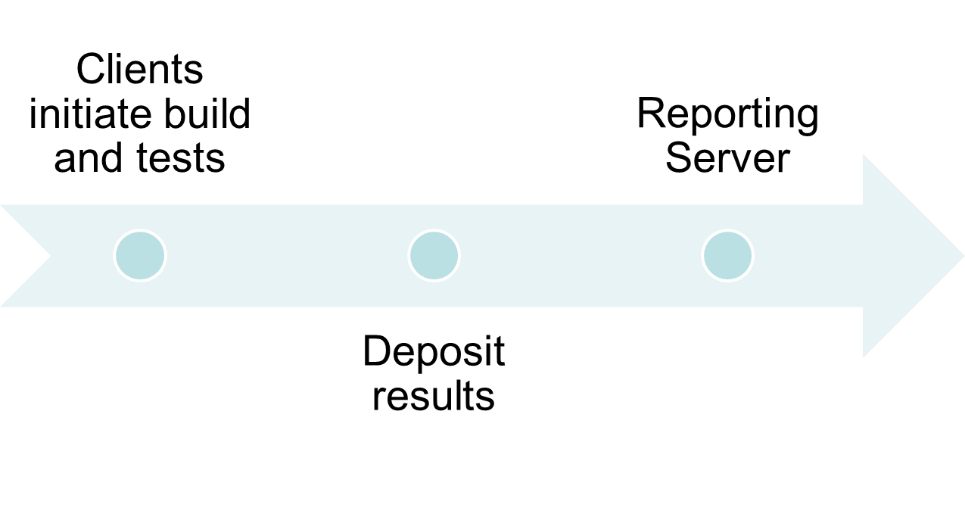
Reporting Server

Slide 23
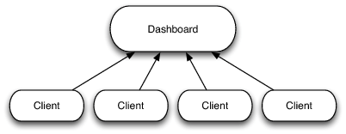
Reporting Server - Example
Cdash

Slide 24
Cdash
Repository of information on remote builds
Report of build and test failures, code coverage analysis, and memory usage
Clients make decision about the builds
Clients can be added dynamically
Cdash is part of a large build infrastructure : Kitware
No centralized coordination of resources
Clients are anonymous => unreliable

Slide 25
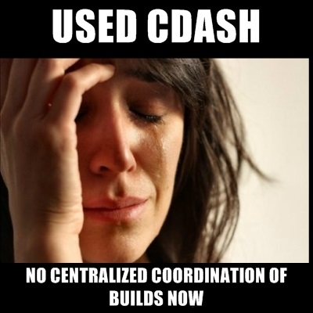
Cdash – Shortcomings

Slide 26
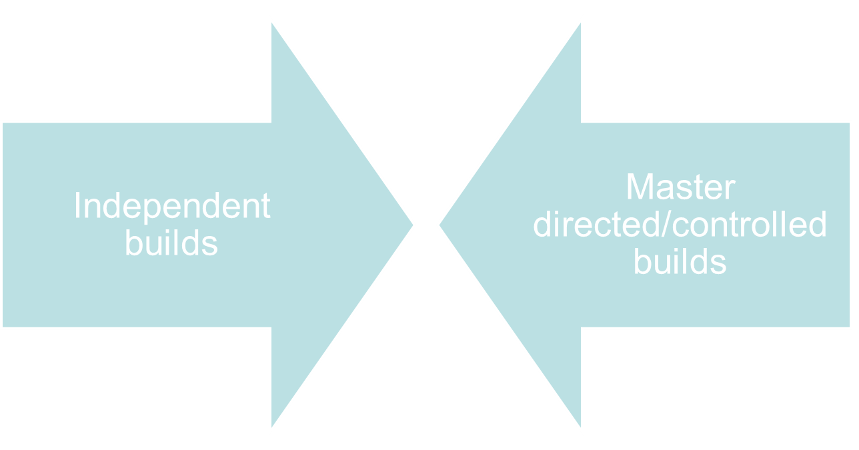
Hybrid Architecture

Slide 27

Hybrid Architecture Example - Jenkins

Slide 28
Jenkins
By default it is run as master/slave
Builds can be server or client initialized
Master initiates connection through SSH
Clients initiate connection through JNLP
Jenkins supports plugins

Slide 29
Pony-build
A proof-of-concept decoupled decentralized CI in Python
Contains 3 cores:
  Result server
  Clients
  Reporting server
Use of RPC mechanisms to facilitate build and change notification and build introspection
Implementation of Recipes and Managing Trust

Slide 30
Summary
What is CI?
Continuous Integration (CI)?
  - Build and test software automatically and regularly
  Avoiding long periods between build and test runs
What Does Continuous Integration Software Do?
  Build software, run tests and report the results
  A UNIX Script Example

Slide 31
Summary
Implementation Models for CI
  - Buildbot
  - CDash
  - Jenkins(a hybrid model)
  - Pony-Build(Python-based decentralized reporting server )

Slide 32
Summary
CI friendly project types
  - Size Type
    Teams of fewer than 50 people working on less complex projects
  Embedded systems development
    - A car horsepower vs. its embedded software technology (self-park, advanced safety warnings, fuel efficiency)
    - The number of LOC written to create a new car is higher than the number of lines of code written for an F16 fighter jet.

Slide 33
Conclusion
- Expanding the use of Agile
  - Combining CI with TDD puts more people under the agile umbrella, because it allows agile methods to work more efficiently
- Bring products to market faster
  - They can bring products to market faster, by finding issues when they are young and small, not waiting until they are large and more difficult to fix
- Are we done when sprint is over?
  - Combining CI with test-driven helps Scrum to be closer to Ideal Burndown Charts

Slide 34
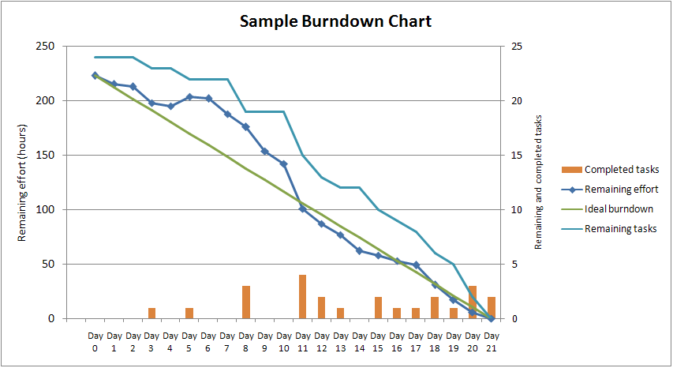
Sample Burndown chart in scrum

Slide 35

No questions? Right?

Slide 36
References
http://www.infoq.com/articles/Build-Jobs-Continuous-Delivery
http://en.wikipedia.org/wiki/Continuous_integration
http://svenpet.com/2013/03/11/git-continuous-integration-feature-branches/
http://www.drdobbs.com/architecture-and-design/driving-continuous-integration-from-git/240161383

