Slide 1
Project bug fixing
Twilio-Csharp
Course : Open Source Software
Instructor: Dr. Peter Rigby
Presented by:
Manouchehr Azizi
December 6 , 2013

Slide 2
Agenda
Overview of project and Project policies
Discussion with the core team
Bogs , root causes and solutions
Conclusions

Slide 3
Twilio-Csharp
Twilio provides a simple HTTP-based API for sending and receiving phone calls and text messages.
Twilio license is “Apache License 2.0”
232 commits, 14 releases and 53 forks

Slide 4
Twilio-Csharp(cunt.)
Consist of one Solution and 8 Projects
Project category:
  Project test
  Developed for different framework such as: Silverlight, WindowsPhone, WebMatrix,...
Easy installation (NuGet)

Slide 5
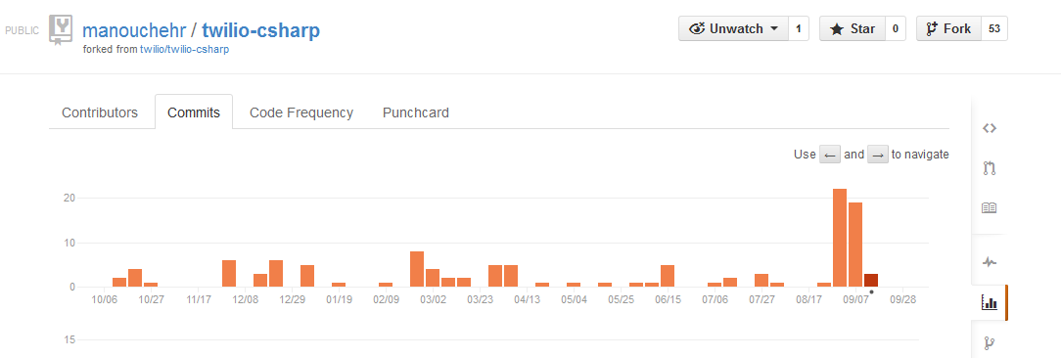
Commits

Slide 6
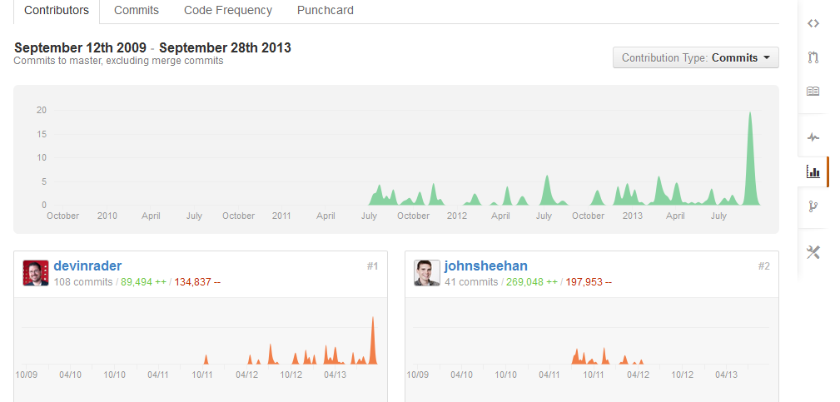
Committers and Contributors

Slide 7
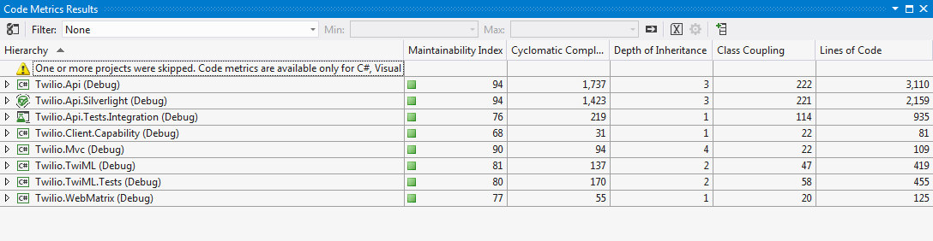
Project Metrics

Slide 8
Discussion with the core team
My email to some of Core developer :
“I am master computer science students who is required to fix a bug and/or...”
Devin (Core developer and Twilio website Admin) Reply:
“We gladly accept pull requests, so your always welcome to fork the project and fix issues”.

Slide 9
Bug fixing Steps
Register to receive ACCOUNT SID and Twilio phone number
Make a new project and NuGet Twilio
Capturing bugs
Trace and finding Issue’s root
Solution

Slide 10
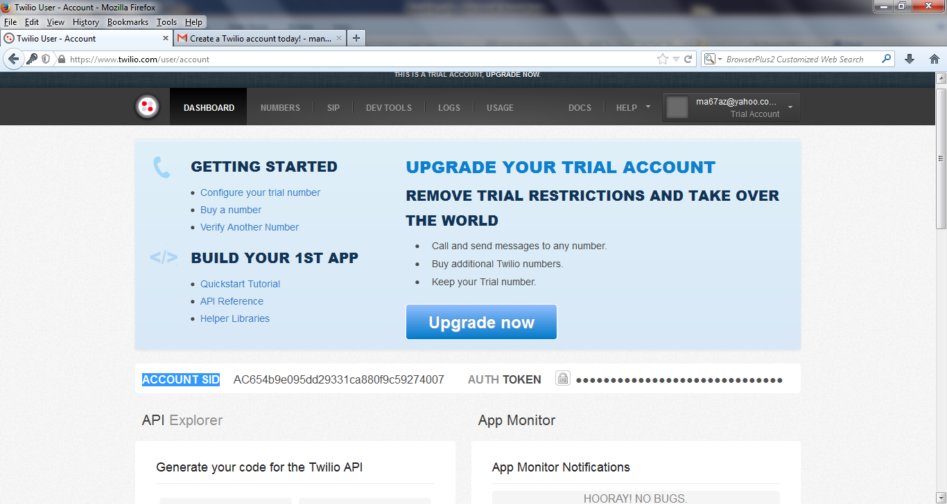
ACCOUNT SID and Twilio phone number

Slide 11
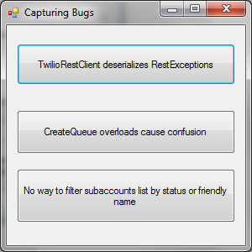
Capturing bugs

Slide 12
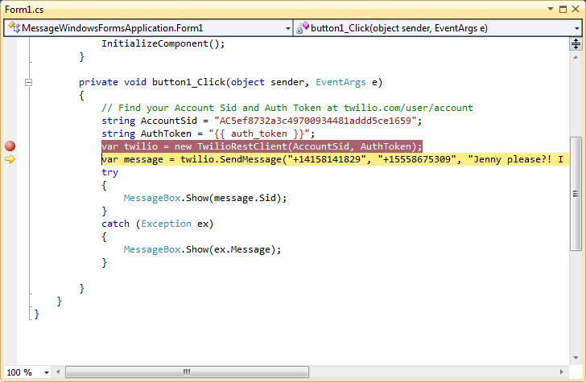
First Bug :
Code for capturing bug

Slide 13
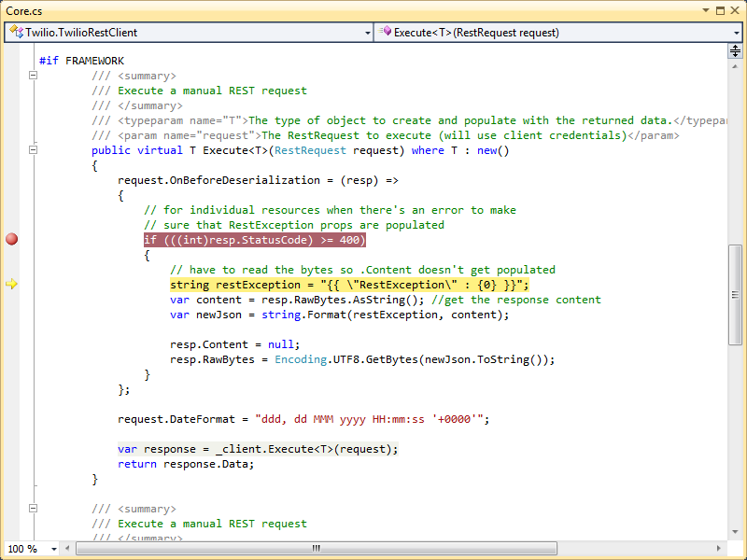
First Bug :
RestException in Twilio core

Slide 14
First bug:
Root cause and Solution
RestSharp Api :
- serialization and deserialization (I.e. Marshal and Unmarshal in java)
Solution :
- This issue is reported as RestSharp’s Issues by Devin Rader(Core developer)

Slide 15
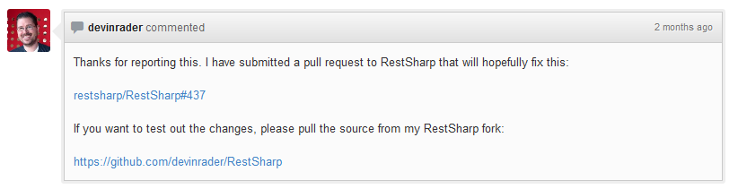
RestSharp’s Issue Reported by Devin Rader(Core developer)

Slide 16
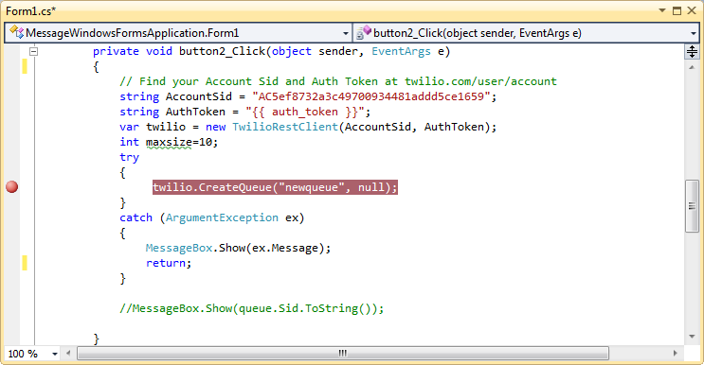
Second Bug :
Code for capturing bug

Slide 17
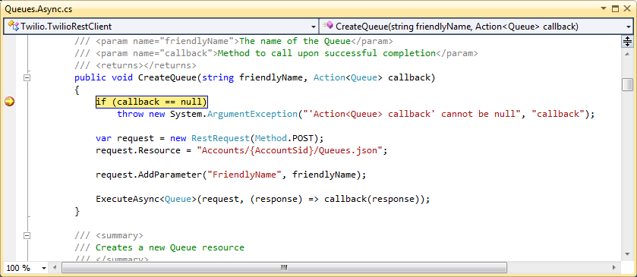
Second Bug :
ArgumentException in Twilio core

Slide 18
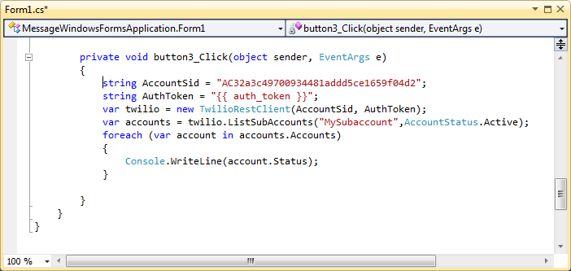
Third Bug :
Code for capturing bug

Slide 19
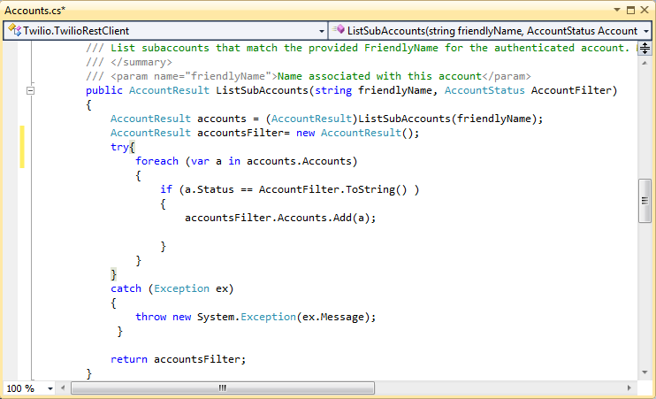
Tird Bug:
Overload to filter subaccounts list by status

Slide 20
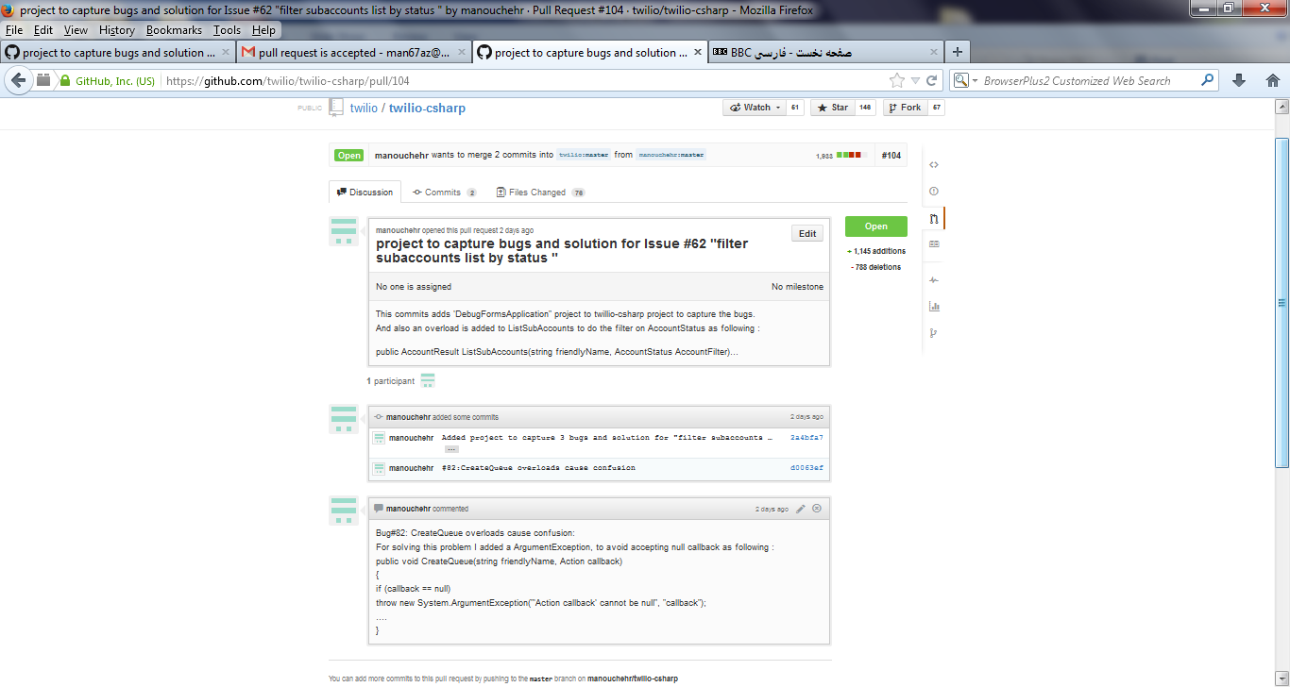
Pull Request

Slide 21
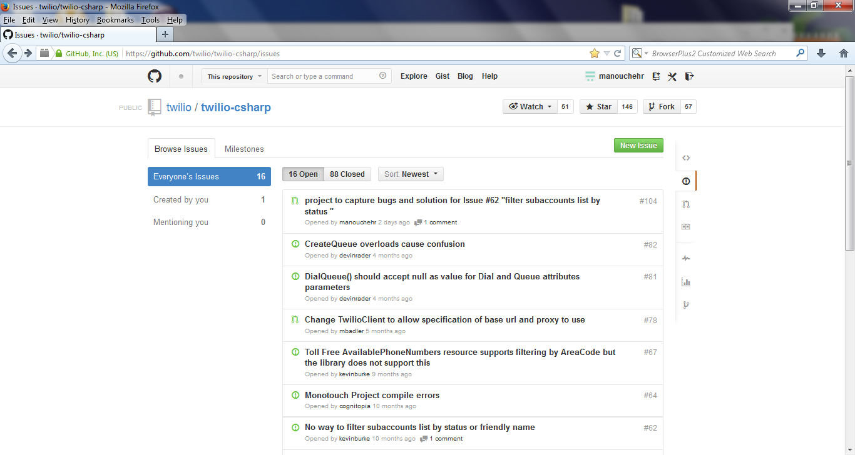
Pull request Acceptance

Slide 22
Conclusion
Open source is not just “open source ”
  License
  Making money
  Became famous
Practicing how to Communicate with open source community
Practicing in group has benefit for all participant

Slide 23
References
Twilio REST API Documentation https://www.twilio.com/docs/api/rest
https://www.twilio.com/docs/api/rest/queue
https://www.twilio.com/docs/api/rest/subaccounts#listing-subaccounts-example-2

