Slide 1


Diabetes Risk
Prediction
Dataset: 100,000 patients | 16 features | Target: Diabetes (0/1)
100K
16
Patient Records
Features
Notes:
1

Slide 2
Problem Statement
Can we predict whether a patient has diabetes based on their medical history and demographic data?
Q1
How does age differ between diabetic & non-diabetic patients?
Q4
How does smoking history correlate with diabetes prevalence?
Q2
What BMI and HbA1c thresholds indicate highest diabetes risk?
Q5
Are there racial or gender-based differences in diabetes rates?
Q3
Do hypertension and heart disease increase diabetes likelihood?
Notes:
2

Slide 3

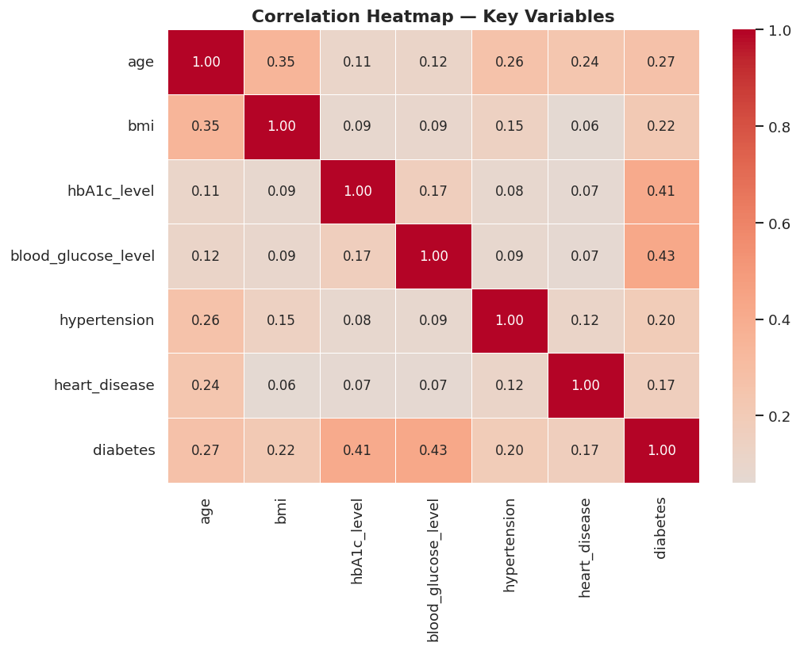
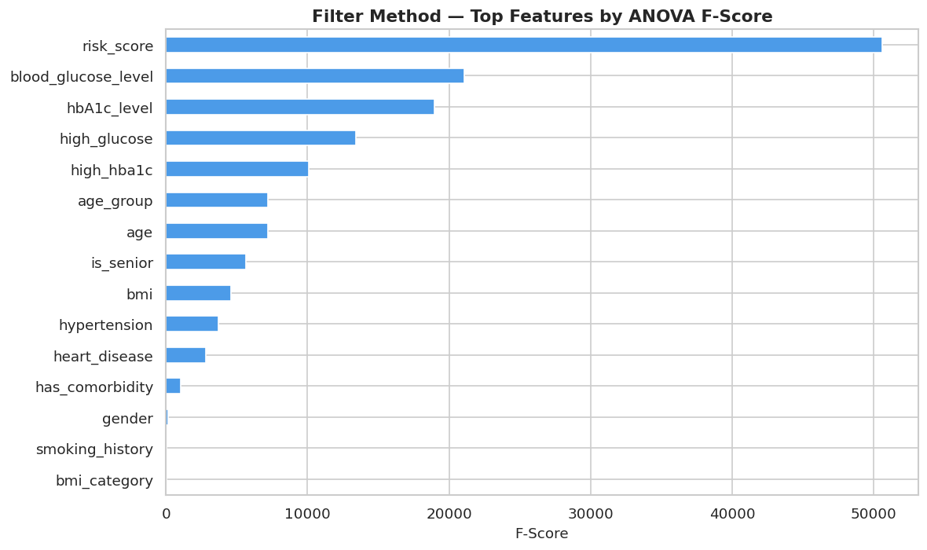
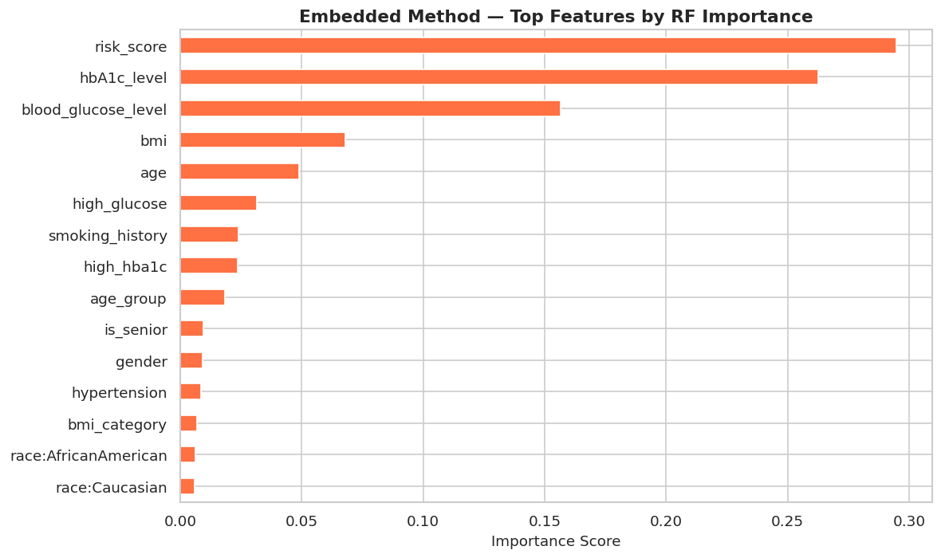
Exploratory Data Analysis
Notes:
4

Slide 4

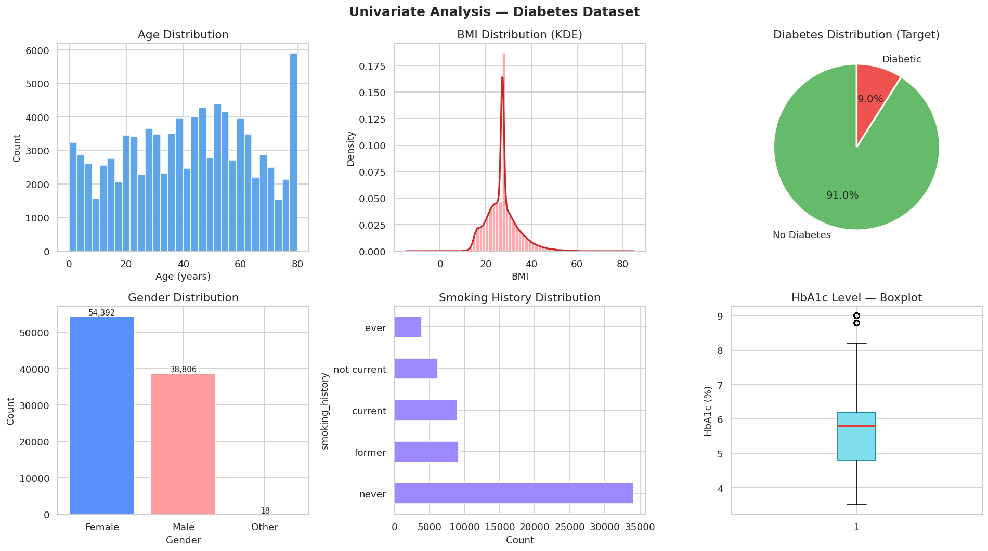
Exploratory Data Analysis
Notes:
4

Slide 5
Feature Engineering & Selection
✦ New Features Created (7)
✦ Feature Selection (3 Methods)
risk_score
Weighted combo: HbA1c(35%) + glucose(35%) + BMI(15%) + age(10%)
Filter
SelectKBest (ANOVA F-score)
high_hba1c
Binary: HbA1c ≥ 6.5% (clinical diabetes threshold)
Top 15 features selected
high_glucose
Binary: blood glucose ≥ 200 mg/dL
Embedded
has_comorbidity
Binary: has BOTH hypertension AND heart disease
Random Forest Importance
Top 15 by importance score
age_group
Age binned: 0-18, 19-35, 36-50, 51-65, 65+
bmi_category
Wrapper
WHO BMI: Underweight / Normal / Overweight / Obese
Recursive Feature Elimination (RFE)
⚠ Dropped: year (imbalanced) & location (too granular — 50 states)
is_senior
Binary flag: age ≥ 60 (elevated risk group)
12 features selected
Notes:
5

Slide 6
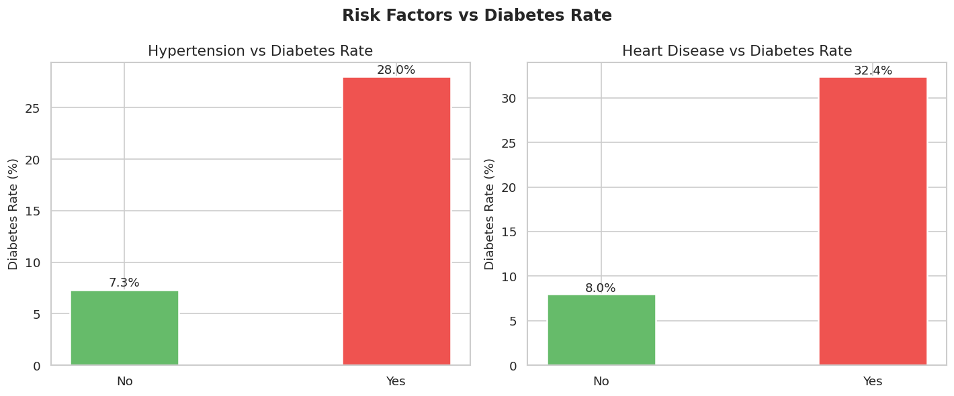
Feature Engineering & Selection
Notes:
4

Slide 7
Model Training & Comparison
01
Logistic Regression
Params: class_weight=balanced, max_iter=1000
Baseline model — fast, interpretable
02
Random Forest
Params: n_estimators=100, class_weight=balanced
Handles non-linearity, robust to outliers
03
Gradient Boosting
Params: n_estimators=100, learning_rate=0.1
Often best performer on tabular data
GridSearchCV Tuning — 5-fold cross-validation on F1-score (handles 8.5% class imbalance) | Best params auto-selected
Notes:
6

Slide 8
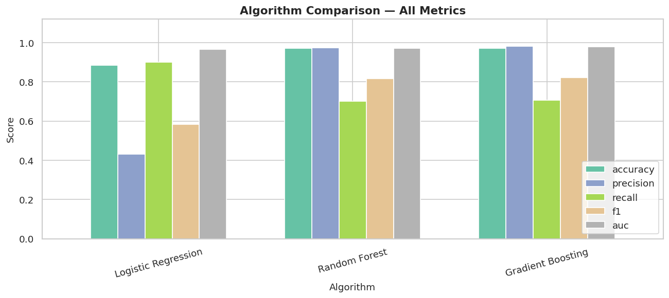
Validation & Evaluation
Notes:
4

Slide 9
Web Application Deployment
Streamlit
scikit-learn
joblib
GitHub
Web framework
ML library
Model serialization
Version control
1
Run scripts in Colab
null handler → duplicates → EDA → features → modeling
2
Download .pkl files
diabetes_model.pkl | scaler.pkl | feature_cols.pkl | label_encoders.pkl
3
Push to GitHub
app.py + all .pkl files + requirements.txt
4
Deploy on Streamlit Cloud
share.streamlit.io → connect repo → set main file: app.py
5
Get live link
https://your-name-diabetes-app.streamlit.app
Notes:
8

Slide 10
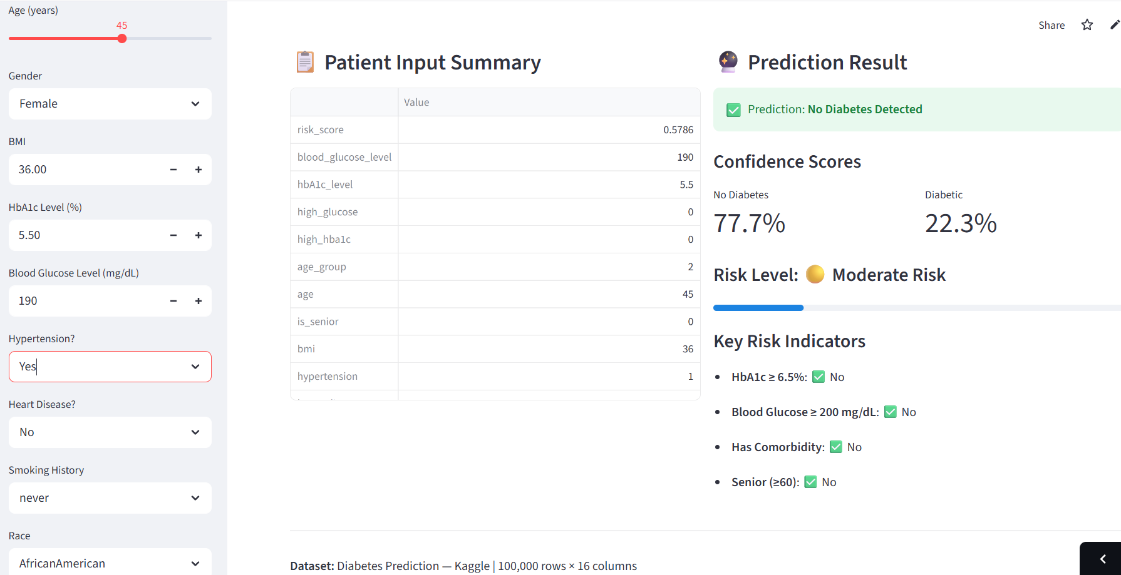
Web Application Deployment
Streamlit
scikit-learn
joblib
Notes:
8

Slide 11

Thank You
Diabetes Risk Prediction — Final Data Science Project
Dataset
New Features
Algorithms
Metrics
Deployed
100K patients, 16 features
7 engineered features
3 trained + GridSearchCV tuned
Precision, Recall, F1, AUC-ROC
Streamlit Cloud
Notes:
10

