Slide 1
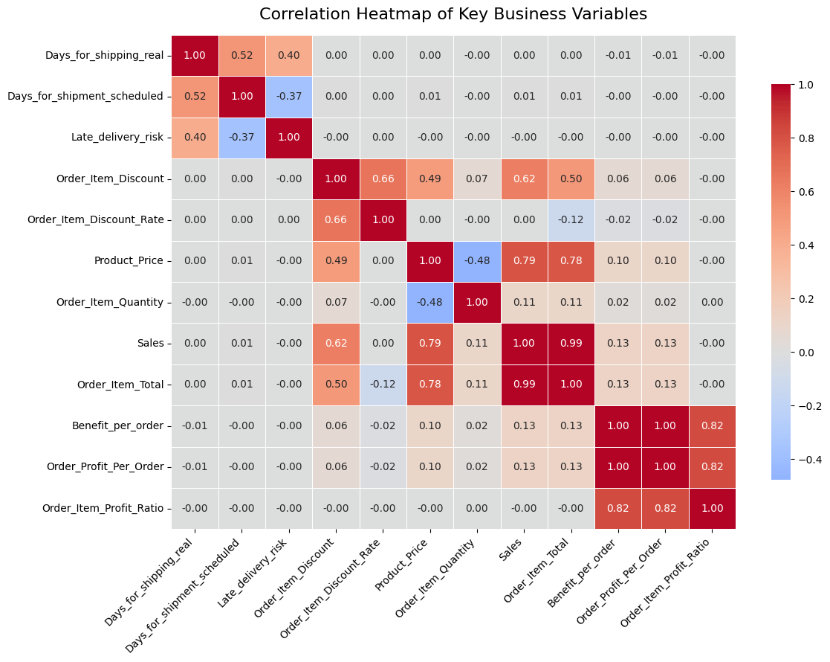
Data Preparation and Statistical Analysis of Supply Chain Performance
By Manovarma Krishnasamy Thalaivar – (FD0003362)

Slide 2
Refinement of Research Questions
Initial exploratory analysis revealed that some early research questions were Not well aligned with the statistical methods required in this lecture.
Based on correlation analysis, feasibility of statistical testing, and lecture guidelines, the research questions were refined
RQ1: How do regional differences influence sales levels and product category demand?
RQ2: Are there seasonal or monthly patterns in order volume and shipping performance?
RQ3: How do customer segments differ in their ordering behaviour (order quantity, product categories, and chosen shipping modes)?

Slide 3
Research Question 1
Research Question Does the chosen shipping mode influence delivery delay beyond planned shipment time?
Hypothesis (H1) Even after controlling for scheduled shipping time, delivery delay differs significantly by shipping mode.
Variables
Dependent: Delivery delay (actual − scheduled)
Independent: Shipping mode
Control: Scheduled shipment days

Slide 4
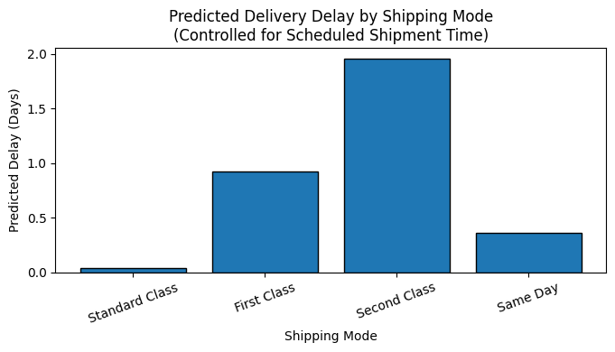
Effect of Shipping Mode on Delivery Delay
Multiple linear regression controlling for scheduled shipment time
Shipping mode has a significant effect on delivery delay
Type II ANOVA to test independent effects
H1 Supported

Slide 5

RQ2 - Does increasing the discount amount lead to higher sales?
Hypothesis (H2)
Discounts have significant effect on sales.

Slide 6
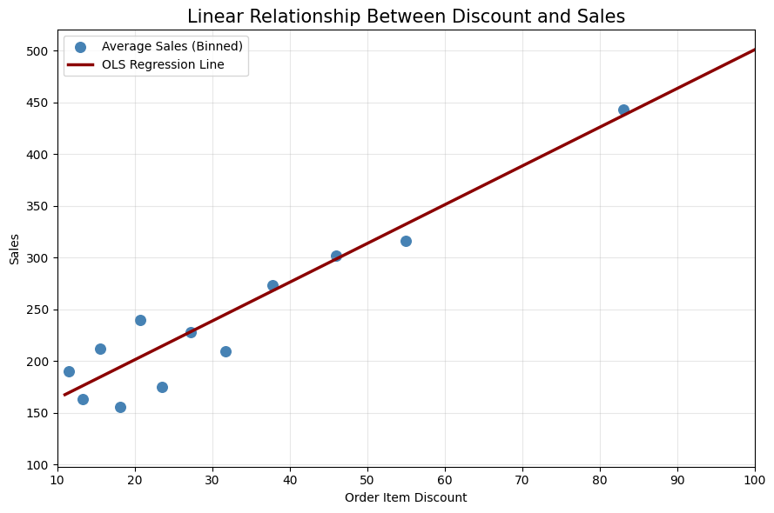
Methodology
Model Specification
Dependent Variable: Sales
Independent Variable: Order Item Discount
Method: Ordinary Least Squares (OLS)
Model Results
R² = 0.381
There are other factors which supports the Sales
H - Supported
Interpretation
Discounts explain 38.1% of sales variation
Discount alone increases sales, but sales behavior is better explained when product price is also considered.

Slide 7

RQ3: Do monthly changes in order volume affect shipping performance?
Hypothesis
Although order volume varies significantly across months, shipping performance remains stable and does not deteriorate during high-demand periods.

Slide 8
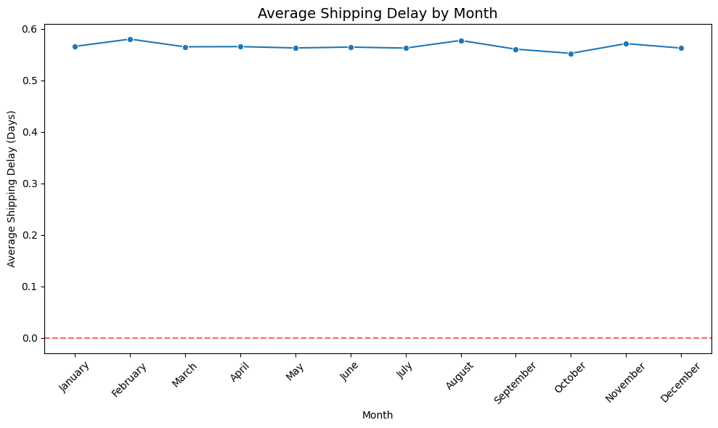
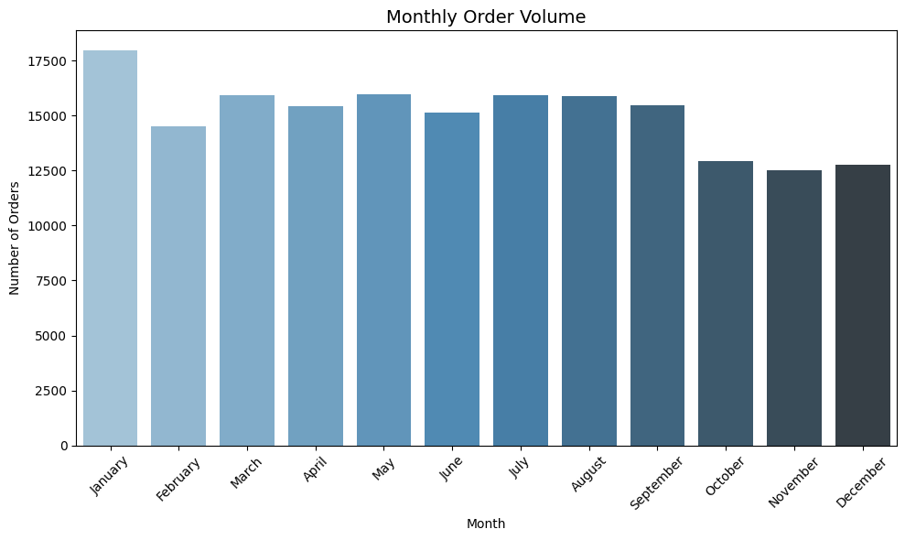
Key Results
Order volume exhibits strong seasonal variation, while shipping performance remains statistically stable, indicating robust logistics operations that handle demand fluctuations effectively.
We used one-way ANOVA.
Hypothesis is supported

