Slide 1
CURENATION
Manpreet Mann (2022596)
Btech-CSE(6th)

Slide 2
Aim
Drawback of Existing System
Project Explanation
Modules
Advantages of Project
DFDs
Technology Used
Requirements
Screenshots
Conclusion
Future Scope
Thank you

Slide 3
Drawback of Existing System
More man power.
Consumes large volume of paper work.
Time consuming.
Needs manual calculations.

Slide 4
Project Explanation
Can take appointments while sitting at home from any hospital in your city.
And get instant results.
Pay as you book appointment, so not much interaction required.
Book Ambulance.

Slide 5
Modules
1. Admin
2. User
3. Hospital

Slide 6
Admin - Functionalities
Login
Add Doctors
Add Ambulance
Add Hospitals
Check Appointment Data
View Contact Message
Block/ Unblock User

Slide 7
User - Functionalities
Register
Book Ambulance, if in emergency
Book Appointment
Contact, if any query
View status of appointment whether accepted or rejected
Pay online

Slide 8
Hospital - Functionalities
Login
Check appointments
Update status (accept/reject)

Slide 9
Advantages
Minimize manual data entry.
Minimum time needed for the various processing.
Better service.
User friendliness and interactive.
Minimum time required.
Minimum chance of spreading infection
Reduces physical interaction

Slide 10
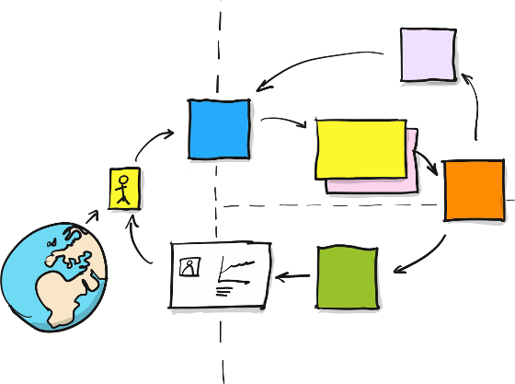
DATA FLOW DIAGRAM

Slide 11
DFD of Project

Slide 12
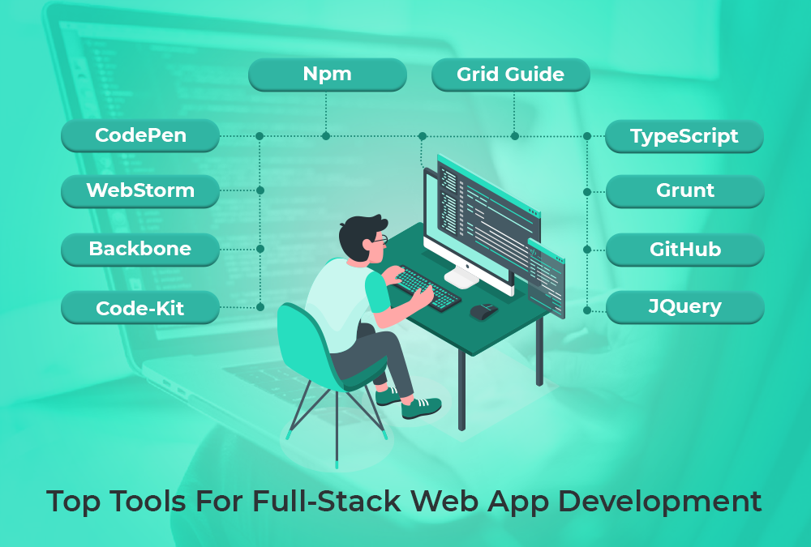
Technology Used

Slide 13
Front End Technology
1. HTML
2. CSS
3. JAVASCRIPT
4. BOOTSTRAP

Slide 14
Backend Technology
01
MY SQL
02
PHP

Slide 15
Hardware Requirements
1. PROCESSOR
Intel i3
01
3. Hard Disk
8 GB
03
02
4 GB
2. RAM

Slide 16
Software Requirements
01
Front End Tool
PHP 7.2.6
02
Web Server
Apache HTTP Server 2.4.39
03
Back End Tool
MySQL
04
Operating System
Windows Operating System/Linux
05
Browser
Microsoft Edge Version 104.0.1293.47

Slide 17
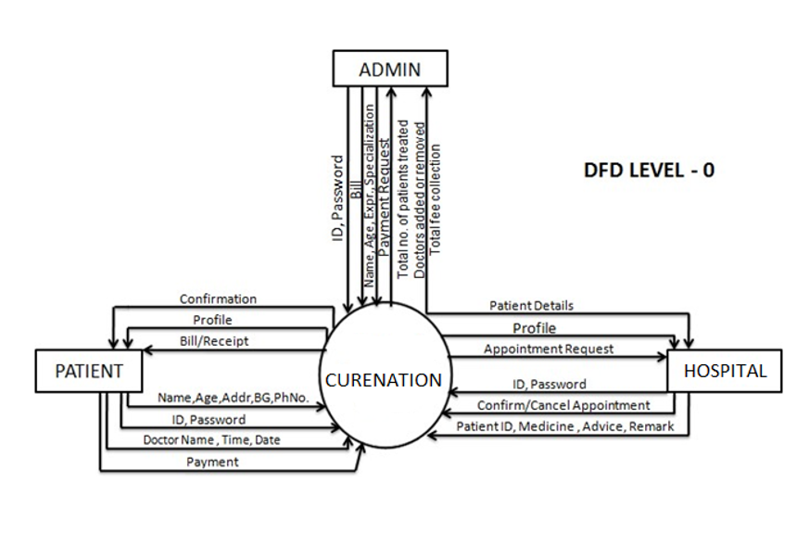
Screenshots

Slide 18
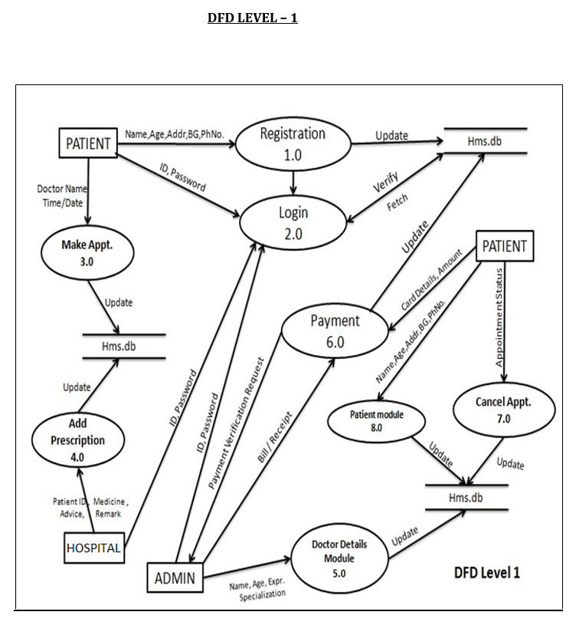

Slide 19
Conclusion
In the conclusion, I would like to say that the problem this project is solving is to help people take services of booking the appointment, sitting at their home if they feel any illness from their desired hospital.
In addition to it, if anybody is not in the stage of booking appointment i.e. is in emergency then he/she can take the ambulance services by providing their city name in the search box.

Slide 20
Future Work
Will add IP Calling while booking ambulance.
Will add the feature that will display the message that your money will be refunded within some working days, if the appointment is rejected.

Slide 21
Thank you!

